Slide 1
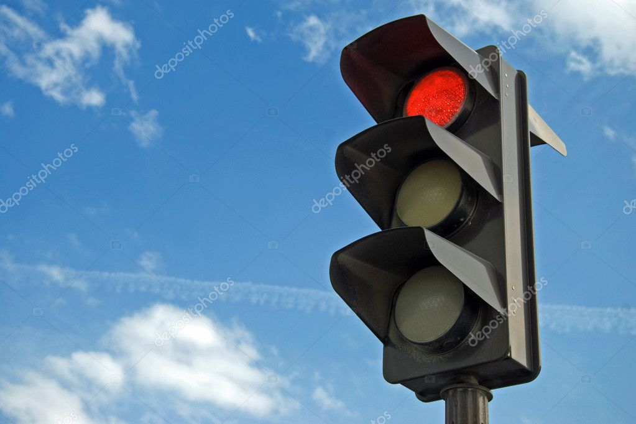
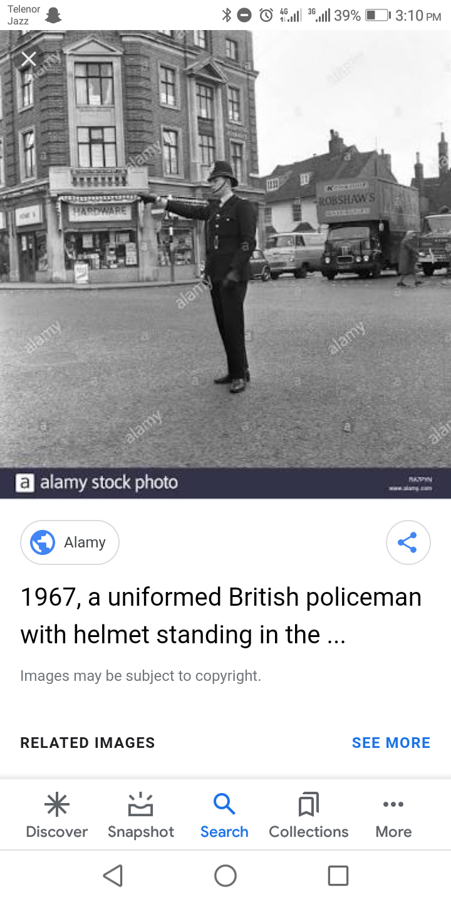
Background
..........Before 20th Century..........
Before traffic lights, traffic police controlled the flow of traffic.
A well-documented example is that on London Bridge in 1722.
Three men were given the task of directing traffic coming in and out of either London and Southwark.
On December 1868, the first non-electric gas-lit traffic lights were outside the Houses of Parliament in London.

Slide 2
Background
..........Before 20th Century..........
They were proposed by the railway engineer J.P Knight of Nottingham.
Although it was said to be successful at controlling traffic, its operational life was brief.
It exploded on 2 January 1869 as a result of a leak in one of gas lines underneath the pavement.
And it injured the policeman who was operating it.

Slide 3
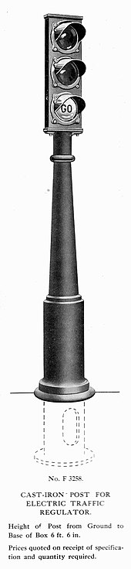
Background
..........20th Century..........
An electric traffic light was developed in 1912 by Lester Wire.
The first four-way, three-color traffic light was created by Police Officer William Potts in Detriot, Michigan in 1920.
The tower was the first innovation that used the three-colored traffic signal.
The man behind this three-color traffic light was police officer William Potts of Detroit.

Slide 4
Background
..........20th Century..........
Automatic control of interconnected traffic lights was introduced March 1922 in Houston, Texas.
In 1922, Traffic towers were beginning to be controlled by automatic timers.
The first company to add timers in traffic lights was Course Hinds.
The main advantage for the use of the timer was that it saved cities money by replacing traffic officers.
In 1949, the first traffic light in the continent of Asia was installed in Haifa, Israel.

Slide 5
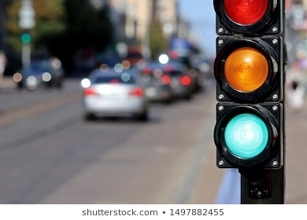
Background
..........20th Century..........
The control of traffic lights made a big turn with rise of computer in America in the 1950s.
In 1967,the city of Toronto was the first to use more advanced computers that were better at vehicle detection.
The computers maintained control over 159 signals in the cities through telephone lines.

Slide 6
Problems
Problems faced before traffic signals
Lot of accidents occur.
Traffic police control was much expensive.
Difficulty in traffic handling.
Control traffic is difficult in foggy weather or at night or on a rainy day.

Slide 7
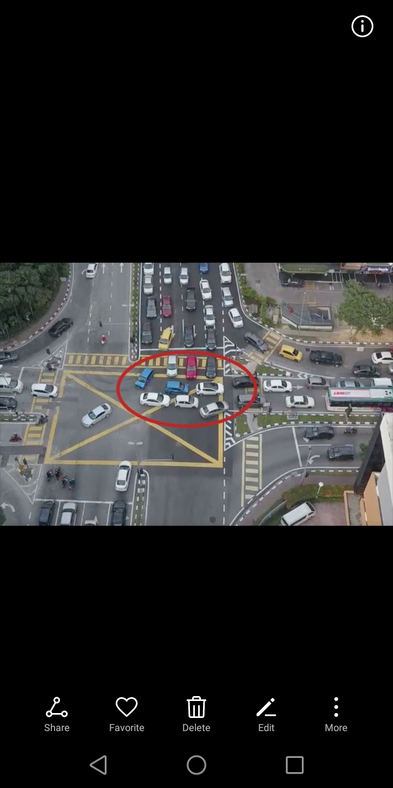

Slide 8
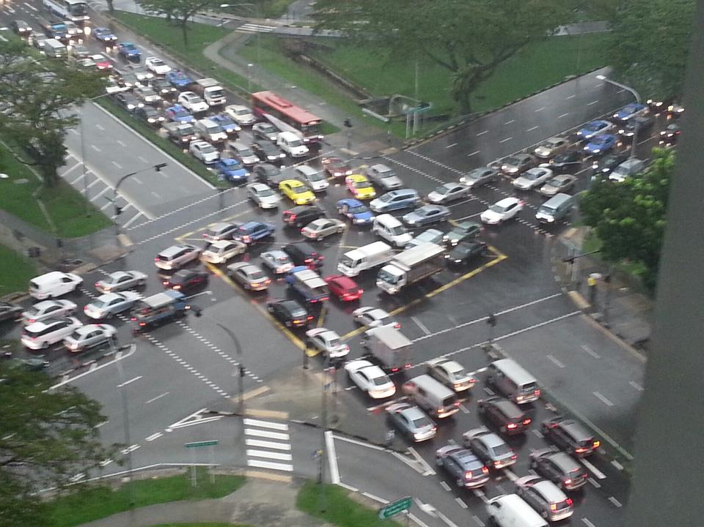
Problems
Lot of accidents occur:
Control traffic by traffic police is very difficult.
Traffic police control was much expensive:
It save cities money by replacing traffic officers.
The city of New york was able to reassign all but 500 of its 6000 officers working on the traffic squad.
This saved the city $12,500,000.

Slide 9
Problems
Difficulty in traffic handling:
Difficult to control the traffic in crowded places.
Control traffic is difficult in foggy weather or at night or on a rainy day:
In foggy weather or at night, its difficult to see the signs of traffic control officer.
Similarly, its very difficult for officers to stay on roads on a rainy day.

Slide 10
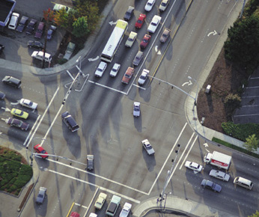
Objectives
The objective is:
to limit the stoppage time.
to regulate the traffic flow
to reducing the traffic jams in order to reduce traffic congestion.
to protect pedestrians and vehicles at busy intersections.
to reduce the severity and frequency of accidents.

