Slide 1
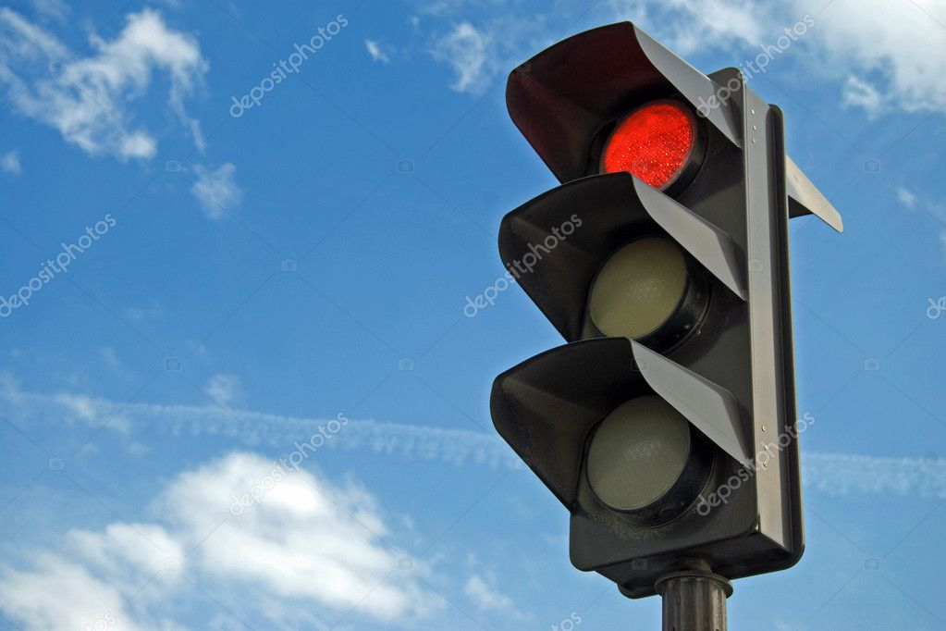
Traffic Lights System To Reduce Negative Impact Of Transport On Urban Environment
Submitted to:
Sir Kamran Shaheen
Submitted by:
Umar Hayyat(2019-EE-360)
Fatima Shafiq (2019-EE-362)
Aswa Arif(2019-EE-370)
Abdul Jabbar(2019-EE-376)
Muhammad Shaheed(2019-EE-408)
Ahmad Hafeez(2019-EE-432)

Slide 2
Traffic Lights System To Reduce Negative Impact Of Transport On Urban Environment
CONTENTS
1
History
2
Objectives
3
Introduction
4
Components
5
Construction
6
Working
7
Advantages
8
Disadvantages
9
Conclusion

Slide 3
Introduction
Traffic Lights are used to control the vehicular traffic.
In the modern era, everyone has different types of vehicles resulting in rise to the numbers of vehicles.
That’s why traffic lights are mandatory to avoid the traffic jams and accidents.
Traffic light has proved to be an amazing way to stop the vehicular collisions.
It also control the traffic jams in today’s modern era where everyone owns the different types of vehicles.

Slide 4
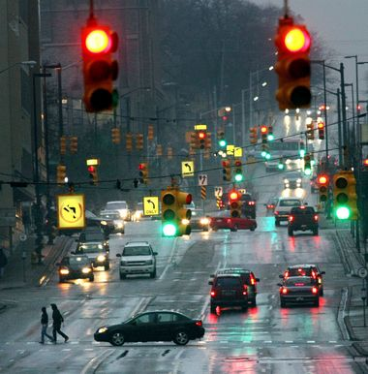
Introduction
Traffic signals are the most suitable method of controlling traffic in busy junction or lane.
The monitoring and controlling of Road/lane traffic is a major problem in many country.
Because Number of vehicles is increasing daily but highways developments have a lower phase that lead to traffic blocking problem or congestion problem.

Slide 5
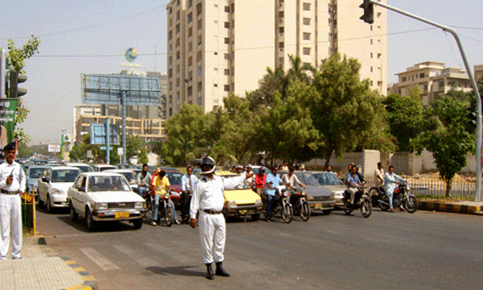
Introduction
Traffic policeman are stand at a traffic intersection daily in order to overcome these congestion in peak hour then one of the roots are a problem is due to unsuccessful traffic light controllers.

Slide 6
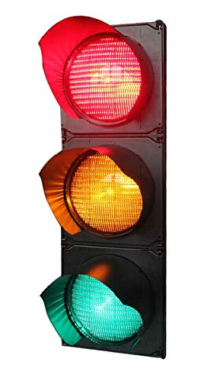
Introduction
There are three lights in the traffic signal, having different message for the drivers.
Red light (upper one) asks the driver to yield at the intersection.
Green light (last one) gives the driver free license to drive through the intersection.
The yellow light (middle one) alerts the driver to wait.
If the next light is red one or get ready to go / turn the engine ON if the green light is next.

Slide 7
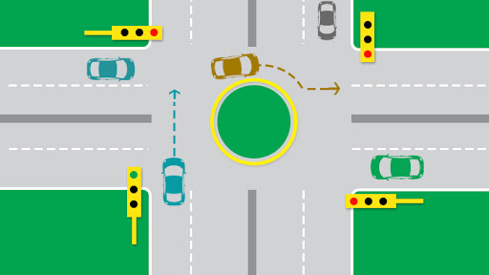
Introduction
Basic idea is that presentation we have chosen is a traffic light controller is to create four ways traffic controller through the concept of digital logic design.
That we create such a circuit in which there will be four traffic signals which will turn GREEN one by one while the other traffic signals are will be RED, simultaneously.

Slide 8
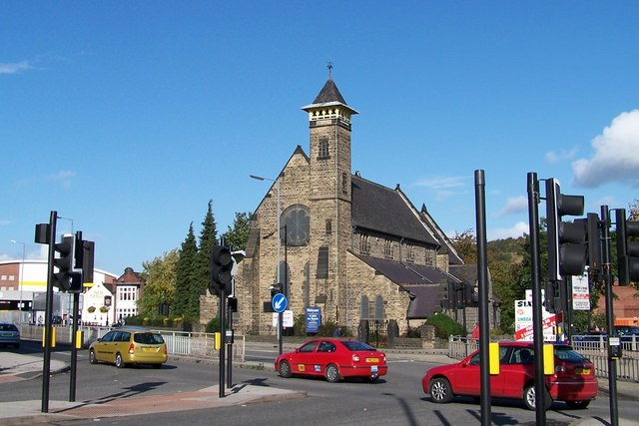
Introduction
Idea behind the design is to avoid accidents of vehicles by providing appropriate signals to different directions for a limited time slot, thus providing safety against collisions of vehicles.
After which the next waiting drivers will be given same treatment.

Slide 9
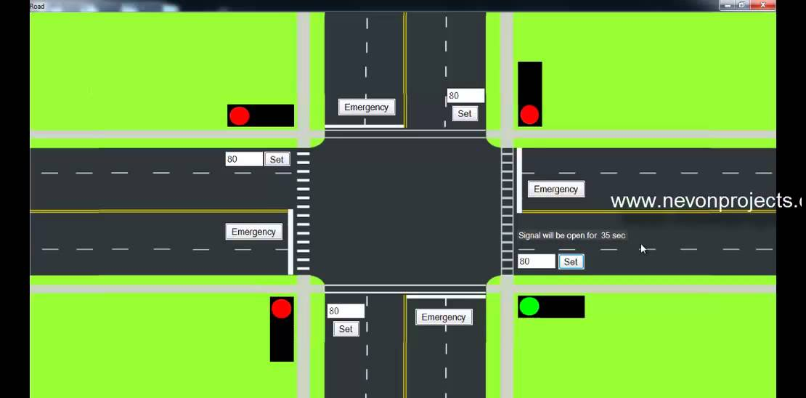
Introduction
The control signals are 3-lights.
Top light is Red, Middle light is Yellow , Bottom light is Green.
There are eight lanes and each lane will open one by one.
In this way 4 states are possible for which different vehicles will pass through the signals.

Slide 10
Design Criteria
In a traffic lights control system have a following assumptions are usable for designing.
Four way junction where traffic are coming on the four directions. These directions are a north and west and south and east.
Where traffic is moves from north and south direction then traffic are stop from west and east direction.
Left and right side turns are not considered.

Slide 11
Design Criteria
When East-west lane is assumed as the main approach or south-north lane is assumed as the main approach.
Maximum and minimum time for green light are determine Where traffic is moves from north and south direction then traffic are stop from west and east direction.

