Slide 1

Traffic Lights System To Reduce Negative Impact Of Transport On Urban Environment
Submitted to:
Sir Kamran Shaheen
Submitted by:
Umar Hayyat(2019-EE-360)
Fatima Shafiq (2019-EE-362)
Aswa Arif(2019-EE-370)
Abdul Jabbar(2019-EE-376)
Muhammad Shaheed(2019-EE-408)
Ahmad Hafeez(2019-EE-432)

Slide 2
Traffic Lights System To Reduce Negative Impact Of Transport On Urban Environment
CONTENTS
1
History
2
Problem Statement
3
Introduction
4
Components
5
Construction
6
Working
7
Advantages
8
Disadvantages
9
Conclusion

Slide 3
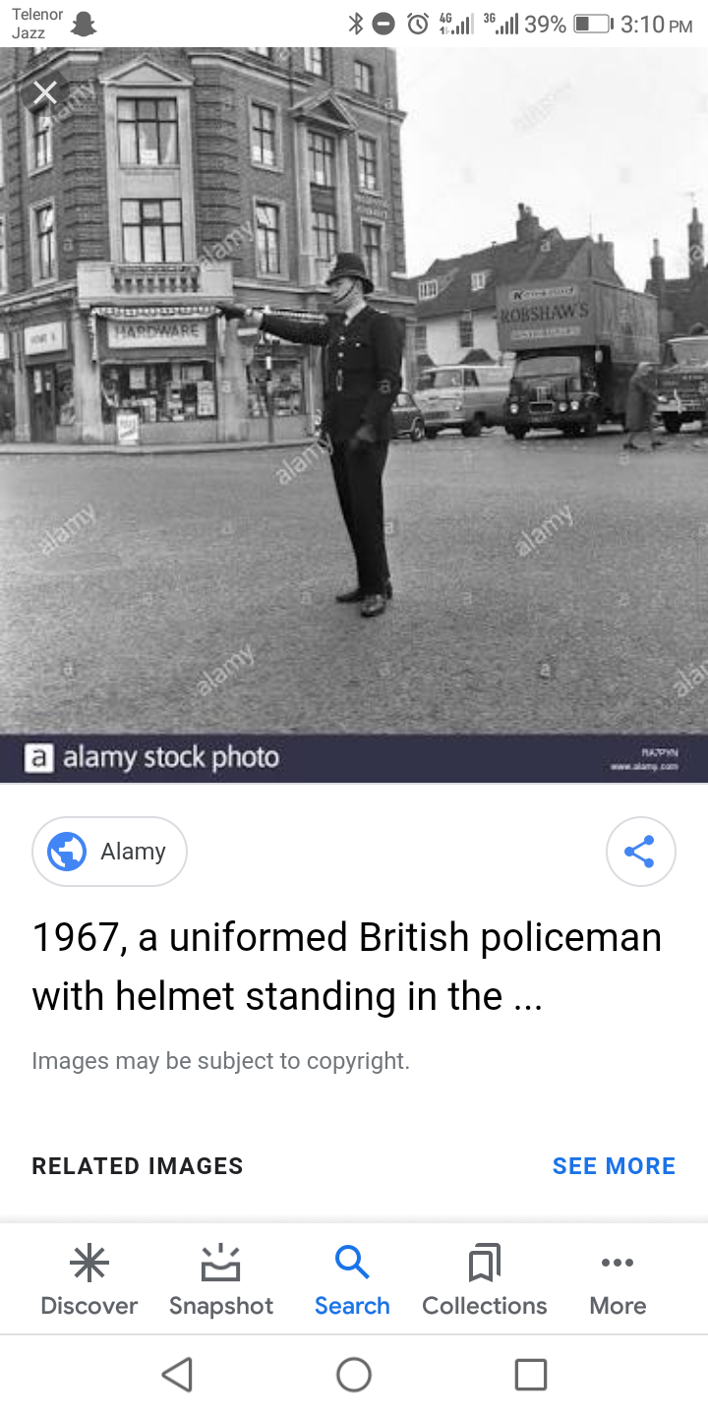
History
..........Before 20th Century..........
Before traffic lights, traffic police controlled the flow of traffic.
A well-documented example is that on London Bridge in 1722.
Three men were given the task of directing traffic coming in and out of either London and Southwark.
On December 1868, the first non-electric gas-lit traffic lights were outside the Houses of Parliament in London.

Slide 4
History
..........Before 20th Century..........
They were proposed by the railway engineer J.P Knight of Nottingham.
Although it was said to be successful at controlling traffic, its operational life was brief.
It exploded on 2 January 1869 as a result of a leak in one of gas lines underneath the pavement.
And it injured the policeman who was operating it.

Slide 5
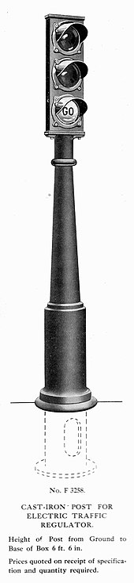
History
..........20th Century..........
An electric traffic light was developed in 1912 by Lester Wire.
The first four-way, three-color traffic light was created by Police Officer William Potts in Detriot, Michigan in 1920.
In 1922, Traffic towers were beginning to be controlled by automatic timers.
In 1949, the first traffic light in the continent of Asia was installed in Haifa, Israel.

Slide 6
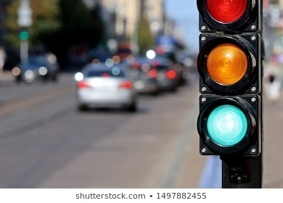
History
..........20th Century..........
The control of traffic lights made a big turn with rise of computer in America in the 1950s.
In 1967,the city of Toronto was the first to use more advanced computers that were better at vehicle detection.
The computers maintained control over 159 signals in the cities through telephone lines.

