Slide 1


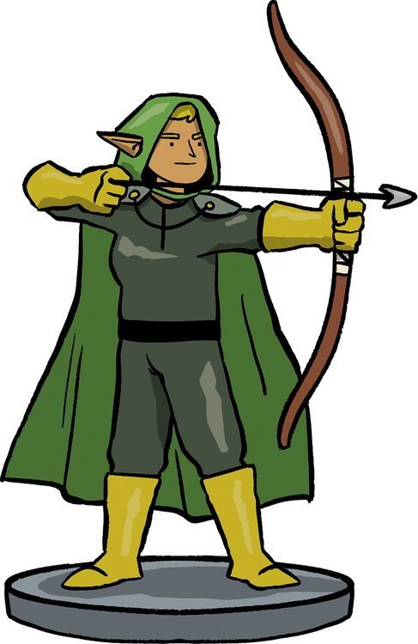
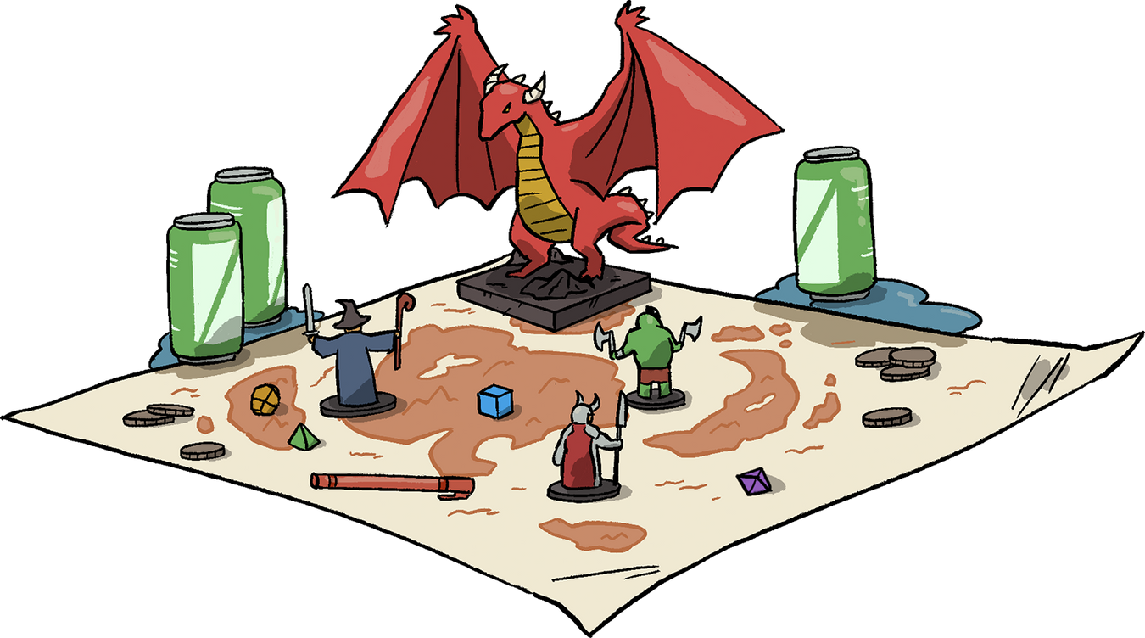
ISTE 240 Project Briefing
Safia Siddque 761008460
Masifah Mazhar 418003492
Arina Baiazitova 761008753

Slide 2
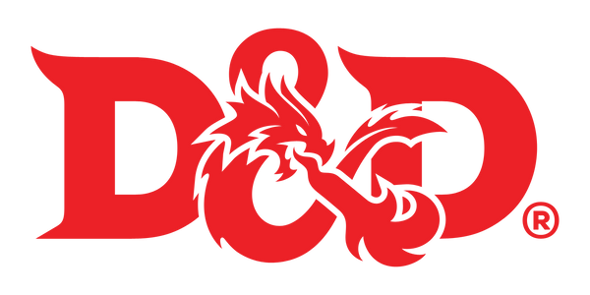
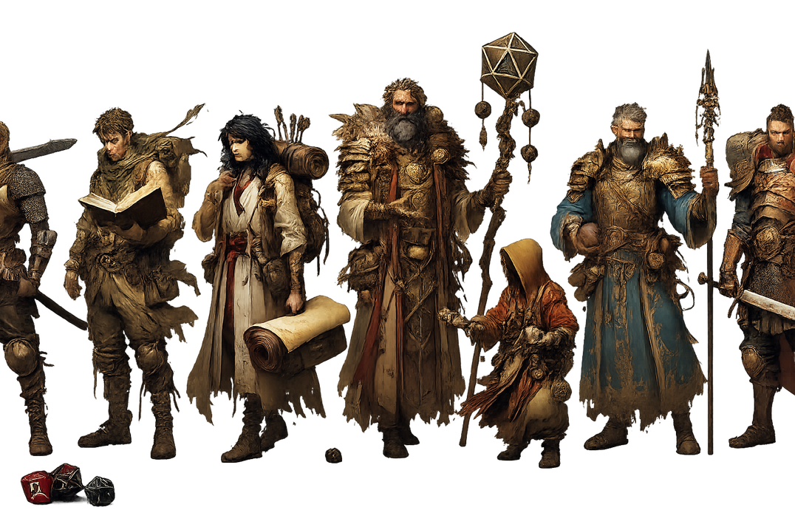
Shattered Realms is a web-based platform designed to centralize everything a Dungeons & Dragons league needs, making the game easier to understand, track, and manage for both players and organizers. By combining interactive onboarding, player profiles, schedules, and performance dashboards in one place, it creates a more organized, fair, and enjoyable league experience.
Features to be added:
1: Registration, Login, and Profile Capabilities
2: Dashboards with Data Visualization
3: Fundraising Campaigns
4: News Feed with Subscription
5: Interactive merch Store
User Interaction scenarios
1. New user signing up
2. Game sessions scheduling
3. Shopping cart for merch
Project scope and timeline:
Week 1 – 2: Planning and Design
Week 3: User System and Profiles
Week 4 – 5: Dashboard and Data Visualization
Week 6 – 7: Management Interface and Fundraising Section
Week 8: Testing and Final Integration

Slide 3
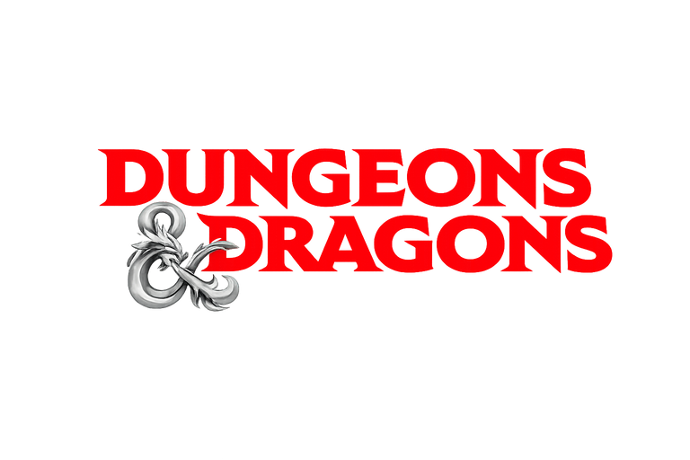
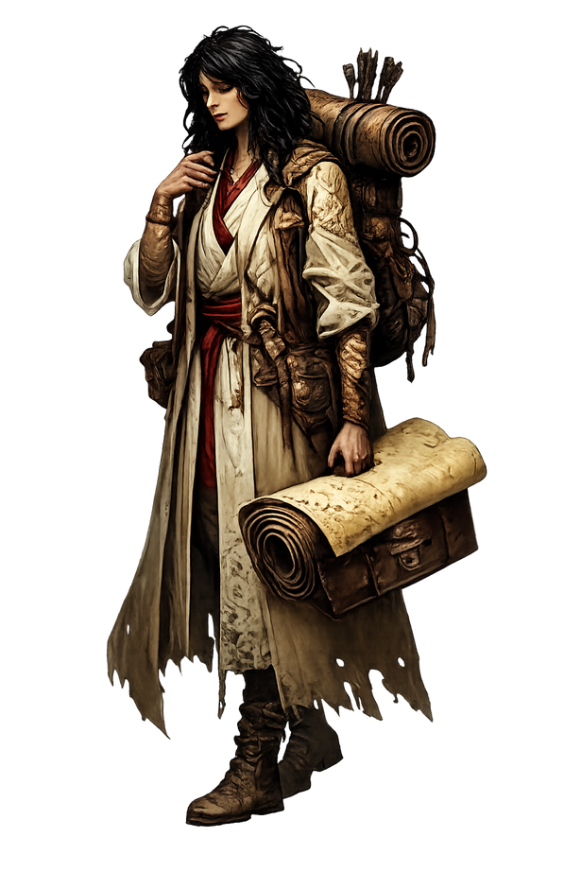
Implementation details Frontend:
CSS (Possibly implement bootstrap), HTML, JavaScript
Backend: Java(Springboot) with MVC structure
Database Management: MySQL
Tools: GitHub, IntelliJ IDEA
Anticipated challenges, limitations:
Linking the frontend to the backend smoothly
Collaborating harmoniously on GitHub
Implementing as we learn about new backend concepts
Mitigations:
  Start with small features, test them locally, and only then connect them to the backend to avoid breaking the system.
  A task checklist that members tick to secure before working on it to avoid clashes or redoing the tasks.
  For git, we will use commit messages and regular pull requests. We will communicate before making major changes, review each other’s work.
  Research/Self-study ahead based on the features needed to be implemented

