Slide 1
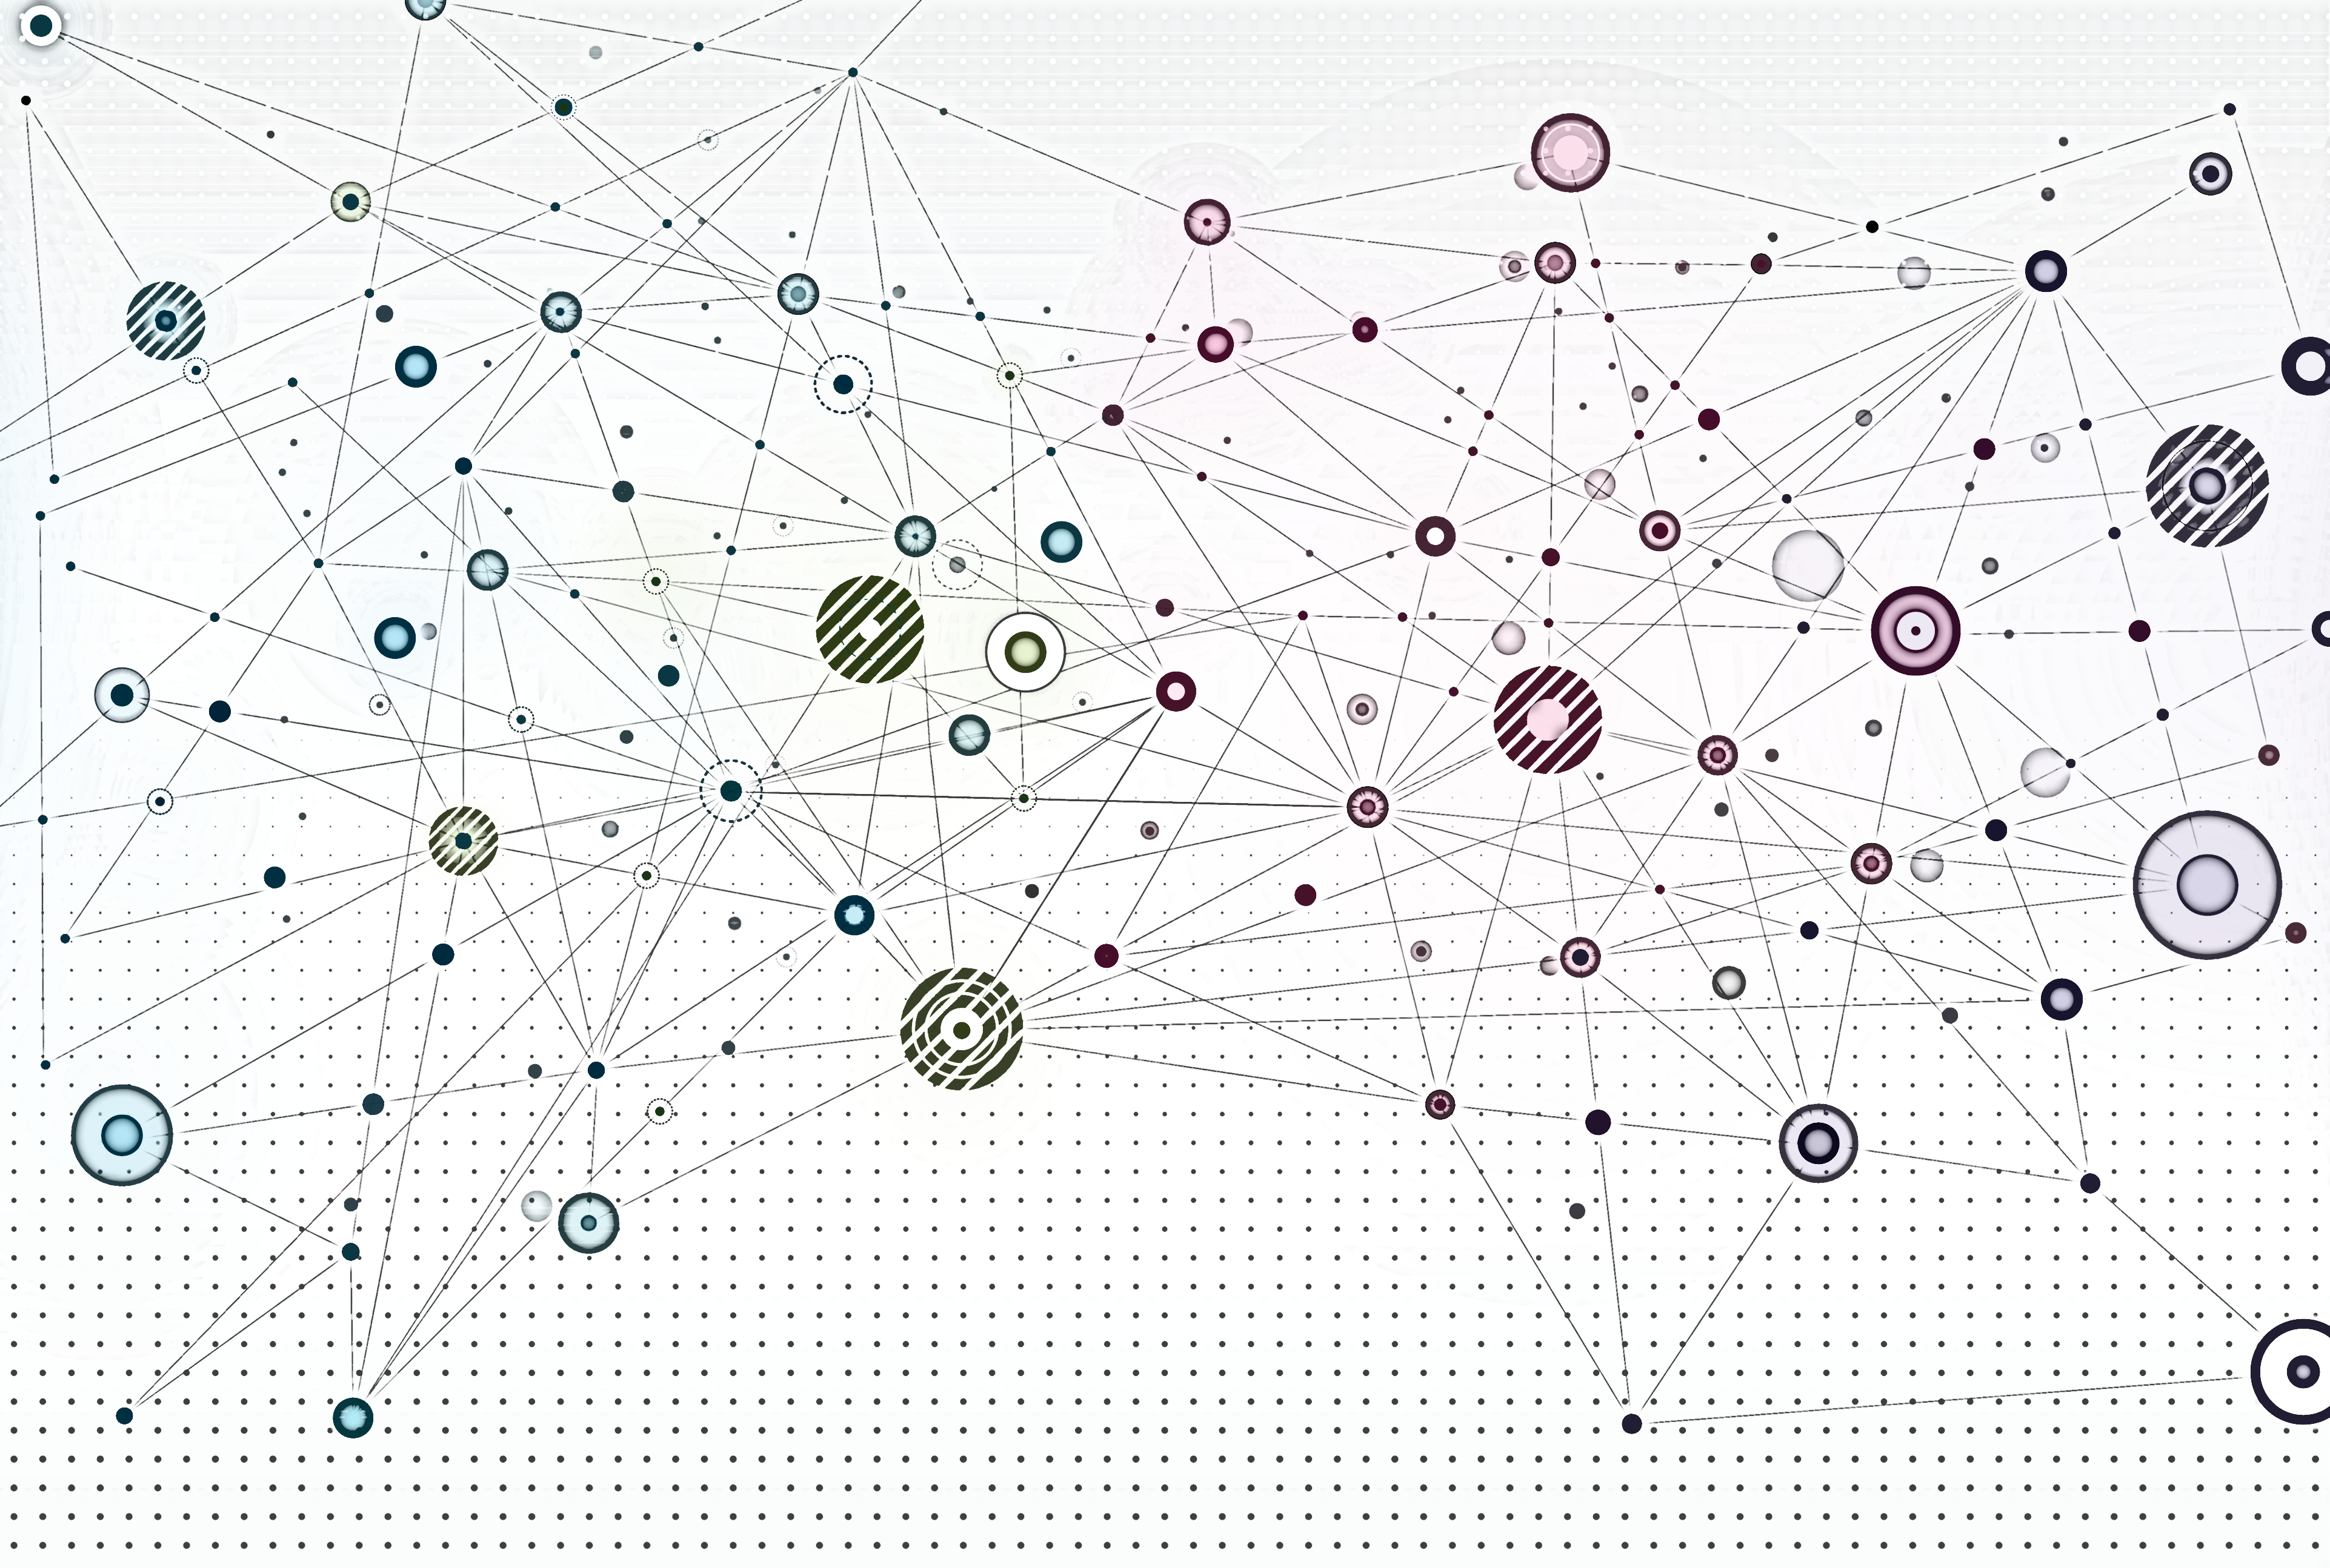
Classical Graph Representations and Properties

Slide 2
Overview
Adjacency matrix
Node degree and network density (sparsity)
Graph Laplacian
Walks and paths
Centrality measures
Node groups
Node similarity metrics

Slide 3
Adjacency matrix

Slide 4
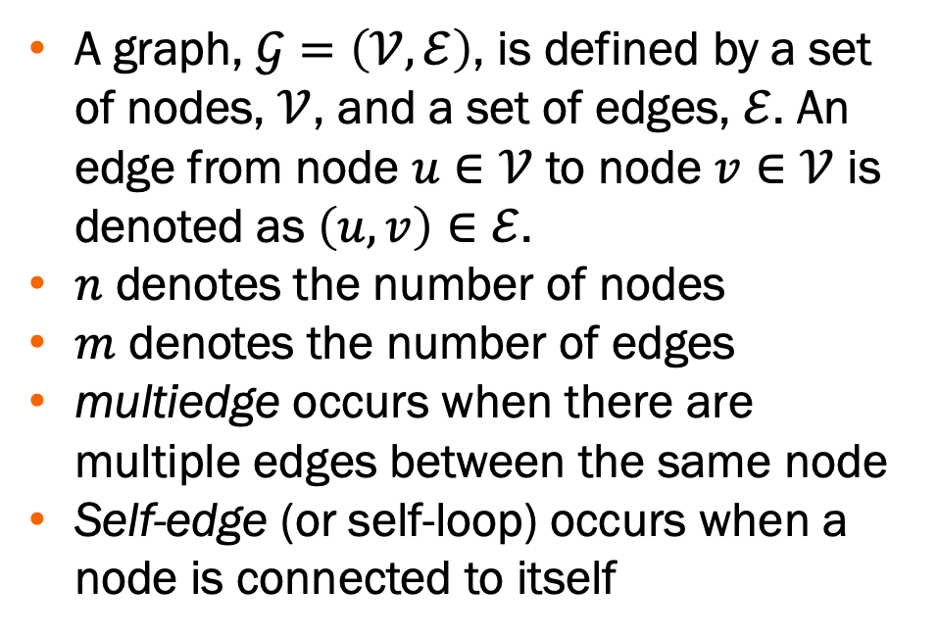
What is a graph?
A graph, $𝒢=\left(𝒱,ℰ\right)$, is defined by a set of nodes, $𝒱$, and a set of edges, $ℰ$. An edge from node $u∈𝒱$ to node $v∈𝒱$ is denoted as $\left(u, v\right)∈ℰ$.
$n$ denotes the number of nodes
$m$ denotes the number of edges
multiedge occurs when there are multiple edges between the same node
Self-edge (or self-loop) occurs when a node is connected to itself
Multiedge
Self-edge
Notes:
Multi-edge can occur in models of real networks for example where more than one road connects two locations or multiple data lines connect two devices (e.g., ethernet and wifi)
Self-edge can occur for example if a web page links to itself

Slide 5
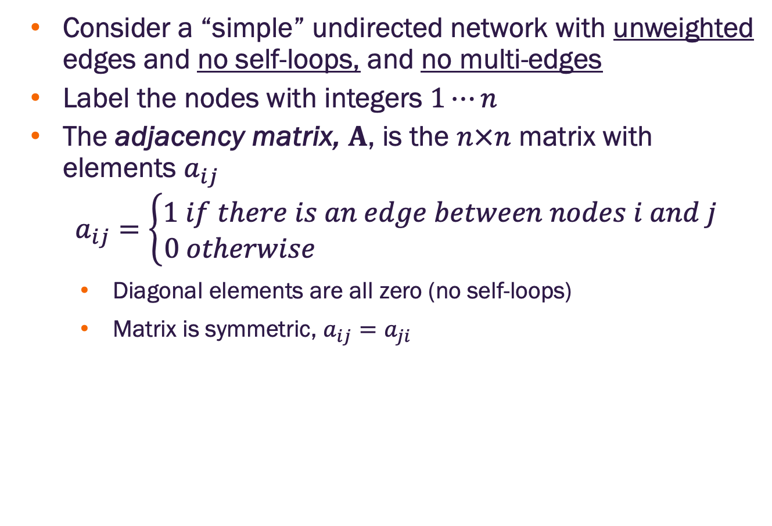
Adjacency matrix for a simple undirected network
Consider a “simple” undirected network with unweighted edges and no self-loops, and no multi-edges
Label the nodes with integers $1⋯n$
The adjacency matrix, $A$, is the $n×n$ matrix with elements $a_{ij}$
$$a_{ij}=\left\{\begin{matrix}1 if there is an edge between nodes i and j \\ 0 otherwise \end{matrix}\right.$$
Diagonal elements are all zero (no self-loops)
Matrix is symmetric, $a_{ij}=a_{ji}$
1
2
3
4
1 2 3 4
1
2
3
4
0 | 1 | 1 | 1
1 | 0 | 0 | 1
1 | 0 | 0 | 0
1 | 1 | 0 | 0

Slide 6
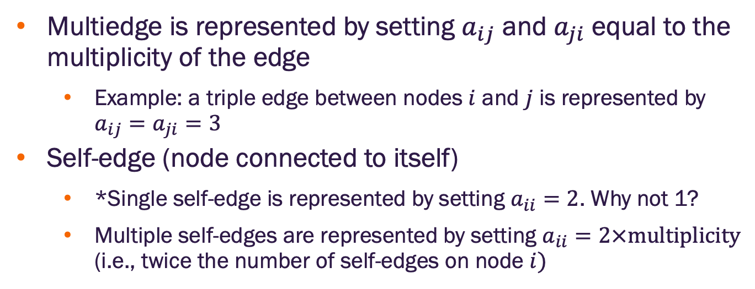
Adjacency matrix with self-loops and multiedges
Multiedge is represented by setting $a_{ij}$ and $a_{ji}$ equal to the multiplicity of the edge
Example: a triple edge between nodes $i$ and $j$ is represented by $a_{ij}=a_{ji}=3$
Self-edge (node connected to itself)
*Single self-edge is represented by setting $a_{ii}=2$. Why not 1?
Multiple self-edges are represented by setting $a_{ii}=2×multiplicity$ (i.e., twice the number of self-edges on node $i)$
1
1 2 3 4
1
2
3
4
0 | 1 | 3 | 1
1 | 4 | 0 | 1
3 | 0 | 0 | 0
1 | 1 | 0 | 2
2
3
4
*In directed networks, self-edges are indicated by $a_{ii}=1$ (see slide 9)
Notes:
Self loops are represented in the adjacency matrix by setting $a_{ii}=2∗multiplicity$ because: (1) it maintains consistency with other edges which are represented twice in the matrix (2) mathematical convenience

Slide 7

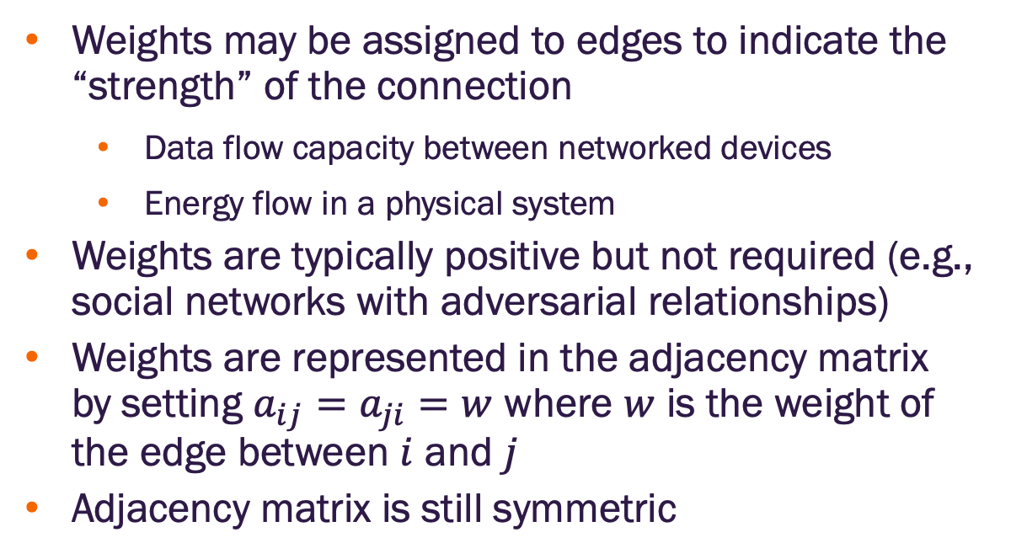



Adjacency matrix on weighted networks
Weights may be assigned to edges to indicate the “strength” of the connection
Data flow capacity between networked devices
Energy flow in a physical system
Weights are typically positive but not required (e.g., social networks with adversarial relationships)
Weights are represented in the adjacency matrix by setting $a_{ij}=a_{ji}=w$ where $w$ is the weight of the edge between $i$ and $j$
Adjacency matrix is still symmetric
1
$$w=2$$
$$w=0.5$$
$$w=4$$
3
2
$$w=1$$
4
1 2 3 4
1
2
3
4
0 | 2 | 0.5 | 4
2 | 0 | 0 | 1
0.5 | 0 | 0 | 0
4 | 1 | 0 | 0

Slide 8
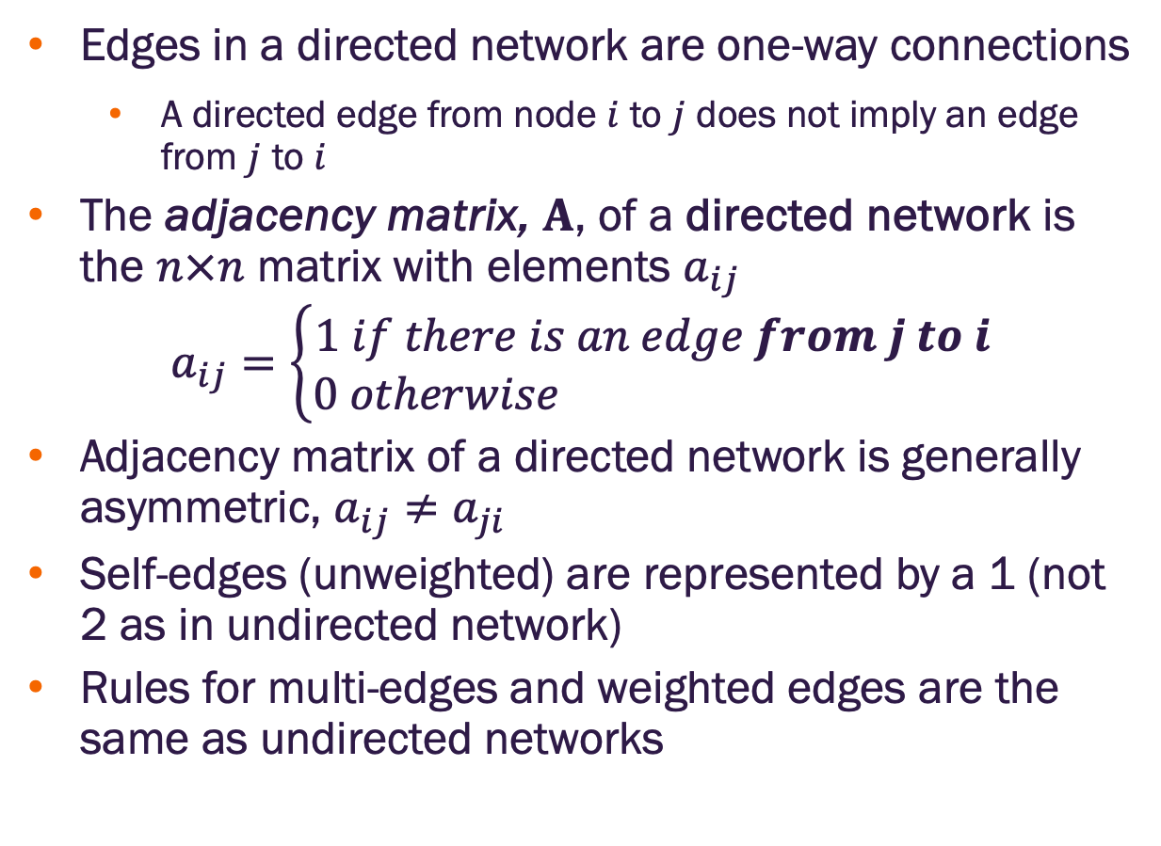
Adjacency matrix on directed networks
Edges in a directed network are one-way connections
A directed edge from node $i$ to $j$ does not imply an edge from $j$ to $i$
The adjacency matrix, $A$, of a directed network is the $n×n$ matrix with elements $a_{ij}$
$$a_{ij}=\left\{\begin{matrix}1 if there is an edge from j to i \\ 0 otherwise \end{matrix}\right.$$
Adjacency matrix of a directed network is generally asymmetric, $a_{ij}≠a_{ji}$
Self-edges (unweighted) are represented by a 1 (not 2 as in undirected network)
Rules for multi-edges and weighted edges are the same as undirected networks
1
2
3
4
1 2 3 4
1
2
3
4
0 | 0 | 0 | 1
1 | 0 | 0 | 1
1 | 0 | 0 | 0
0 | 0 | 0 | 1
Notes:
Note that $a_{ij}=1$ indicates a directed edge from j to i which is somewhat counterintuitive but turns out to be mathematically convenient
Self edges are represented by a 1 for mathematical convenience

Slide 9
Node degree & network density (sparsity)

Slide 10

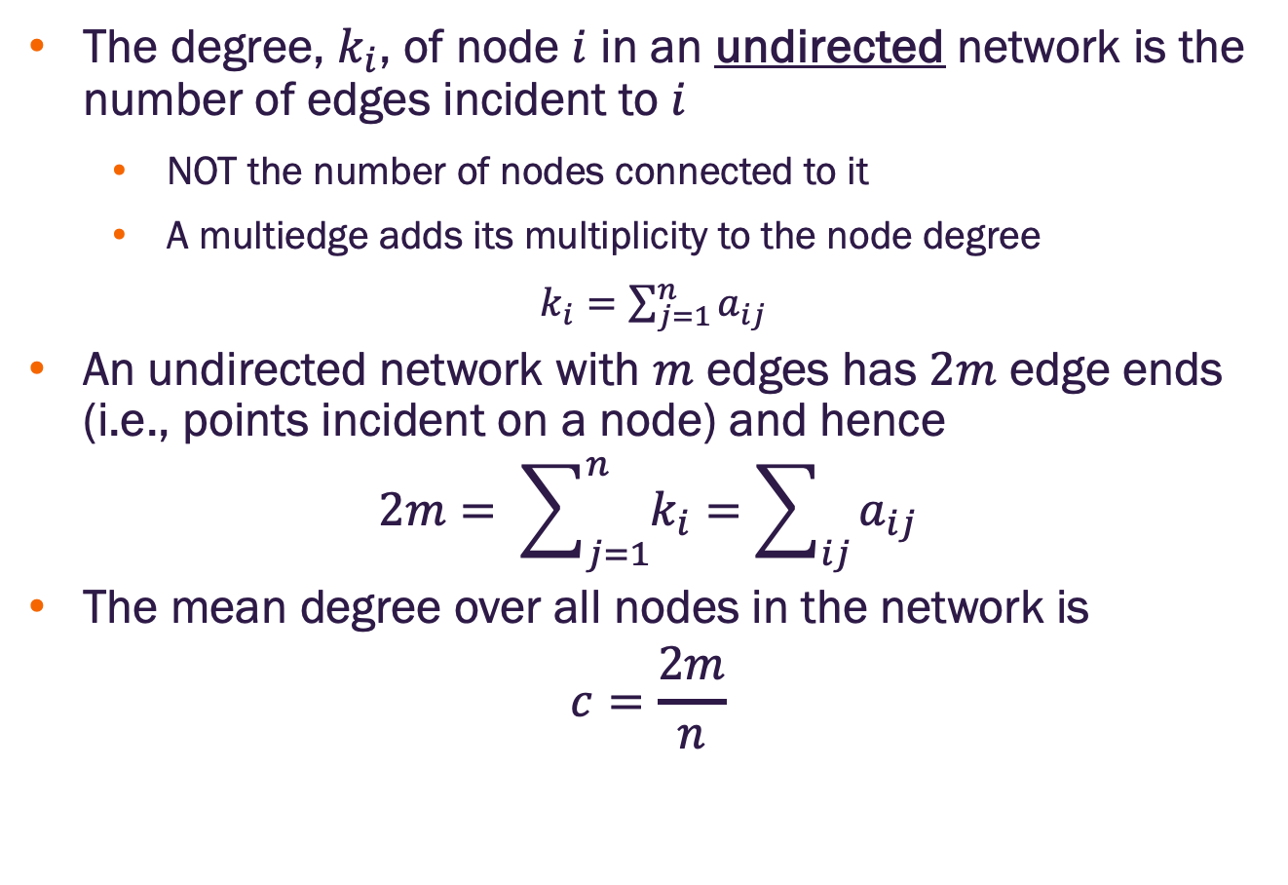
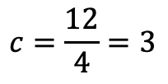
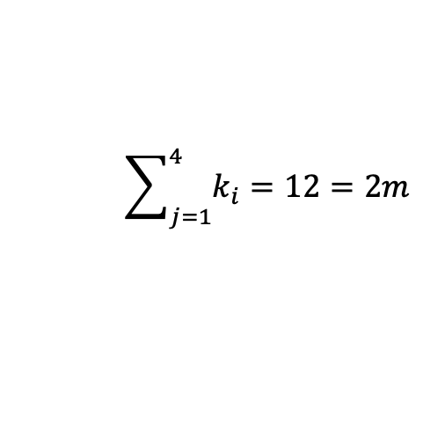
Node degree for undirected networks
1
The degree, $k_{i}$, of node $i$ in an undirected network is the number of edges incident to $i$
NOT the number of nodes connected to it
A multiedge adds its multiplicity to the node degree
$k_{i}=\sum_{j=1}^{n}{a_{ij}}$
An undirected network with $m$ edges has $2m$ edge ends (i.e., points incident on a node) and hence
$$2m= \sum_{j=1}^{n}{k_{i}}=\sum_{ij}{a_{ij}}$$
The mean degree over all nodes in the network is
$$c=\frac{2m}{n}$$
$$m=6$$
2
3
4
Node | Degree
1 | 4
2 | 2
3 | 3
4 | 3
$$\sum_{j=1}^{4}{k_{i}}=12=2m$$
$$c=\frac{12}{4}=3$$

Slide 11
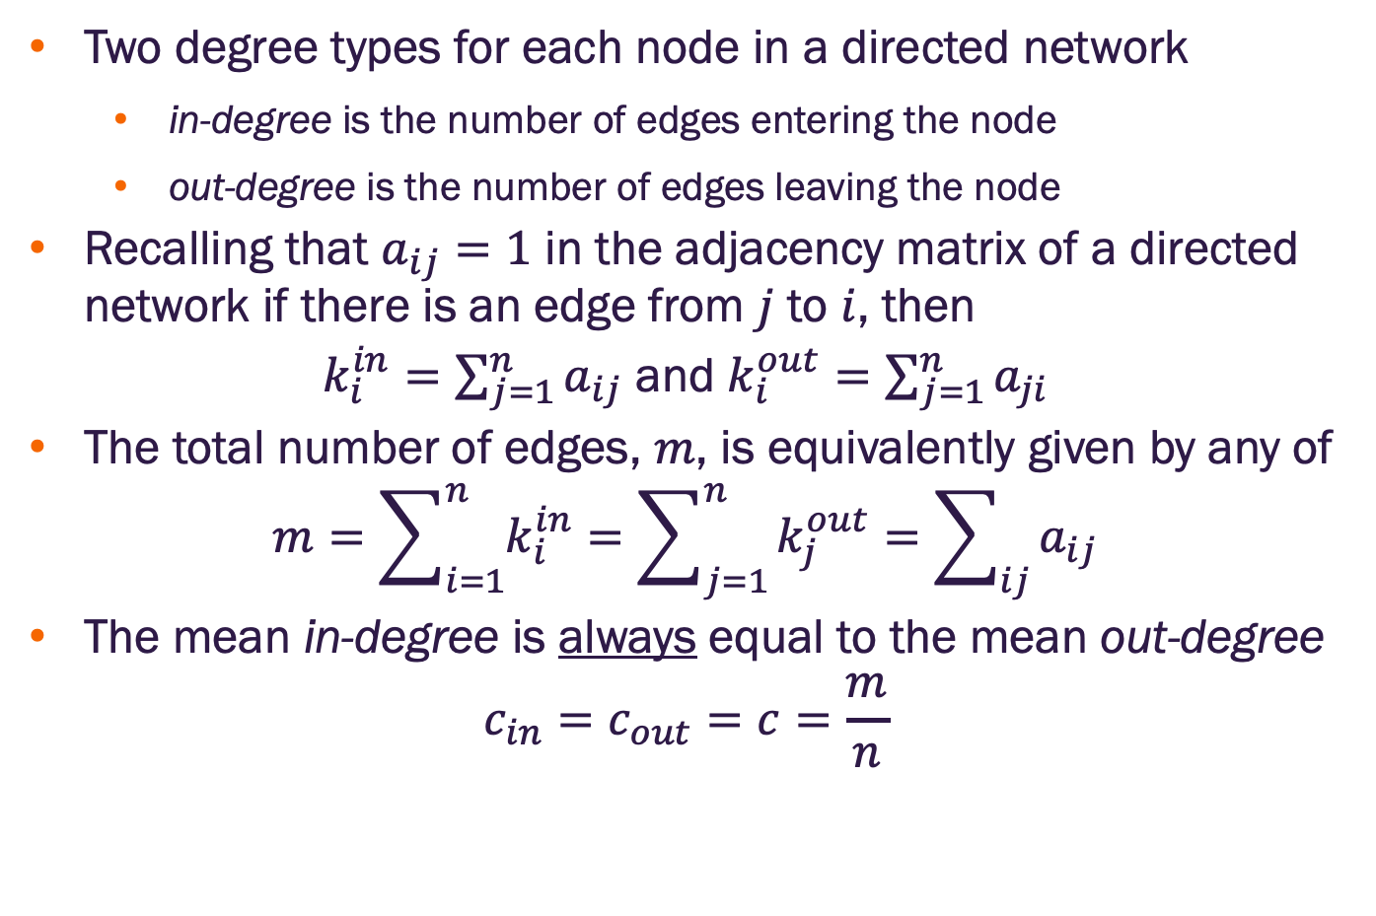
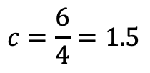
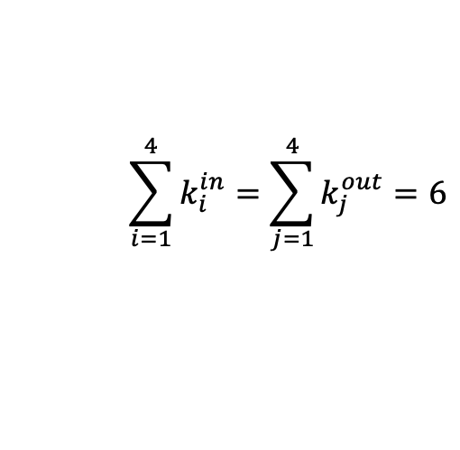
Node degree for directed networks
1
Two degree types for each node in a directed network
in-degree is the number of edges entering the node
out-degree is the number of edges leaving the node
Recalling that $a_{ij}=1$ in the adjacency matrix of a directed network if there is an edge from $j$ to $i$, then
$k_{i}^{in}=\sum_{j=1}^{n}{a_{ij}}$ and $k_{i}^{out}=\sum_{j=1}^{n}{a_{ji}}$
The total number of edges, $m$, is equivalently given by any of
$$m=\sum_{i=1}^{n}{k_{i}^{in}}=\sum_{j=1}^{n}{k_{j}^{out}}=\sum_{ij}{a_{ij}}$$
The mean in-degree is always equal to the mean out-degree
$$c_{in}=c_{out}=c=\frac{m}{n}$$
$$m=6$$
2
3
4
Node | In-degree | out-degree
1 | 1 | 3
2 | 2 | 0
3 | 2 | 1
4 | 1 | 2
$$\sum_{i=1}^{4}{k_{i}^{in}}=\sum_{j=1}^{4}{k_{j}^{out}}=6$$
$$c=\frac{6}{4}=1.5$$

Slide 12
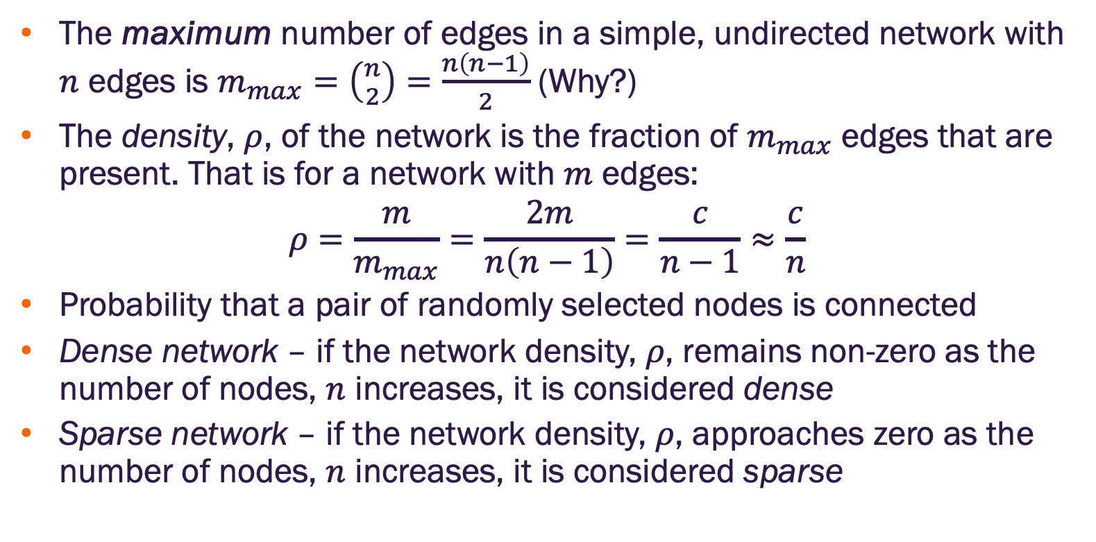
Network density
The maximum number of edges in a simple, undirected network with $n$ edges is $m_{max}=\left({n \atop 2}\right)=\frac{n\left(n−1\right)}{2}$ (Why?)
The density, $ρ$, of the network is the fraction of $m_{max}$ edges that are present. That is for a network with $m$ edges:
$$ρ=\frac{m}{m_{max}}=\frac{2m}{n\left(n−1\right)}=\frac{c}{n−1}≈\frac{c}{n}$$
Probability that a pair of randomly selected nodes is connected
Dense network – if the network density, $ρ$, remains non-zero as the number of nodes, $n$ increases, it is considered dense
Sparse network – if the network density, $ρ$, approaches zero as the number of nodes, $n$ increases, it is considered sparse

Slide 13
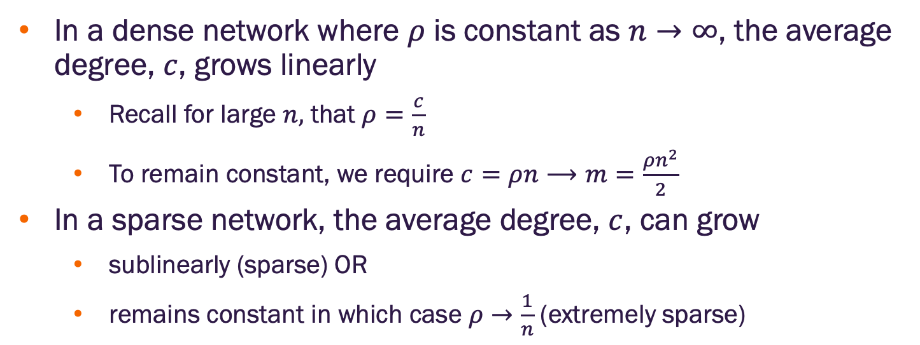
Network density and growth
In a dense network where $ρ$ is constant as $n→∞$, the average degree, $c$, grows linearly
Recall for large $n,$ that $ρ=\frac{c}{n}$
To remain constant, we require $c=ρn⟶m=\frac{ρn^{2}}{2}$
In a sparse network, the average degree, $c$, can grow
sublinearly (sparse) OR
remains constant in which case $ρ→\frac{1}{n}$ (extremely sparse)

Slide 14
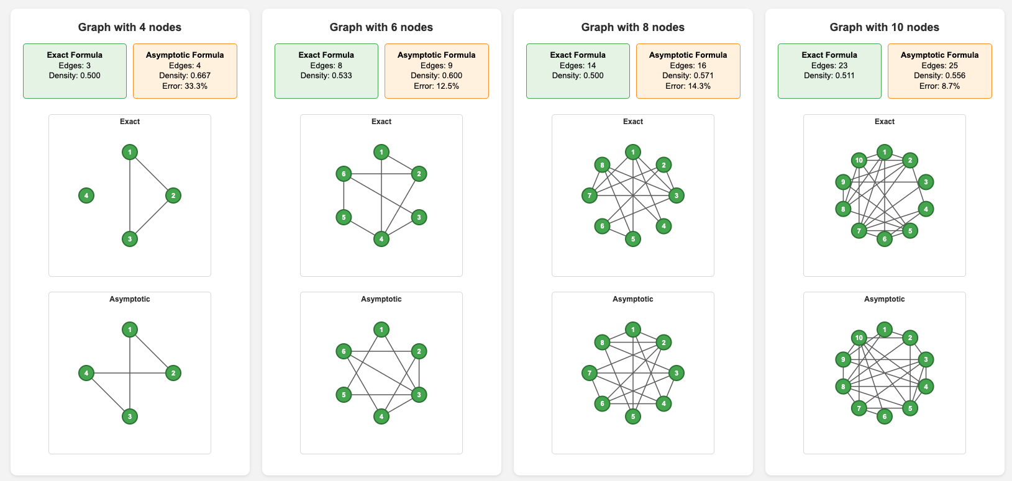
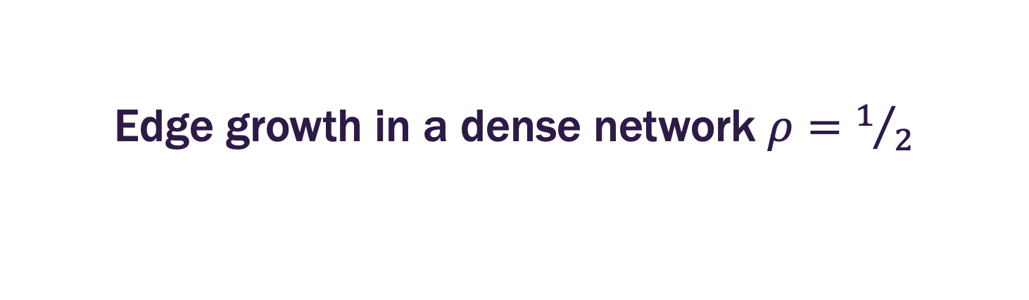
Edge growth in a dense network $ρ=1/2$

Slide 15
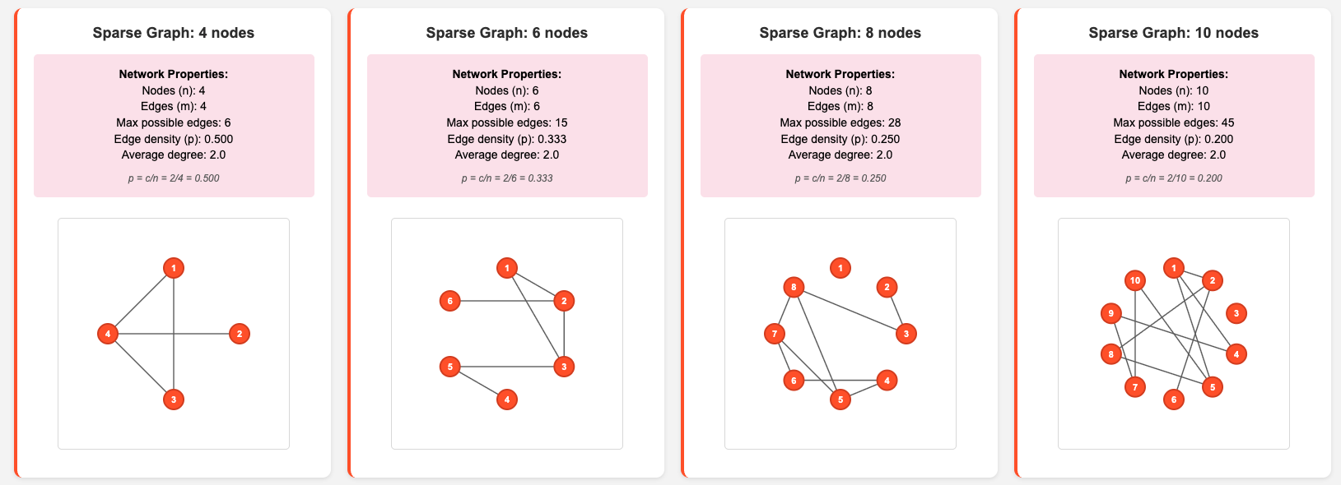
Edge growth in a sparse network $c=2$

Slide 16
Graph Laplacian

Slide 17
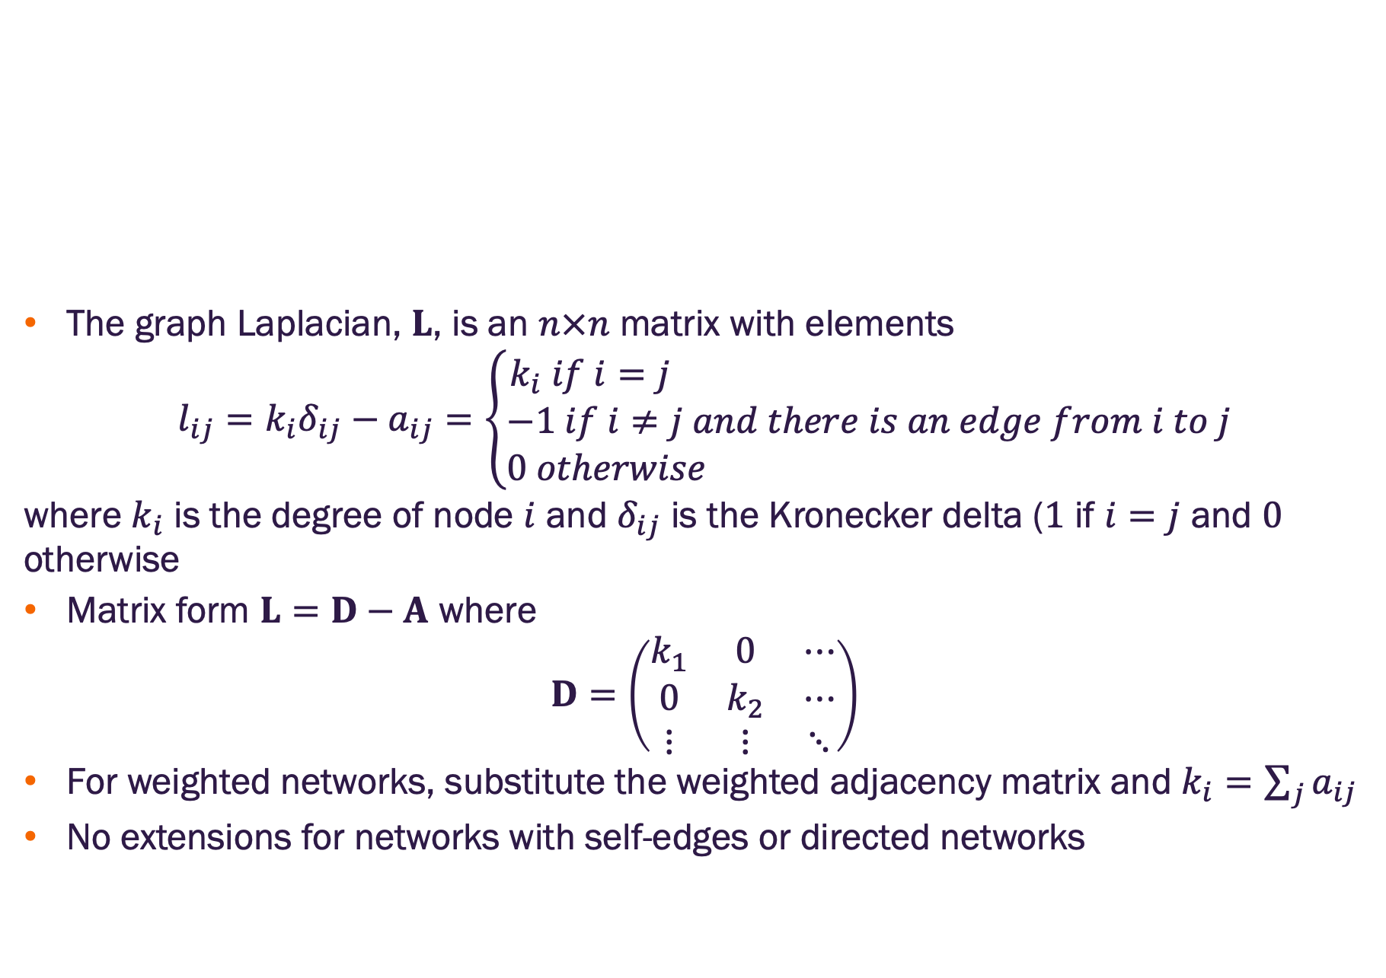
Graph Laplacian
The graph Laplacian, $L$, is an $n×n$ matrix with elements
$$l_{ij}=k_{i}δ_{ij}−a_{ij}=\left\{\begin{matrix}k_{i} if i=j \\ −1 if i≠j and there is an edge from i to j \\ 0 otherwise \end{matrix}\right.$$
where $k_{i}$ is the degree of node $i$ and $δ_{ij}$ is the Kronecker delta ($1$ if $i=j$ and $0$ otherwise
Matrix form $L=D−A$ where
$$D=\left(\begin{matrix}k_{1} & 0 & ⋯ \\ 0 & k_{2} & ⋯ \\ ⋮ & ⋮ & ⋱\end{matrix}\right)$$
For weighted networks, substitute the weighted adjacency matrix and $k_{i}=\sum_{j}{a_{ij}}$
No extensions for networks with self-edges or directed networks

Slide 18
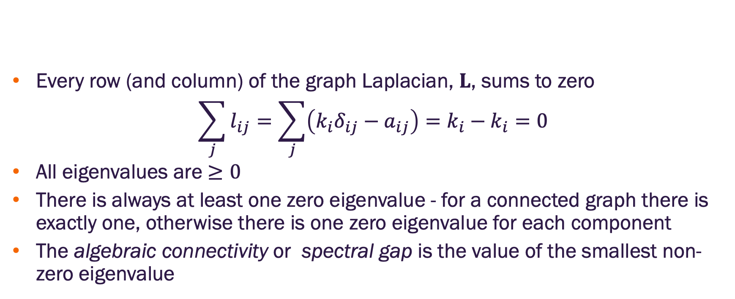
Graph Laplacian properties
Every row (and column) of the graph Laplacian, $L$, sums to zero
$$\sum_{j}{l_{ij}}=\sum_{j}{\left(k_{i}δ_{ij}−a_{ij}\right)}=k_{i}−k_{i}=0$$
All eigenvalues are $≥0$
There is always at least one zero eigenvalue - for a connected graph there is exactly one, otherwise there is one zero eigenvalue for each component
The algebraic connectivity or spectral gap is the value of the smallest non-zero eigenvalue

Slide 19
Walks and paths

Slide 20
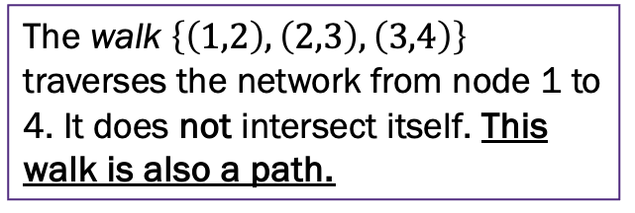
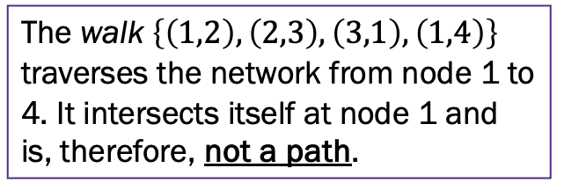
Walks and paths
A walk is any sequence of nodes such that every consecutive pair is connected by an edge
In a directed network, each edge in a walk must follow the edge direction
A path is a walk that does not intersect itself (i.e., all nodes in a path are distinct)
2
2
2
2
1
1
1
1
3
3
3
3
4
4
4
4
The walk $\left\{\left(1,2\right),\left(2,3\right),\left(3,1\right),\left(1,4\right)\right\}$ traverses the network from node 1 to 4. It intersects itself at node 1 and is, therefore, not a path.
The walk $\left\{\left(1,2\right),\left(2,3\right),\left(3,4\right)\right\}$ traverses the network from node 1 to 4. It does not intersect itself. This walk is also a path.

Slide 21
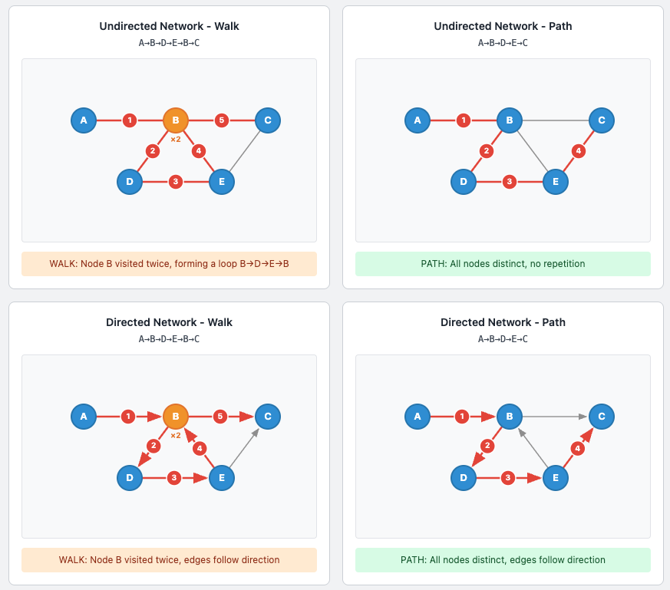
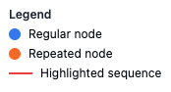
Network walks & paths
Walk – sequence of nodes where consecutive pairs are connected by edges
Path – a walk where all nodes are distinct

Slide 22
Survey – participation is optional
Please take a moment to complete this survey

Slide 23
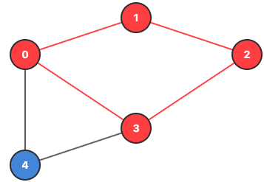
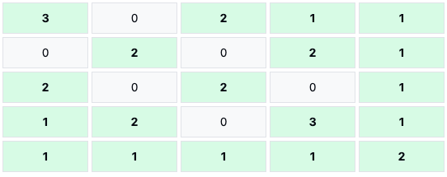
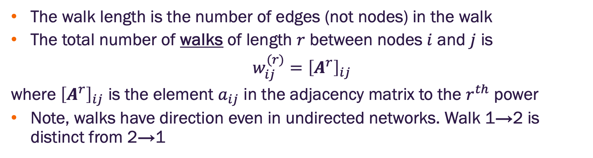
Walk length and walk counts
The walk length is the number of edges (not nodes) in the walk
The total number of walks of length $r$ between nodes $i$ and $j$ is
$$w_{ij}^{(r)}={\left[A^{r}\right]}_{ij}$$
where ${\left[A^{r}\right]}_{ij}$ is the element $a_{ij}$ in the adjacency matrix to the $r^{th}$ power
Note, walks have direction even in undirected networks. Walk 1→2 is distinct from 2→1
Walks of length two from node 0 to 2 are highlighted in red. The corresponding value of ${\left[A^{2}\right]}_{0,2}$ is equal to 2 indicating these are the only two paths.

Slide 24
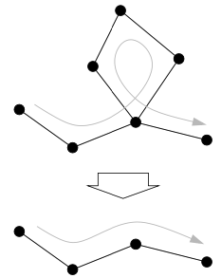
Shortest paths
A shortest path is the shortest walk (i.e., traverses the fewest edges) between a pair of nodes
Such a walk is necessarily a path (Why?)
The network diameter is the length of the longest shortest path (i.e., among all shortest paths between every pair of nodes, the diameter is the longest of these)
Knowledge of shortest path distributions can inform graph neural network design (e.g., how many layers) (future lecture)
Image credit: Newman 2018

Slide 25
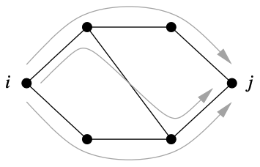
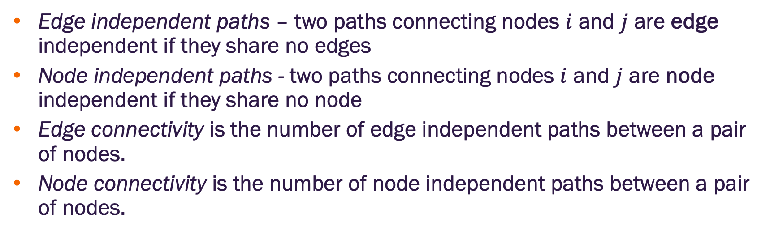
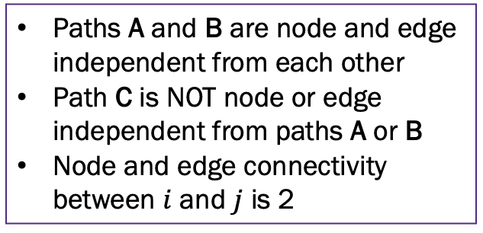
Independent paths and connectivity
Edge independent paths – two paths connecting nodes $i$ and $j$ are edge independent if they share no edges
Node independent paths - two paths connecting nodes $i$ and $j$ are node independent if they share no node
Edge connectivity is the number of edge independent paths between a pair of nodes.
Node connectivity is the number of node independent paths between a pair of nodes.
A
Paths A and B are node and edge independent from each other
Path C is NOT node or edge independent from paths A or B
Node and edge connectivity between $i$ and $j$ is 2
C
B
Image credit: Newman 2018

Slide 26
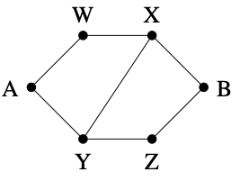
Bottlenecks and cut sets
Image credit: Newman 2018
A node cut set is a set of nodes whose removal will disconnect a specified pair of nodes
A cut set with a single node is a bottleneck
We’ll see later that bottlenecks can be a problem in GNNs
An edge cut set is a set of edges whose removal will disconnect a specified pair of nodes
Minimum cut set is the smallest cut set that will disconnect a pair of nodes
Menger’s theorem: the minimum cut set is equal to the number of independent paths between the nodes
Two independent paths from A to B: {A, W, X, B}, and {A, Y, Z, B}
Minimum cut sets are {W, Y} and {X, Z}, {X, Y}
Why isn’t {W, Z}?

Slide 27
Centrality measures

Slide 28
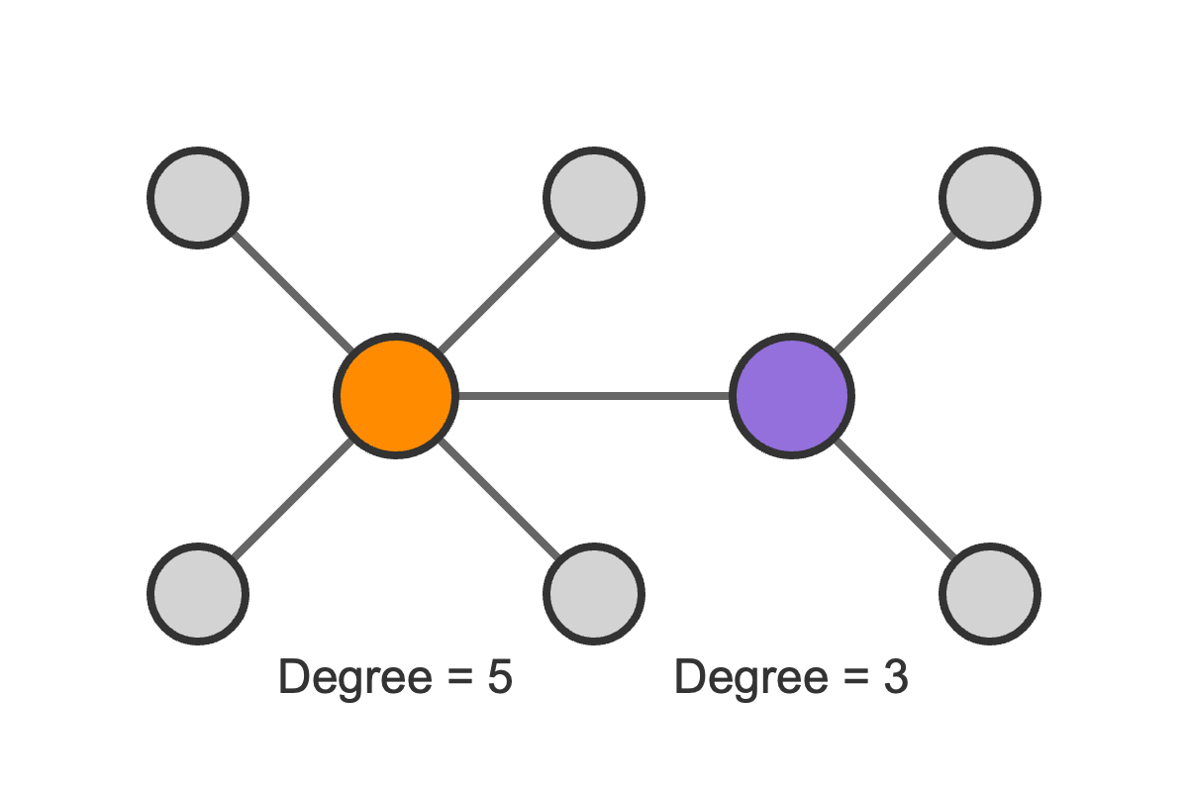
Centrality concept
Centrality metrics are intended to measure the importance of a node in a network
Node degree can be considered a centrality measure where nodes with higher degree are considered more important
Doesn’t consider importance of neighbors
Doesn’t consider role in network structure
There are many others to discuss

Slide 29
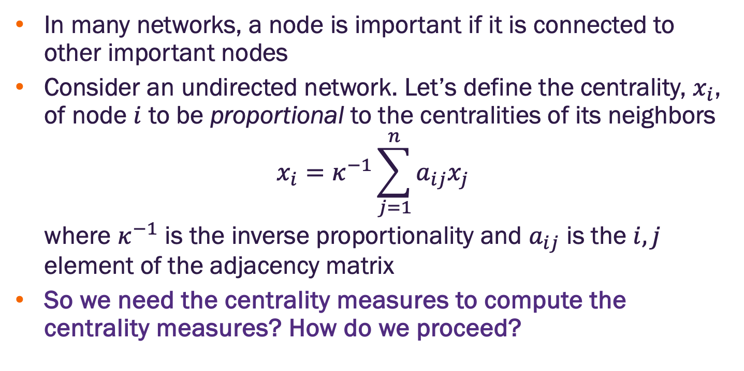
Eigenvector centrality for undirected networks
In many networks, a node is important if it is connected to other important nodes
Consider an undirected network. Let’s define the centrality, $x_{i}$, of node $i$ to be proportional to the centralities of its neighbors
$$x_{i}=κ^{−1}\sum_{j=1}^{n}{a_{ij}x_{j}}$$
where $κ^{−1}$ is the inverse proportionality and $a_{ij}$ is the $i,j$ element of the adjacency matrix
So we need the centrality measures to compute the centrality measures? How do we proceed?

Slide 30
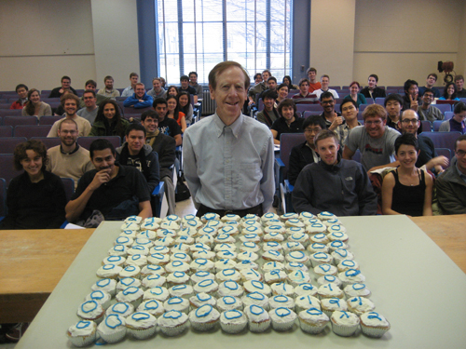
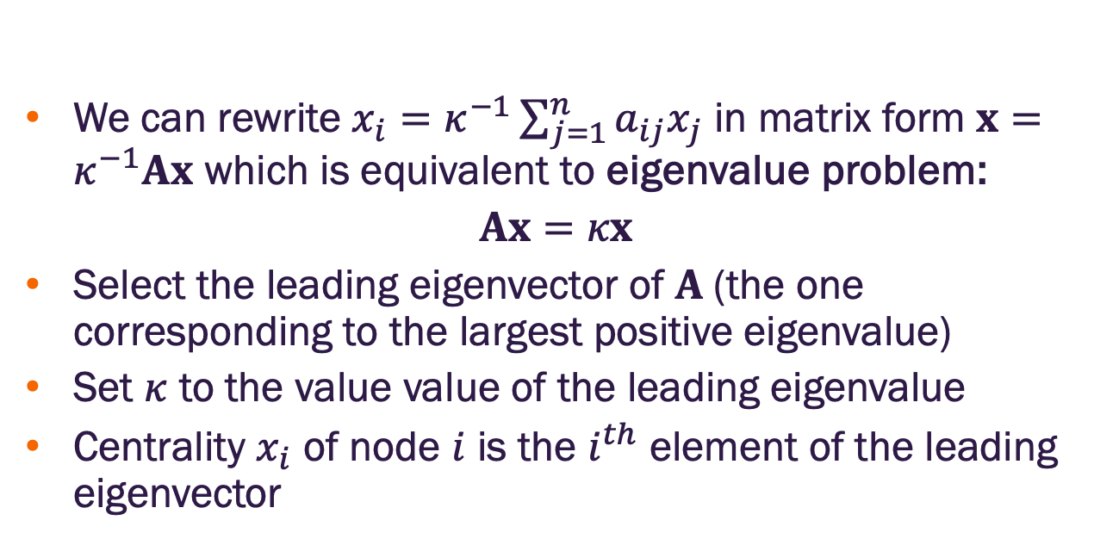
Eigenvector centrality for undirected networks
We can rewrite $x_{i}=κ^{−1}\sum_{j=1}^{n}{a_{ij}x_{j}}$ in matrix form $x=κ^{−1}Ax$ which is equivalent to eigenvalue problem:
$$Ax=κx$$
Select the leading eigenvector of $A$(the one corresponding to the largest positive eigenvalue)
Set $κ$ to the value value of the leading eigenvalue
Centrality $x_{i}$ of node $i$ is the $i^{th}$ element of the leading eigenvector
Linear Algebra for the win!!
Linear algebra is fundamental to machine learning. Graph learning is no exception. If you want a linear algebra refresher, I suggest Dr. Gilbert Strang’s MIT’s open course.
Notes:
For a matrix with all positive values such as the adjacency matrix, there is only one positive eigenvalue per the Perron-Frobenius theorem)
Technically, this is only true for connected networks (i.e., networks with one component). For multi-component networks, each component will have exactly one positive eigenvalue.

Slide 31
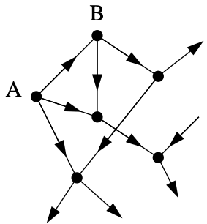
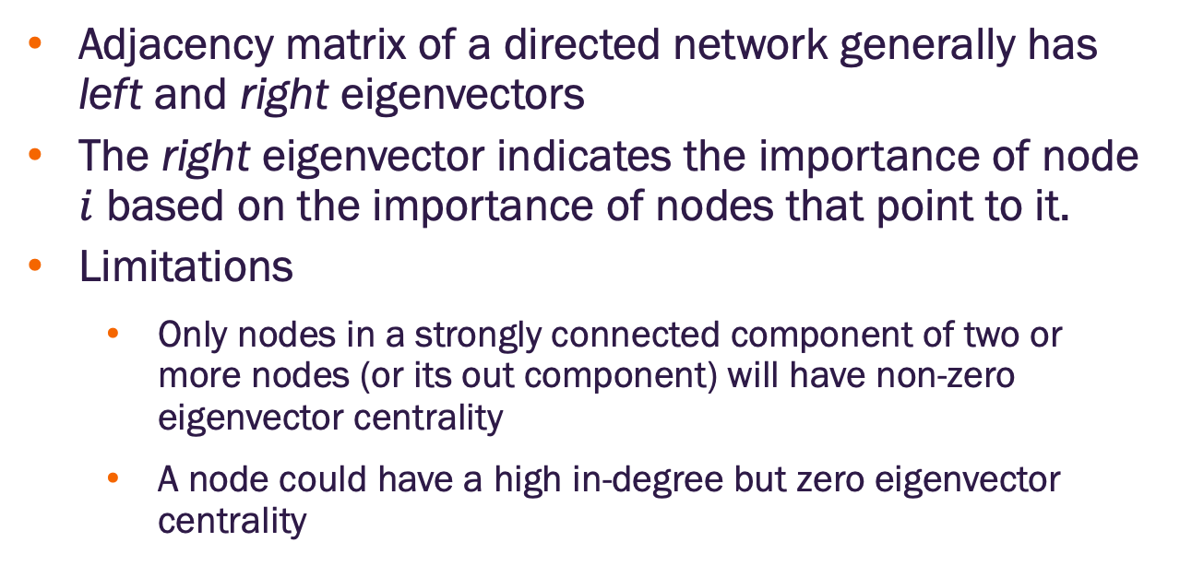
Eigenvector centrality on directed networks
Image credit: Newman 2018
Adjacency matrix of a directed network generally has left and right eigenvectors
The right eigenvector indicates the importance of node $i$ based on the importance of nodes that point to it.
Limitations
Only nodes in a strongly connected component of two or more nodes (or its out component) will have non-zero eigenvector centrality
A node could have a high in-degree but zero eigenvector centrality
Node A has zero eigenvector centrality because it has no nodes pointing to it
Node B is pointed to by node A only, so it also has zero eigenvector centrality
Notes:
Out component of a node A is the set of nodes that are reachable from the node on a directed path

Slide 32

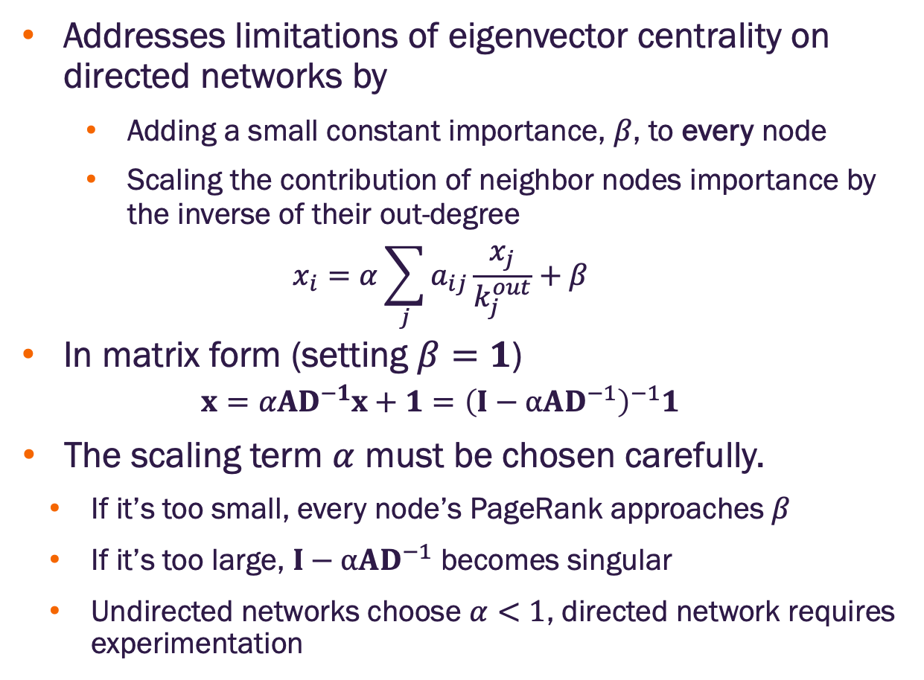
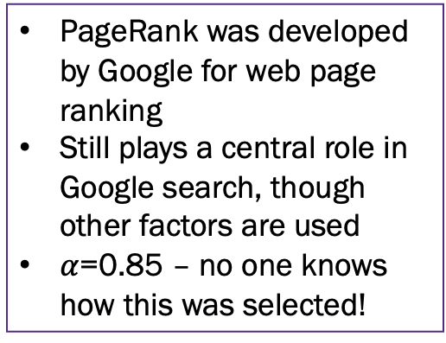
PageRank
Addresses limitations of eigenvector centrality on directed networks by
Adding a small constant importance, $β$, to every node
Scaling the contribution of neighbor nodes importance by the inverse of their out-degree
$$x_{i}=α\sum_{j}{a_{ij}\frac{x_{j}}{k_{j}^{out}}}+β$$
In matrix form (setting $β=1$)
$$x=αAD^{−1}x+1={\left(I−αAD^{−1}\right)}^{−1}1$$
The scaling term $α$ must be chosen carefully.
If it’s too small, every node’s PageRank approaches $β$
If it’s too large, $I−αAD^{−1}$ becomes singular
Undirected networks choose $α<1$, directed network requires experimentation
PageRank was developed by Google for web page ranking
Still plays a central role in Google search, though other factors are used
$α$=0.85 – no one knows how this was selected!

Slide 33
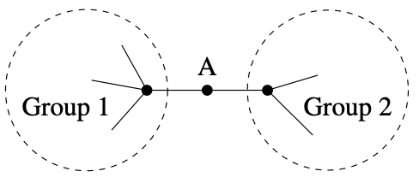
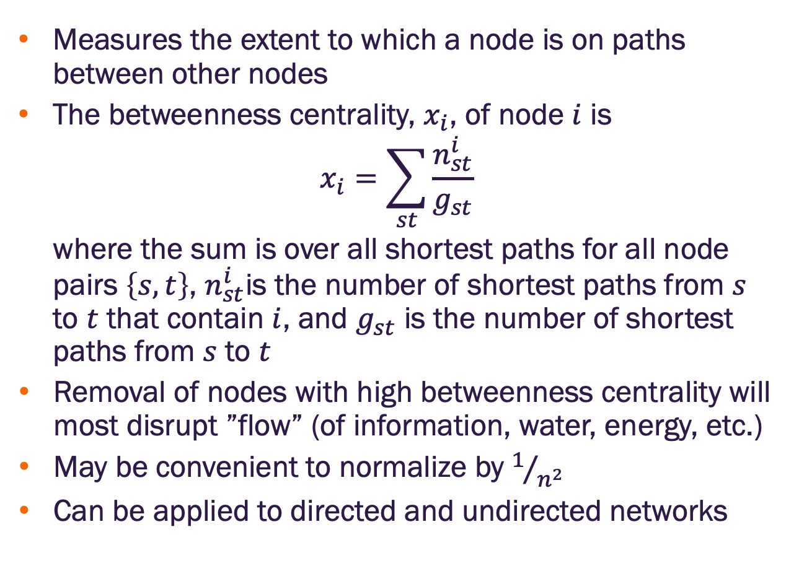
Betweenness Centrality
Image credit: Newman 2018
Measures the extent to which a node is on paths between other nodes
The betweenness centrality, $x_{i}$, of node $i$ is
$$x_{i}=\sum_{st}{\frac{n_{st}^{i}}{g_{st}}}$$
where the sum is over all shortest paths for all node pairs $\left\{s,t\right\}$, $n_{st}^{i}$is the number of shortest paths from $s$ to $t$ that contain $i$, and $g_{st}$ is the number of shortest paths from $s$ to $t$
Removal of nodes with high betweenness centrality will most disrupt ”flow” (of information, water, energy, etc.)
May be convenient to normalize by $1/{n^{2}}$
Can be applied to directed and undirected networks
Node A has low degree (only 2 neighbors)
All paths between nodes in Group 1 and those in Group 2 must pass through A
A will have high betweenness centrality

Slide 34
Node groups

Slide 35
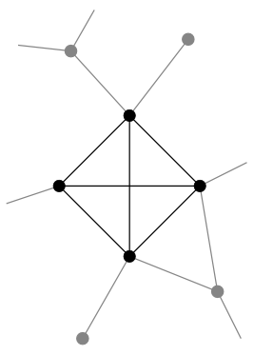
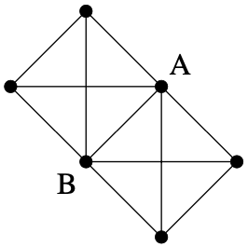
Cliques
Image credit: Newman 2018
A clique is a set of nodes in which every node is connected to every other node within an undirected network
Cliques may overlap, i.e., some nodes in one clique may belong to another clique
A clique found in a sparse network may indicate that the clique nodes are more similar than randomly selected nodes
Family members in a social group
Groups of interacting proteins in cellular networks
Financial entities that interact through transactions
A clique of 4 nodes (top)
Two cliques with overlapping nodes (bottom)

Slide 36
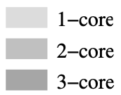
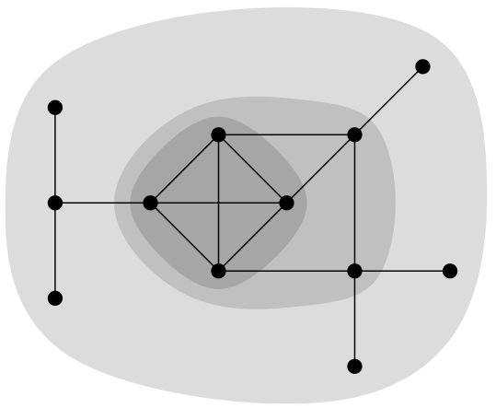
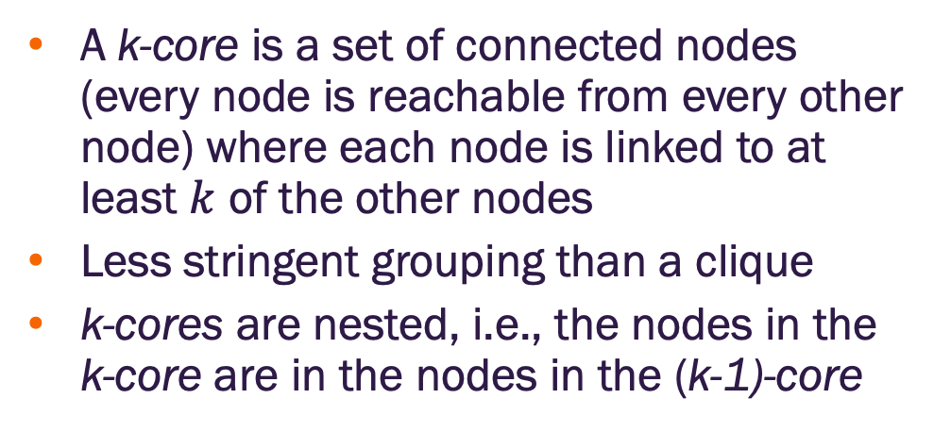
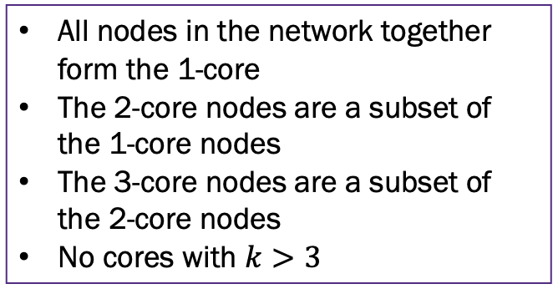
k-cores
A k-core is a set of connected nodes (every node is reachable from every other node) where each node is linked to at least $k$ of the other nodes
Less stringent grouping than a clique
k-cores are nested, i.e., the nodes in the k-core are in the nodes in the (k-1)-core
Image credit: Newman 2018
All nodes in the network together form the 1-core
The 2-core nodes are a subset of the 1-core nodes
The 3-core nodes are a subset of the 2-core nodes
No cores with $k>3$

Slide 37
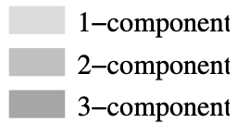
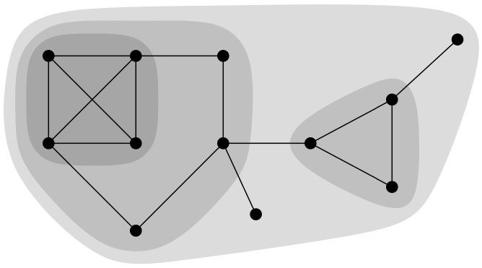
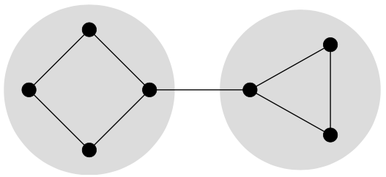
k-components
Image credit: Newman 2018
A k-component is a set of nodes where every node is reachable from every other node by at least k node-independent paths
No pair of nodes can be disconnected without removing less than k other nodes
k-components are nested like k-cores
Distinct from k-cores
K-components are different than k-cores
(Bottom) Two 2-components (shaded) and one 2-core (entire network)

Slide 38


Clustering coefficient
Image credit: Newman 2018
Consider an undirected network in which node $u$ is connected to node $v$ and node $v$ is connected to node $w$
Yields the 2-edge path $u→v→w$
If $u$ is also connected to $w$ we say the path is closed
The clustering coefficient, $C$, is the fraction of all such paths of length two that are closed
$$C=\frac{Number of closed paths of length two}{number of paths of length two}$$
$$C=\frac{\left(number of triangles\right)×6}{number of paths of length tow}$$
Social network studies have found clustering coefficients around 0.1
Random connections in the studied networks would yield clustering coefficients <0.001
Suggests two people will be connected if they have a shared connection

Slide 39

Homophily
Homophily in networks is the tendency of nodes to be connected to similar nodes
Also called assortative mixing
Often based on node features, e.g., class membership
Degree homophily (assortative mixing by degree) is derived from network structure and is defined by
$$\frac{1}{2m}\sum_{ij}{\left(a_{ij}−\frac{k_{i}k_{j}}{2m}\right)}k_{i}k_{j}$$
which is the covariance of node degree across all node pairs in the network

Slide 40
Node similarity metrics

Slide 41
Node similarity
Here, we focus on similarity measures that only consider network structure.
Later, we’ll see methods that incorporate node features

Slide 42

Cosine similarity
Consider two vectors $x$ and $y$. The cosine of the angle, $θ$, between them is
$$cosθ=\frac{x∙y}{\left|x\right|\left|y\right|}$$
Consider an undirected, unweighted network. Let the $i^{th}$ and $j^{th}$ rows, $a_{i}$ and $a_{j}$, of the adjacency matric be vectors, their cosine similarity, $σ_{ij}$, is
$$σ_{ij}=\frac{a_{i}∙a_{j}^{T}}{\left|a_{i}\right|\left|a_{j}\right|}=\frac{n_{ij}}{\sqrt{k_{i}k_{j}}}$$
where $n_{ij}$ is the number of shared nodes between nodes $i$ and $j$
Structural equivalence metric
Value lies in $\left[0,1\right]$ (assuming non-negative vector values)
Widely used in machine learning to compare embedding vector similarity

Slide 43

Other structural equivalence similarity metrics
Jaccard coefficient
$$J_{ij}=\frac{n_{ij}}{k_{i}+k_{j}−n_{ij}}$$
Pearson correlation coefficient
$$r_{ij}=\frac{\left(a_{i}−\overline{a_{i}}\right)∙\left(a_{j}−\overline{a_{j}}\right)}{\sqrt{{\left(a_{i}−\overline{a_{i}}\right)}^{2}}\sqrt{{\left(a_{j}−\overline{a_{j}}\right)}^{2}}}$$
Where $\overline{a_{j}}$ is the mean of row $j$

Slide 44


