Slide 1
Building Internet Systems of Lasting Value
Larry Masinter
Xerox Corporation
Palo Alto Research Center
http://www.parc.xerox.com/masinter
Notes:
Principal Scientist for Xerox Corporation
Internet architecture, Internet document services, and Internet standards. Focus on systems and technologies for document management and document processing. Background in “digital libraries”. Internet Engineering Task Force, World Wide Web consortium.
Topic this morning of long-term interest.
Dilemma: Technology changes. I and my friends are responsible for the advancement of technology, of inventing new mechanisms, systems, capabilities that are, in some way, better than the old.
Technology change also brings technology obsolescence. When working on the problems surrounding digital libraries, there was an issue that was continually recurring: how to create real capital, and not expense; how to create something that could have as long a lifetime and value as a building.
We are all, in some way or another, involved in creating the _next_ thing. But how can we think beyond that, and create value that lasts as long as a library or a new building might?
Planning for Y2010

Slide 2
Creating Lasting Value
Technology changes accelerate
  increasing rate of change
  the problem of obsolescence
Three rules for a happy life
planning for Y2010
  some guidelines
  a few motivating examples
  technology directions that can help
Notes:
I thought I would try to open the conference with some general thoughts about the future, in order to set a context for the talks and discussions over the next few days.
I will spend some time on “why there is a problem”, and review some of the trends: have you ever needed to find something when you weren’t in your office? Have you ever looked for some data or file and found it missing? Have you ever run across a web page with out of date information?
Then, present three rules for a happy life. Well, not really solve the problem, but guidelines that might ease things in the future.
Some perspectives on the future, share some general thoughts on directions.
Talk for 30 minutes, 15 minutes for Q&A; you can raise questions during the talk or wait until end.

Slide 3
Web and Speed
Years to reach 50M users:
Radio = 38
120
TV = 13
Cable = 10
90
Internet/Web = 5
60
Users (Millions)
30
Radio
Cable
Internet/
Web
TV
0
‘22
‘30
‘38
‘46
‘54
‘62
‘70
‘78
‘86
‘94
‘02
70 New users every minute (Source: New York Times)
Notes:
The rate of change and rate of introduction of technology is increasing.
This slide shows the relative times taken for the last four telecommunications innovations to reach 50 million users.
Moore’s law, that computing power doubles every two years, seems to have effect not only in silicon, memory, and bandwidth, but also in the every shortening lengths of the ages of man. Changes in culture as well as technology are ever quickening.
Most significant in the rise of the Internet is the advent of true globalization. Babel is undone technically on a global scale. Variations in dialect no longer hinder giant construction projects, as is evident on a daily basis at global firms in which products vastly more complex than towers are are designed and delivered by international product delivery teams. The sun never sets on the development activities of a product delivery team in a modern multinational firm. Engineering drawings are generated worldwide, by employees of widely varying cultures and languages, working together to speed up the time to market in a global economy.

Slide 4
The Massless Economy
“America’s output, measured in tons, is barely any heavier now than it was 100 years ago. In the same period, real GDP, by value, has increased 20 times.” - (Alan Greenspan, chair, Federal Reserve Board, USA)
More than half of the total GDP in 1996 in
the rich countries was knowledge-based.
Notes:
One of the driving forces that is causing technology change in systems is the trend towards a massless economy. The value that is created can is no longer correlated with brick, mortar, steel or mass. The value is created from services, enhancements, refinements, and advice, and knowledge is the fuel of today’s economy. This economical boost adds fuel to the introduction of new technology.
The world we are living in has changed dramatically; the Internet has made the world smaller, made every geographical area global, and added chaos to the number of things that you must track in order to be "current”.

Slide 5
Accelerating Trends
Rise of Services over Products
New information-based intermediaries
Services are distributed over the network
“Universal Service” includes Internet Service
But…new technologies displace old slowly
Notes:
These changes are accompanied by several other trends. Products will increasingly become the basis for e-commerce services. Direct distribution leads to the disintermediation, but also leads to the rise of others, such as infomediaries that collect, make sense of, and provide services related to information. The Internet shifts power from sellers to buyers by lowering the cost of information and cost of switching, but the lowered cost of information overloads ability of users to attend to it giving rise to trusted third party infomediaries. ·Bookstores have been losing business to online booksellers such as Amazon.com. Amazon has larger stock than any physical bookstore and it is rapidly searchable. In addition, it recommends books similar to a book of interest. NTE (National Transportation Exchange) uses the Web to collect daily and sell unused trucking capacity from several hundred truckers, who would otherwise return from runs empty.
Our notion of what constitutes "universal service", formerly for telephone access, is now extending to include data and Internet services.
Counterbalancing these trends is the fact that new technologies do not (completely) displace the old. Thus, even as newer and newer technologies are introduced, there are a large number of users who convert only slowly. The future like the past, only more complicated.

Slide 6
Three Rules for Lasting Value
Device independence
Capture & preserve
The system is not the system
Notes:
How can we survive in a world of chaos and change? This part of the talk is directed at those who are planning or building information systems for use in the next decade.
I don't know the answer.
But I do have a few perspectives that might help, just a little, to carry along those systems as technology evolves and changes, and I hope will be useful to you.
These are certainly not everything we need to know.
My idea is that you might keep these guidelines in mind as you listen to the talks.

Slide 7
Rule 1: Device Independence
“The browser on the PC”
will not be the primary access device
New kinds of devices
  Handheld, Embedded
  Audio/Voice
  Paper Interfaces
Universal access to those with disabilities
Notes:
The first rule for a happy life: plan for device independence.
We have been building information systems for access by terminals, and, subsequently, window systems. We’ve seen some interest in “kiosk” information systems in a limited way. But on the horizon is an explosion of devices and access methods for information and information services that appears unprecedented.
I’ll tell you about these...

Slide 8
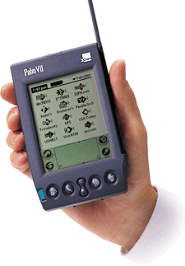
Handheld, Portable
Handheld computers
Cell phones
Portable, wireless
Small screen
Simpler interaction methods
Notes:
The first category of device that looks like it has enormous potential are small devices with information access capability. The market for these devices is increasing rapidly; the next generation of cellular telephones and wireless access devices will have data interaction. This is important technology for organizations with mobile workers (how many of you work for organization where people are outside, or travel from place to place in the course of their job)?

Slide 9

Embedded in Devices
Convergence of TV (WebTV)
Embedded in appliances
Phone, refrigerator, microwave
Notes:
In addition, a separate category are information appliances that are “converged” with other devices. WebTV, Refrigerator with web browser, microwave with access to recipes.
Pundits talk about “convergence”, with a gleeful attitude, although there remains the possibility that with the loss of one remote control in the cushions of your sofa, you might lose access not only to tonight’s television program, but your email, garage door opener, and tomorrow night’s dinner recipe.
Increasing rise of specialized devices that offer some amount of information integration with other functions.

Slide 10
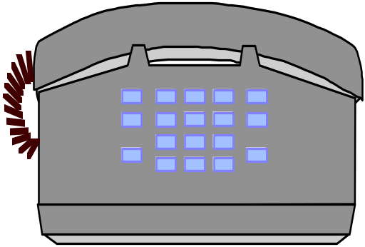
Audio
Access to information through
  dial-up touch-tone response
  audio response system
Screen reader for blind
Audio response in car
Notes:
Although the peak of misuse of touch-tone phone “hell” is diminishing, we are seeing the continued deployment of systems for access to information over audio, both for contexts where visual and screen interaction are difficult or impossible, or for individuals for which this is a problem.
The telephone is the closest thing we have to universal access today.

Slide 11


Paper Forms for Interaction
John Q. Smith
P
History Test 2 October 24, 1998
1. Who killed Abraham Lincoln?
George Washington
John Wilkes Booth
Aaron Burr
James Garfield
Checked boxes will be identified when form is scanned
2. When was the war of 1812 fought?
In the 18th century
1776
1812
1998
Data glyphs containing application-specific
information
3. Who said “Give me liberty or give me death”?
Martin Luther
Martin Luther King
Benjamin Franklin
Patrick Henry
Data glyphs uniquely identifying this page
Registration mark for scanning
Notes:
Finally, I wanted to introduce some technology from Xerox that is attempting to assist with those cases where the “last mile” of the Information superhighway is paved with paper. When some of the users of the system -- students in a class, executives on the airplane -- do not have or do not want laptops, palmtops, wireless appliances, or so on.
Our approach has been to attempt to ensure that paper itself (low cost, weight, portable, durable) can be used as an interaction medium, as a way of expressing both the presentation of information (for which it has been used since the invention of paper) but also as a way of interactng directly with information systems.

Slide 12
Tools for Device Independence
Author content and purpose
  what you’re saying or asking
Transform to presentation and interaction
  how to display or ask for it
W3C WAI: Web Accessibility Initiative of World Wide Web Consortium
  guidelines for content and interaction
HTML (HyperText Markup Language)
  XHTML; XML plus style
Notes:
Given this background, of the increasing scope of devices, interaction methods, and desire to have systems that interact equally with each, what advice can I leave you with for technology directions? The most important thing to do is to be careful about the way in which systems are designed to allow them to be device independent. This is where some of the standards work in the World Wide Web consortium comes to play. One of the primary focus interests of W3C is to help continue to tease out the distinction between purpose and presentation. This was an objective of the original World Wide Web (platform and operating system independence) and continues to be a priority.
Everyone, Everything Connected can only work when differences are accomodated.

Slide 13
Rule 2: Capture and Preserve
Budget for preservation and conversion
  The value of access is ephemeral
Archiving changes culture
  Preserve information, not conversation
Access control allows trust
  preservation without access control
  introduces risk of release
Plan for media refresh
  preservation of data in perpetuity
Notes:
Access is only ephemeral; you only build long-term value in information if you also focus on preservation.
Adage from the library community: “Copy what’s used. Preserve what’s copied.”
Long-term preservation is less expensive than initial acquisition, so budgeting 2x for preservation will work. Spend as much on archival as on access.
Create in media-independent ways.
Store in multiple formats.
Plan for redundant storage & replication.
XML Schema

Slide 14

Web In a Box
In 1999, the entire collection of text from the entire WWW:
  less than 500 gigabytes
  fits on 1 machine.
Total in all of existence (from Lesk)
  ~10 terabytes of text
  ~100 petabytes, including video, audio
  ~12000 petabytes of everything
Disk & tape production will soon exceed this
Notes:
How much information is there in the world? Figures from Michael Lesk. Currently estimated that the entire collection of text from the web is perhaps 1000 gigabytes. Soon after the year 2000 the production of disks and tapes will outrun human production of information to put on them. Soon after that, it will be possible to archive everything
There will be enough disk space and tape storage in the world to store everything people write, say, perform or photograph. For writing this is true already; for the others it is only a year or two away. Only a tiny fraction of this information has been professionally approved, and only a tiny fraction of it will be remembered by anyone. The storage media will outrun our ability to create things to put on them; and so after the year 2000 the average disk drive or communications link will contain machine-to-machine communication, not human-to-human. When we reach a world in which the average piece of information is never looked at by a human, we will need to know how to evaluate everything automatically to decide what should get the precious resource of human attention.
The cost of refresh of media decreases as rapidly, so that, if sufficient attention is paid to being careful about format, it is will be possible to keep everything online.

Slide 15
Problems with preservation
Media refresh
Organization
Trust & warrantee
Copyright & usage rights
Replication, redundancy
Notes:
Securing copyrighted works against unauthorized use in print and electronic format, in the domestic and international marketplace
Protecting the integrity of copyrighted works in the digital environment
Tracking the use of these works
Developing workable compensation mechanisms
Goal: An online distribution system with good protection and tracking capabilities, integrated with a flexible e-commerce system, and one that is easy to use for the consumer!

Slide 16
Tools for Preservation
Standards for document formats
Remembering metadata:
  RDF: Resource Definition Format
    structure for saving metadata
  Dublin Core: standards for metadata
Technologies of trust:
  digital signatures, copyright
  authentication, access control, accounting
Global persistent naming
Notes:
Technology development for preservation
Careful attention to storing data in archival forms:
documented, published representations (not “vendor HTML”)
TIFF images
Pay attention to technology for metadata: remembering data about data. Standards for recording metadata.
Focus on being careful about references inside hypertext.

Slide 17
Rule 3:The System is not the System
The value of organizational change outlasts the technology used to
introduce it
Technology changes organizations
Improving process creates value
Building knowledge as capital
Notes:
It’s the people, stupid!
The value of systems are often measured by the value of the social changes that they enable. This value lasts well beyond the installation of software. Plan the system so that the social structures are explicit, can evolve, and are accounted for explicitly.
The importance of the adage is to realize that when we deploy technology, we are actually creating more responsive organizations, and that the cultural changes outlast the system that enabled them.
A “web site” is not a publication, it is a communication channel
As such, if there is no one home, it has no value. Static ‘information’ is dead information.
Even the most static of information sources, a library, must remain open, vibrant, responsive, it is not a “collection of books”
By allowing the integration of work processes with the consumers of those processes and the suppliers, we are creating resiliant organizations.

Slide 18
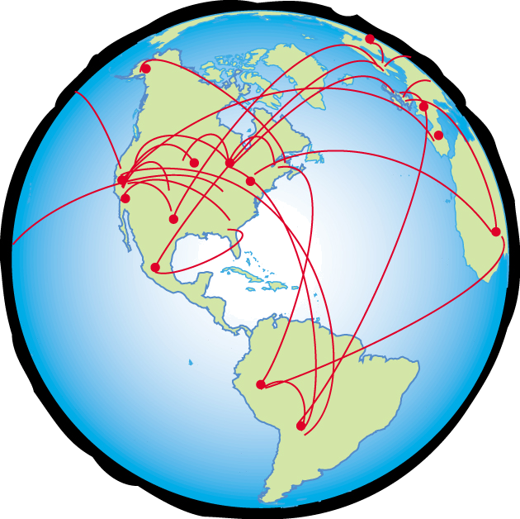





Tapping The Social Mind
Knowledge
Learning
Information
Data
Notes:
Internet systems allow the creation of a social mind that crosses organizational boundaries. It is important to recognize and enhance this, by providing for collaborative tools. The knowledge of an organization is more than in the minds of any individual. By building knowledge-based systems, we allow the enhancement of the intelligence of the organization.
Knowledge sharing tools developed for the web are focused on enabling getting the right information to the right person at the right time.
Knowledge sharing can be built with increasing value
The simplest kind of knowledge sharing is “access to information”, where the experts create a web site which contains their “knowledge”, and secondly, that others are able to add information.
Next: trust in the information for accuracy, authenticity
Next: process for insuring quality
Mechanisms for creating information warrantee.
Add the ability to learn, grow, evolve.
Focus the organization on mechanisms for learning.

Slide 19
Tools for Process Improvement
The Internet community is building technology for “e-commerce”, in the broadest sense of commerce:
  communication
  collaboration
  negotiation
XML descriptions of business processes, industry elements, commercial
Public sector analogues build long-term value
Notes:
At the base, the Internet has provided a global mechanism for “commerce” in its broadest sense: to have interaction, communication, conversation, over space and time. Layered on top of this, though, are some emerging standards for organization of processes without prior arrangement, through standardized descriptions of work processes in industry after industry.

Slide 20

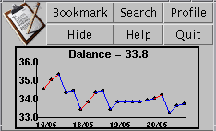
Tools for Building Knowledge
Warranty
Quality
Trust
Access
Tapping the Social Mind:
Recommendations
Communities
Incentives
Markets
Notes:
The principles for tools for building community are being developed, but we see some of their early expression in numerous web applications:
The first element is to provide some support for the basic element of community knowledge: references, recommendations, reviews, such as with Amazon.com.
Secondly to create tools for explicitly supporting, acknowledging, and building the communities themselves, such as Geocities.
Third, we are starting to see the nature of incentives for collaboration, whether through credit, acknowledgement, status, or reputation, being explicitly supported, such as Xerox’s Eureka.
Finally, systems for explicitly creating markets and settlement provide for the more efficient functioning of financial communities, such as at Ebay.

Slide 21
Where is the Life we have lost in living?
Where is the Wisdom we have lost in Knowledge?
Where is the Knowledge we have lost in Information?
T. S. Eliot
Provide access to all
Preserved information
Build knowledge
Develop understanding
Aspire to wisdom
Notes:
Following a poem by T.S. Elliot, we might ask, Where is the life we have lost in living, where is the wisdom we have lost in knowledge, where is the knowledge we have lost in information?
For today, we can focus on some simpler aspirations (build)
Build systems that provide access to all
Preserve the information so that it can be accessed in the future
Build the knowledge that is embedded in our organizations
It will help us to develop understanding
So that we can aspire to wisdom

