Slide 1
Quick Emulator (QEMU)
Mahmoud Jadaan

Slide 2
Agenda
Intoduction to Emulation & QEMU
User Mode: Emulating ARM Binary
GDB with User Mode
System Mode: Emulating Rasbperry PI board
GDB with System Mode

Slide 3
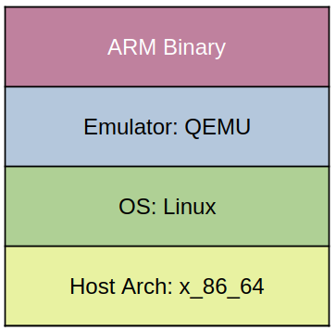
Introduction

Slide 4
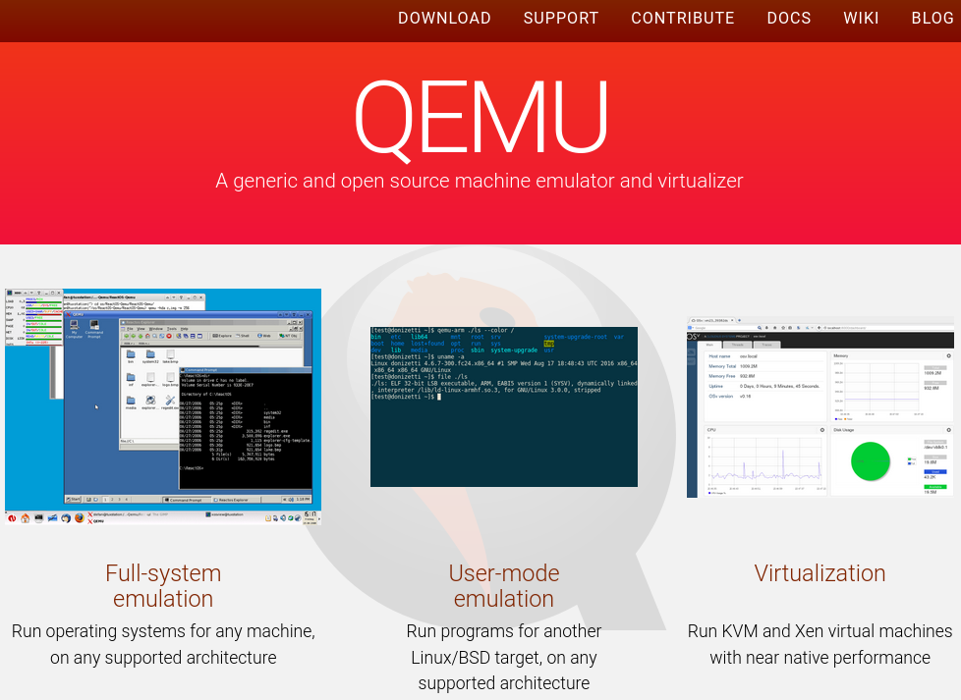
QEMU
Website
  https://www.qemu.org/
Github
  https://github.com/qemu/qemu

Slide 5
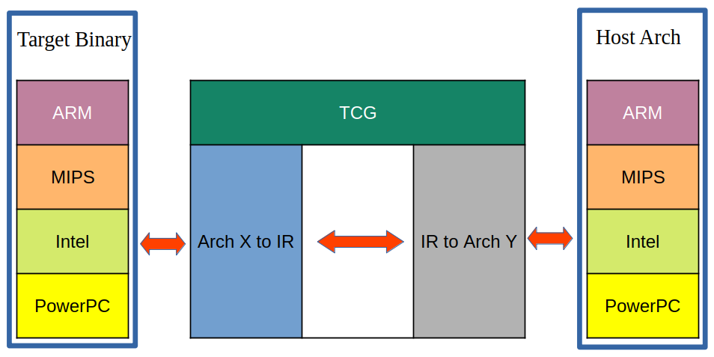
QEMU Translation

Slide 6
Emulatoin vs Virtualization
Emulation
Runs as a process in host OS
Allows execution of SW from different arch
Slower because of translation
Virtualization
Bare-metal hypervisor runs one level lower than kernel
Virtualized system must have same arch
Faster

Slide 7
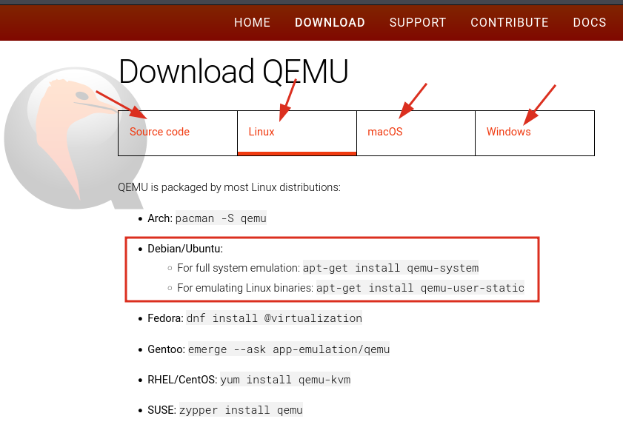
Installation
For full system emulation
# sudo apt-get install qemu-system
For user binaries emulation
# sudo apt-get install qemu-user-static

