Slide 1
QEMU System Mode
Emulating Raspberry PI 3B
Mahmoud Jadaan

Slide 2
Enviroment
Test machine
Installation
lsb_release -a
sudo apt-get install qemu-system

Slide 3
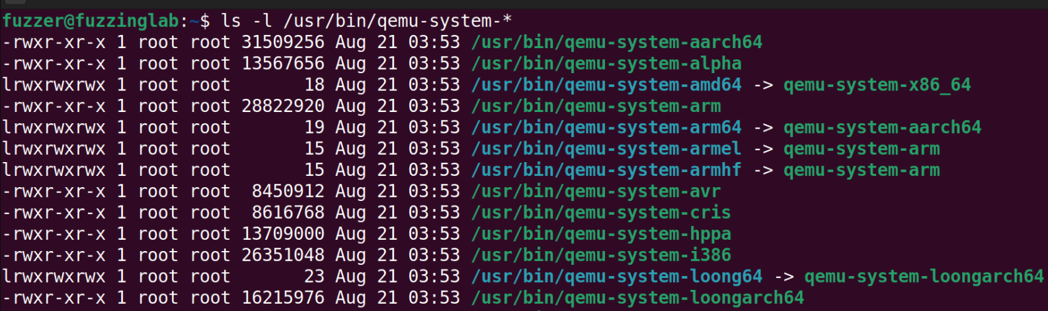
Supported Architectures

Slide 4
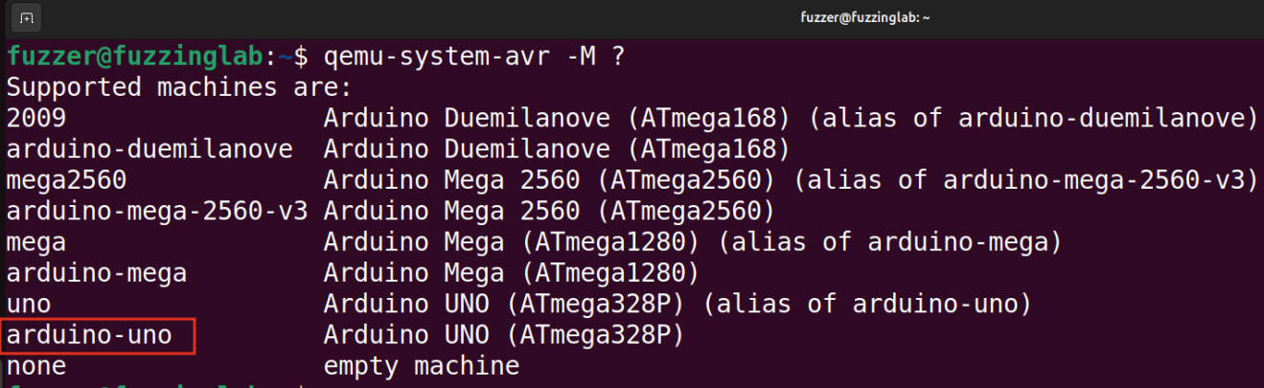
Arduino

Slide 5
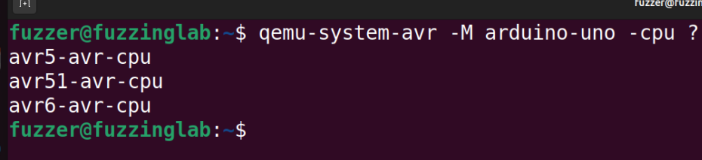
Arduino

Slide 6
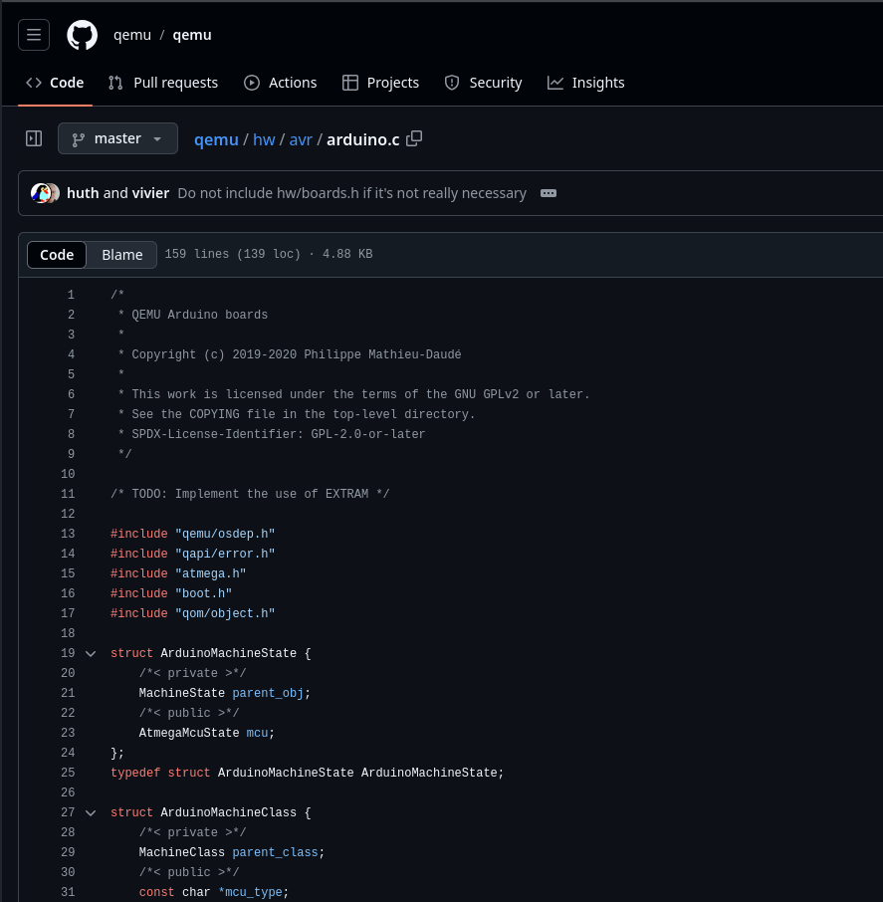
Implementation
https://github.com/qemu/qemu/blob/master/hw/avr/arduino.c

Slide 7
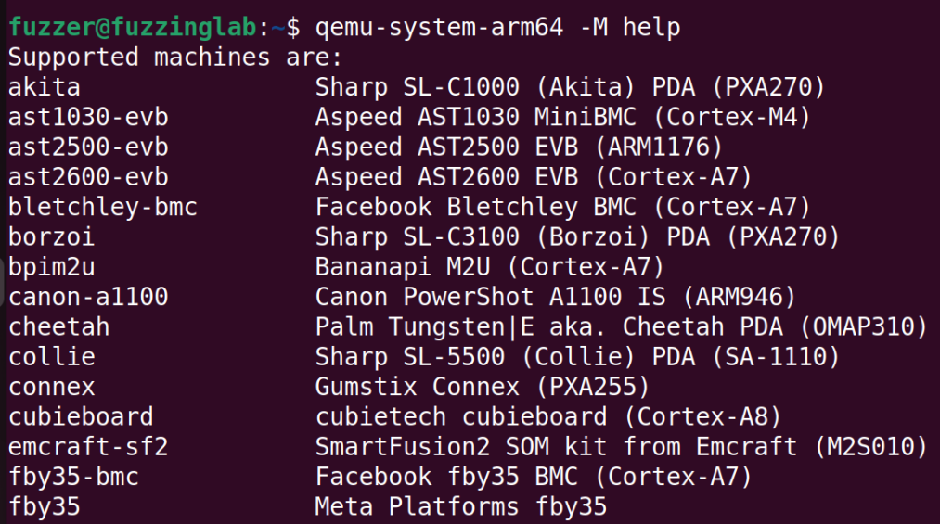
ARM

Slide 8
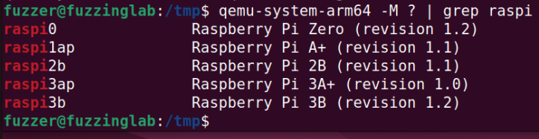
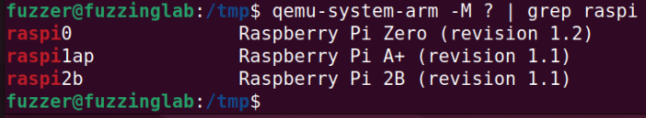
ARM
ARM64
ARM32

Slide 9
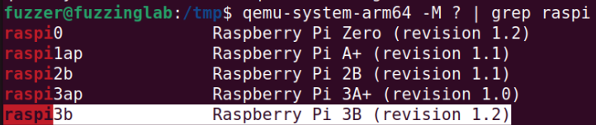
ARM
RASPI3b

Slide 10
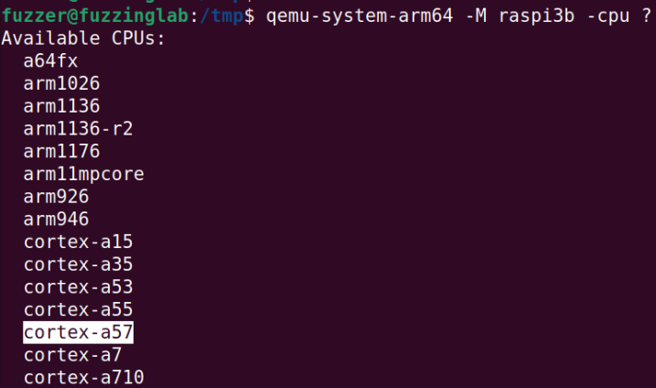
ARM

Slide 11
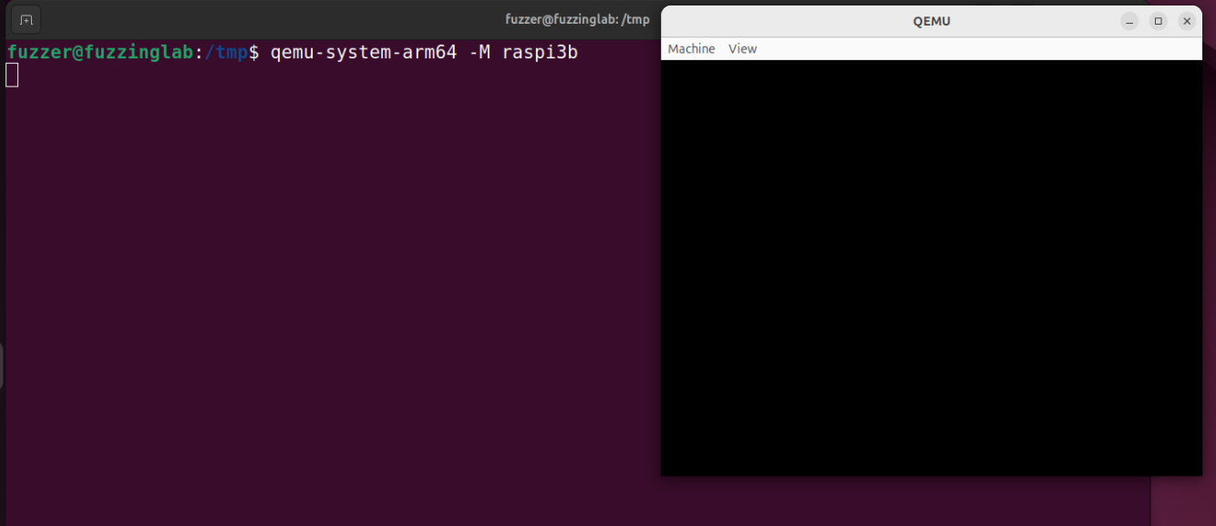
Emulating Raspberry Pi 3B

Slide 12
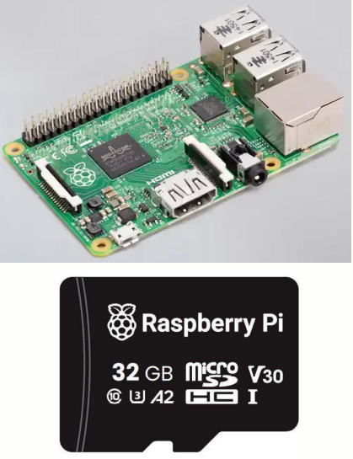
Emulating Raspberry PI 3B
SD card
Kernel

Slide 13
Emulating Raspberry PI 3B
Creating SD card
qemu-img create -f raw sd-card.img 32G parted sd-card.img mklabel msdos parted sd-card.img mkpart primary fat32 1MiB 256MiB parted sd-card.img mkpart primary ext4 256MiB 100%

Slide 14
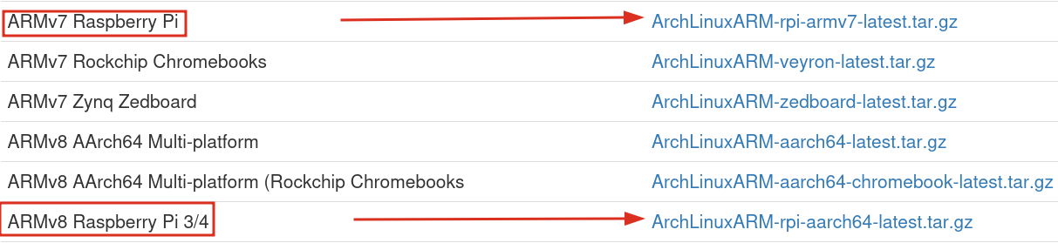
Emulating Raspberry PI 3B
wget http://os.archlinuxarm.org/os/ArchLinuxARM-rpi-aarch64-latest.tar.gz
mkdir archLinuxARM64
sudo tar -xzf ArchLinuxARM-rpi-aarch64-latest.tar.gz -C ./archLinuxARM64

Slide 15
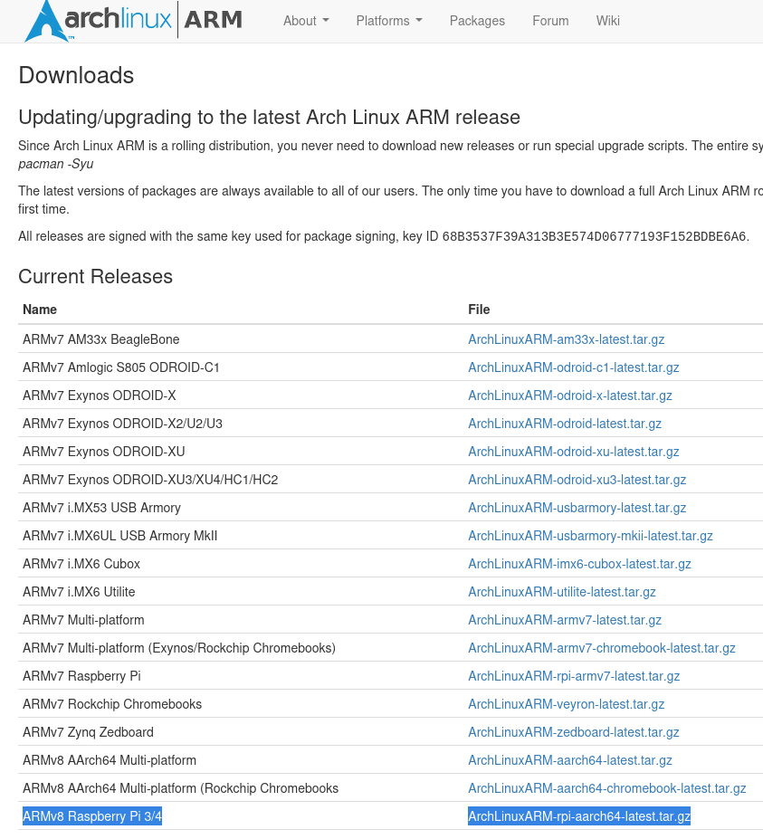
Emulating Raspberry PI 3B
Flashing SD Card
# Create loop devices sudo losetup -fP sd-card.img losetup -a sudo mkfs.vfat /dev/loop1p1 sudo mkfs.ext4 /dev/loop1p2 sudo mkdir /mnt/boot sudo mkdir /mnt/rootfs sudo mount /dev/loop1p1 /mnt/boot sudo mount /dev/loop1p2 /mnt/rootfs sudo cp -r /tmp/test/archLinuxARM64/boot/* /mnt/boot/ sudo rsync -a ./archLinuxARM64/ /mnt/rootfs/ # clean up sudo umount /mnt/boot sudo umount /mnt/rootfs sudo losetup -d /dev/loop1

Slide 16
Emulating Raspberry PI 3B
Starting QEMU
qemu-system-aarch64 \ -M raspi3b \ -m 1G \ -smp 4 \ -kernel ./archLinuxARM64/boot/kernel8.img \ -dtb ./archLinuxARM64/boot/bcm2710-rpi-3-b.dtb \ -drive file=./sd-card.img,format=raw,if=sd \ -serial pty \ -serial mon:stdio \ -append "root=/dev/mmcblk0p2 rw console=ttyAMA0,115200 loglevel=7 earlyprintk"

Slide 17
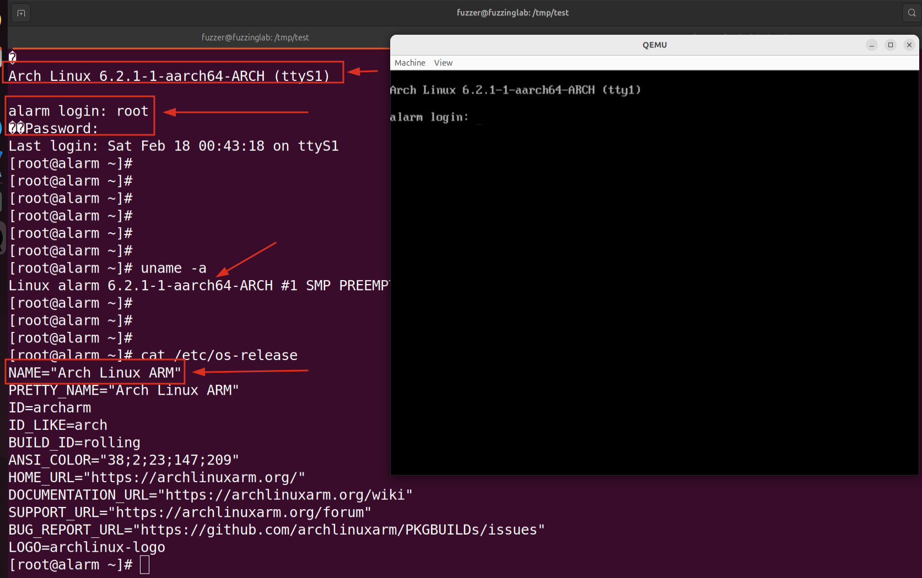
Emulating Raspberry PI 3B

