Slide 1
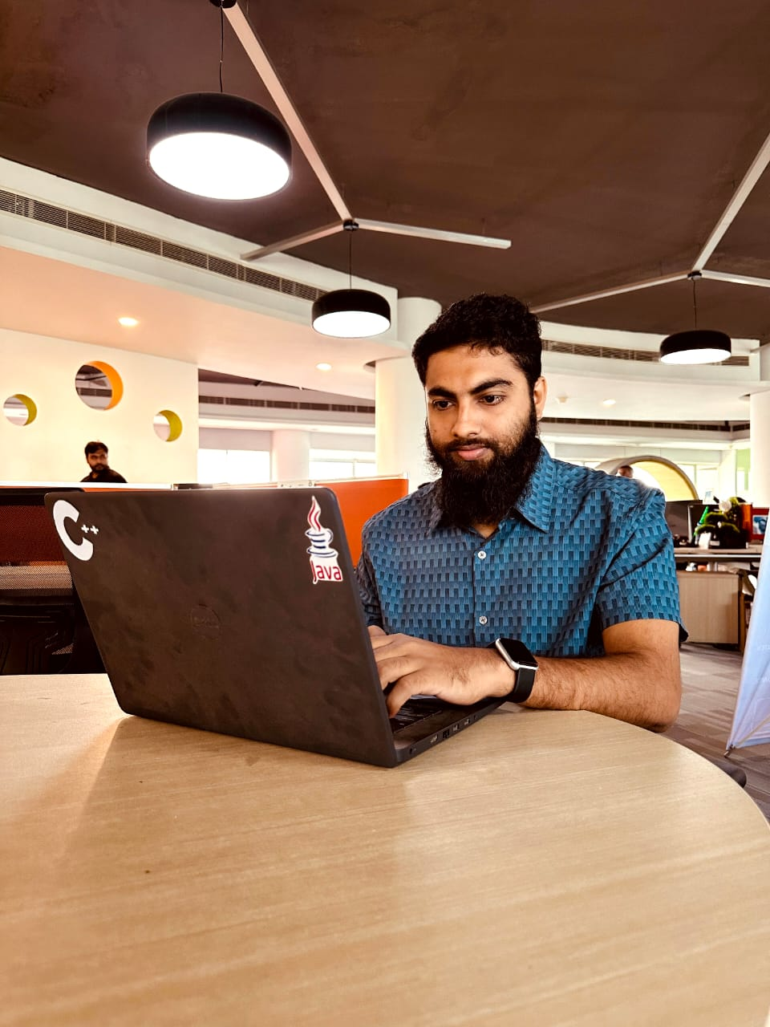
A Practical Journey of Software Engineer in MERN Stack Development
Date: 29-08-2024
Page | 01

Slide 2


Green University of Bangladesh
Department of computer science and engineering
Academic Supervisor:
Name: Md. Zahidul Hasan
Designation: Lecturer
Green University of Bangladesh
Presented By:
Name: M A S K Shakil
ID: 201002029
Industrial Supervisor:
Name: Nadim Mahmud
Designation: CEO, Mastermind Technology, ICT Tower
Date: 29-08-2024
Page | 02

Slide 3
Contents
Introduction
Motivations
Objectives
Overview the Organization
Tools and Technology
Problem Statement
Adaptation to Technological Changes
Project UI
Conclusion
References
Date: 29-08-2024
Page | 03

Slide 4
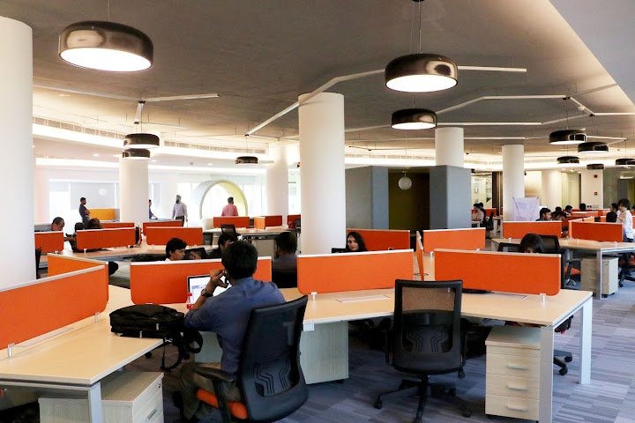
Gantt Chart
Introduction
16
Practical learning for web development skills and hands-on experience.
At Mastermind Technology, learned new things and developed practical experience.
Developed web development skill and explored career paths.
Date: 29-08-2024
Page | 04

Slide 5

Motivations
Practical application
Career advancement
Industry exposure
Networking opportunities
Continuous learning
Confidence building
Creative expression
Personal growth
Date: 29-08-2024
Page | 05

Slide 6

Objectives
Practical skill development
Understanding web development concepts
Project Experience
Project-based learning
Collaboration and Teamwork
Problem-solving Abilities
Testing and debugging skills
Date: 29-08-2024
Page | 06

Slide 7
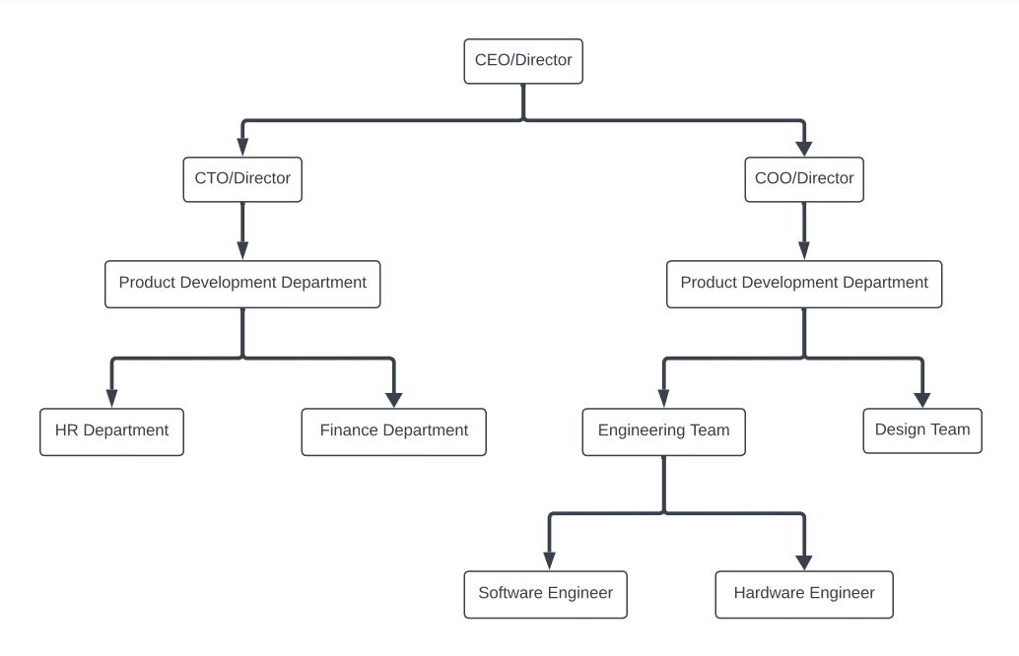
Overview of the Organization
Mastermind Technology specializes in web development and IT solutions, providing unique services and skills. The organization is well-known for promoting digital transformation.
Fig 1: Organizational Structure of Mastermind Technology
Date: 29-08-2024
Page | 07

Slide 8

Tool and Techniques
Tailwind CSS
JavaScript
React js
Redux
Firebase
Version Control System (Git, GitHub)
Chrome Dev Tool
Figma
Date: 29-08-2024
Page | 08

Slide 9
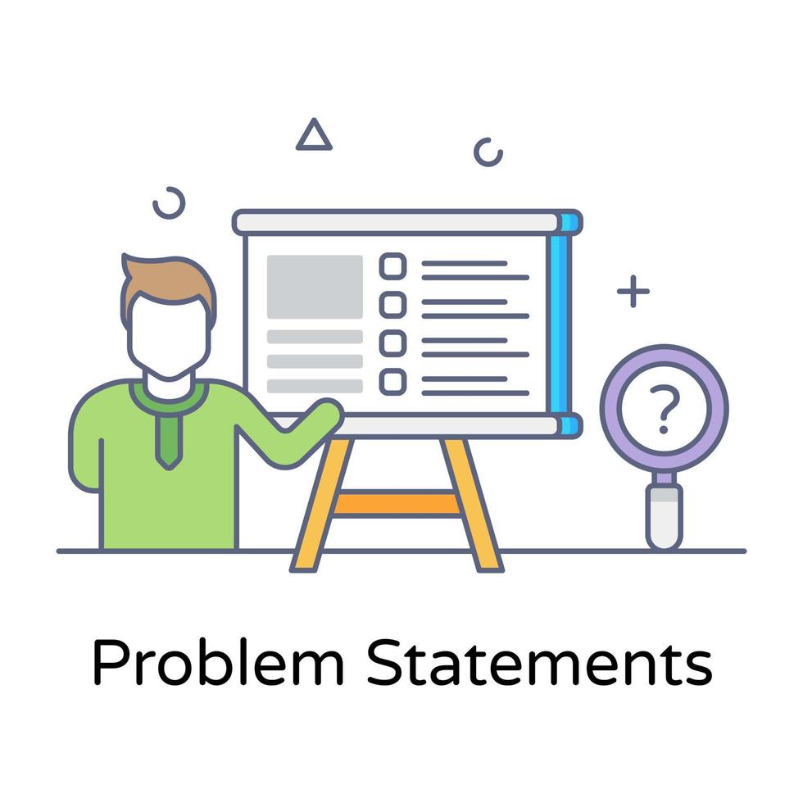
Problem Statement
How can we get more hands-on experience and exposure to real-world projects during industrial training?
What can be done to enhance resources and infrastructure for better hands-on learning experiences?
How can we better align academic learning with industry requirements to prepare graduates adequately?
Date: 29-08-2024
Page | 09

Slide 10

Gantt Chart
Adaptation to technological changes
16
Learnt new technology such as React js, Redux, Git and Firebase.
Overcome setbacks and learn from failures during the learning process.
Foster transparent collaboration within the team.
Find solutions when faced with coding obstacles.
Embrace feedback to enhance coding skills and professional growth.
Tackle coding challenges creatively and systematically.
Date: 29-08-2024
Page | 10

Slide 11
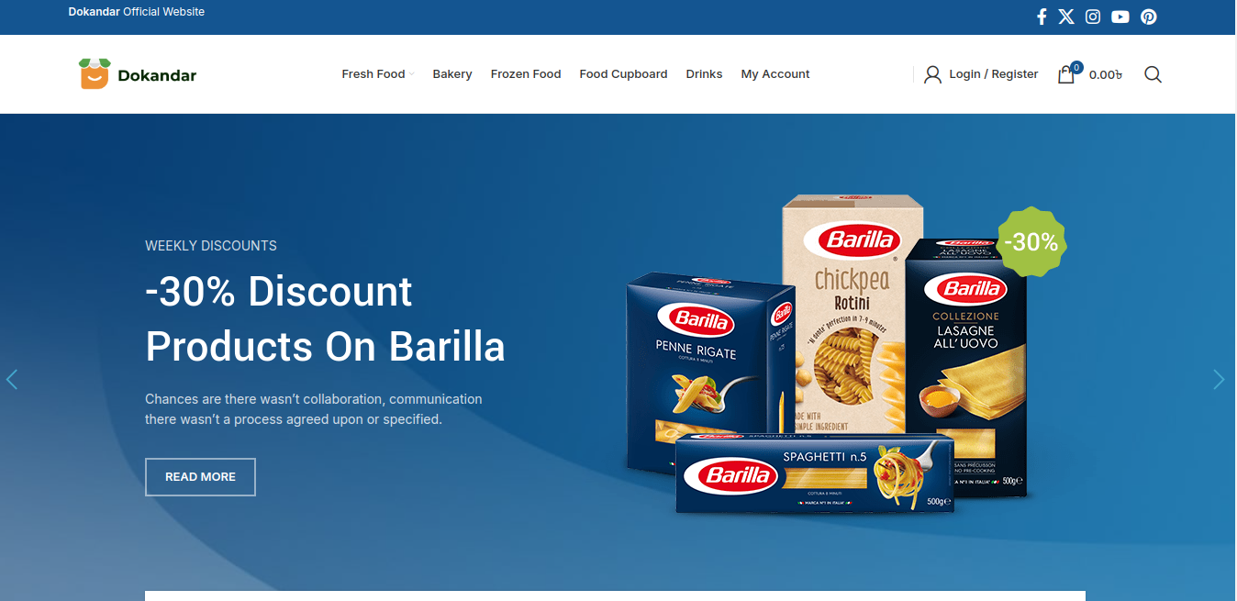
Gantt Chart
Application UI
16
Fig 2 : Home Page of Project Dokandar
Date: 29-08-2024
Page | 11

Slide 12
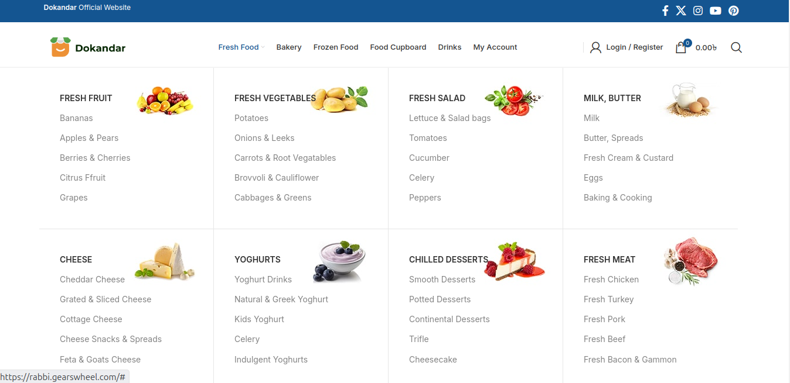
Gantt Chart
Application UI (Cont.)
16
Fig 3 : Megamenu of Project Dokandar
Date: 29-08-2024
Page | 12

Slide 13

Gantt Chart
Conclusion
16
My internship at Mastermind Technology helped me bridge the gap between academic knowledge and practical experience in web development and networking. The experience helped me improve my abilities, develop beneficial insights into industry processes, and simplify my professional path. I am grateful having the chance to contribute to and learn from such an innovative institution.
Date: 29-08-2024
Page | 13

Slide 14
Gantt Chart
References
16
https://eclassmate.com.bd/
https://wistraining.medium.com/what-is-industrial-training-7c2aecab978f
Banerjee, N., & Das, S. (2020, March). Prediction lung cancer–in machine learning perspective. In 2020 International Conference on Computer Science, Engineering and Applications (ICCSEA) (pp. 1-5). IEEE.
Lakshmanaprabu, S. K., Mohanty, S. N., Shankar, K., Arunkumar, N., & Ramirez, G. (2019). Optimal deep learning model for classification of lung cancer on CT images. Future Generation Computer Systems, 92, 374-382.
Nageswaran, S., Arunkumar, G., Bisht, A. K., Mewada, S., Kumar, J. N. V. R., Jawarneh, M., & Asenso, E. (2022). Lung cancer classification and prediction using machine learning and image processing. BioMed Research International, 2022.
Alsheikhy, A. A., Said, Y., Shawly, T., Alzahrani, A. K., & Lahza, H. (2023). A CAD System for Lung Cancer Detection Using Hybrid Deep Learning Techniques. Diagnostics, 13(6), 1174.
Date: 29-08-2024
Page | 14

Slide 15

Thank you!

