Slide 1
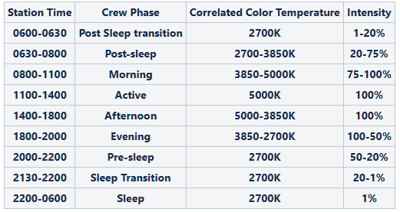

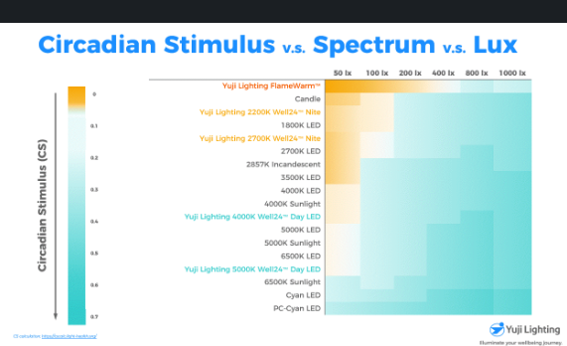
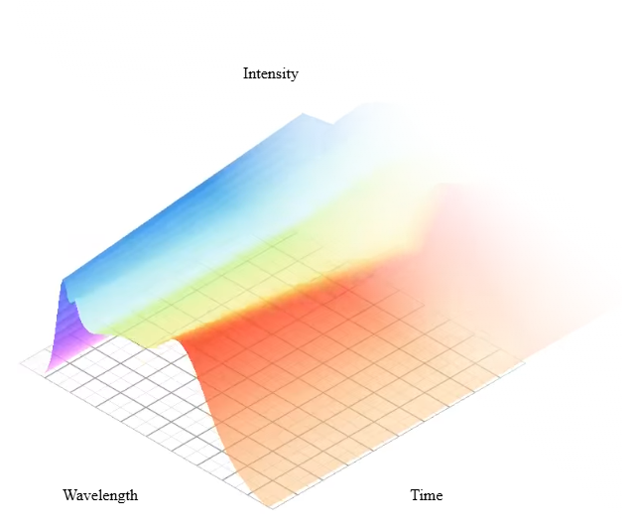
Circadian effect
Color rendering

Slide 2
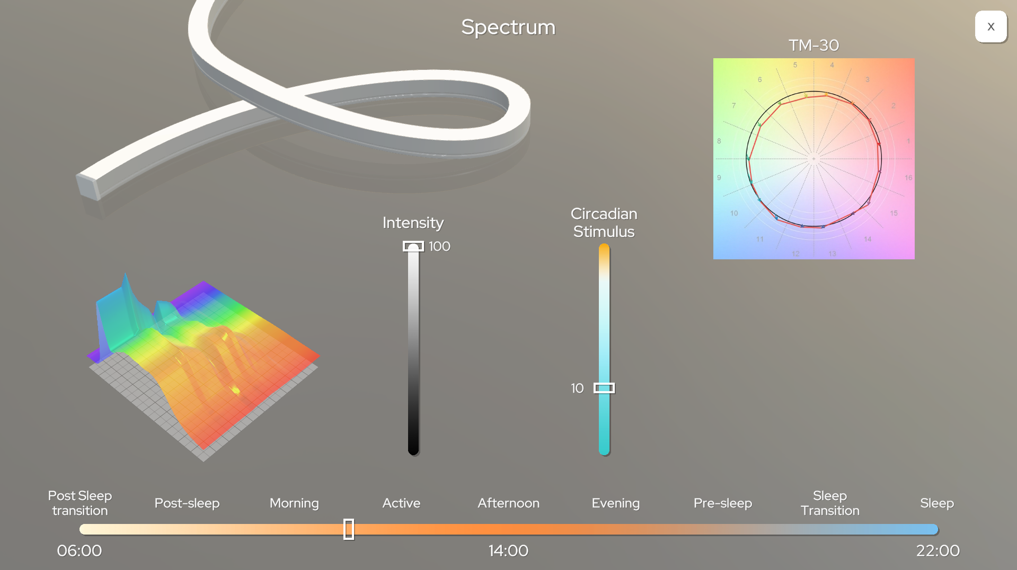
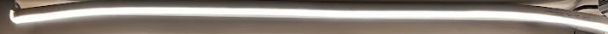
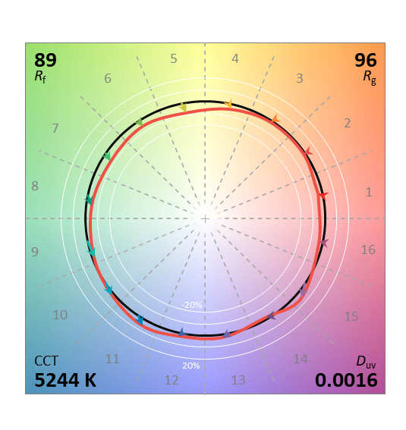


Dynamic Light Quality Dashboard
Intensity, %
Lumen output, lm
___ Photopic Lux at ~150 mm
Color Rendering Metrics
Spectral & Circadian Metrics
CS
M DER
M EDI, lx
0.7 Sufficient
0.556 5000K Sun Light (1000lx)
0.7
250
470nm
0.3 Medium
490nm
550nm
0.3
10
Ra 96
0.1 Low
6
0.008
0.09
FlameWarm™
FlameWarm™(50lx)

