Slide 1
Applying face filters on the face, by using already existing images of filters.
Face Detection is done using DLib library Frontal Face Detection.
Once faces are detected, we use the DLib library 68-point landmark detection on our detected faces.
Once indexing is done,we extract the coordinates from our landmark indexes and use them to resize our nose filter image

Slide 2
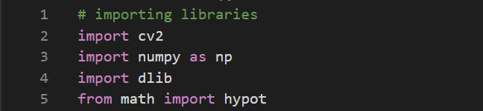
Importing libraries
Before importing libraries make sure to install openCV and dlib library in your computer using pip command on your cmd panel
pip install dlib
pip install opencv-python

Slide 3
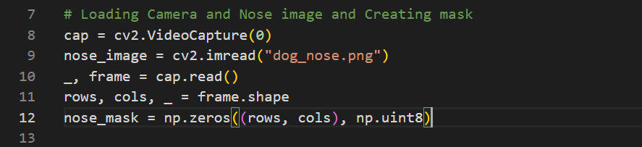
Turning on webcam and loading dog-nose filter image
Using the in-built function of openCV library , turn on the web camera of your computer, and also load the dog-nose filter image that you have already stored on your pc and create a mask

Slide 4
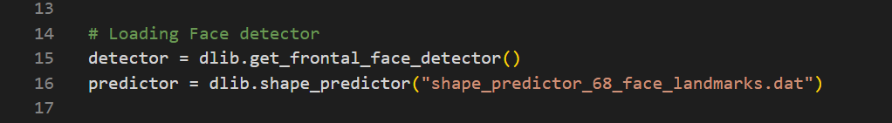
Loading the face recognition and 68 landmark detector of the dlib library
Load the built in face - recognition function of the dlib library which will use HOG+SVM internally to detect the faces , also load the 68 landmark detector of the dlib library to identify important facial features

Slide 5
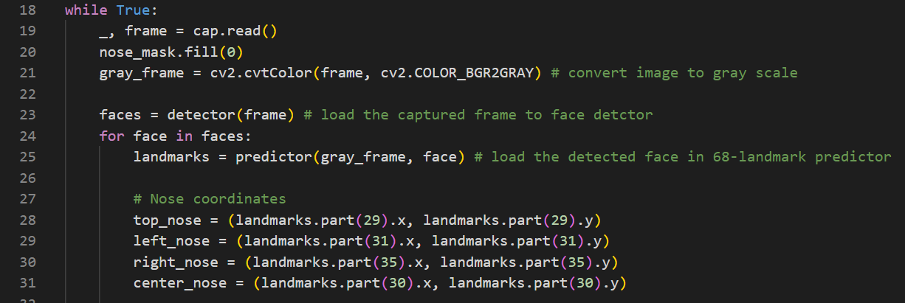
Extracting the coordinates
Convert the captured frame to grayscale first, after that load that image into face detector. Once the faces are detected , load those detected faces in 68-landmark predictor which does indexing of the detected faces. And finally extract the coordinates of those indexes which marks the boundary of our nose

Slide 6
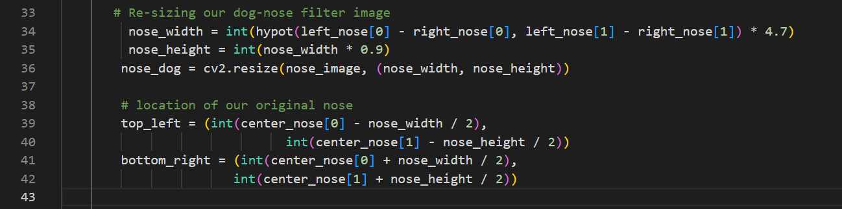
Using the extracted coordinates
Once we have extracted the coordinates ,we could use these coordinates for two purposes ->
We could use the distance between these coordinates,to continuously keep resizing our nose-filter image
We could also get the location where we would need to place our dog-nose filter on our face

Slide 7
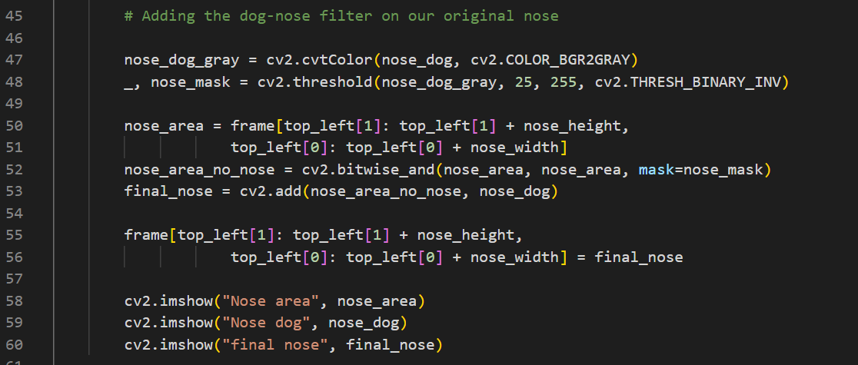
Adding dog-nose on our original nose
Adding the resized dog-nose filter image on our original nose , with the help of the coordinates that we extracted

Slide 8
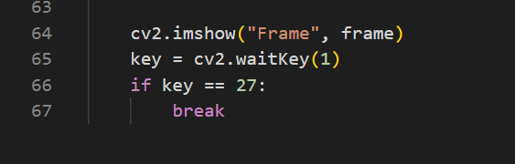
Turning off the camera and exiting the program
At last display the captured frame , and add a functionality to exit from the infinite loop , using Esc key that we ran earlier

Slide 9
Reproducibility
Once we have understood how we are able to resize our filter image using the extracted coordinates , this code can be extended to apply many more filter like sunglasses,hat,beard just by changing few lines
If we are able to understand ,how with the help of 68 - landmark indexes we could target the specific facial features of our face , this 68-landmark detection code can be extended for implementing many more projects like -> face swap , detect whether person is sleeping or not and etc..

Slide 10
References
[1] Canu, S. (2019, June 12). Pig’s nose (Instagram face filter) – Opencv with Python. Pysource. https://pysource.com/2019/03/25/pigs-nose-instagram-face-filter-opencv-with-python/
[2] GitHub - Practical-CV/Facial-Landmarks-Detection-with-DLIB. (n.d.). GitHub. https://github.com/Practical-CV/Facial-Landmarks-Detection-with-DLIB
[3] GitHub - acl21/Selfie_Filters_OpenCV: This deep learning application can detect Facial Keypoints (15 unique points). They mark important areas of the face - the eyes, corners of the mouth, the nose, etc. (n.d.). GitHub. https://github.com/acl21/Selfie_Filters_OpenCV

