Slide 1
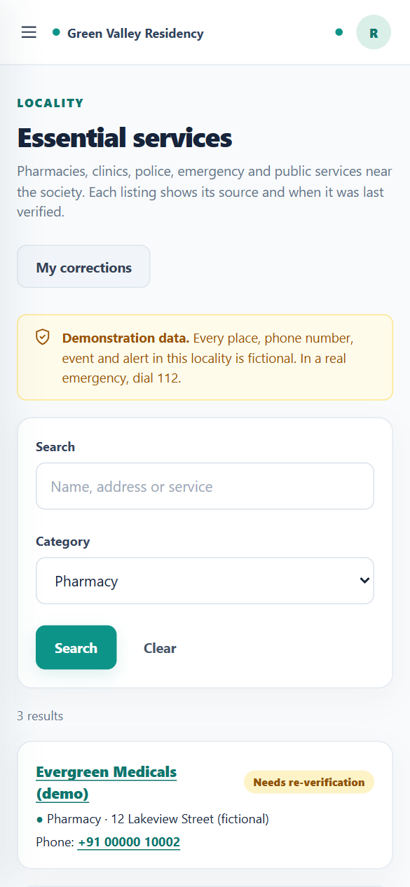
KNOWALL · MODULE 4
Locality Intelligence & Community Discovery
A verified neighbourhood directory, resident corrections, and moderated local events and alerts
Project presentation · October 2026
Notes:
Introduce the module: Module 4 adds a neighbourhood layer to KNOWALL. Residents get a directory of nearby essential services they can trust, and a way to report when something is wrong. A dedicated Locality Coordinator keeps it correct. Everything shown in the demo is fictional demonstration data.

Slide 2
Why a locality module
Residents need reliable information about the neighbourhood around their society
1
2
3
Information goes stale
Residents notice first
Trust needs accountability
Phone numbers change and shops move. A directory nobody maintains quietly becomes wrong.
The people who call the pharmacy know the number is dead, but have no way to fix the listing.
Every change should have a source, a reviewer, a reason and a history, never a silent edit.
Goal Give residents a trustworthy view of their neighbourhood, and a fair, recorded way to keep it correct.
KNOWALL · Module 4 — Locality Intelligence & Community Discovery
2 / 16
Notes:
Explain the problem. Directories go out of date quietly. Residents are the first to notice, but usually have no way to fix anything. And changes need accountability: who changed it, why, and based on what source. Then state the goal at the bottom.

Slide 3
What Module 4 delivers
1
2
3
Services directory
Verification badges
Resident corrections
16 fictional demo listings in 6 categories, with search, a category filter and a schematic coverage map.
Verified, Needs re-verification, Not yet verified or Flagged for recheck, computed on every read.
Report outdated information with a reason, then follow the outcome in My corrections.
4
5
6
Coordinator review
Local events
Alerts, feed and reports
Compare reported, current and proposed values; approve, reject or ask for clarification.
Resident suggestions and opted-in society events, published only after review.
Sourced alerts that expire, a combined local feed, and content reports for moderation.
KNOWALL · Module 4 — Locality Intelligence & Community Discovery
3 / 16
Notes:
Walk through the six feature areas quickly; each is shown in detail later. Mention that the directory is seeded with 16 fictional listings in 6 categories for the demo.

Slide 4
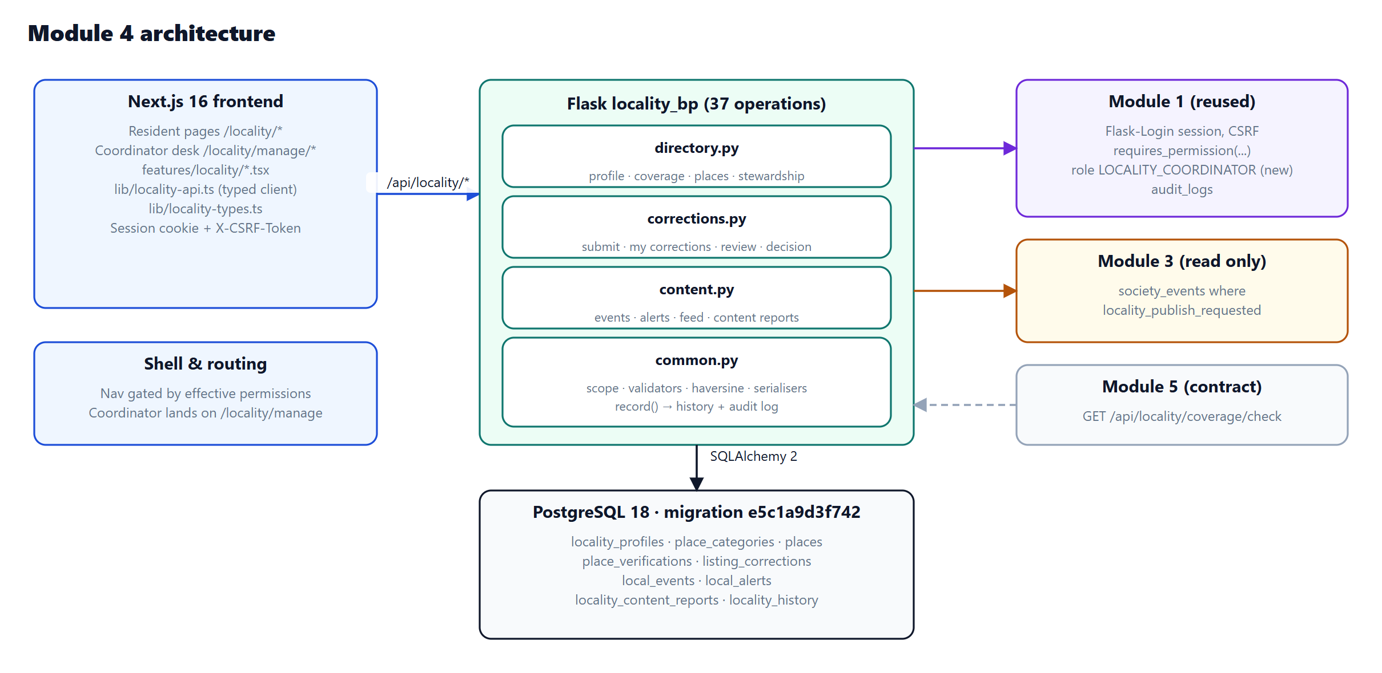
How it fits into KNOWALL
A new Flask blueprint and Next.js pages, built on Module 1 identity, roles and audit
37
API operations on 34 paths, in OpenAPI
13
Next.js routes under /locality
9
new tables, one additive migration
6
backend Python files in app/modules/locality
KNOWALL · Module 4 — Locality Intelligence & Community Discovery
4 / 16
Notes:
Show the architecture. The browser talks to Next.js, which proxies /api to Flask. The locality blueprint is self-contained and reuses Module 1 for authentication, roles and the audit log. Modules 1 to 3 were not rewritten; the only change to an existing table is widening the role column.

Slide 5
Three roles, least privilege
A Society Admin does not automatically get locality powers
Resident
Society Admin
Locality Coordinator
locality.read
locality.read
locality.manage
locality.listings.suggest
• Browse like a resident
• Share opted-in society events (never RSVPs or capacity)
• Coordinator desk refused (403)
• New role, granted separately
• Maintain and verify listings
• Review corrections with a reason
• Moderate events, alerts and reports
• Set coverage radius and re-verify period
• Browse directory, events, alerts and feed
• Report outdated information
• Suggest events and missing services
• Report a problem with content
KNOWALL · Module 4 — Locality Intelligence & Community Discovery
5 / 16
Notes:
Key design decision: managing the locality is a separate job. A new role, LOCALITY_COORDINATOR, holds locality.manage. The Society Admin can read and share opted-in society events, but opening the coordinator desk is refused by the API with 403.

Slide 6
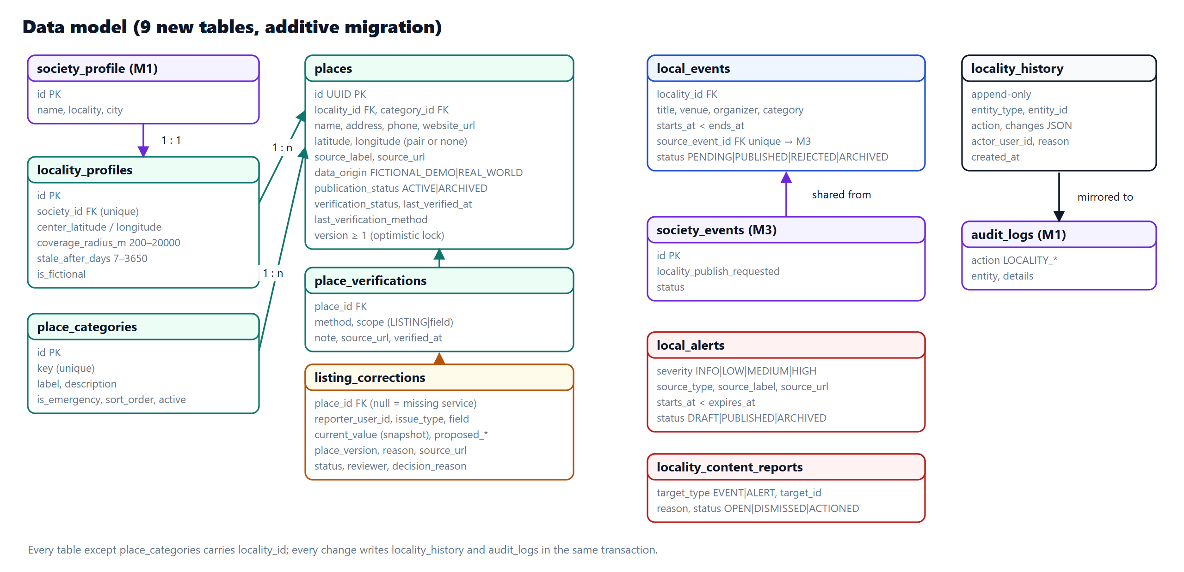
Data model
Nine new tables, added by one reversible migration
9
new tables
1
additive, reversible migration
0
Module 1–3 tables rewritten
Only change to existing schema: role column widened 16 → 30 characters.
KNOWALL · Module 4 — Locality Intelligence & Community Discovery
6 / 16
Notes:
Places carry verification fields and a version number. Corrections store the value at the time of the report, so the coordinator can see whether the listing already changed. History tables are append-only. Existing modules are untouched except the role column, widened from 16 to 30 characters so the new role name fits.

Slide 7
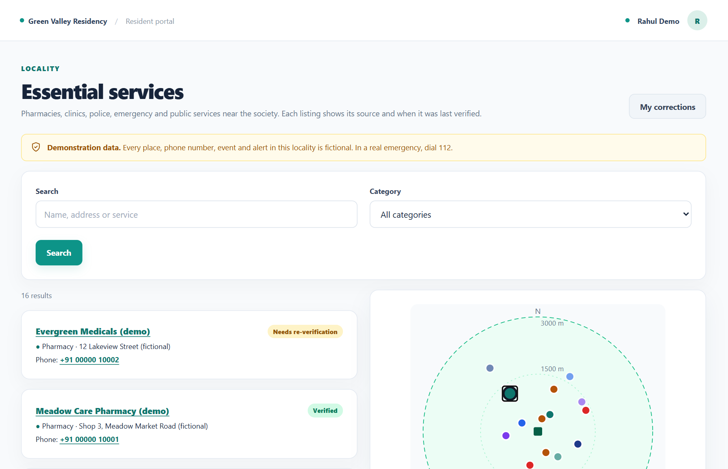
Essential services directory
Search, category filter, verification badges and a schematic coverage map
Verification badge
Verified
checked within the period
Needs re-verification
older than 180 days
Not yet verified
never checked
Flagged for recheck
coordinator flagged it
Archived
hidden from residents
Stale listings show a warning to call ahead; they are never silently hidden.
KNOWALL · Module 4 — Locality Intelligence & Community Discovery
7 / 16
Notes:
Show the resident directory. Every listing shows a badge computed from stored data on each read. A listing verified more than 180 days ago shows Needs re-verification and a warning to call ahead, but it is never silently hidden. The map is schematic: it shows distance and direction from the society, not real streets, because the data is fictional.

Slide 8
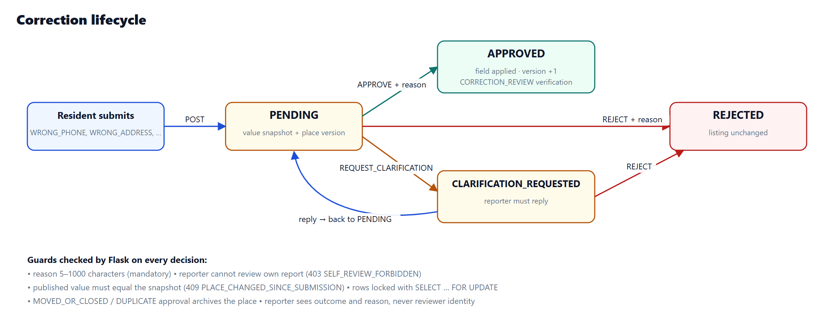
The correction workflow
From a resident's report to a recorded decision
Every decision needs a written reason
Row locks stop two conflicting decisions
Approval changes only the reported field
KNOWALL · Module 4 — Locality Intelligence & Community Discovery
8 / 16
Notes:
Explain the state machine. A report is PENDING until the coordinator decides. Asking for clarification sends it back to the resident, who can reply with an updated proposal. Approving applies only the reported field and records a correction-review verification for that field only.

Slide 9
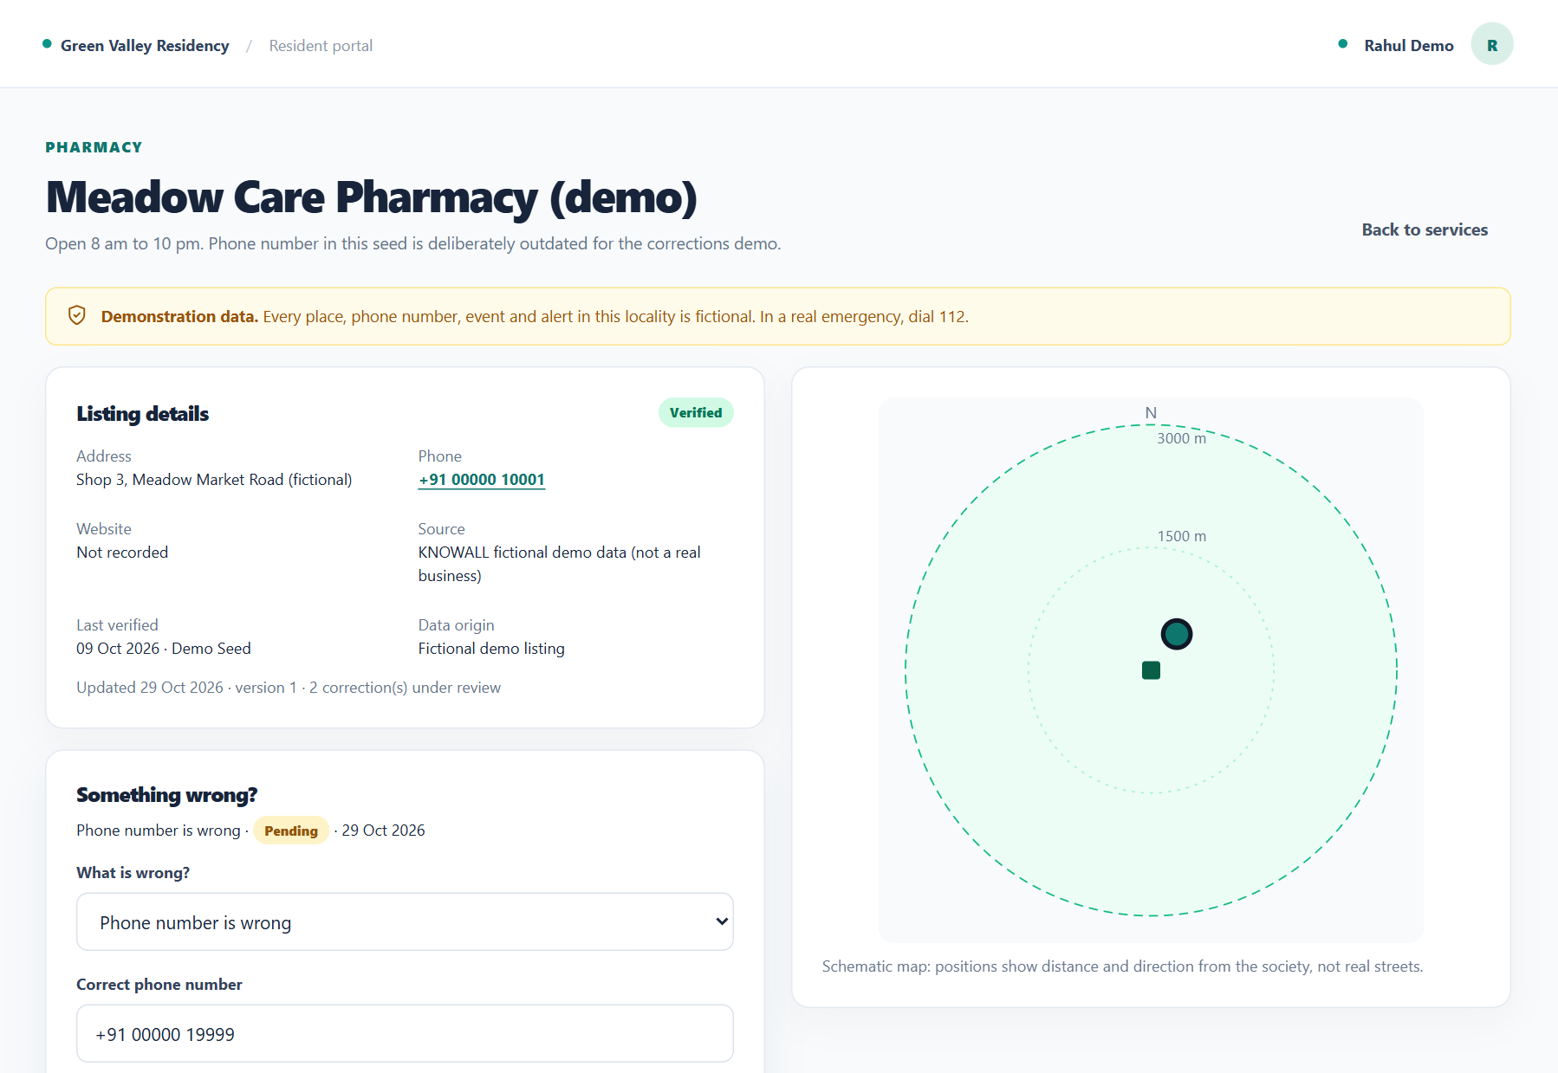
Demo 1: a resident reports an outdated number
Rahul (resident) finds that Meadow Care Pharmacy's phone number is disconnected
1
Open the listing
Meadow Care Pharmacy (demo) in the directory.
2
Choose the issue
“Phone number is wrong”, new number +91 00000 19999.
3
Give a reason
Mandatory; an evidence link is optional.
4
Track it
The report appears in My corrections as Pending.
KNOWALL · Module 4 — Locality Intelligence & Community Discovery
9 / 16
Notes:
Live demo or screenshot. Log in as rahul@greenvalley.test, open Meadow Care Pharmacy (demo), click Report outdated information, pick Phone number is wrong, enter the new number and a reason. The reason is mandatory; an evidence link is optional. Limits: one open report per field per resident, and at most ten open reports.

Slide 10
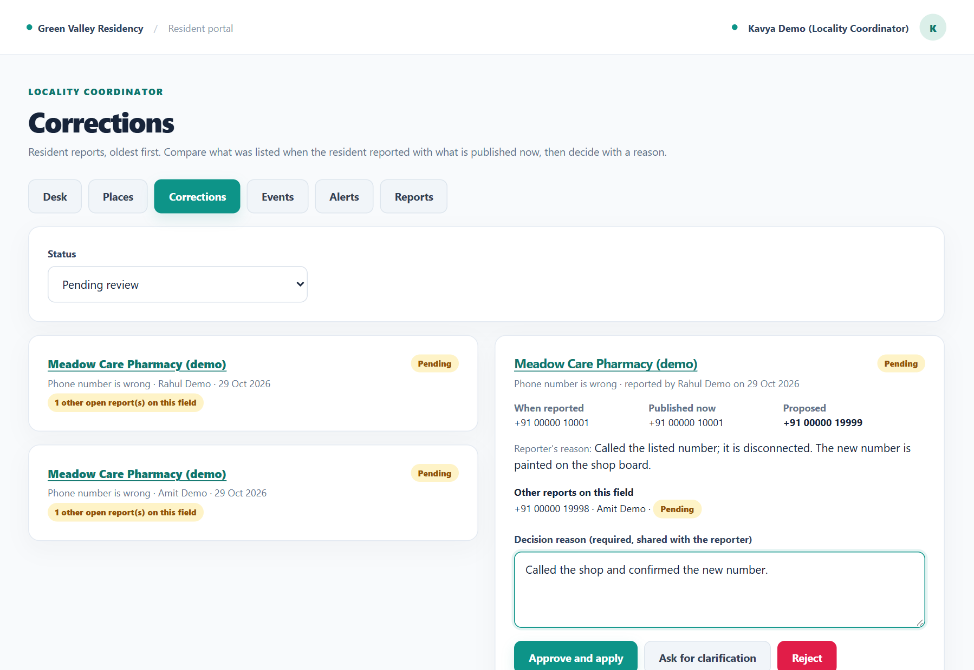
Demo 2: the coordinator reviews it
Kavya (Locality Coordinator) compares the values and decides with a reason
1
Open the queue
A badge shows a competing report from Amit.
2
Compare values
When reported, published now, and proposed.
3
Write a reason
“Called the shop and confirmed the new number.”
4
Approve
Version increases; history and audit log record it.
KNOWALL · Module 4 — Locality Intelligence & Community Discovery
10 / 16
Notes:
Log in as kavya@greenvalley.test and open Corrections. The queue shows a competing report from Amit on the same field. The panel compares the value when Rahul reported, the value published now and the proposed value. Kavya writes the reason and approves.

Slide 11
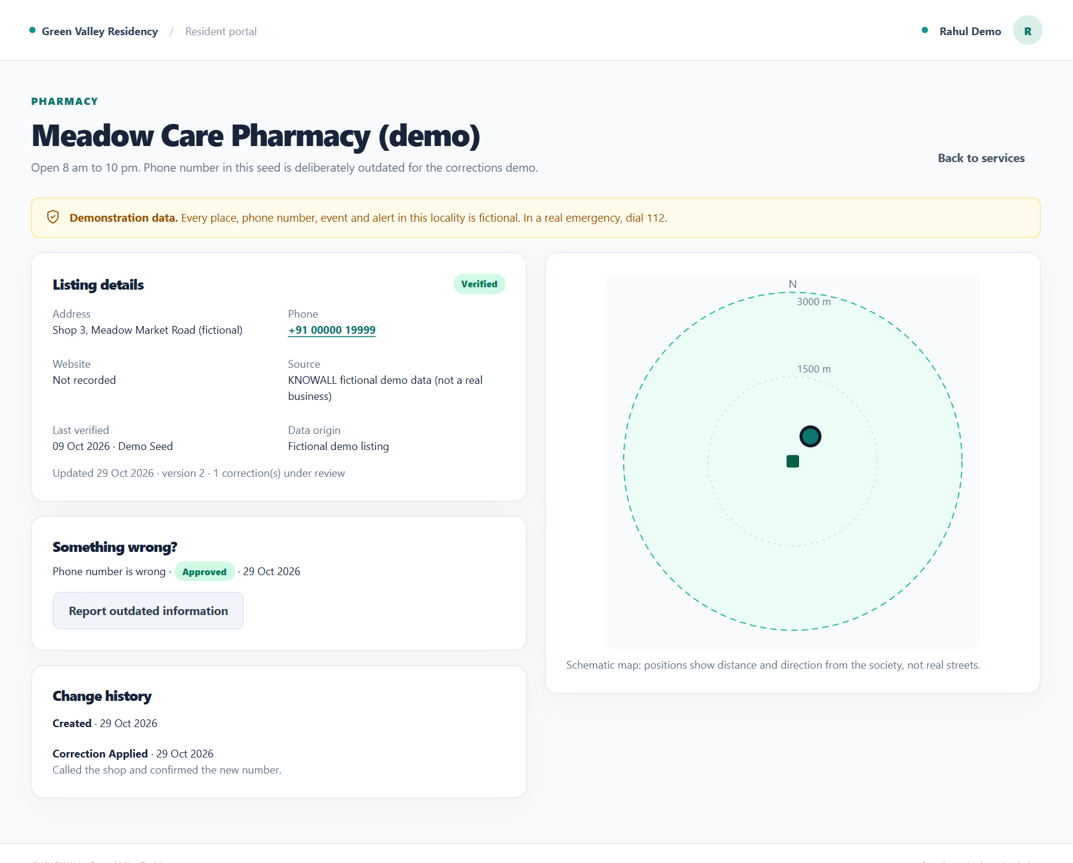
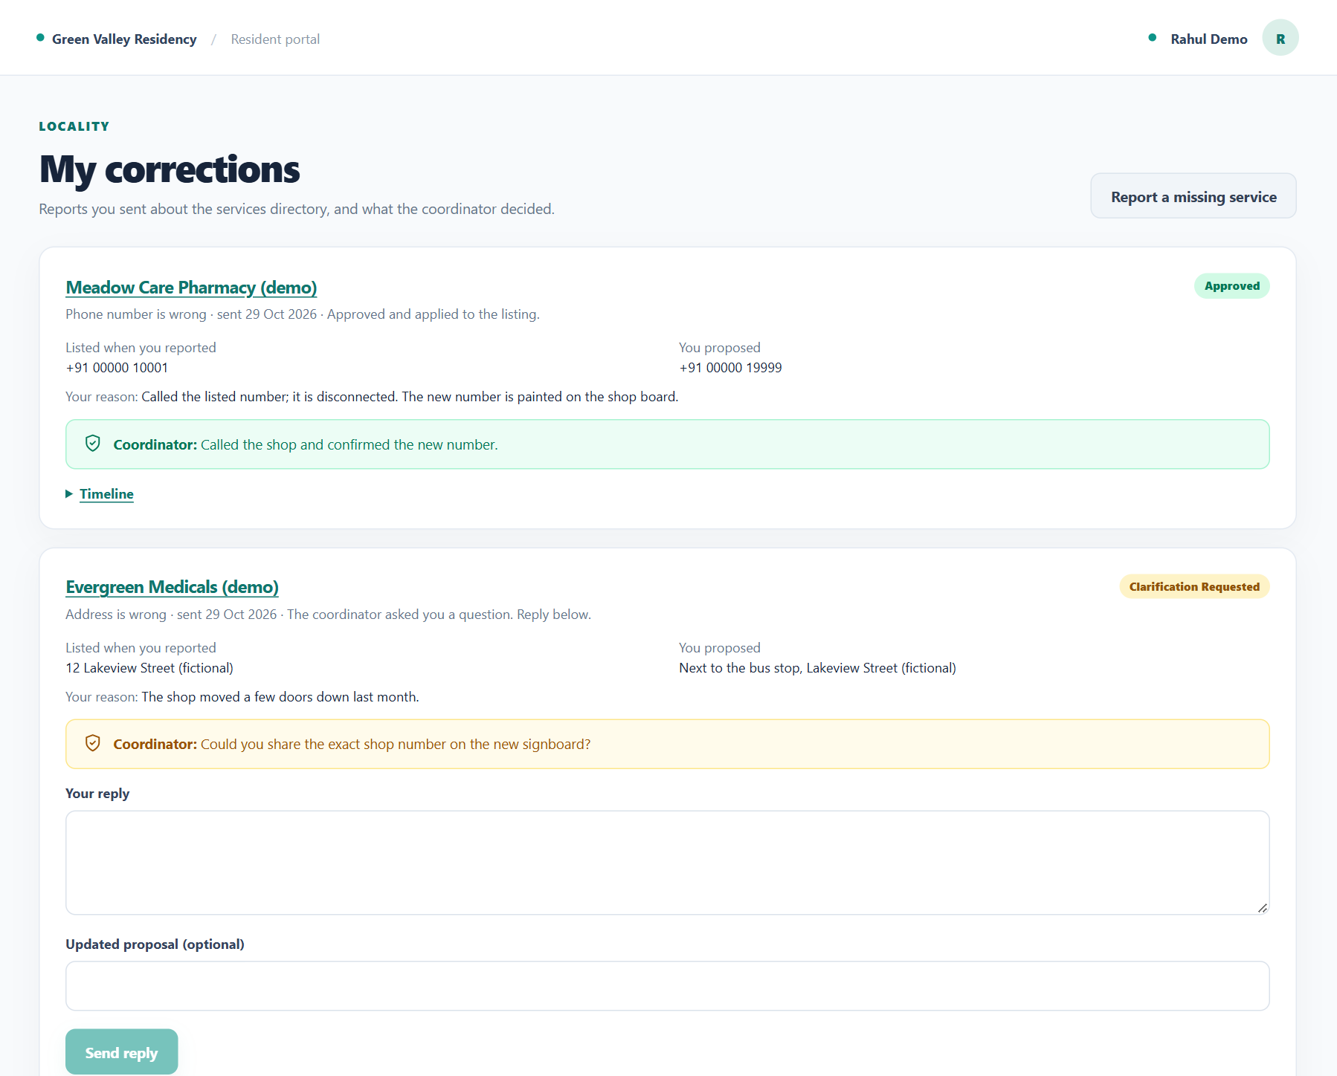
Demo 3: the result everyone sees
The listing shows the corrected number
Rahul sees Approved and the reason, not the reviewer
KNOWALL · Module 4 — Locality Intelligence & Community Discovery
11 / 16
Notes:
After approval the listing shows the new number and the public history shows Correction Applied. Rahul sees Approved and the coordinator's reason in My corrections, but not the reviewer's name. The local feed shows Listing corrected.

Slide 12
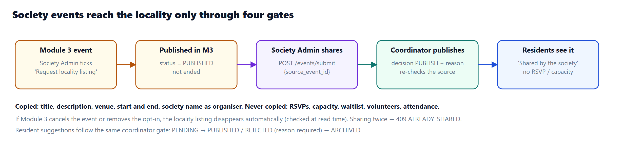
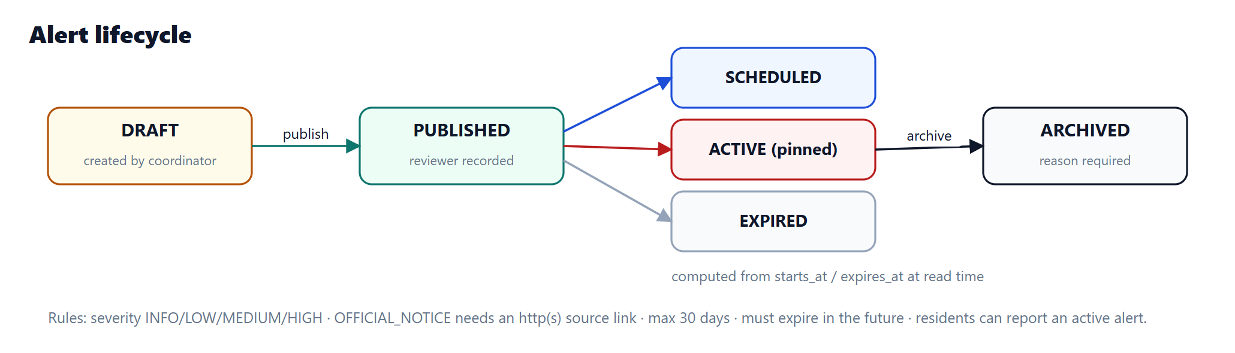
Local events and alerts
Nothing reaches residents without review
Events
Resident suggestions wait for the coordinator. Society events pass four independent checks.
Alerts
Drafted with a named source, published with a recorded reviewer, expire automatically.
KNOWALL · Module 4 — Locality Intelligence & Community Discovery
12 / 16
Notes:
Events: residents suggest events, which stay pending until the coordinator publishes them. A Module 3 society event reaches the locality only through four independent checks, and RSVPs and capacity are never shared. Alerts carry a named source, are published by a recorded reviewer, expire automatically and are archived with a reason.

Slide 13
Security and privacy by design
1
2
3
Server-side permissions
Session and CSRF
Reviewer anonymity
The server checks locality.read, .suggest or .manage; the UI hides what the API refuses.
Every write needs the session cookie and a CSRF token, reusing Module 1.
Reporters see the decision and reason, never who reviewed it.
4
5
6
Full history
Safe concurrency
Abuse limits
Each change is versioned, kept in append-only history and mirrored to the audit log.
Row locks (SELECT … FOR UPDATE) prevent conflicting decisions.
One open report per field, at most 10 open reports; search wildcards escaped.
KNOWALL · Module 4 — Locality Intelligence & Community Discovery
13 / 16
Notes:
Summarise the safeguards. Permissions are enforced on the server for every endpoint; the UI only mirrors them. Writes reuse Module 1's session and CSRF protection. Reporters never learn who reviewed their report. Every change is versioned and audited.

Slide 14
Tested, not just written
All results come from actually running the checks on 29 October 2026
250 / 250
92 / 92
15 / 15
37
backend tests pass
(15 new for Module 4)
frontend tests pass
(12 new for Module 4)
end-to-end HTTP
demo steps pass
API operations
documented in OpenAPI
✓
TypeScript type check, ESLint and Next.js production build: clean
✓
Migration applied to PostgreSQL; flask db check reports no schema drift
✓
Seed script is repeat-safe: 16 listings created, then 0 on a second run
KNOWALL · Module 4 — Locality Intelligence & Community Discovery
14 / 16
Notes:
These numbers were produced by running the suites. 250 backend tests include the 15 new Module 4 tests; 92 frontend tests include 12 new ones. The end-to-end script runs the full resident to coordinator demo over HTTP. The migration was applied to the real PostgreSQL database with no drift.

Slide 15
Limitations and next steps
Limitation
Next step
Schematic map, not street tiles
→
Tile map once real, sourced listings exist
No notifications yet
→
Notify reporters once the platform notification contract exists
Coordinates entered by hand
→
Geocoding with source attribution
One locality per society
→
Support multiple coverage areas
Simple ILIKE search
→
PostgreSQL full-text search with ranking
KNOWALL · Module 4 — Locality Intelligence & Community Discovery
15 / 16
Notes:
Be honest about the scope. The map is schematic on purpose because the data is fictional. There are no notifications yet because the platform has no notification contract, the same as Modules 2 and 3. The rest are natural extensions.

Slide 16
Thank you
Demo accounts
Resident
rahul@greenvalley.test
Questions?
Locality Coordinator
kavya@greenvalley.test
Society Admin
admin@greenvalley.test
All locality data in the demo is fictional demonstration data.
Notes:
Thank the audience and invite questions. Offer to run the live demo with the three demo accounts. Remind them that all locality data is fictional.

