Slide 1
Retinex Image Decom-Net
Conv
Conv+ReLU
…
Conv+ReLU
Conv
Sigmoid
Conv
Conv+ReLU
…
Conv+ReLU
Conv
Sigmoid
Share weight

Slide 2
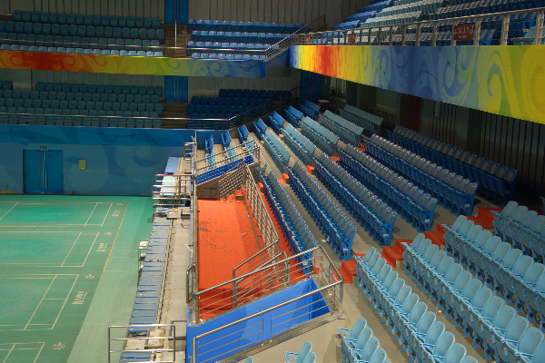
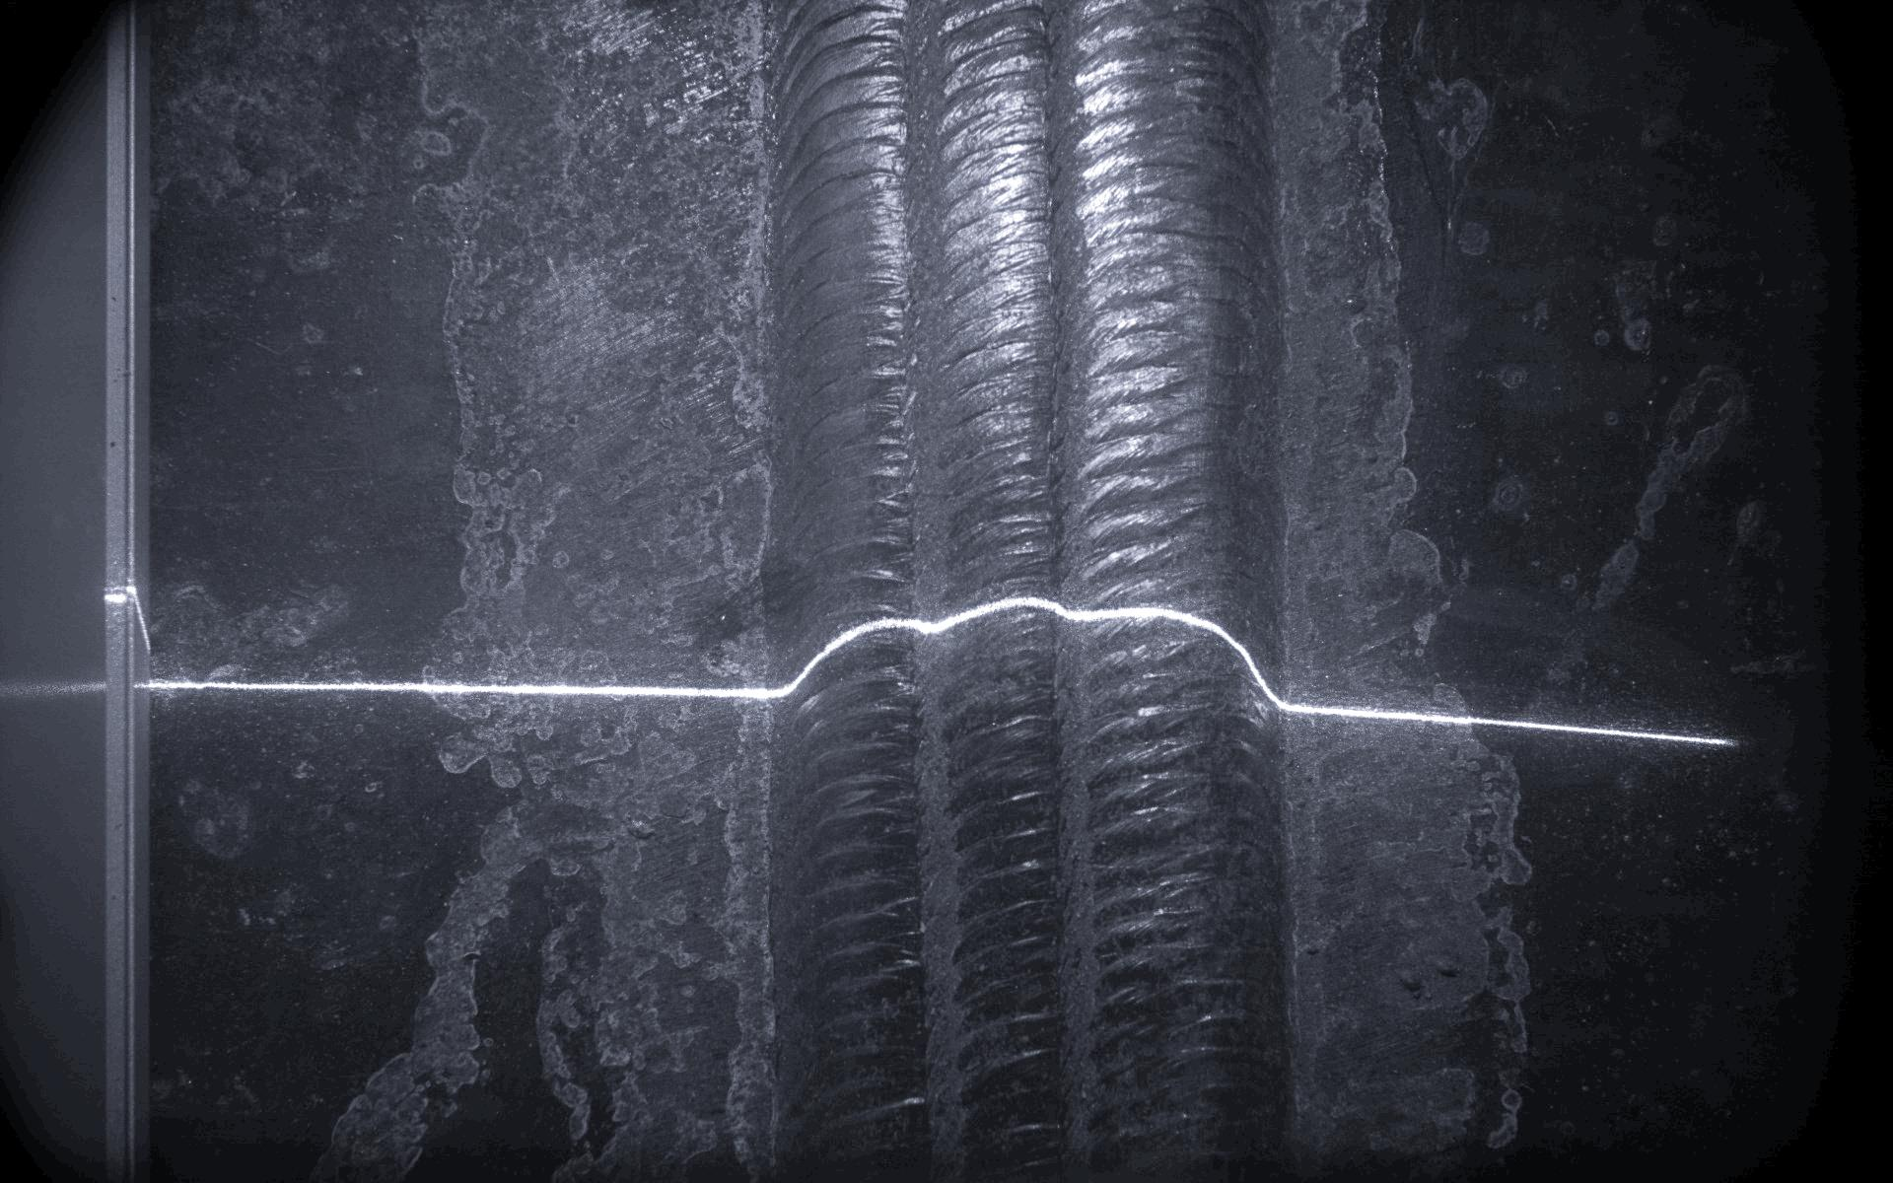
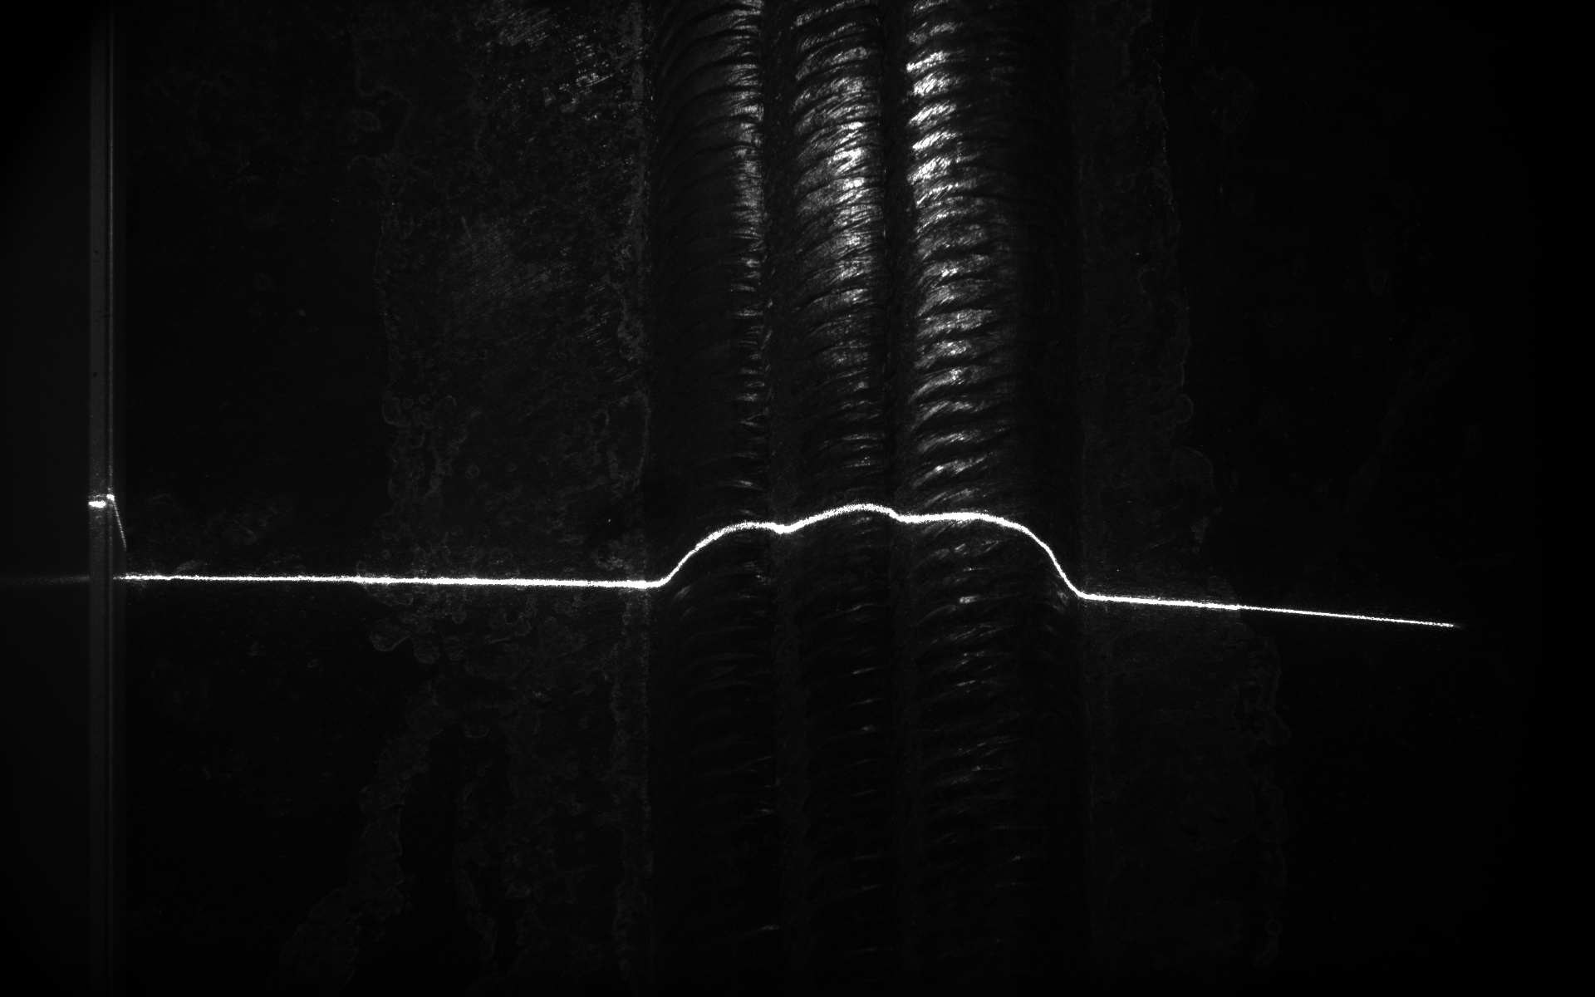
Decomposition
Enhancement
Reconstruction
Decom-Net
Reflectance Image Enhancement
S_{normal}
Illumination Curve Estimation
Decom-Net
S_{low}
Share weight

Slide 3
Output
1x7 conv
Inception 2
Inception 2
Inception 2
Inception 1
FC
FC
1x7 conv
1x11 conv
1x11 conv
Input

