Slide 1
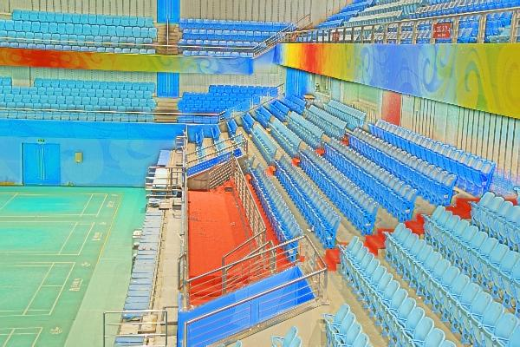
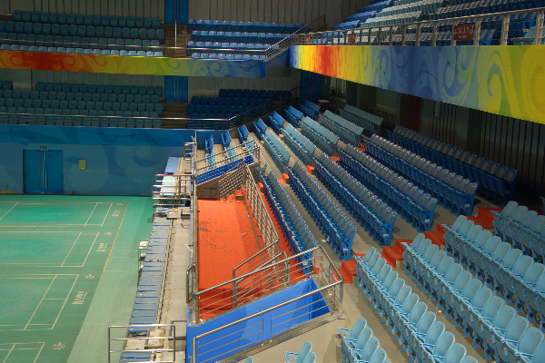
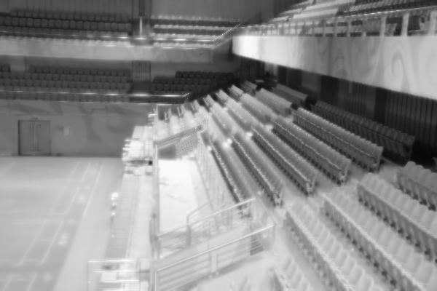

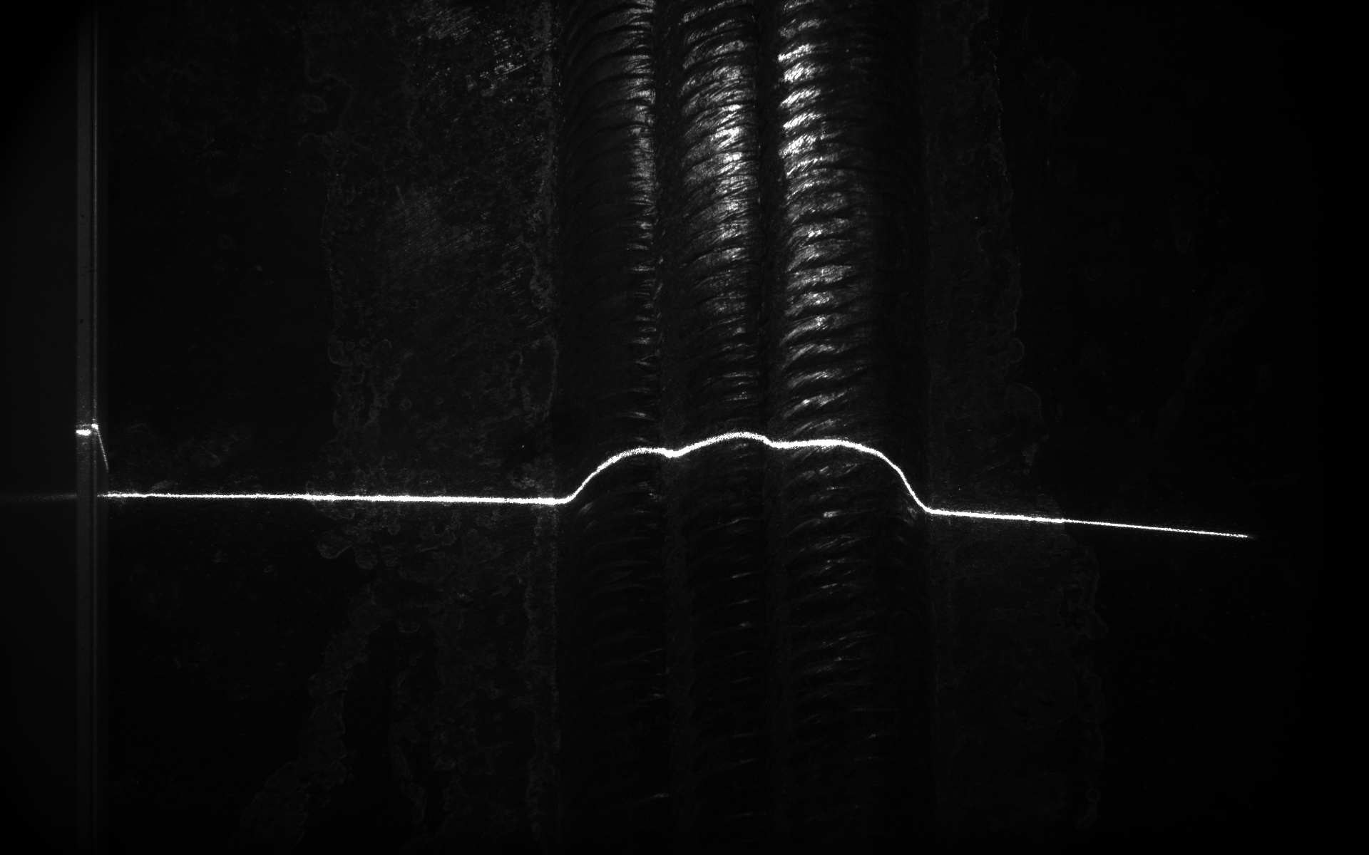

Retinex Image Decom-Net
R_{normal}
Conv
Conv+ReLU
…
Conv+ReLU
Conv
Sigmoid
I_{normal}
S_{normal}
R_{low}
Conv
Conv+ReLU
…
Conv+ReLU
Conv
Sigmoid
S_{low}
I_{normal}
training
Share weight

Slide 2
Retinex Image Decom-Net
R_{normal}
Conv
Conv+ReLU
…
Conv+ReLU
Conv
Sigmoid
I_{normal}
S_{normal}
R_{low}
Conv
Conv+ReLU
…
Conv+ReLU
Conv
Sigmoid
S_{low}
I_{normal}
testing
Share weight

Slide 3
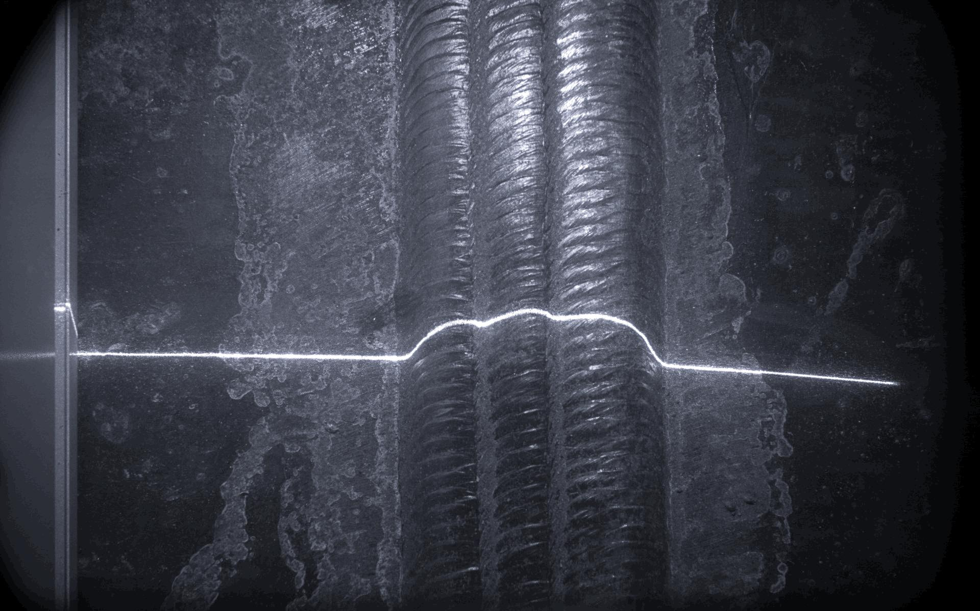
Decomposition
Enhancement
Reconstruction
R_{low}
Decom-Net
Reflectance Image Enhancement
S_{normal}
Illumination Curve Estimation
Decom-Net
Ŝ_{low}
S_{low}
I_{low}
Share weight

Slide 4
Output
1x7 conv
Inception 2
Inception 2
Inception 2
Inception 1
FC
FC
1x7 conv
1x11 conv
1x11 conv
Input
Input

Slide 5
Start
Sensor Data Acquisition
Low light enhancement
Weld Seam Feature Extraction
No
Task Completed?
Yes
Data storage/Transmission
End

Slide 6

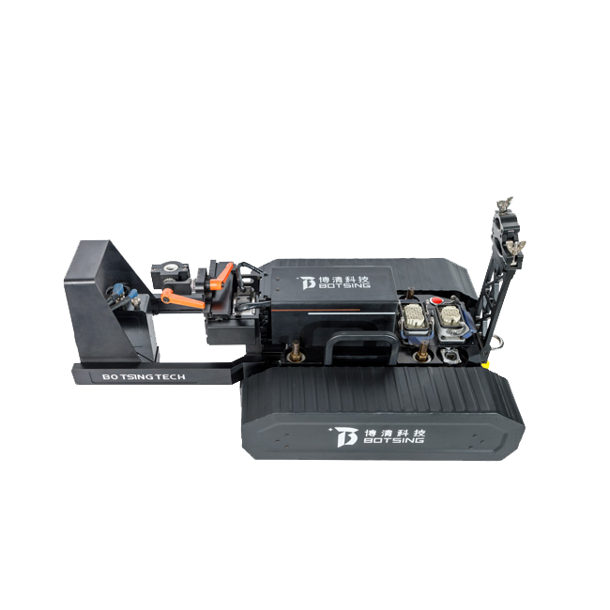

Control System
Ar
Gas
Wire Feeder
Argon Arc Welder
Weld Gun
Camera
Position of Welding
6CM
Weld Robot
Weld Test Plate

