Slide 1
APIGEE ANALYTICS
Gokulnath Chidambaram
Notes:
This is an example of a Title Slide. We need to convey Life Is On in everything we do, so try to lead with compelling images that are vibrant, authentic, and human. The human element should be apparent and within the context of a segment that we touch.
To keep this PowerPoint template file size reduced, we included a small library of image choices in the Slide Master (under View). You can also get them from the SE Asset Library: https://schneiderelectric.telescopeondemand.com

Slide 2
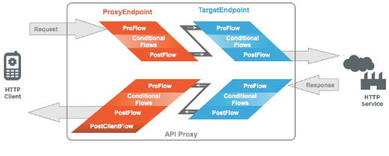
Apigee Data Collection and Reporting
Logz.io
Errors/Custom Logs
Statistics Collector policy
Apigee Environment
Apigee Statistics Reporting
Custom Parameters
API Data

Slide 3
API Data Value
Kinds of Data
KNOWN’s
UNKNOWN’s
API Statistics
Response time
Request latency
Request size
Target errors
API product name
Developer email address
App name
Many others
api statistics /health(we know what we know) | BI Analytics (we know what we don’t know)
Opportunities for Sales Teams (we don’t know what we know) | Explore and Research! (we don’t know what we don’t know)
K
N
O
W
N
U
N
K
N
O
W
N
Custom Data
Custom format data from Body, Headers,
Request and Response

Slide 4
Logical View
Apps (LEAP?)
API PORTAL
Integrate
Custom Report/Charts
Knowledge API’s
Knowledge Graph
Query
Build
Analytics Data Store
Export API
API metrics data for health and actions
Knowledge Derivation
Apigee Analytics+Custom Data
Apigee statistics collector
Apigee Platform

Slide 5
Customer Knowledge Graph
Where are my customers?
What end user is using my product, and where?
Orders come from which location?
Which product is queried most?
Which device is used mostly to order the product
uses
Customer 1
orders from
Region
Device
API 1
with the time zone
located in
orders/queries
Time
Country
Product
orders using
ordered using
Customer 2
API 2
orders using
Notes:
This is an example of a Text Slide. Reference the different layout options in the Slide Master (under the View tab) for different variations. Remember, our new Brand Guidelines call for clean and simple messages and design. Reference the PowerPoint Guidelines on the Brand Book for tips and useful information on creating effective presentations.

Slide 6

Deployment View
Google Cloud
AWS
LEAP APP
API PORTAL
Knowledge API
Kubernetes Cluster
Query API
API Data
Export API
Intel Data Store

Slide 7
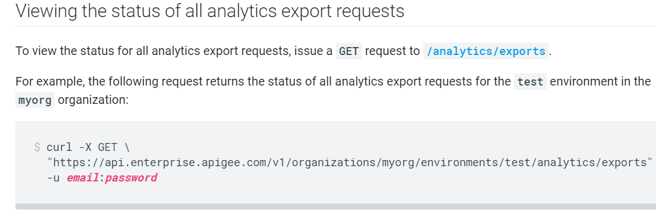
Apigee Analytics Export API
https://docs.apigee.com/api-platform/analytics/export-data

Slide 8
Neptune DB format (Gremlin)
Needs vertices and the edges in separate files.
Example:Vertex file
Edgefile:
~id | name:String | name:Country | ~label
v1 | Customer 1 | France | person
v2 | iPhone | France | device
~id | ~from | ~to | ~label
e1 | Customer 1 | iPhone | uses

Slide 9
Data upload from Apigee to IDS (Option 1)
AWS S3 Bucket
Apply Security polices, Data upload policies as per IDS guidelines.
Integrate with IDS Dataflow pipeline?
Apigee Hosted Runtime
Node.js App Scheduler (daily)
<<call>>
S3 multipart API
<<get>>
Apigee API Data
Intel Data Store

Slide 10

Apigee analytics data-Extract,Transform,Load (Option 2)
Calls apigee export api @ scheduled intervals
S3
load
Graph properties files
S3
sql extract query
Neptune db
lambda task, aws glue
api analytics data
ext.table
Redshift Spectrum
Intel Data Store
Data Pipeline

Slide 11
Option1 vs Option 2
 | Option 1 | Option 2
Pro’s | Better data control/data management on Input Data at Apigee side | Better Data Security, Compliance at AWS side on both Input and Target Data (Neptune) Well defined AWS data pipeline (aws glue) for data pipeline
Con’s | 1.Complexity in terms of developing Scheduler and maintaining them at Apigee side 2. No visibility on Target Data Source ingestion and response | 1.Debugging from source ->Target data transformation

Slide 12
Data upload from Apigee to IDS (Option 3)
To be discarded
Apigee Hosted Runtime
.js code that connects to REDSHIFT (node-redshift) and Inserts
<<JDBC>>
Intel Data Store
3
2
Node.js App Scheduler (daily)
Pros:
1. Enables Quick deliverables with limited Data - 3 or 4 API’s (Marketing Teams)
Cons:
1.Slow in uploading as INSERT takes time
1
Apigee Export Data API

Slide 13
Notes:
Closing slide

