Slide 1

IFW API SERVICE PLAN
100 TPS
API-1
No Productization .
Service Plan, limit are maintained separately for each consumer and API wise .
APP-1
200 TPS
API-2
APP-2

Slide 2
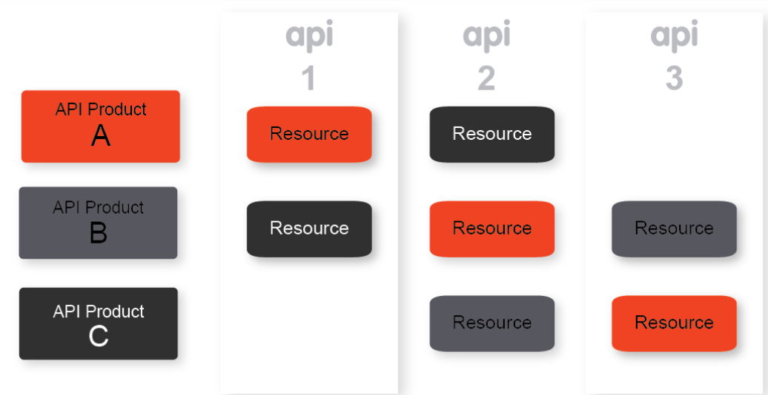
API Product
API products bundle your APIs and make them available to app developers for consumption.
You can think of API products as your product line.
Specifically, an API product bundles together the following:
-Collection of API resources (URIs)
-Service plan
-Metadata specific to your business

Slide 3
One Product Per API
10 TPS
All subscriber will have same service plan predefine limit .Always in higher limit.
Need N number of product for a single proxy for N number of service plan.
Difficult to manage so many product as the API inventory grows
API – Product-A
API-1
50 TPS
API – Product-B
API-1
100 TPS
API – Product-C
API-2

Slide 4
One Product Per Provider
All subscriber will have same service plan predefine limit .Always in higher limit.
Consumer intended to consume few APIS however will get access to all API for particular provider.
Impact business value ,revenue and pricing of product
Un limited TPS
API-1
Provider Product
Un limited TPS
API-2
Un limited TPS
API-3

Slide 5
One Product Per Consumer
All subscriber will have same service plan predefine limit .Always in higher limit.
Consumer intended to consume few APIS however will get access to all API for particular provider.
Impact business value ,revenue and pricing of product
Existing TPS
API-1
Consumer Product
Existing TPS
API-2
Existing TPS
API-3

Slide 6
Products Per Capability
Add business value ,revenue and pricing of product

Slide 7
THANK YOU
Reference
https://docs.apigee.com/api-platform/publish/create-api-products

