Slide 1

IFW API SERVICE PLAN
100 TPS
API-1
No Productization .
Service Plan, limit are maintained separately for each consumer and API wise .
APP-1
200 TPS
API-2
APP-2

Slide 2
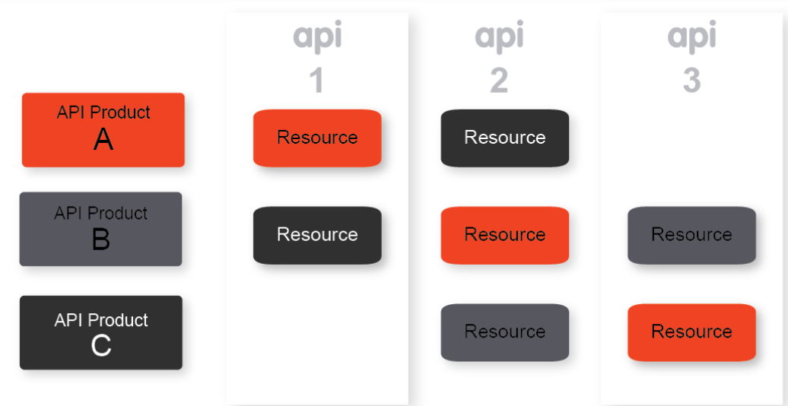
API Product
API products bundle APIs and make them available to app developers for consumption.
You can think of API products as your product line.
Specifically, an API product bundles together the following:
-Collection of API resources (URIs)
-Service plan
-Metadata specific to your business

Slide 3
One Product Per API
10 TPS
All subscriber will have same service plan predefine limit .Always in higher limit.
Need N number of product for a single proxy for N number of service plan.
Difficult to manage so many product as the API inventory grows
API – Product-A
API-1
50 TPS
API – Product-B
API-2
100 TPS
API – Product-C
API-3

Slide 4
One Product Per Provider
All subscriber will have same service plan with predefine limit .Always in higher limit.
Consumer intended to consume few APIS however will get access to all API for particular provider.
Impact business value ,revenue and pricing of product
Un limited TPS
API-1
Provider Product
Un limited TPS
API-2
Un limited TPS
API-3

Slide 5
One Product Per Consumer
Retain existing subscription of API with defined quota limit .
Will get access to only previously subscribed API
Applicable only for migration .
Existing TPS
API-1
Consumer Product
Existing TPS
API-2
Existing TPS
API-3

Slide 6
Products Per Capability
Address business value of api.
Helps in decision for pricing and revenue generation.
Helps in sales and marketing of the API product .

Slide 7
Implementation approach Consumer Product
Existing TPS
Create a product with name of the consumer for migration.
Add existing subscribed API to the product
Add custom attribute(isMigration) to identify the product is for migration
Add Custom attribute to configure all subscribed proxy with quota limit
API-1
Consumer Product
Existing TPS
API-2
Existing TPS
API-N

Slide 8
Implementation approach Capability product
Create products based on business value and capability
Add existing API to the corresponding product
Add Custom attribute to configure to define Qouta and limited number or in unlimited
This process shall be same for single and provider based product.

Slide 9
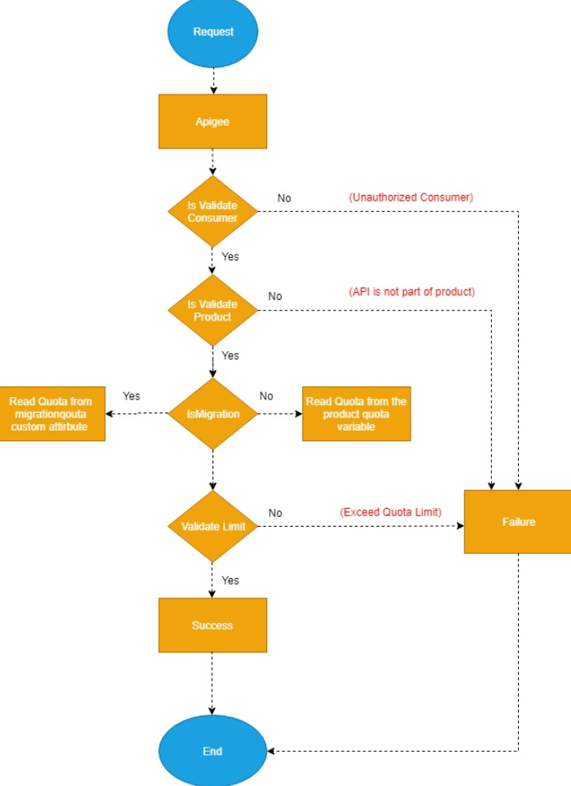
Flow diagram Quota implementation

Slide 10
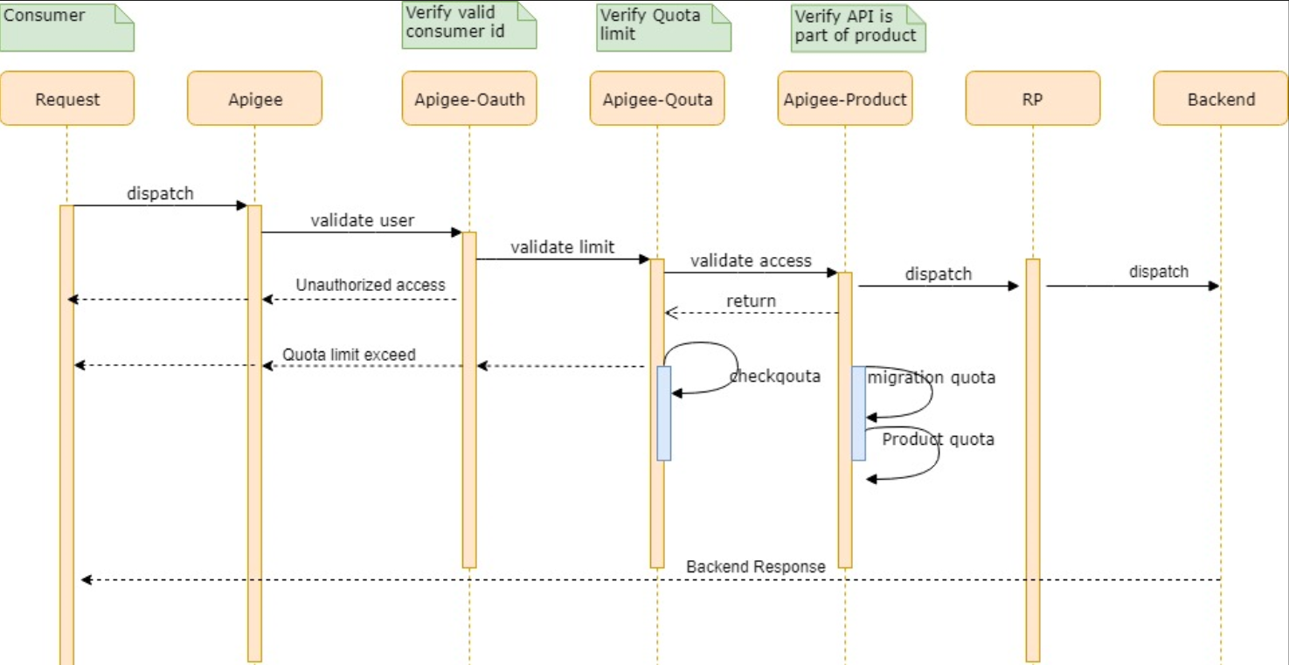
Sequence Diagram Quota implementation

Slide 11
THANK YOU
Reference
https://docs.apigee.com/api-platform/publish/create-api-products

