Slide 1
Python
Bartosz Maślanka

Slide 2
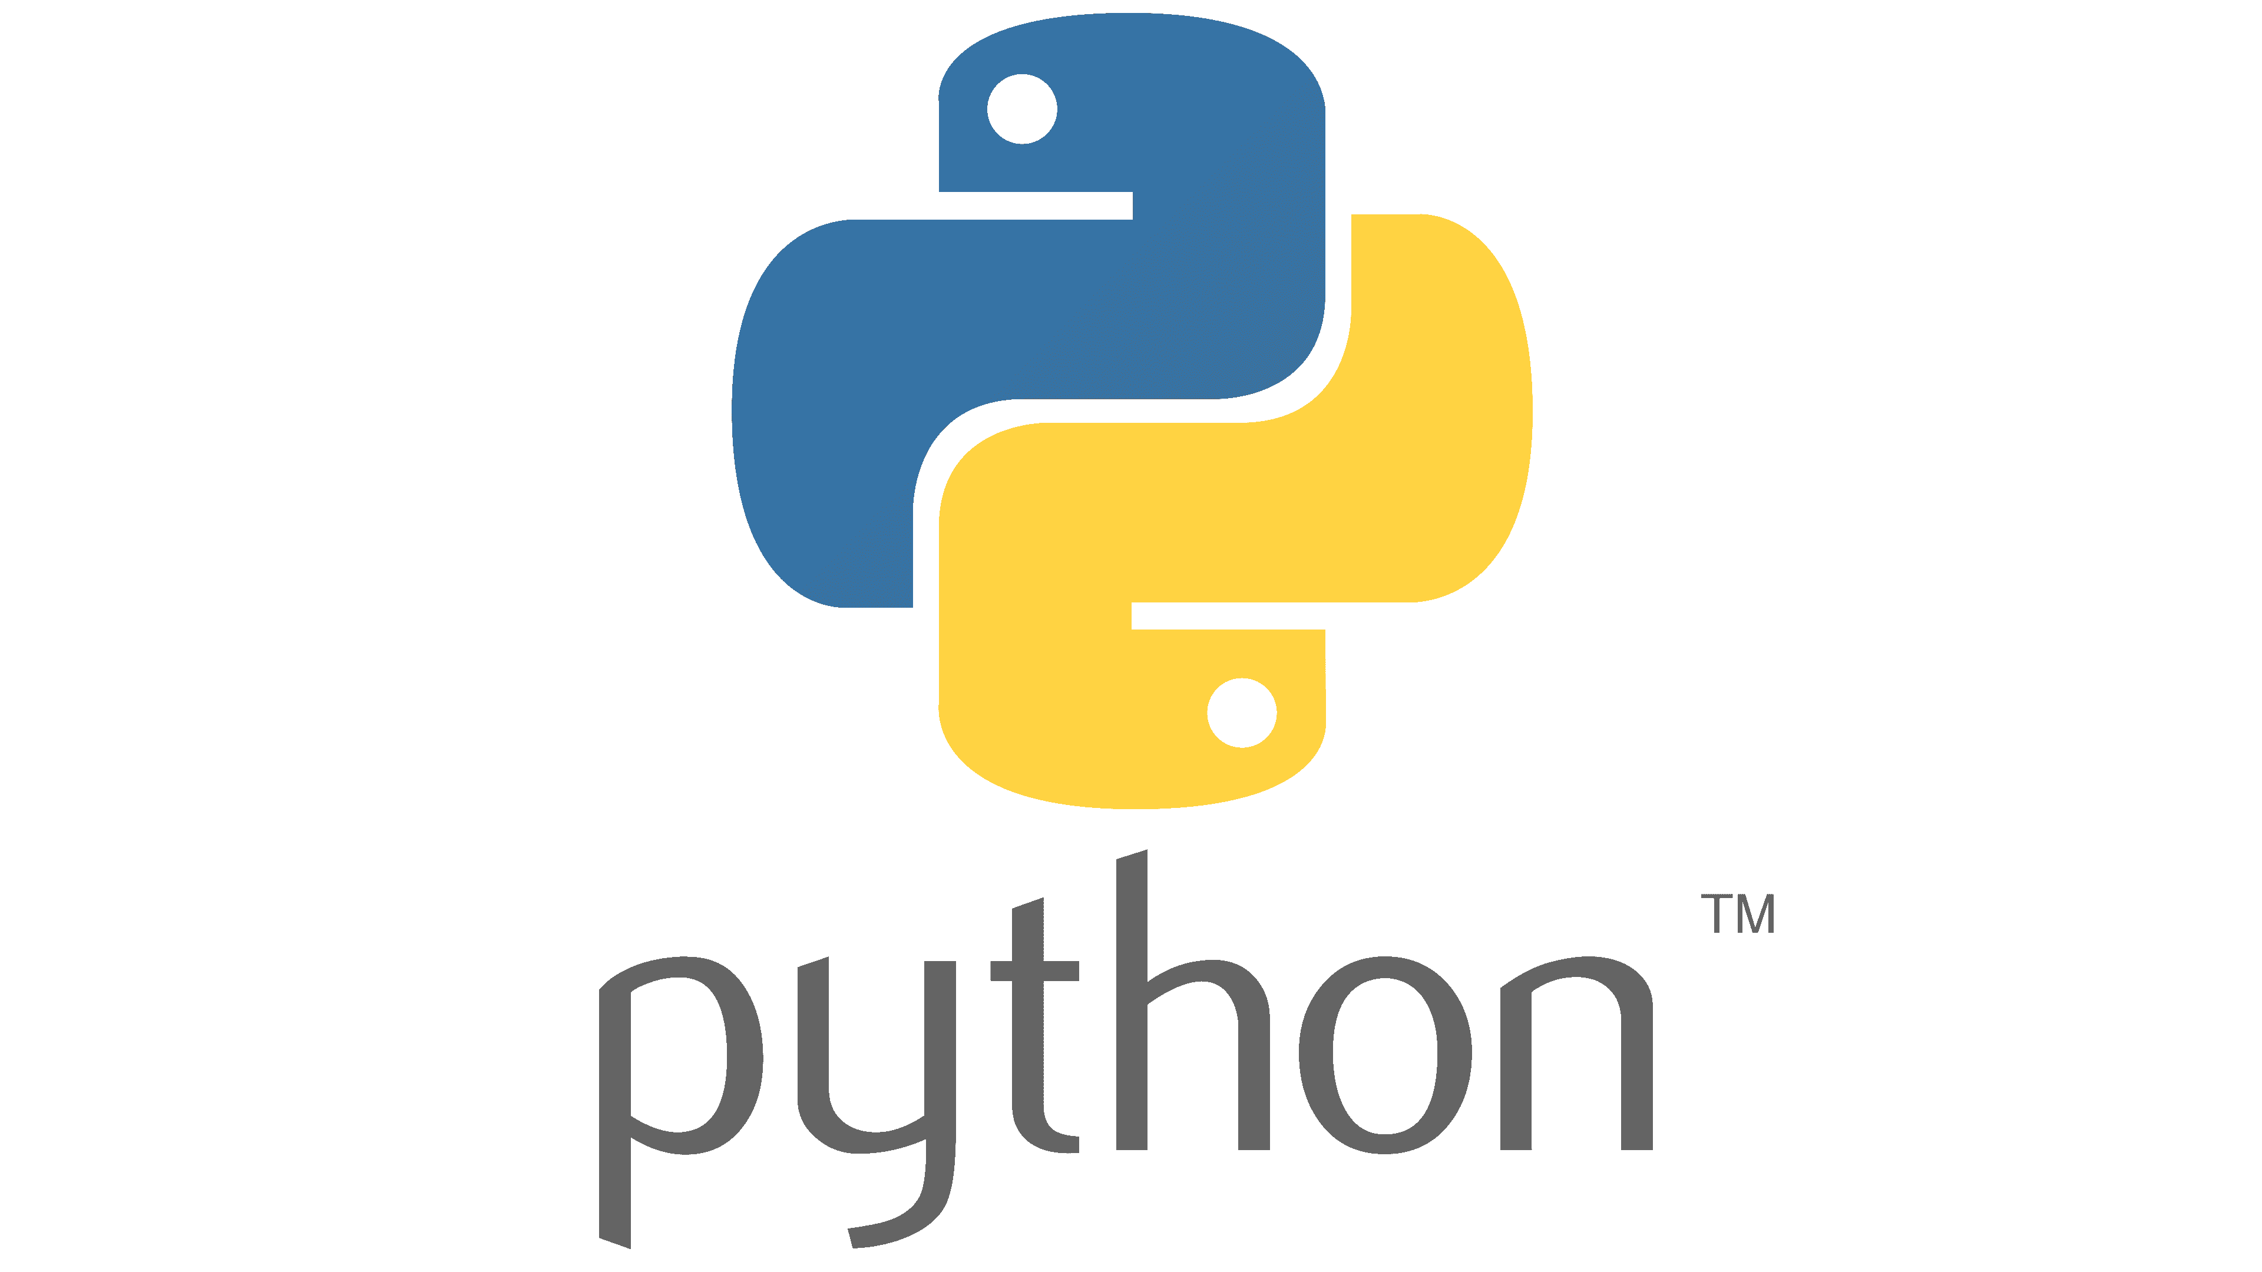
Agenda
What is Python?
Why Python is The Best?
Before we start
Let’s begin
What makes you a good developer?

Slide 3

Who Am I?
Python Software Engineer
AI/ML
BlockChain Technology
"The Boundaries are only in our heads.“ – “Ograniczenia są tylko w naszych głowach”
Cofounder of LynxSense

Slide 4
What is Python?

Slide 5
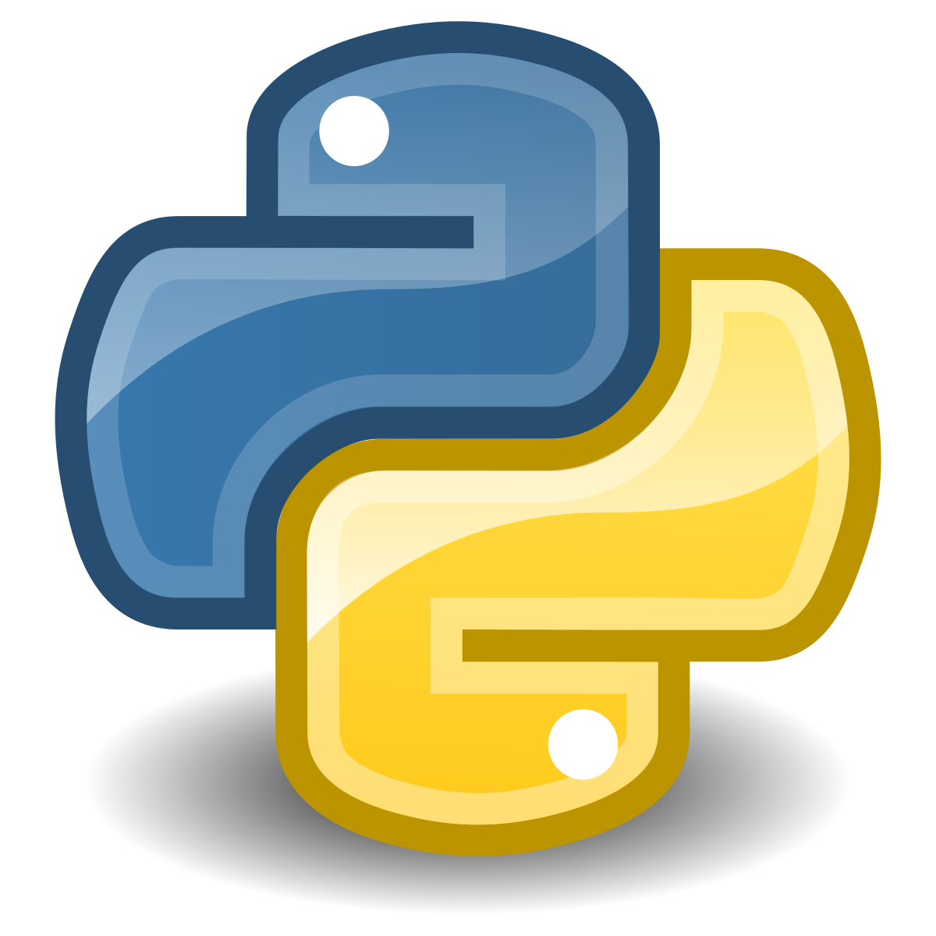
Dynamic typing
Philosophy of readability
High-level programming language
Based on CPython
Interpreted language
Automatic memory management (Garbage-collector)

Slide 6
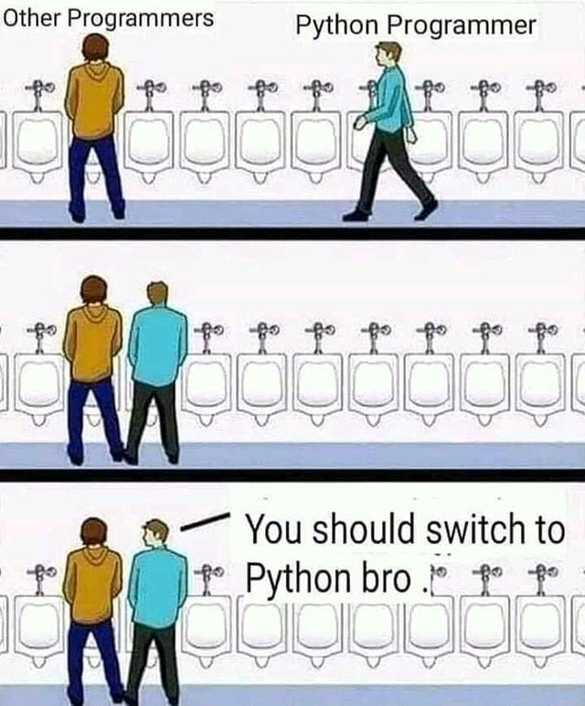
Why Python is The Best?

Slide 7
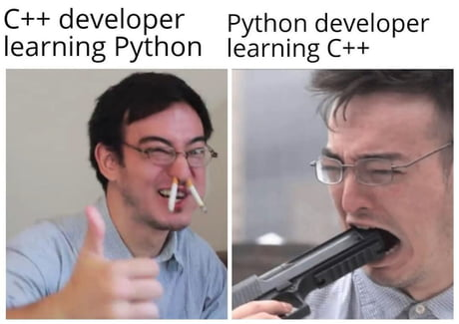
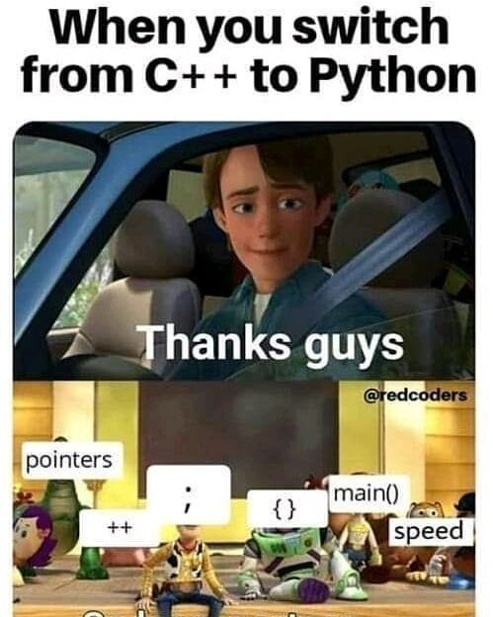
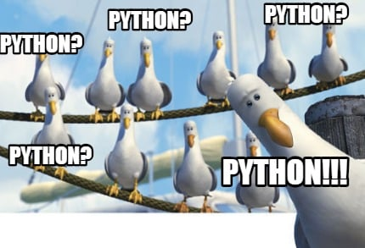
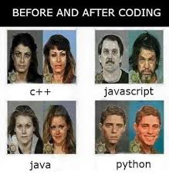
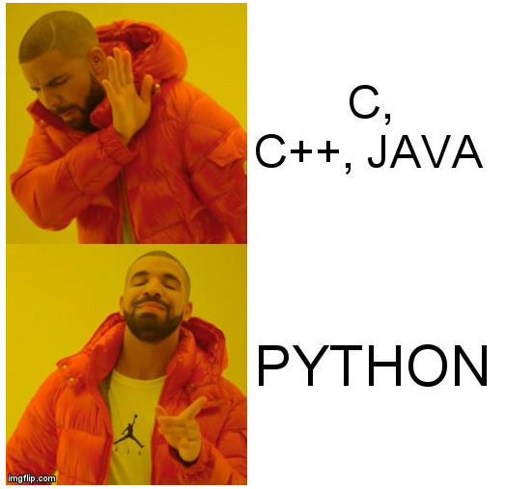

Slide 8
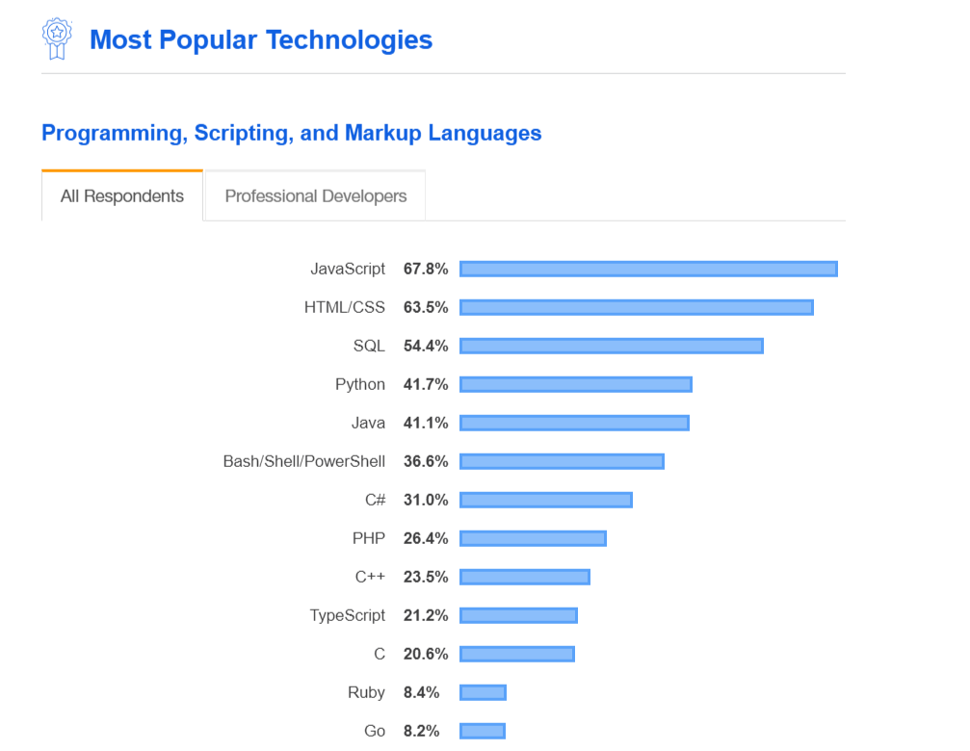
Computer Vision
Automation
Data Science
AI/ML
PoC
Data Analyst
Software development
Web applications
Network Programming

Slide 9
Before we start

Slide 10



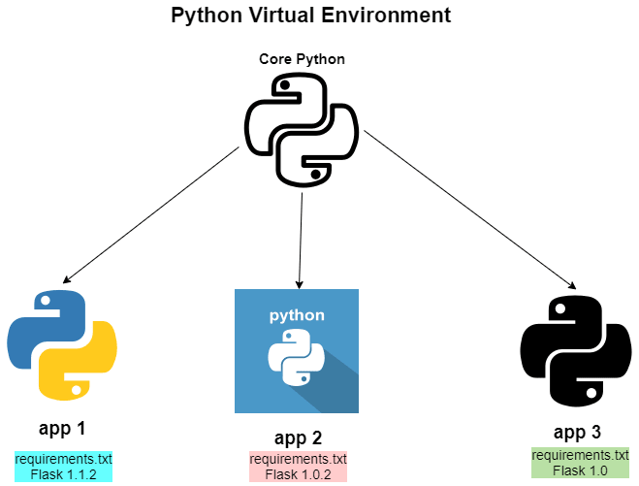
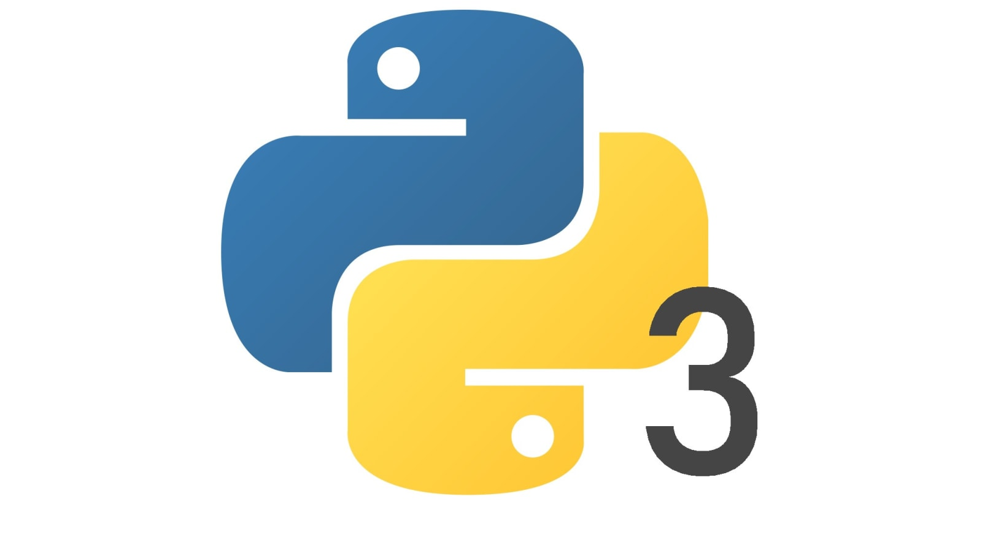
PIP
VENV (Virtual Environment)
Python Version
GIT
bash/PowerShell

Slide 11




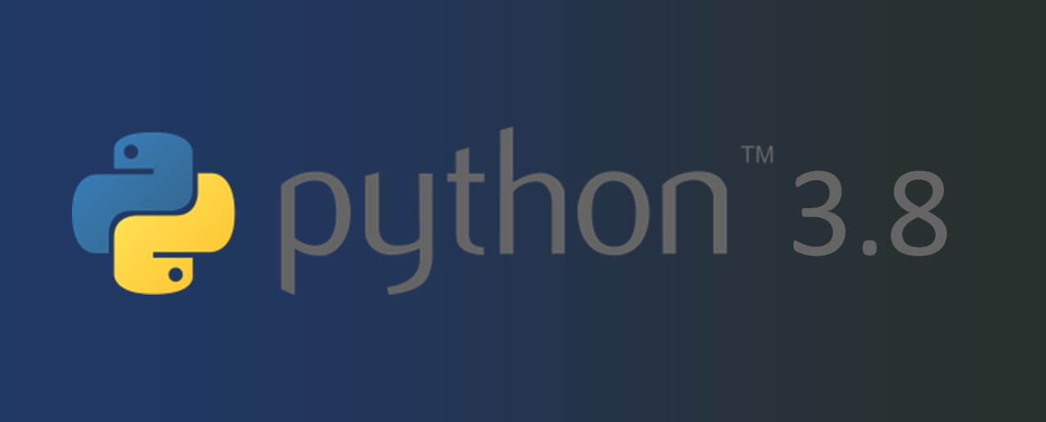
My software tools

Slide 12
Let’s begin

Slide 13
Link to download Python:
Python 3.8.0 -https://www.python.org/downloads/release/python-380/
Link to PyCharm:
https://www.jetbrains.com/pycharm/download/#section=windows
Git Bash
https://gitforwindows.org/

Slide 14
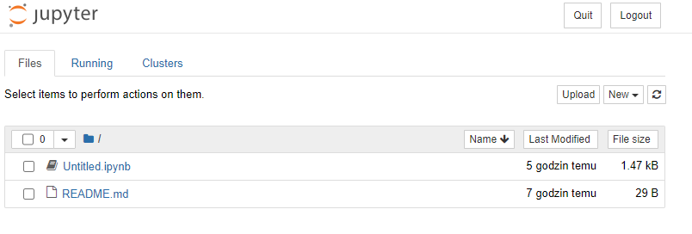
Check Python version:
“python –V”
Check pip version:
“python -m pip install --upgrade pip”
Install Jupyter Notebook:
“python -m pip install jupyter”
Run Jupyter Version:
“python -m notebook”

Slide 15
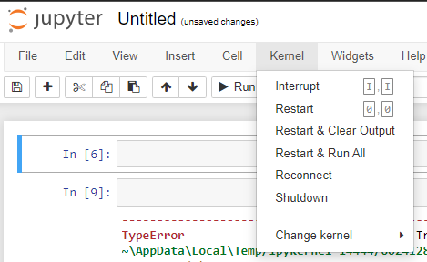
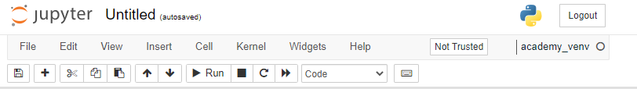
Creating virtual environment
“python -m venv academy_venv”
Install ipykernel:
“python -m pip install --user ipykernel”
Add our venv to jupyter:
“python -m ipykernel install --user --name=academy_venv”

Slide 16
What makes you a good developer?

Slide 17


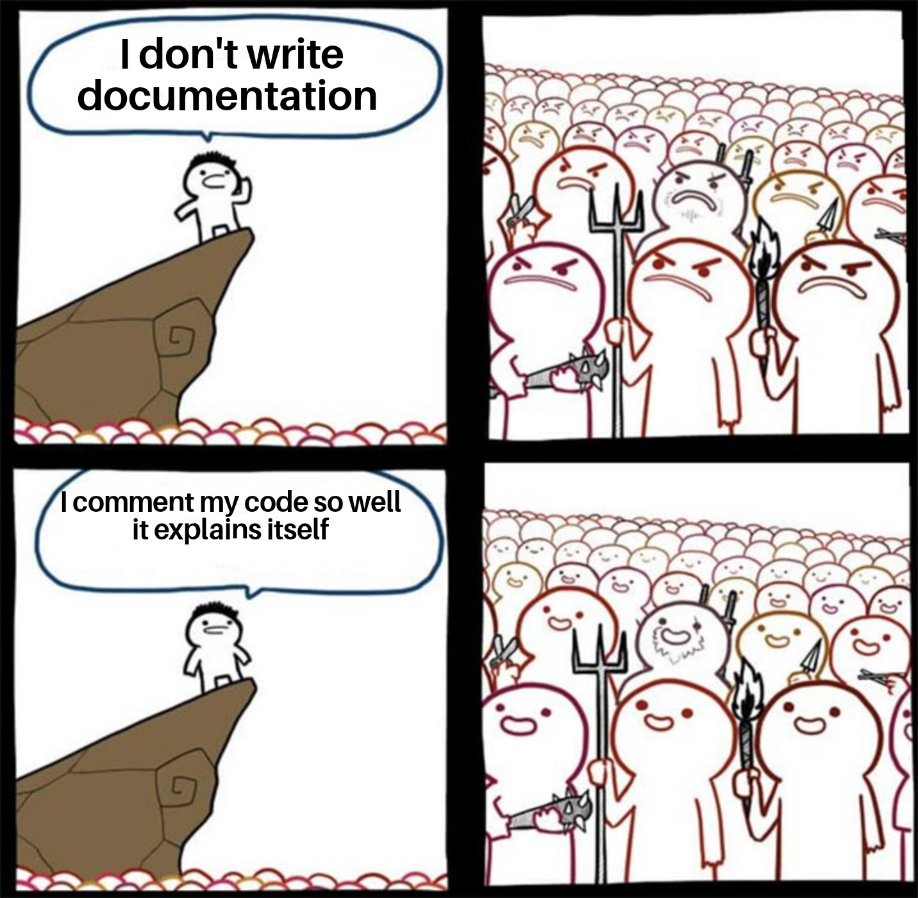
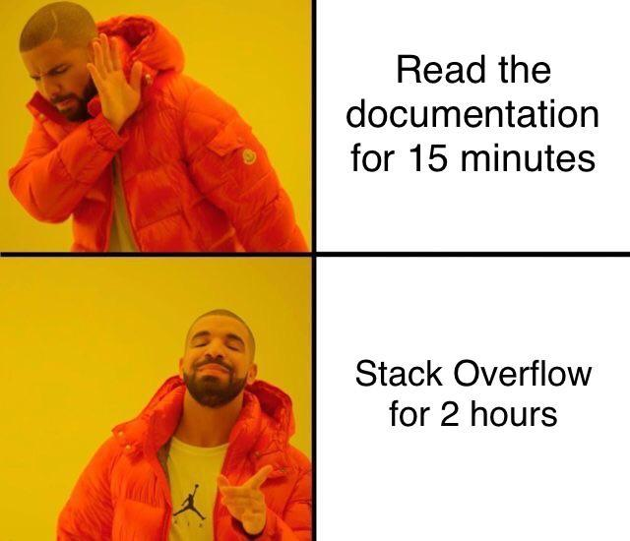
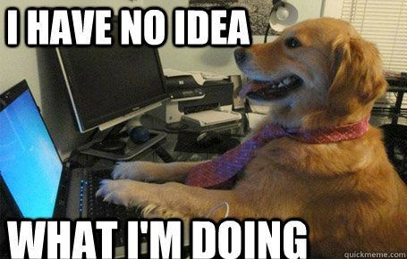



PEP 8 https://peps.python.org/pep-0008/

