Slide 1

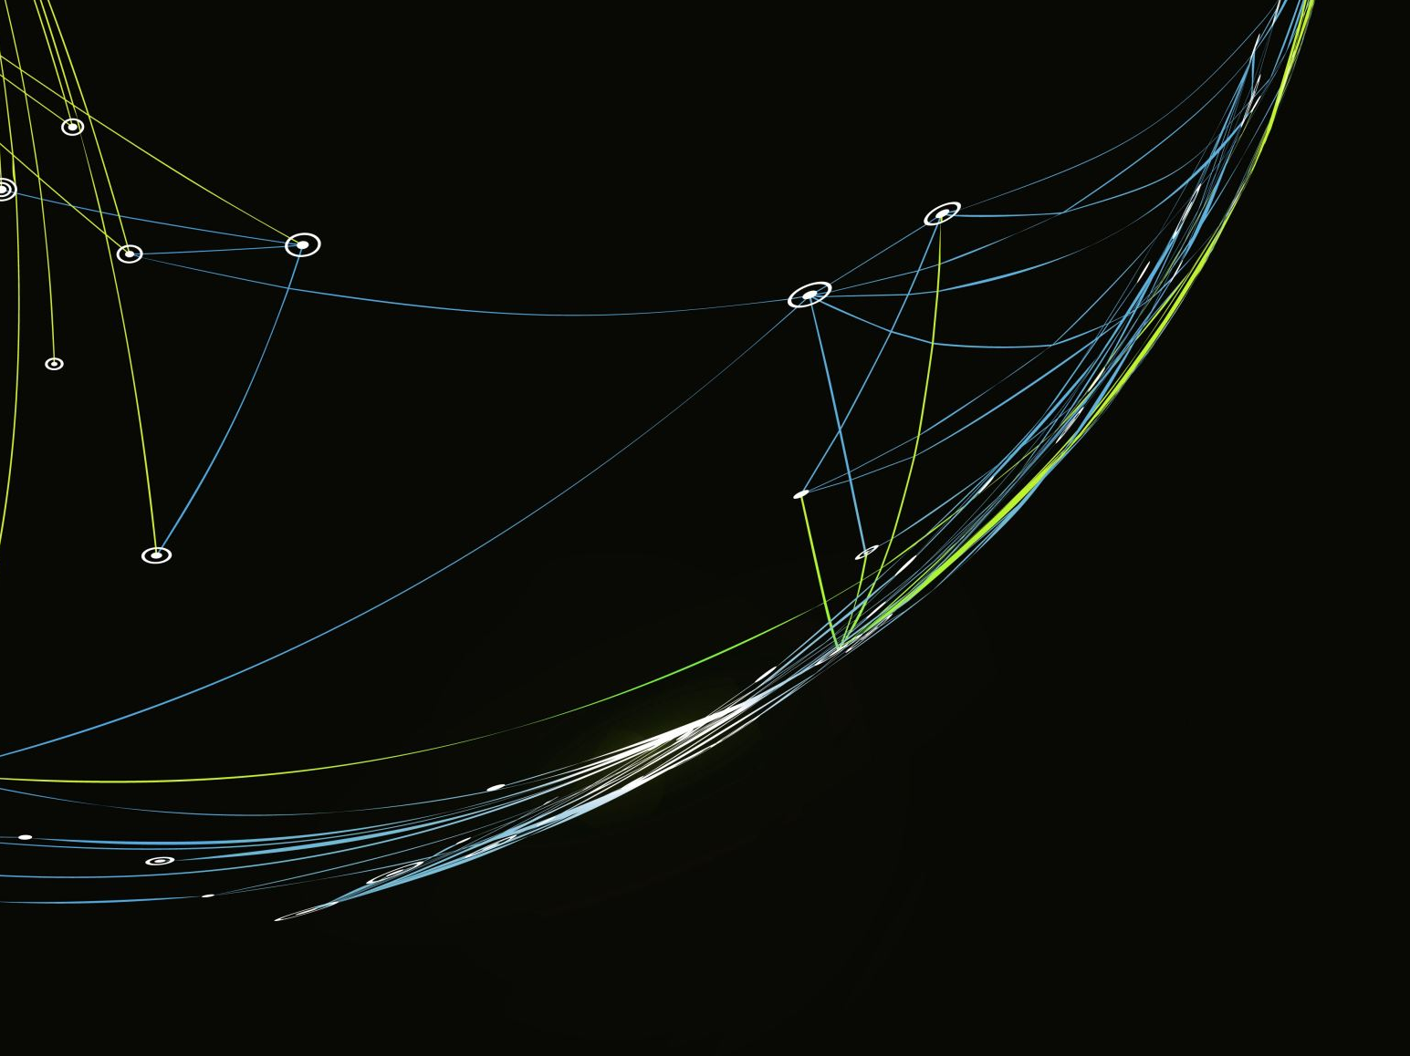


Analyzing NFL Draft Trends and Contracts Over the Last Four Years
Team Members: Luis Llamas, Jack Thomas, Christian Fincher, Santiago Cardenas

Slide 2


Project Overview
This project aims to identify and analyze the factors influencing the likelihood of NFL players receiving a second contract with the same team. The analysis focuses on the past four draft classes and considers attributes such as draft positions, player performance metrics, positional value, initial contract length, performance statistics, injury history, and team dynamics.

Slide 3

Team Members and Roles
Luis Llamas: Set up the GitHub repository, create README.md, and PPT presentation
Santiago Cardenas: Data collection and preprocessing
Christian Fincher: Data analysis and visualization
Jack Thomas: Statistical analysis and report writing

Slide 4


Data Sources
1. nfldatapy: Provides data on NFL draft picks, player statistics, and contract details
2. NFL Contract and Draft Data from Kaggle: Contains NFL contracts and draft pick data for players between 2000 and 2023

Slide 5
Key Aspects to Explore
1. Positional Analysis
2. Performance Metrics
3. Draft Position Impact
4. Contract Length and Value
5. Team Strategies
6. Injury History
7. Player Development
8. Economic Factors
9. Career Longevity
10. Comparative Analysis

Slide 6


Data Standardization and Analysis
- Data Standardization: Dictionary to standardize team names
- Identify Second Contracts: New column indicating second contracts
- Expand Dataset: Include second-round picks
- Player Records: Ensure unique counting of players

Slide 7
Methodology
- Data collection and preprocessing
- Data analysis techniques (e.g., aggregation, correlation, comparison)
- Statistical analysis methods
- Visualization tools used

Slide 8

Visualizations
- Showcase 2-3 key visualizations from the data analysis
- Include charts/graphs with brief explanations

Slide 9

Key Findings
- Summarize major findings
- Insights gained from the analysis
- Patterns and trends identified

Slide 10
Conclusion
- Summary of the project and findings
- Implications of the results
- Recommendations based on the analysis

Slide 11
Future Work
- Potential extensions of the project
- Additional data sources or analyses to consider
- Improvements for future research

Slide 12

Questions and Answers
- Invite questions from the audience
- Provide thoughtful answers to potential questions

Slide 13

References
- List of data sources and references used in the project

