Slide 1

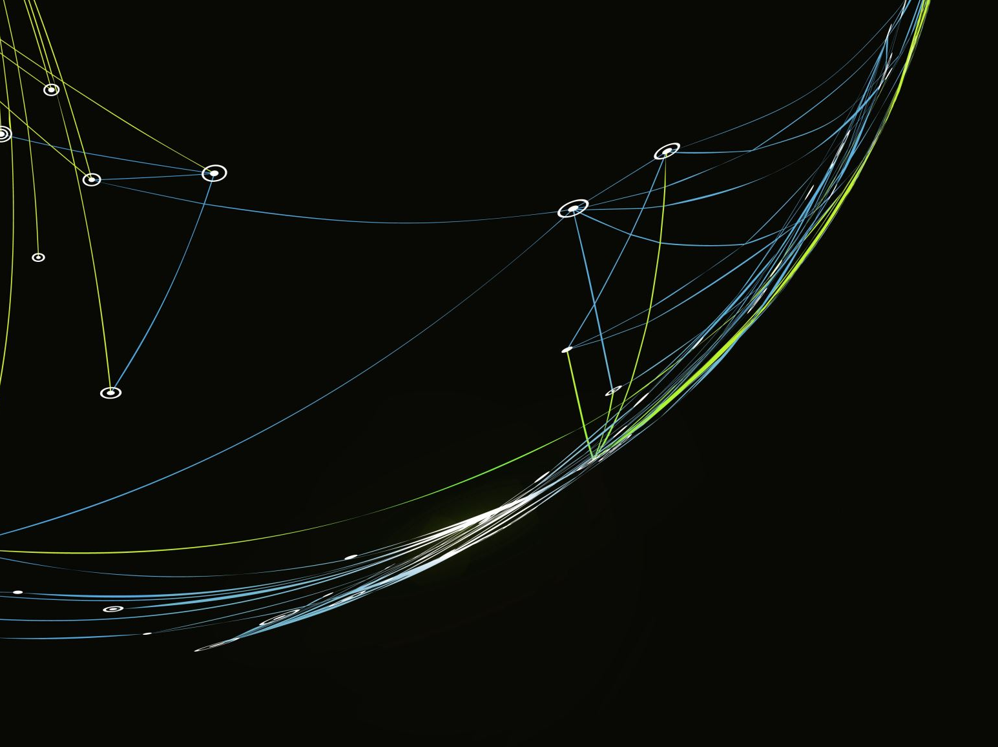


Analyzing the 2016-2019 NFL Draft Trends
Team Members: Luis Llamas, Jack Thomas, Christian Fincher, Santiago Cardenas

Slide 2


Project Overview
This project aims to identify and analyze the factors influencing the likelihood of NFL players receiving a second contract with the same team. The analysis focuses on the draft classes in a four-year span (from 2016 -2019) and considers how player position, round drafted, team drafting, and the draftee’s impact towards receiving a second contract.
Also determining how a draft team’s “hit-rate” is measured across winning average across that four-year span after the second contract is awarded to the players.

Slide 3

Team Members and Roles
Luis Llamas: Set up the GitHub repository, create README.md, and PPT presentation
Santiago Cardenas: Data collection and preprocessing
Christian Fincher: Statistical analysis and report writing
Jack Thomas: Data analysis and visualization

Slide 4


Data Sources
1. nfldatapy: Provides data on NFL draft picks, player statistics, and contract details
Source: Link
2. NFL Contract and Draft Data from Kaggle: Contains NFL contracts and draft pick data for players between 2000 and 2023
Source: Link
3. NFL Records created by Jack Thomas
Source: Link

Slide 5


Data Standardization and Analysis
Cleaning: Dictionaries to standardize team names to current city and acronym usages. Removing the duplicate names of players that appear.
Identify Second Contracts: New column indicating second contracts
Player Records: Ensure unique counting of players
Rounds: Including all seven rounds in the NFL draft

Slide 6
Key Aspects to Explore
1. NFL Overview
2. Team Breakdown
3. Round Breakdown
4. Positional Breakdown
5. Year-to-Year Breakdown
6. Draft Hit-Rate vs. Winning Percentage

Slide 7

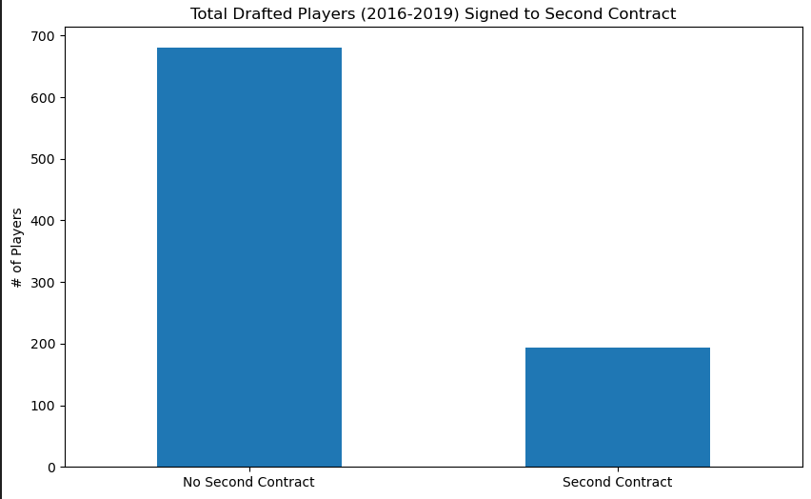
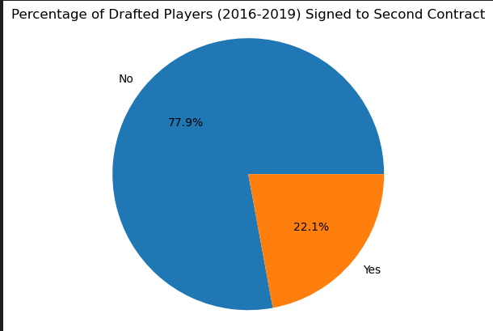
Draft Overview (2016-2019)

Slide 8
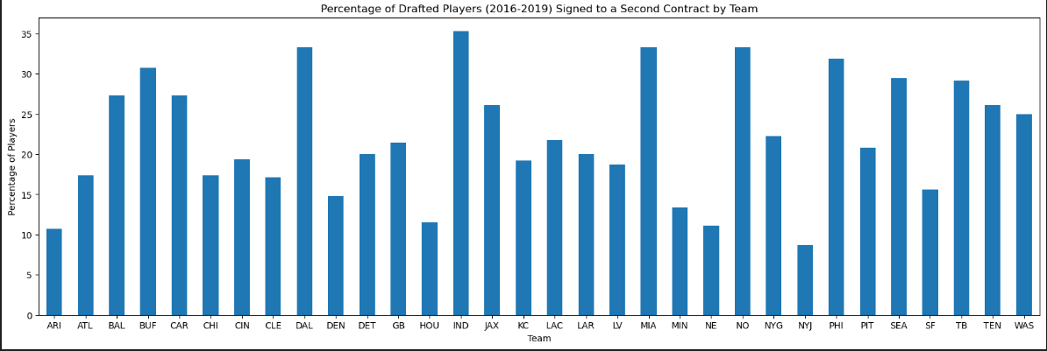
Team Breakdown

Slide 9
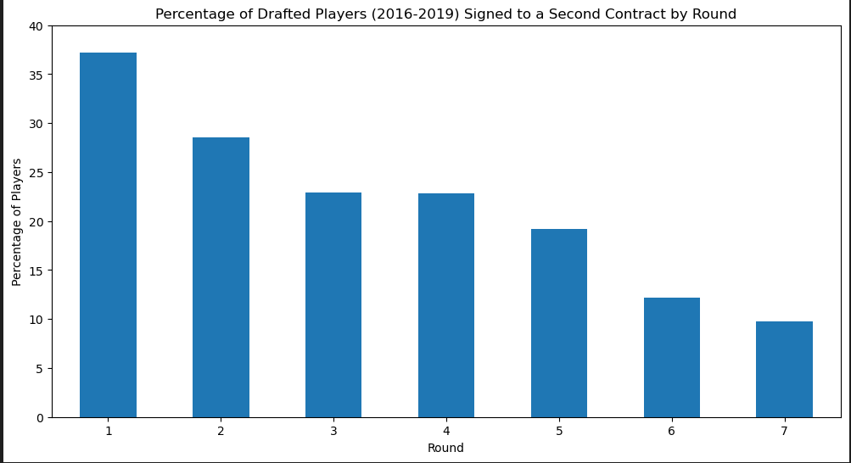
Round (1-7) Breakdown

Slide 10
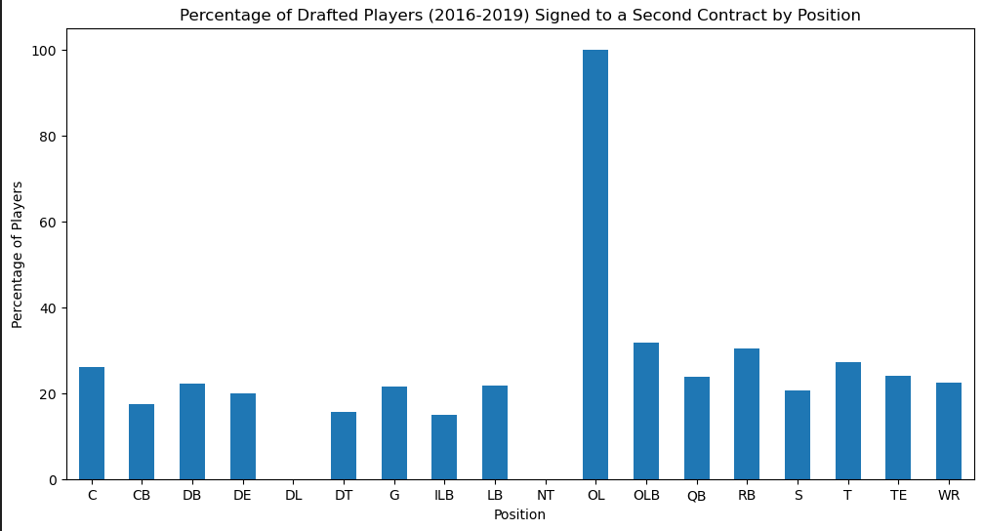
Position breakdown

Slide 11
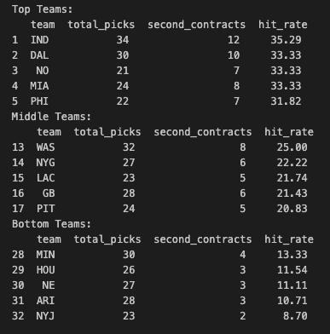
Hit Rate % by Team

Slide 12
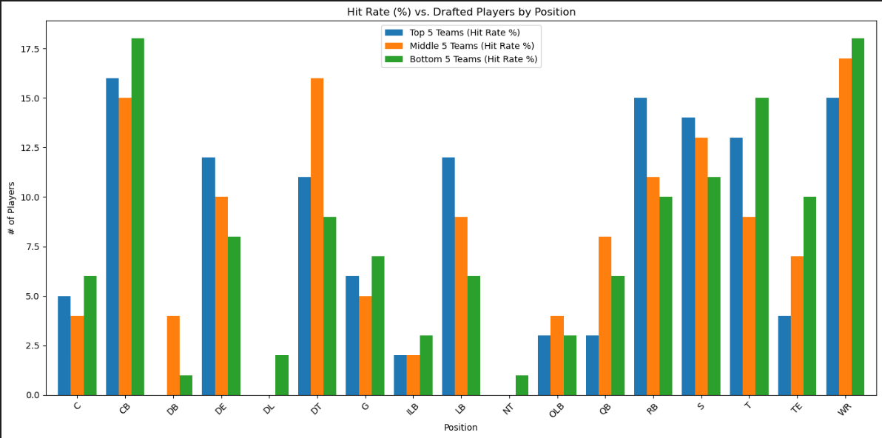
Draft Hit Rate vs. Player Position by Team

Slide 13
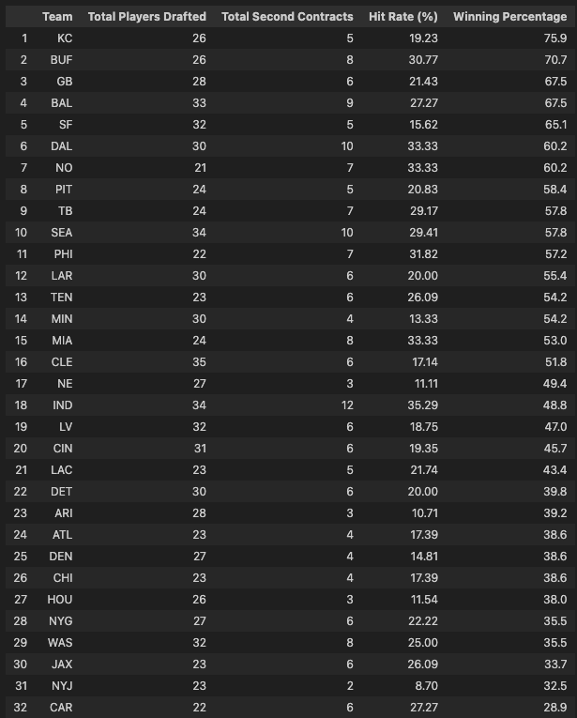
Draft Hit Rate vs. Win %

Slide 14
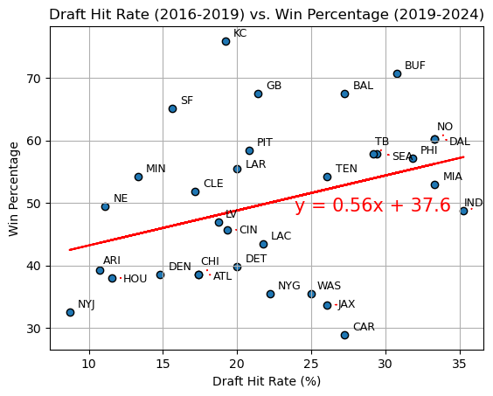
Draft Hit Rate vs Win %

Slide 15
Key Findings
We found there is a low positive correlation of 0.56 for our graph.
Majority of teams on the top half of draft hit rates tend to have better win percentages per season
Argument to be made that those who do not sign players to the second contract can have successful seasons (>50%)
- Summarize major findings
- Insights gained from the analysis
- Patterns and trends identified

Slide 16
Conclusion
- Summary of the project and findings
- Implications of the results
- Recommendations based on the analysis

Slide 17
Future Work
- Potential extensions of the project
Diving deeper into positional analysis to provide further reasoning behind achieving second contract.
Performing analysis behind 1st round picks to 7th round picks, determine cases where a 7th round draftee performed better than a first
- Additional data sources or analyses to consider:
Analysis on the performance across year-by-year, by player
Analysis on contract increases by player and position for second contract
- Improvements for future research
Get the definitive source (NFL) for the data for improved data analysis

Slide 18

Questions and Answers

