Slide 1




Analyzing the 2016-2019 NFL Draft Trends
Team Members: Luis Llamas, Jack Thomas, Christian Fincher, Santiago Cardenas

Slide 2


Project Overview
This project aims to identify and analyze the factors influencing the likelihood of NFL players receiving a second contract with the same team. The analysis focuses on the draft classes in a four-year span (from 2016 -2019) and considers how player position, round drafted, team drafting, and the draftee’s impact towards receiving a second contract.
Also determining how a draft team’s “hit-rate” is measured across winning average across that four-year span after the second contract is awarded to the players.

Slide 3

Team Members and Roles
Luis Llamas: Set up the GitHub repository, create README.md, and PPT presentation
Santiago Cardenas: Data collection and preprocessing
Christian Fincher: Statistical analysis and report writing
Jack Thomas: Data analysis and visualization

Slide 4


Data Sources
1. nfldatapy: Provides data on NFL draft picks, player statistics, and contract details
Source: Link
2. NFL Contract and Draft Data from Kaggle: Contains NFL contracts and draft pick data for players between 2000 and 2023
Source: Link
3. NFL Records created by Jack Thomas
Source: Link

Slide 5


Data Standardization and Analysis
Cleaning: Dictionaries to standardize team names to current city and acronym usages. Removing the duplicate names of players that appear.
Identify Second Contracts: New column indicating second contracts
Player Records: Ensure unique counting of players
Rounds: Including all seven rounds in the NFL draft

Slide 6
Key Aspects to Explore
1. NFL Overview
2. Team Breakdown
3. Round Breakdown
4. Positional Breakdown
5. Year-to-Year Breakdown
6. Draft Hit-Rate vs. Winning Percentage

Slide 7

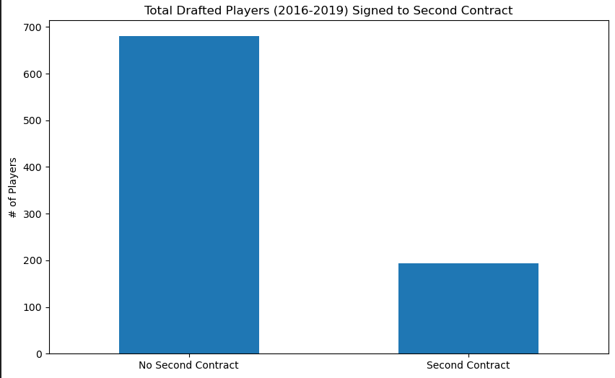
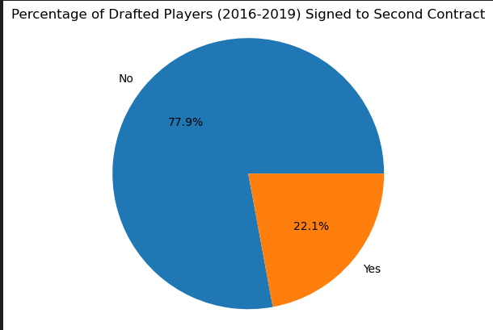
Draft Overview (2016-2019)

Slide 8
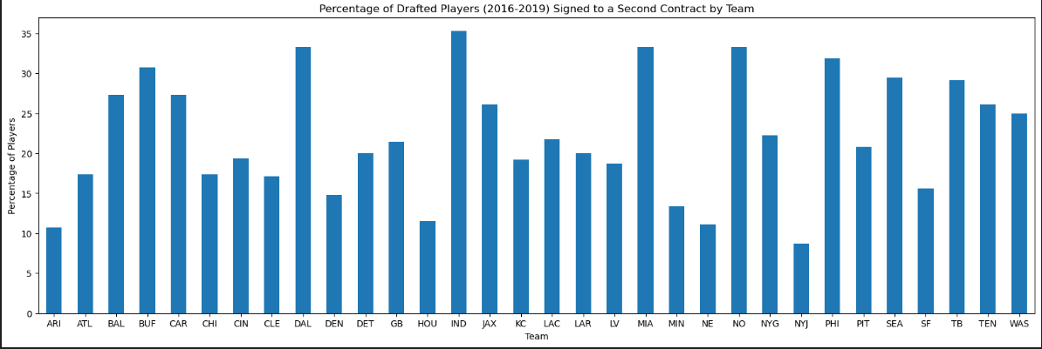
Team Breakdown

Slide 9
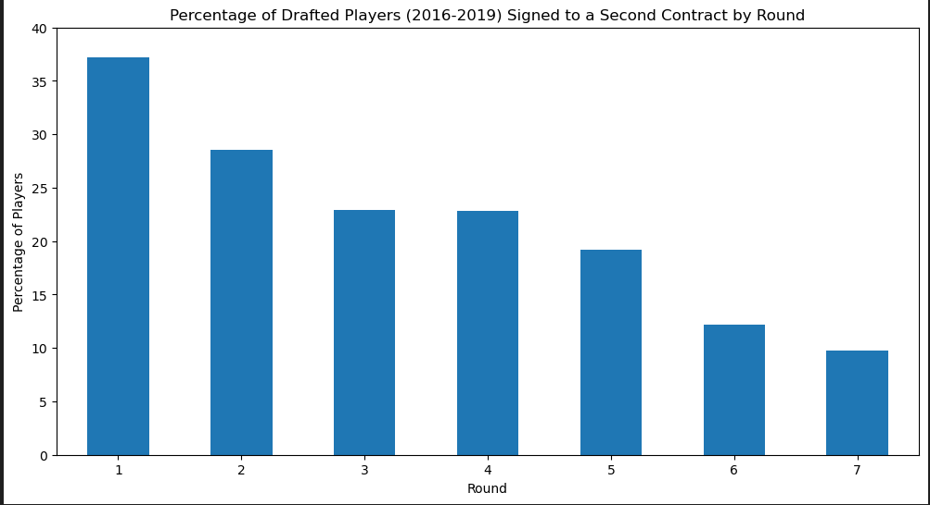
Round (1-7) Breakdown

Slide 10
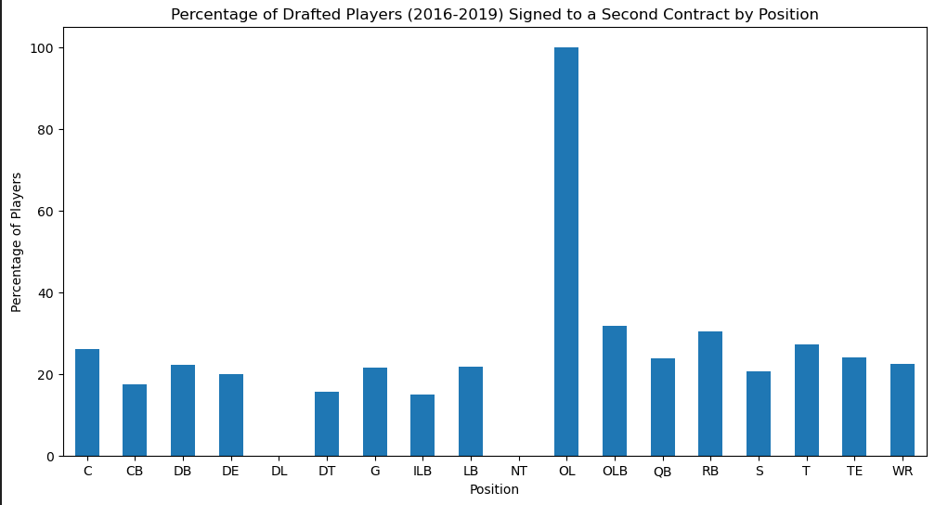
Position breakdown

Slide 11
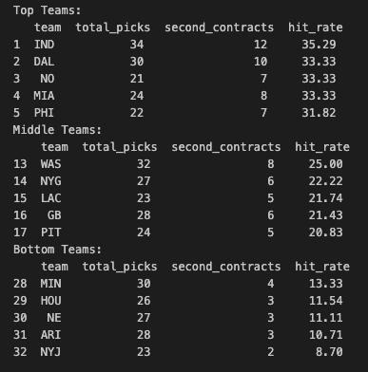
Hit Rate % by Team

Slide 12
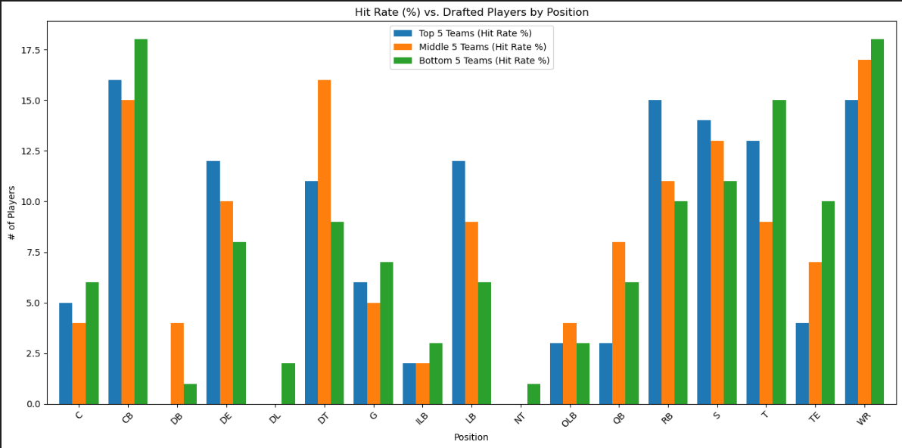
Draft Hit Rate vs. Player Position by Team

Slide 13
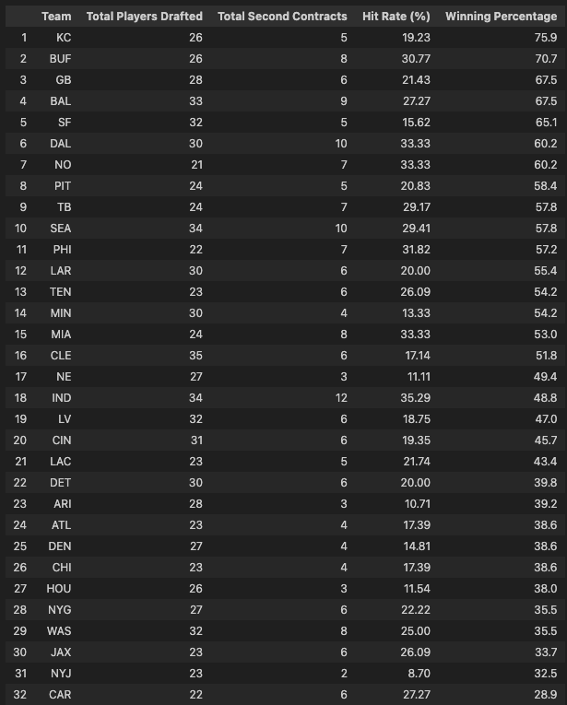
Draft Hit Rate vs. Win %

Slide 14
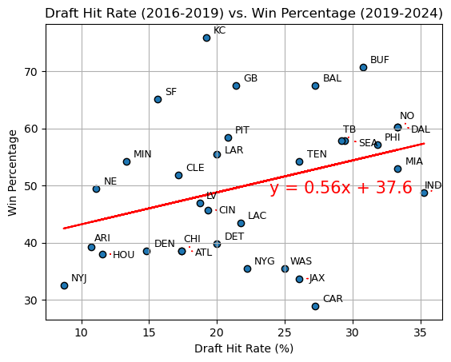
Draft Hit Rate vs Win %

Slide 15
Key Findings
We found there is a low positive correlation of 0.11 for our graph.
Majority of teams on the top half of draft hit rates tend to have better win percentages per season
Argument to be made that those who do not sign players to the second contract can have successful seasons (>50%)
- Summarize major findings
- Insights gained from the analysis
- Patterns and trends identified

Slide 16
Conclusion
It can be determined based on the data that most teams who have a higher hit rate do not always see higher win rates which can equate to better output on the field
There is a high turnover of drafted players who do not received a second contract with their respective team
There are examples of successful teams both for and against the premise that you need to sign your own players to ultimately see the higher win rate and/or more
Overall, it can be stated that there should be consideration to keep the players that best fit the respective team's system. Although, teams have shown being more conservative on their extensions and bringing in talent on the market can show consistent win percentages

Slide 17
Future Work
- Potential extensions of the project
Diving deeper into positional analysis to provide further reasoning behind achieving second contract.
Performing analysis behind 1st round picks to 7th round picks, for example determine cases where a 7th round draftee performed better than a 1st
- Additional data sources or analyses to consider:
Analysis on the performance across year-by-year, by player
Analysis on contract increases by player and position for second contract
- Improvements for future research
Get the definitive source (NFL) for the data for improved data analysis

Slide 18

Questions and Answers

