Slide 1
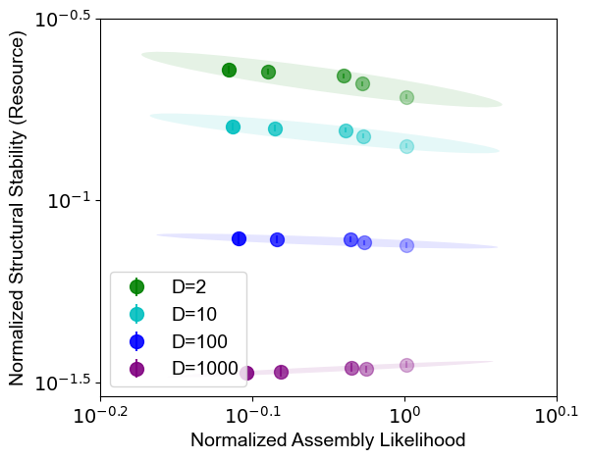
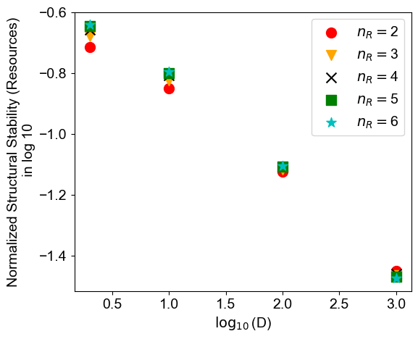
Figures archive
Dilution factor, smart sequential utilizers
Points of the same shade should have same x value if consider feasibility; dynamic stability makes a tiny difference.

Slide 2
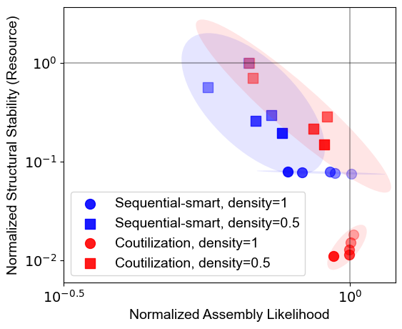
Sparsity

Slide 3
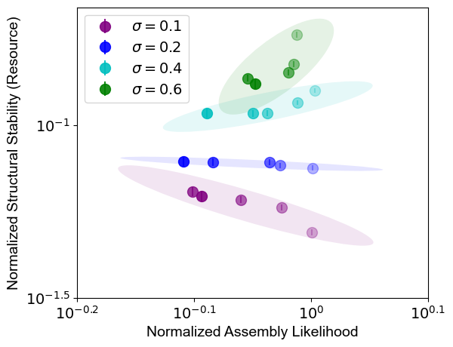
Std in growth rate distribution, smart sequential utilizers
Abs(N(1, sigma^2)) with smaller sigmas. If sigma is larger (0.4, 0.6), cutoff at 0.01 and 1.99.

Slide 4
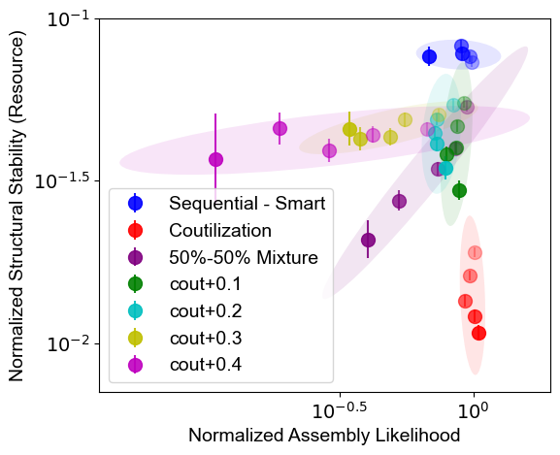
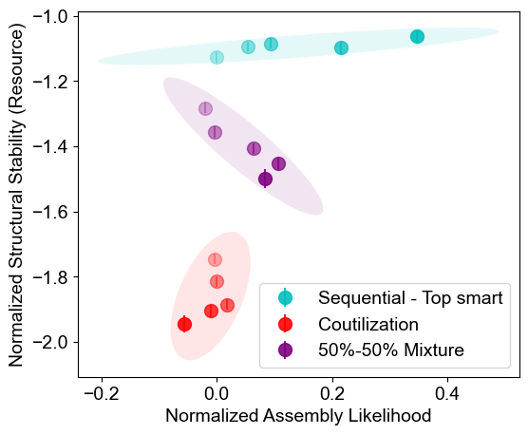
Mixture of strategies
50%-50% means in each community any species has a 50% probability to use either of the strategies.

Slide 5
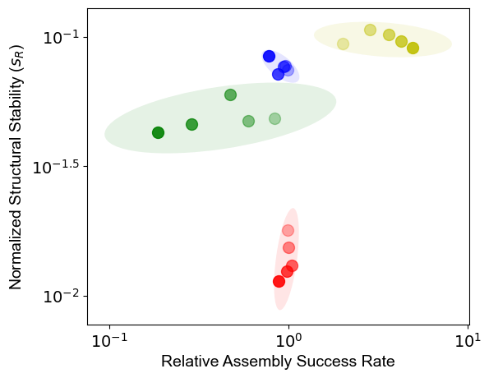
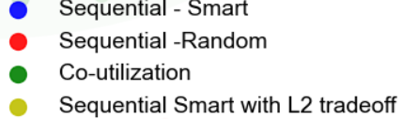
With tradeoff in growth rates
The L2 tradeoff is the one used in Bloxham-Gore.

Slide 6
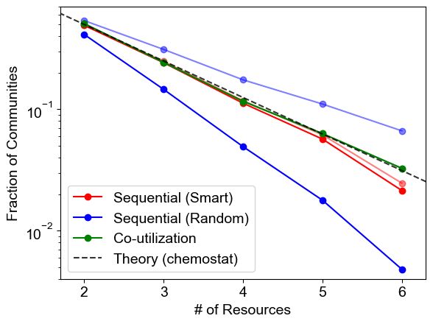
Dynamic stability
Light color: w/o considering dynamic stability. Deep: otherwise.
Uniform coutilizers are always dynamically stable.

Slide 7
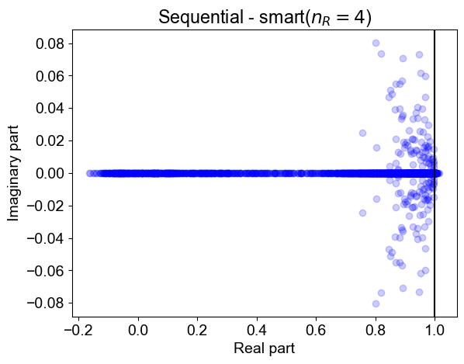
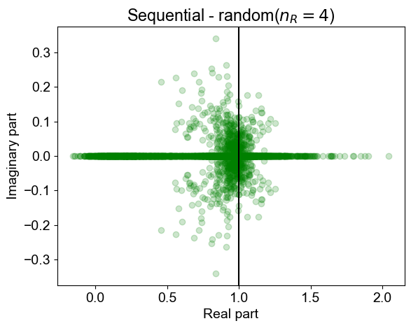
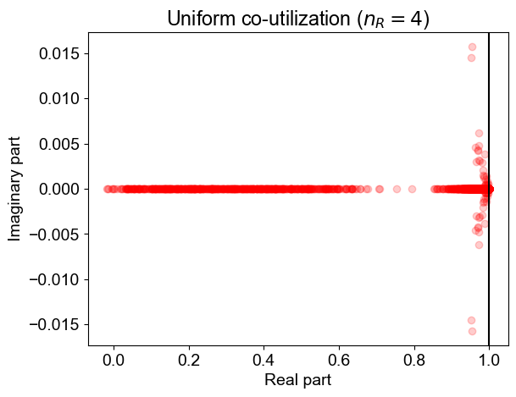
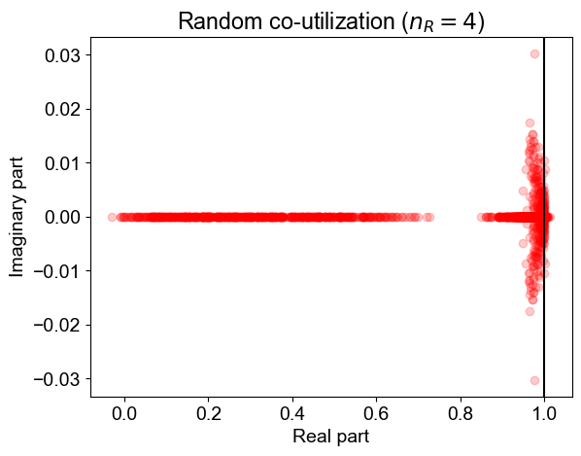
Spectra of the eigenvalues for n_R=4. With the updated code for co-utilizers.
Changing n_R doesn’t qualitatively change anything as I see.

Slide 8
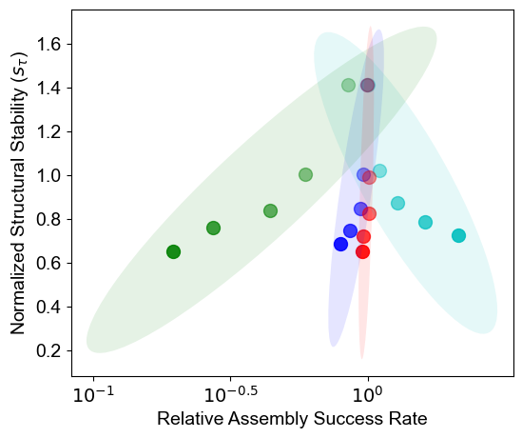
Structural stability in lags.
Red, blue and green are the same as in our main figure. Cyan = top smart

