Slide 2
IQ TEST REPORT
Field testing
Date:
Build Version:
Application version:
Tuning version:

Slide 3
The following information is confidential and
copyrighted to MM Solutions EAD.
No part of this document may be reproduced or transmitted in any form or by any means, electronic, mechanical, photocopying, recording or otherwise without prior written permission of MM Solutions EAD.

Slide 4
Summary
Functional issues

Slide 5
Fixes and Suggestion for improvements

Slide 6
Comparison Scale
Verdict | Severity | Description
Better | Obvious | Undoubtedly better in all aspects. Clearly visible advantages at full screen or 100% zoom, no side effects.
Better | Hardly noticeable | Slightly better in certain aspect. Average users may not notice the difference or need to zoom in at high level to see it.
Comparable | - | Identical, differences are negligible
Worse | Hardly noticeable | Slightly worse in certain aspects. Average users may not notice the difference or need to zoom in at high level to see it.
Worse | Obvious | Undoubtedly worse in all aspects. Clearly visible disadvantages at full screen or 100% zoom, no side effects.
Incomparable | - | Very different and both problematic, cannot be compared. For instance two different strong color casts or one camera is very noisy but with high details level the other is noise free but very smeared

Slide 7
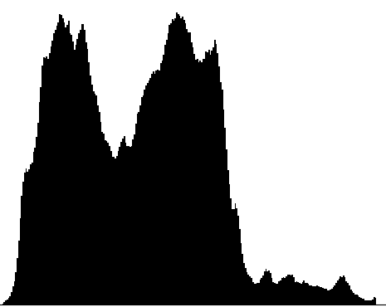
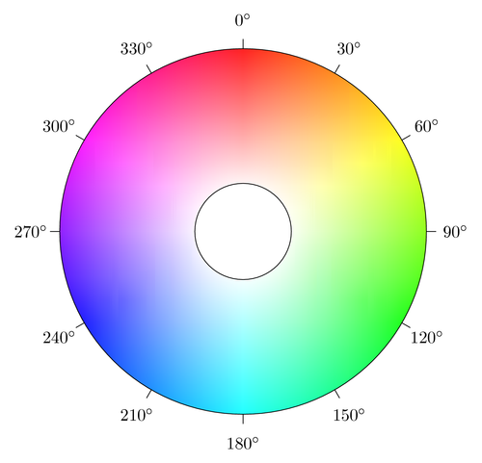
Glossary
IQ Groups | Definitions
Avg Luma | This is the average brightness of all pixel in the image. Higher value means brighter image, lower darker.
Contrast | This is the ration between darker pixels(Black level) and brighten pixels(white level) in the image, converted to percentage. Maximum ration is 100% equal to Black level = 0 and White level = 255. Higher value bigger contrast.
Black level | This is the level of darkest pixels calculated form Y histogram. To avoid noise, death pixels and histogram tail value is taken from the point where the histogram reach 2% of the total pixel count. Lower value means darker blacks, higher value means brighter blacks, 0 means clipping in the low end of the histogram either pure dynamic range, tone mapping or low exposure.
White level | This is the level of brightest pixels calculated form Y histogram. To avoid noise, hot pixels and histogram tail value is taken from the point where the histogram reach 98% of the total pixel count. Lower value means darker whites, higher value means brighter blacks, 255 means clipping in the high end of the histogram either pure dynamic range, tone mapping or high exposure.
Hue | That is the overall hue of the image. Note that in case of mixed color reported hue will be average from all colors. Its useful to compare images with dominant color like sky
Saturation | Saturation is the average saturation for all colors in the image. If dominant color is gray overall saturation will be low, in case of dominant primary color as higher the saturation is as vivid the colors are.
ISO | The actual the image was taken with, extracted from the image EXIF.
ET | The actual exposure time the image was taken with, extracted from the image EXIF.

