Slide 1
CSVS Color Evaluation Pipeline
Internship Progress Presentation ·
CSVS Project · VISART Team · 2026

Slide 2
Presentation Overview
Existing work analysis
01
Project Context & Objectives
02
03
Dataset Analysis & Critique
04
Proposed Pipeline
05
Proposed Approaches
06
CNN Models
07
Hybrid Pipeline
08
Results Summary & Next Steps
0

Slide 3
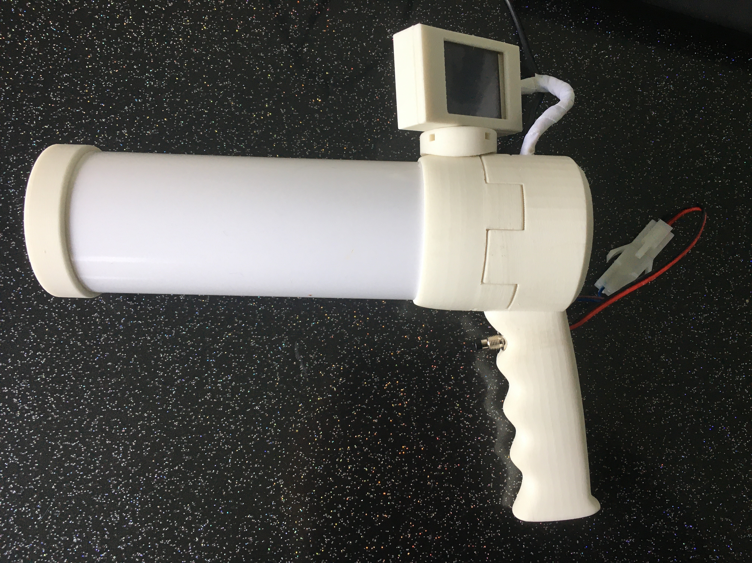
01 · Project Context & Objectives
Color evaluation across three acquisition environments

Slide 4
Project Need & Core Objectives
CSVS Color Correction & Evaluation Project
CORE OBJECTIVE
Develop a robust, reproducible pipeline to evaluate vegetable color across three acquisition environments and benchmark the CSVS color correction pipeline against controlled and uncontrolled aquisition conditions.
ICAB v2
CSVS
Veggie Vision
CONTROLLED
QUASI-CONTROLLED
UNCONTROLLED
Standardised LED lighting
Calibrated color checker
Professional CMOS sensor
Custom LED illuminant
CMOS sensor bias correction
Lucideon disc checker
Smartphones / Score tablets / Digital Camera
Variable ambient lighting
No color checker
CHALLENGES TO SOLVE
CMOS Bias
Artefacts
Sensor offset not correctable by white balance
→ polynomial CCM required
Specular highlights, netting, dirt, dark edges contaminate color
Label Noise
Cross-Device
Manual ranking (1–9) introduces inter-observer variability
CSVS and SCORE scores not comparable without normalisation

Slide 5
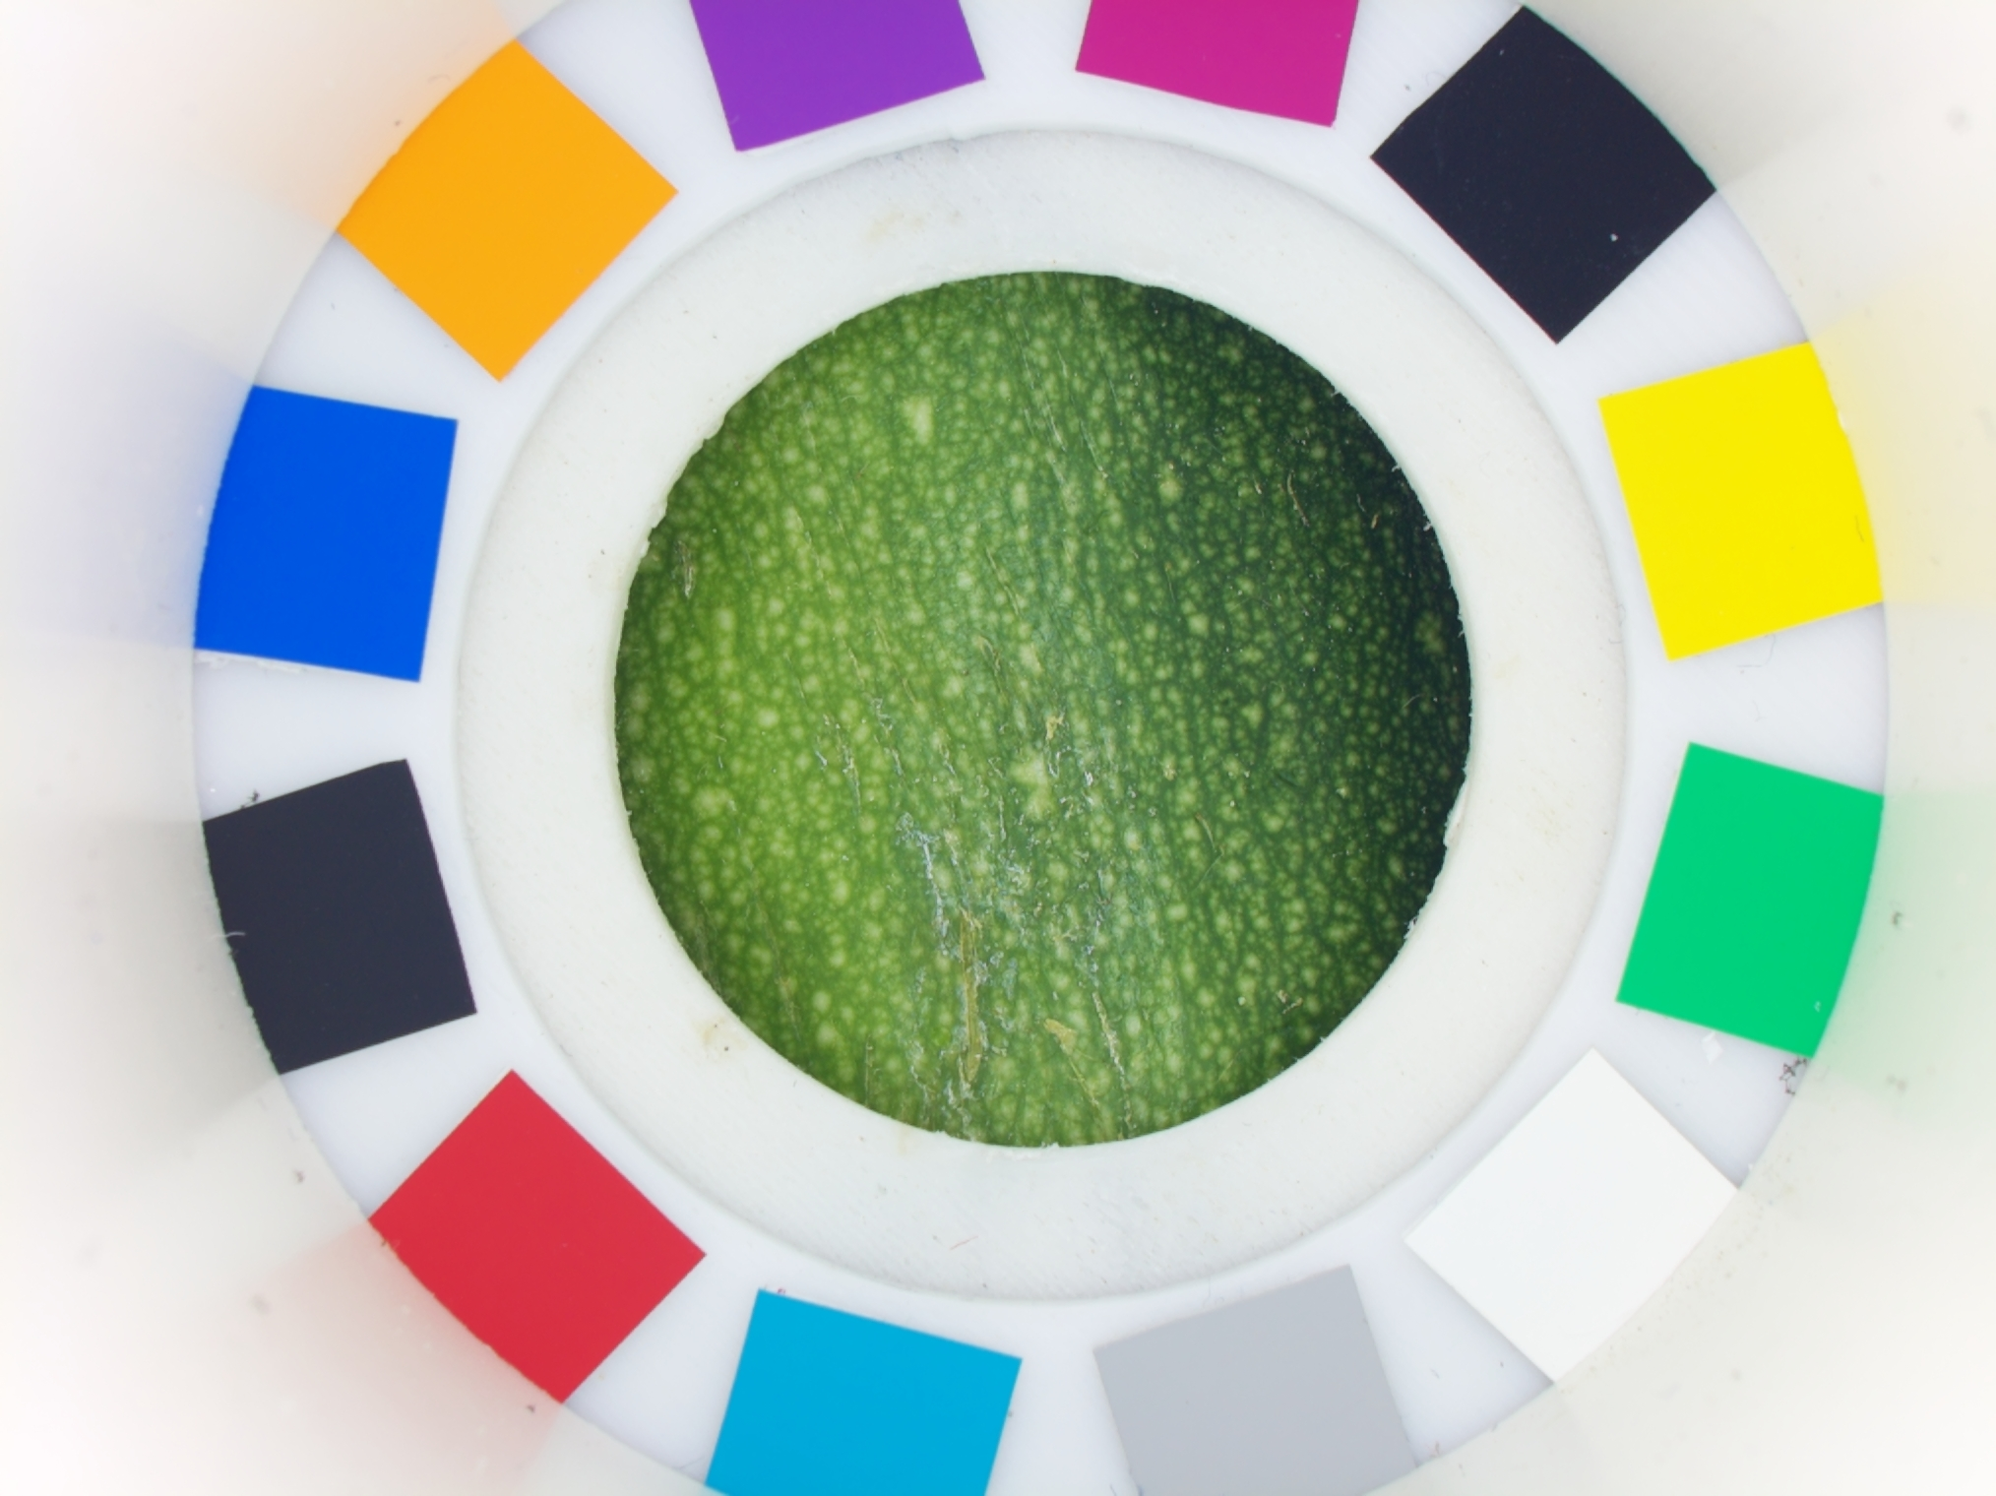
02· existing work
Polynomial CCM analysis, strengths and improvement recommendations

Slide 6
CCM Pipeline 11 Steps
Implemented by Mathis (VISART) polynomial correction from RAW to corrected TIFF
01
Illuminant modelling
07
Polynomial CCM
LED → 3 Gaussian SPDs → XYZ
Degree-2, 10 features, least-squares
02
RAW loading & conversion
08
Quality metrics
rawpy DNG → demosaic → ACES2065-1 16-bit
ΔE2000 per patch + clipping ratios
03
Checker circle detection
09
ROI crop & save
Canny edges + Hough circle transform
90% radius mask, 16-bit TIFF +cc/+nocc
04
Patch position detection
10
Parallel batch processing
12 patches at 30° intervals
230 images via ThreadPoolExecutor
05
Color extraction
11
Analysis & reporting
IQR mean per patch (robust to edges)
ΔE2000 summary + histograms CSV
06
Gray-patch white balance
Degree-2 poly, channels decoupled

Slide 7
03 · Dataset Analysis
Inventory, image quality issues, and annotation weaknesses

Slide 8
Available Datasets
Inventory & Key Image Quality Issues
Source: CSVS camera (Sony IMX477 12Mpx) · RAW DNG + JPEG formats
Dataset / Crop
Device
Format
Scale
Annotation
Key Issues
Pepper (Yellow/Red/Orange)
CSVS00/01
JPEG/DNG
1–9
1-9
Specular, netting, spatial colour gradients
Zucchini
CSVS01
DNG→TIFF
1–9
1-8
Netting, waxy reflections, dark ROI edges
Lettuce (Red / Green)
CSVS01
JPEG/DNG
1-9
—
Water droplets, vine textures, no ripeness scale
Colour Checker (CCP2)
CSVS00/01
JPEG/DNG
16 patches
3×
No product annotation
OBSERVED IMAGE QUALITY ISSUES BY CROP
Specular Highlights
Netting & Textures
Dirt & Disease
Dark ROI Edges
Pepper & zucchini waxy surfaces under LED → saturated pixels
Packaging net on zucchini, fine ridges on pepper
Soil, fungal spots, bruising across all crops
Black background bleeds into outer ring of circular crop

Slide 9
Inventory & Key Image Quality Issues
OBSERVED IMAGE QUALITY ISSUES BY CROP
Specular Highlights
Netting & Textures
Dirt & Disease
Dark ROI Edges
Pepper & zucchini waxy surfaces under LED → saturated pixels
Packaging net on zucchini, fine ridges on pepper
Soil, fungal spots, bruising across all crops
Black background bleeds into outer ring of circular crop

Slide 10
04 ·
Proposed Pipeline
3 step pipeline

Slide 11
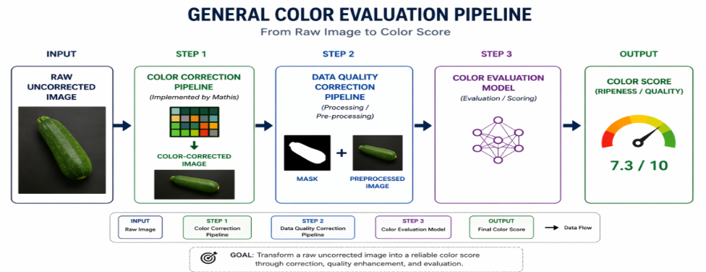
General Pipeline
Specular Highlights
Netting & Textures
Dirt & Disease
Dark ROI Edges

Slide 12
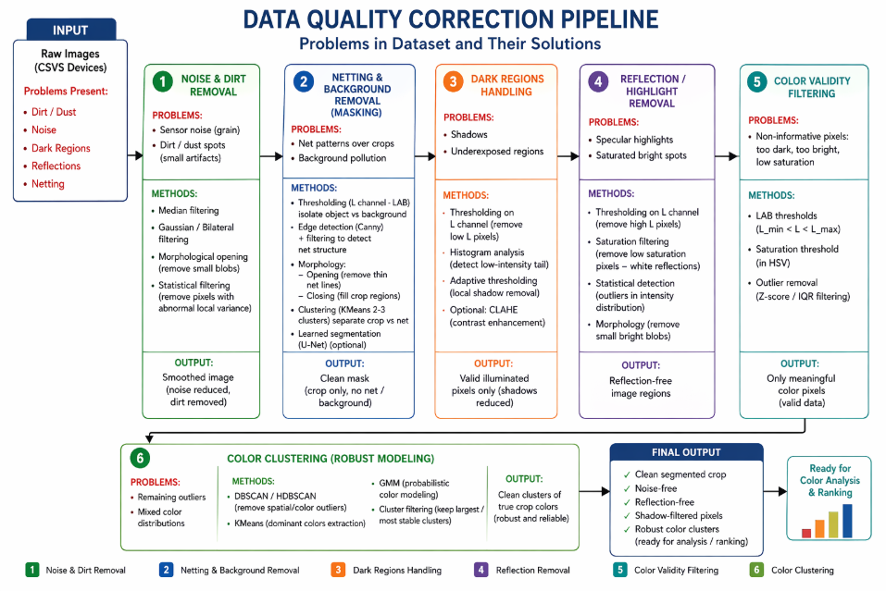
Data Quality Correction Pipeline
Specular Highlights
Netting & Textures
Dirt & Disease
Dark ROI Edges

Slide 13
Key Image Quality Issues
Second Best Method
Best method
OBSERVED IMAGE QUALITY ISSUES BY CROP
Specular Highlights
Netting & Textures
Dirt & Disease
Dark ROI Edges
Pepper & zucchini waxy surfaces under LED → saturated pixels
Packaging net on zucchini, fine ridges on pepper
Soil, fungal spots, bruising across all crops
Black background bleeds into outer ring of circular crop
L High Threshold
Saturation Filter
Statistical Outlier (Z-score)
Morph Blob Removal
Statistical Filter
Clustering
Morph Closing
Inpaint (TELEA)
Black-Hat Fill
Bilateral Chain
Statistical Filter
Median Residual
Gaussian Residual
Bilateral Residual
Morph Residual
Local Z-score
Statistical Filter
LAB Threshold
Morphology (Otsu+LCC)
KMeans (k=3)
GrabCut
Statistical Filter
Chose the best methods based on the visual output
Used metrics PSNR , SSIM , Delta E and std

Slide 14
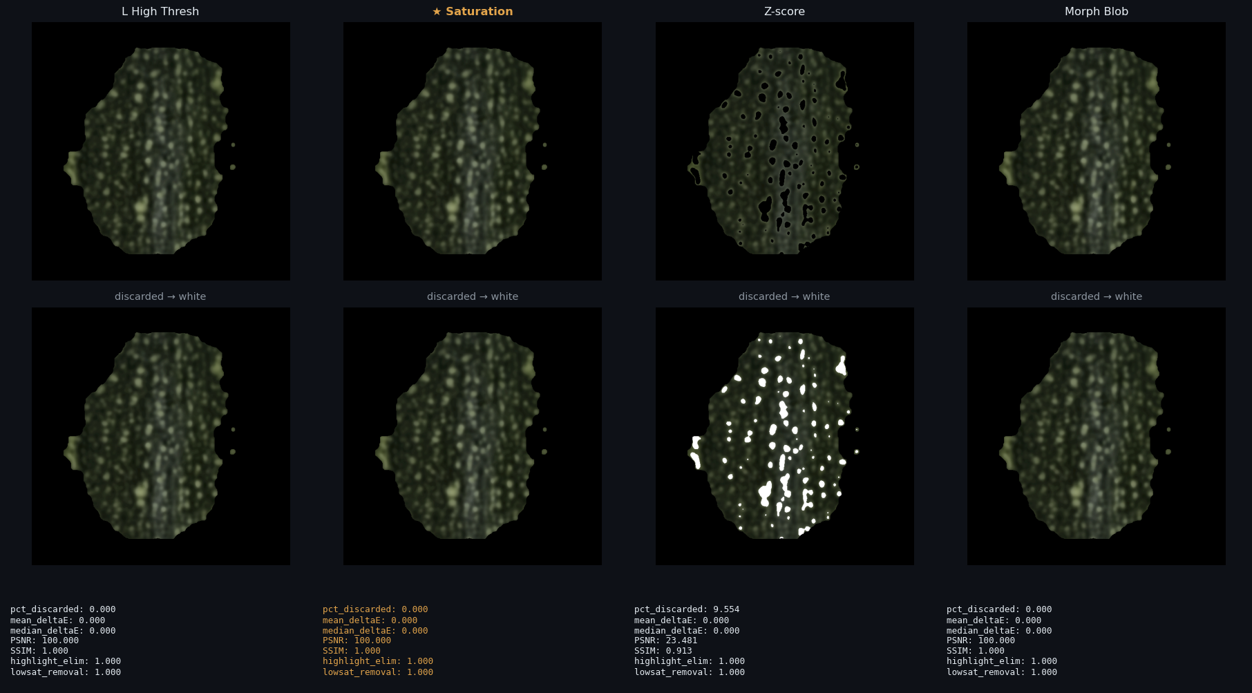
Key Image Quality Issues
Specular Highlights
Pepper & zucchini waxy surfaces under LED → saturated pixels
L High Threshold
Saturation Filter
Statistical Outlier (Z-score)
Morph Blob Removal
Statistical Filter
Clustering

Slide 15
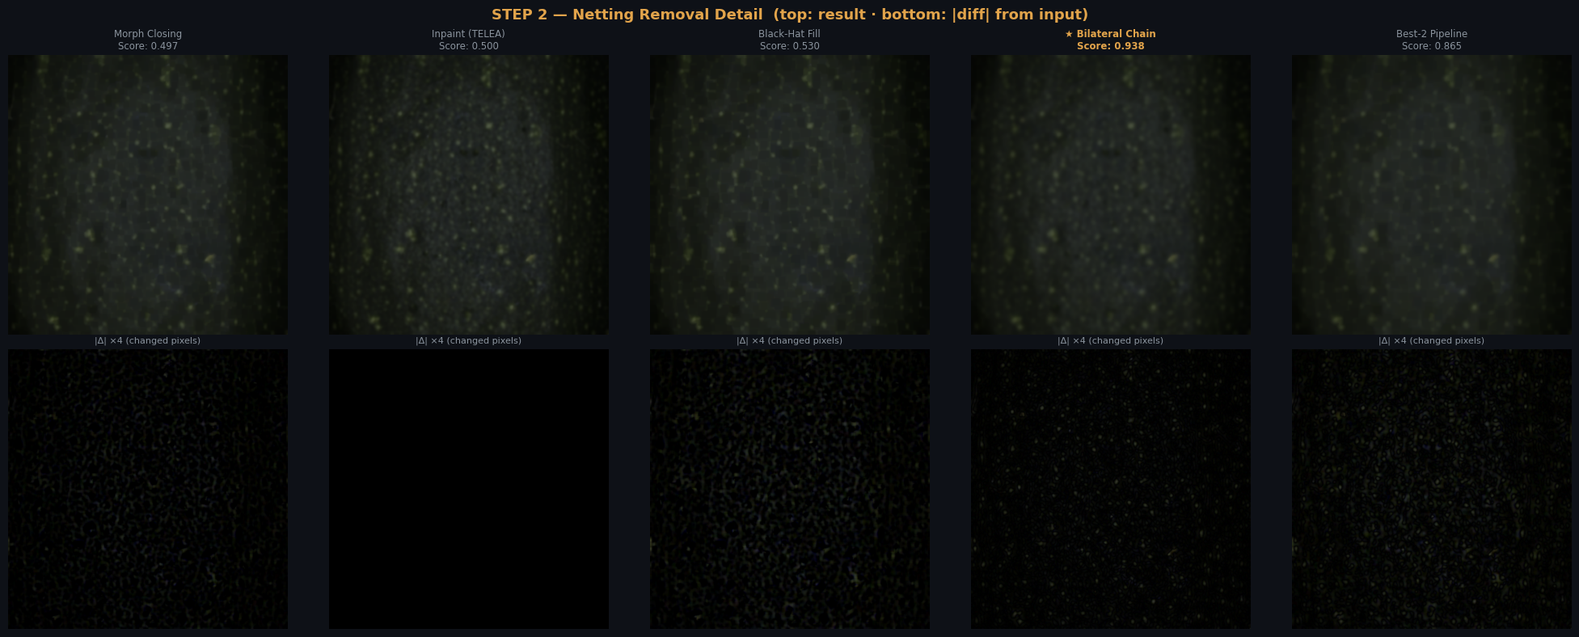
Key Image Quality Issues
Netting & Textures
Packaging net on zucchini, fine ridges on pepper
Morph Closing
Inpaint (TELEA)
Black-Hat Fill
Bilateral Chain
Statistical Filter

Slide 16
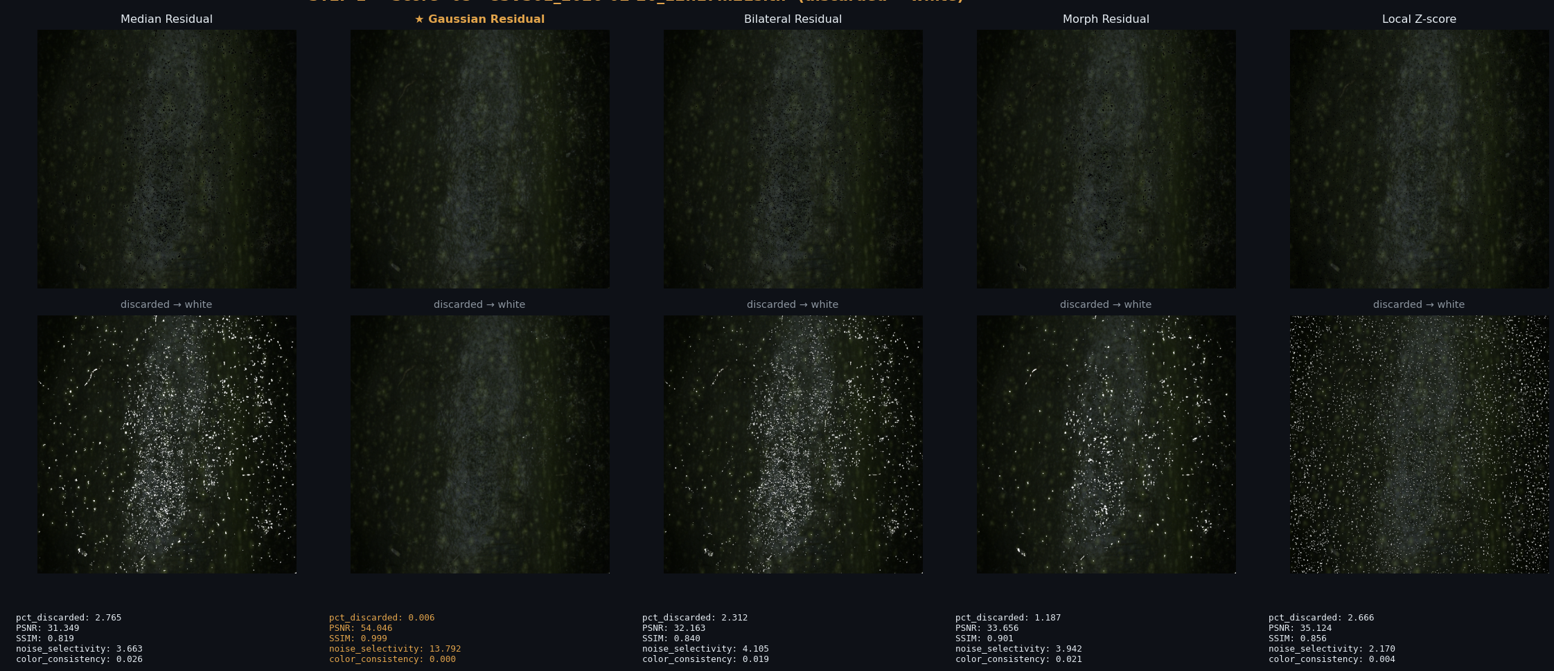
Key Image Quality Issues
Dirt & Disease
Soil, fungal spots, bruising across all crops
Dark ROI Edges
Median Residual
Gaussian Residual
Bilateral Residual
Morph Residual
Local Z-score
Statistical Filter

Slide 17
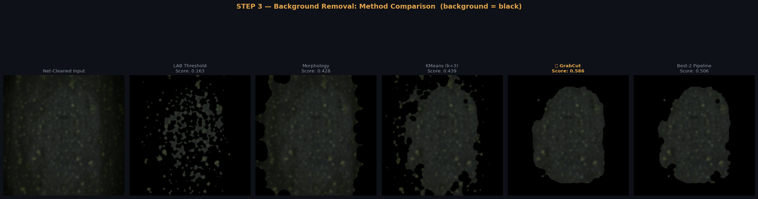
Key Image Quality Issues
Dark ROI Edges
Black background bleeds into outer ring of circular crop
Dirt & Disease
LAB Threshold
Morphology (Otsu+LCC)
KMeans (k=3)
GrabCut
Statistical Filter

Slide 18
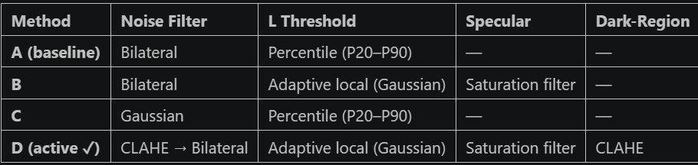
Pixel Filtering
Method A & B & C & D Comparaison

Slide 19
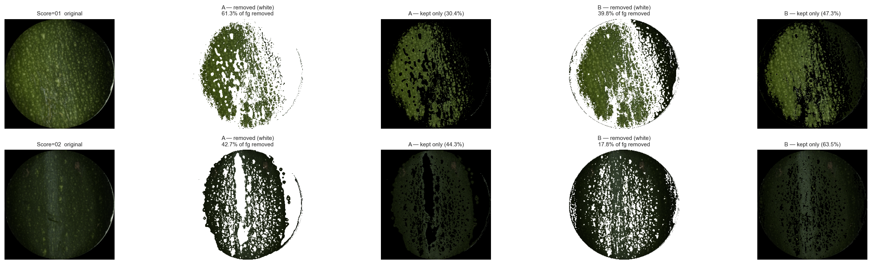
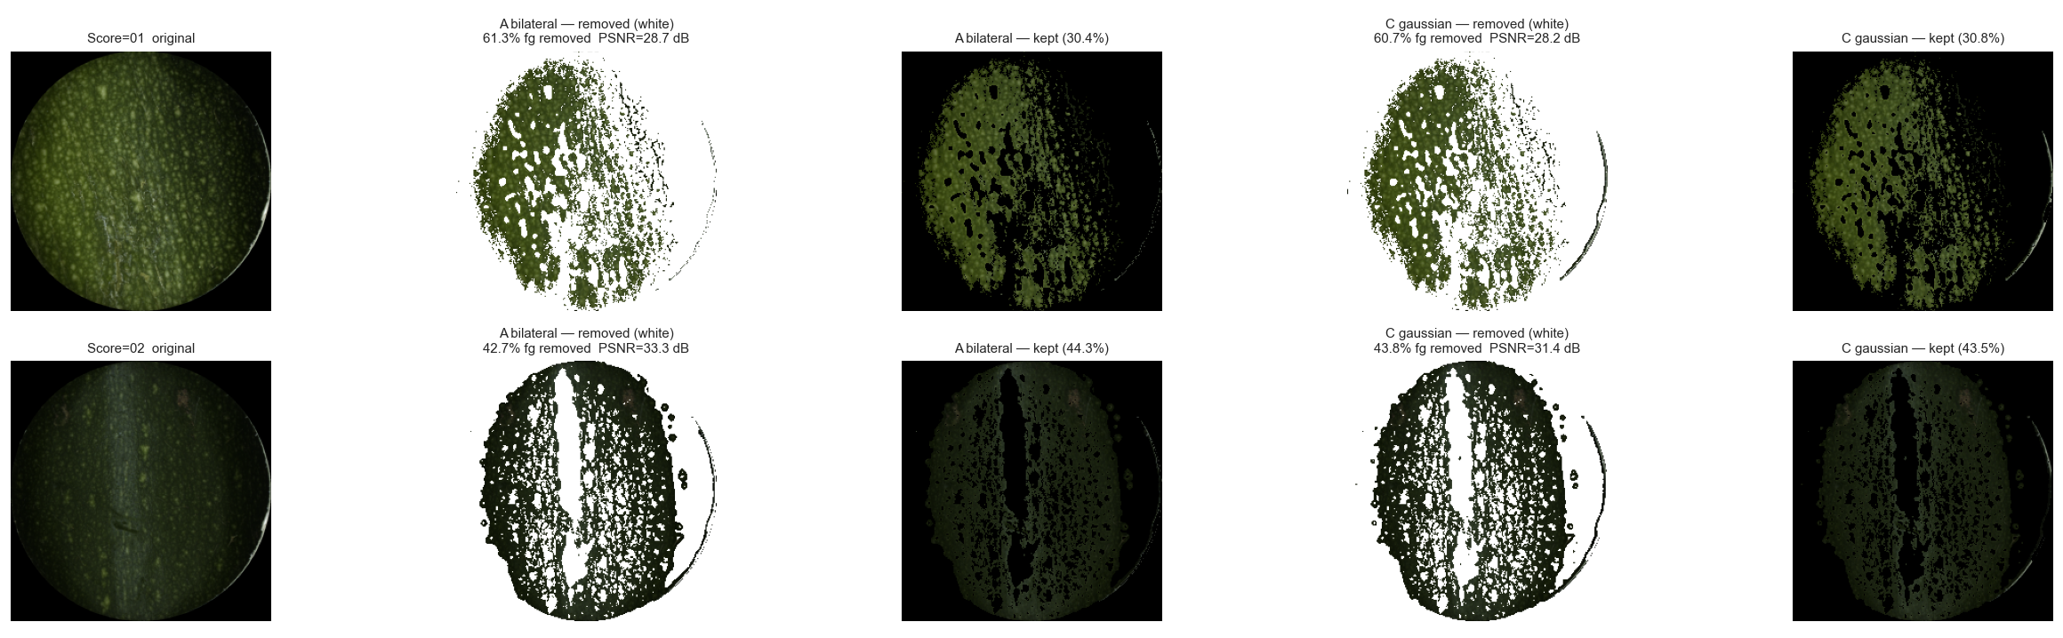
Pixel Filtering
Method A & B Comparaison
Method A & C Comparaison

Slide 20
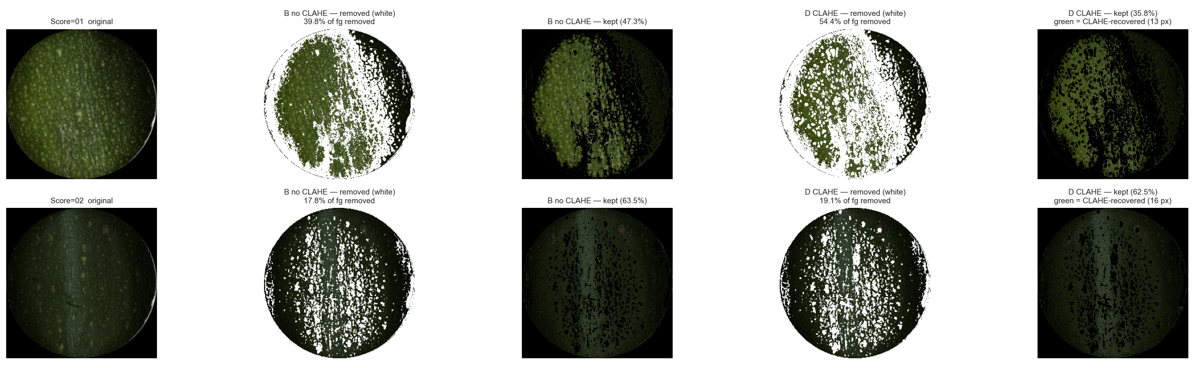
Method B & D Comparaison

Slide 21
05 · Clustering Methods
K-Means, GMM, HDBSCAN
artefact removal

Slide 22
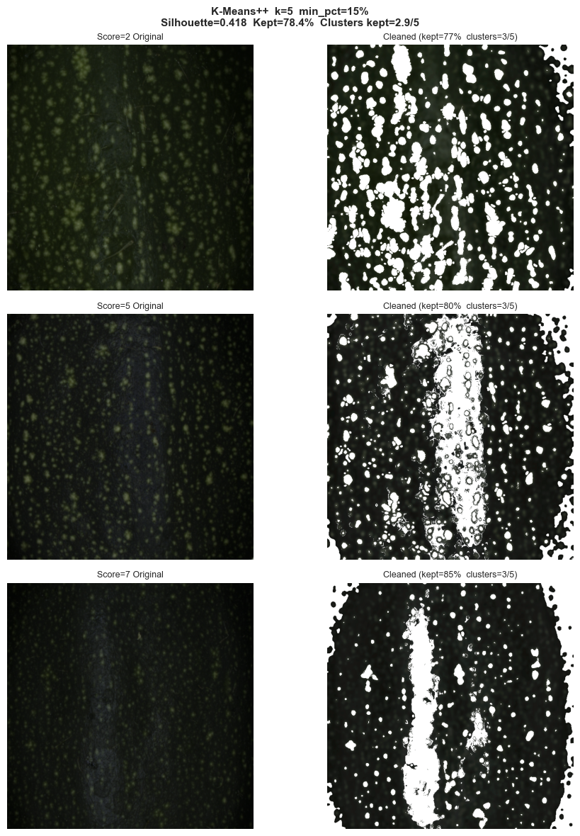
K means clustering

Slide 23
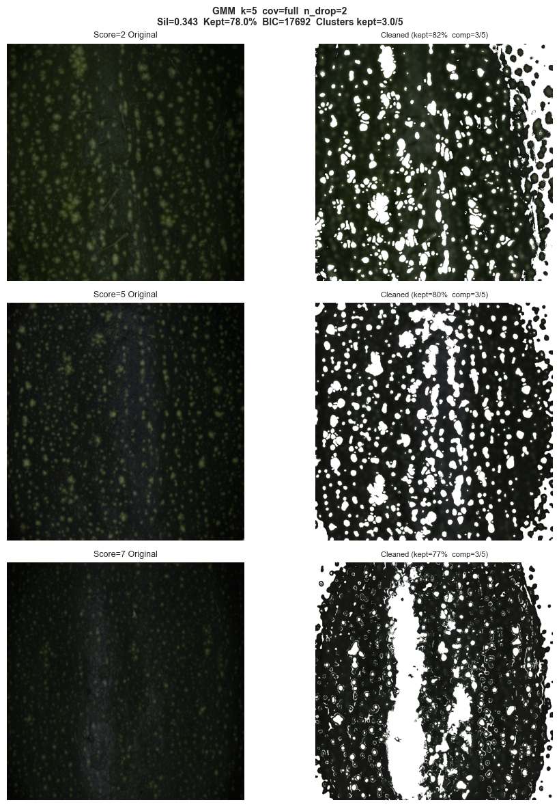
GMM clustering

Slide 24
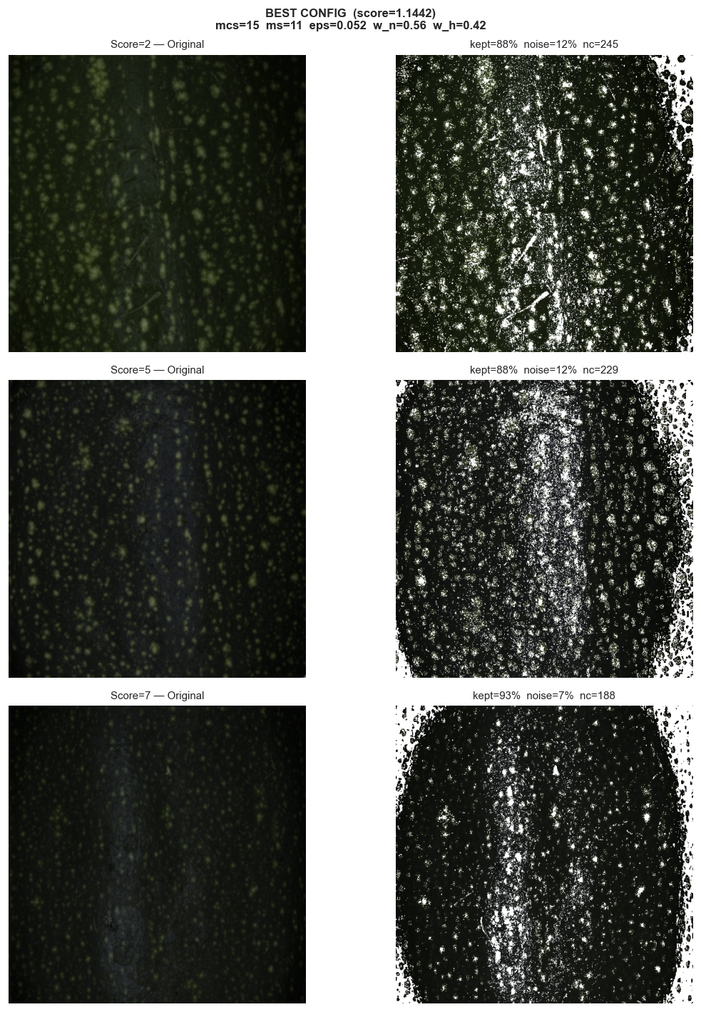
HDBSCAN clustering

Slide 25
Output Examples using statistical filtering method
Compute mean and std then keep pixels in the interval
[Mean –1.5*std , Mean +1.5*std]
Dirt & Disease

Slide 26
04 · Proposed Approaches
Four complementary pipelines :
from interpretable statistics to cross-device normalisation

Slide 27
Proposed Pipelines (Overview)
All four approaches are complementary
Robust Statistical Color
filtering
Artefact-Aware
CNN + Attention
CCM → CIE Lab → 3-layer artefact mask
→ median/IQR → RF / ΔE2000 ranker
Soft masking → CBAM spatial attention
Grad-CAM verify
A
B
Best for: Deep learning eval
Cross-Device
Normalisation
Hybrid Method
CSVS +cc+ ref → SCORE target
→ histogram matching or poly mapping
Clustering masking → feature extraction
→ CNN branch → late fusion → rank head
C
D

Slide 28
Statistical Rankers
Four Strategies Compared
All operate on 7 colour features: L_mean, L_std, L_h0–h3, Chroma
v1
Multi-level Otsu Thresholding
v2
Random Forest / Gaussian NB
7 cut-points on Chroma
minimises within-class variance
7-feature joint classifier
Gini importance per feature
✓ Strengths
✗ Weakness
✓ Strengths
✗ Weakness
Fastest · fully explainable
one-sentence decision rule
1D only · classes 3&4 inseparable
Multi-feature voting
handles non-monotone features
Centroids only · double-counts corr.
v3
ΔE₂₀₀₀ Nearest Prototype
v4
Fuzzy C-Means Membership
Perceptual distance to
class prototype in Lab space
Continuous membership
Fuzziness m=2 standard
✓ Strengths
✗ Weakness
✓ Strengths
✗ Weakness
Physically grounded
ΔE<1.0 = imperceptible
3 features only (L*,a*,b*)
Honest uncertainty output
entropy detects ambiguity
Not a single score for end user

Slide 29
04 · CNN Models ( V3 to Ult )
Evolution of the zucchini colour ranking model across 7 architectures

Slide 30
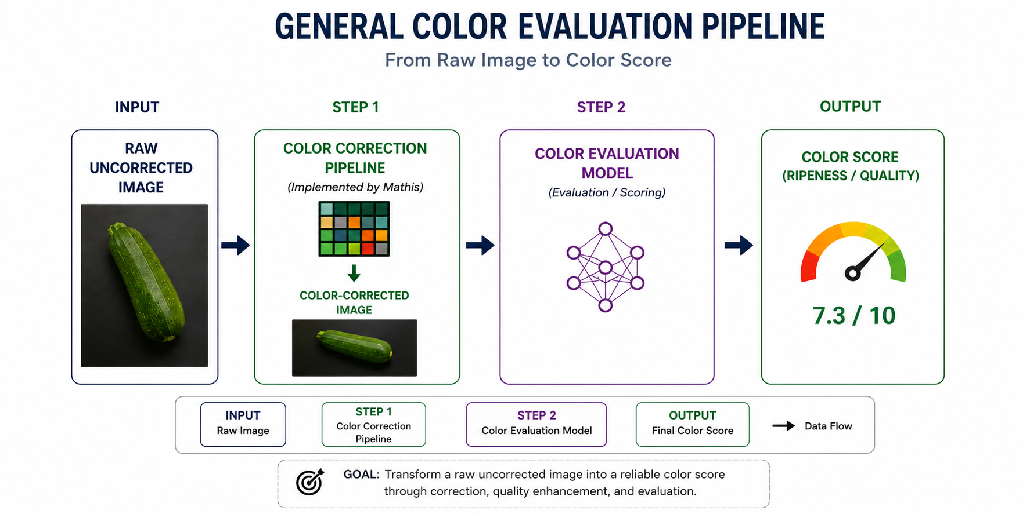
General Pipeline
Specular Highlights
Netting & Textures
Dirt & Disease
Dark ROI Edges

Slide 31
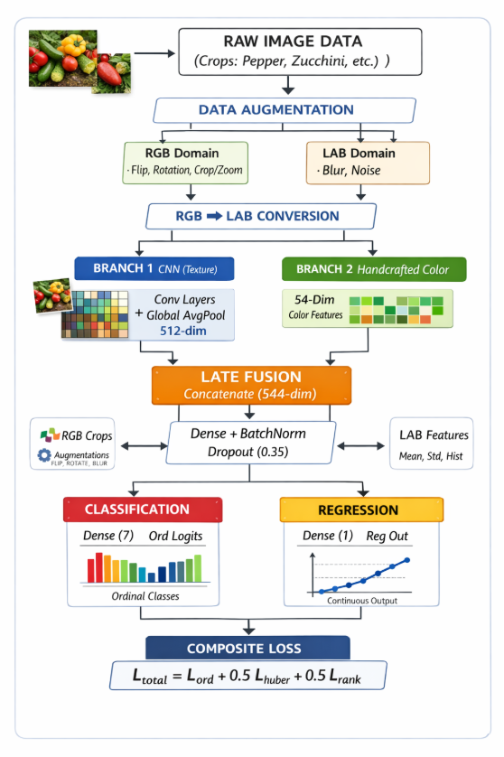
General Pipeline
Specular Highlights
Netting & Textures
Dirt & Disease
Dark ROI Edges

Slide 32
CNN Model Evolution Architecture Comparison
From pure MSE regression (Mathis) → dual-head ordinal+regression
Model
Input
Architecture
Head / Loss
Augmentation
Key change
260305
(Mathis)
64×64 RGB
6 dbl blocks
MaxPool
Pure Regression
MSE loss
H/V Flip
90° Rot
Baseline
V3 / V3.1
64×64 RGB
ResNet stem
4 res. blocks
8-class Softmax
Focal Loss
Flip/Rot/Zoom
Brightness
ResNet + classification
V4 / V4.1/V4u
64-256
CIELAB
7 single blks
GAP + late fusion
Dual Head
Ord+Reg / L_ord+L_hub+L_rank
Flip/Rot/Zoom
LAB blur+noise
CIELAB + 54-dim LAB features
Ult-256
Ult-128
128–256
CIELAB
6–7 dbl blks
GAP + late fusion
Dual Head
Ord+Reg / L_ord+L_hub+L_rank
Flip/Rot/Zoom
LAB blur+noise
Deeper + 2 dense layers

Slide 33
CNN Training Results Performance Metrics
Zucchini dataset · inference on +cc+ ROIs · 1704 train / 426 test images
99.85%
0.989
0.058
0.928
Within-1 Acc
(V4-v3, 256px)
Spearman ρ
(V4u zucchini)
MAE
(V4u best model)
Kendall τ
(V4u best model)
Model
MAE↓
RMSE↓
Spearman ρ↑
Kendall τ↑
Within-1↑
Gap=1↑
Note
ZucchiniRanker
Ultimate
0.349
0.455
0.986
0.918
97.78%
97.90%
Early dual-head
baseline
ZucchiniCNN
V4 (64)
0.168
0.255
0.986
0.921
99.56%
98.50%
64px CIELAB
ZucchiniCNN
V4u (256)
0.058
0.148
0.989
0.928
99.85%
99.80%
BEST MODEL
V4.1 (64)
0.168
0.255
0.986
0.921
99.56%
98.50%
64px faster

Slide 34
06 · Pipeline
11-Step Hybrid
Colour features + CNN fusion for ordinal colour ranking

Slide 35
Pipeline 11-Step Implementation
01
Load & Visualise
07
Feature Extraction
uint16 TIFF→uint8 RGB+LAB histograms
24-dim: mean/med/std and percentiles ΔE spread
02
Convert to CIELAB
08
CNN Feature Extract.
RGB→LAB D65 L*∈[0,100] a*,b*∈[−128,127]
V4u 128-dim embedding FC1 bottleneck layer
03
Robust Pixel Filtering
09
Feature Fusion
4 variants A/B/C/D Bilateral+CLAHE+Adapt
128-dim CNN + 24-dim stats = 152-dim vec
04
K-Means Compression
10
Prediction Head
K=5 colour palette Top-3 clusters kept
Ridge regr. 5-fold CV MLP + ranking loss
05
HDBSCAN Noise Removal
11
Final Visualisation
Density-based outliers Label −1 discarded
Scatter, boxplots Per-class error grid
06
GMM Refinement
Soft cluster (5 comp.) full covariance

Slide 36
09 · Results & Next Steps
Key findings, action plan and phased execution order

Slide 37
Key Results at a Glance
Best model: ZucchiniCNN V4-v3 (256px CIELAB) · Training: 1704 images · Test: 426 images
99.85%
0.989
0.756
ΔE<3
Within-1 Acc
(V4-v3 256px)
Spearman ρ
(V4-v3)
Spearman ρ
(Clustering K8)
Target CCM
quality (checker)
Dual-head > Classification > MSE
Composite loss (L_ord + L_huber + L_rank) + ordinal+regression dual head outperforms both Focal Loss classification and MSE regression at all input resolutions.
256×256 CIELAB beats 64×64 RGB
Higher resolution in perceptual colour space consistently improves all metrics. 64×64 RGB compresses 90% of spatial information before training begins.
Clustering: good mask, poor ranking
K-Means + HDBSCAN effectively remove specular/dark pixels but fail on white/yellow inner flesh. Stage-2 ranking (Spearman 0.756) significantly underperforms CNN (0.989).
Classes 3 & 4 are structurally ambiguous
Euclidean distance between class 3 and 4 centroids ≈ 0.07 (7-D normalised space) ten times smaller than typical inter-class gap. Requires more samples or class merge.

Slide 38
Recommended Execution Order
Next Steps
Three phases : short, medium, and long term with concrete deliverables
PHASE 1
Implement Grad-CAM on existing CNN → test attention hypothesis on specular regions
Short-term
Apply Pipeline A (robust Lab stats) on +cc+ pepper TIFFs → compare vs CNN scores via ΔE2000
Validate CCM quality: ΔE2000 < 3 on checker patches across all crops
PHASE 2
If Grad-CAM rejects hypothesis → implement Pipeline B with CBAM + CORN ordinal loss
Medium-term
Refine clustering white/yellow mask thresholds (CLAHE + adaptive chroma threshold)
Extend CNN training to pepper and lettuce datasets with per-crop calibration
PHASE 3
Acquire paired CSVS + SCOR images on same day → build cross-device paired dataset
Long-term
Implement Pipeline C (histogram matching → target ΔE2000 < 3 on paired samples)
Add acquisition metadata logging: date, operator, calibration file hash, lighting check

Slide 39
Thank You
CSVS Color Evaluation Pipeline · Internship Progress Report 2025
VISART Team · Limagrain Vegetable Seeds

