Slide 1
Dataset | Acc | Acc1 | R² | RMSE
nocc | 58.14 | 97.67 | 0.9082 | 0.6508
K=0.5 | 46.51 | 95.35 | 0.9005 | 0.6775
K=1.0 | 53.49 | 97.67 | 0.9094 | 0.6466
K=1.5 | 46.51 | 95.35 | 0.9028 | 0.6696
K=2.0 | 58.14 | 97.67 | 0.9129 | 0.6340
K=3.0 | 60.47 | 95.35 | 0.9095 | 0.6463
zscore | 53.49 | 97.67 | 0.9055 | 0.6603
Metric | Best Dataset | Value
Acc0_pct | K=3.0 | 60.47
Acc1_pct | Nocc , k=1.0 / 2.0 , zscore | 97.67
R² | K=2.0 | 0.9129
RMSE | K=2.0 | 0.6340

Slide 2
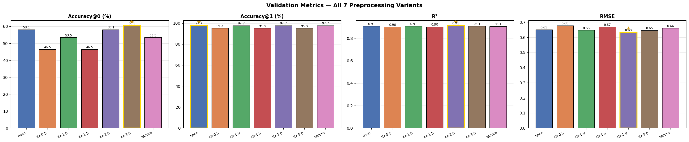
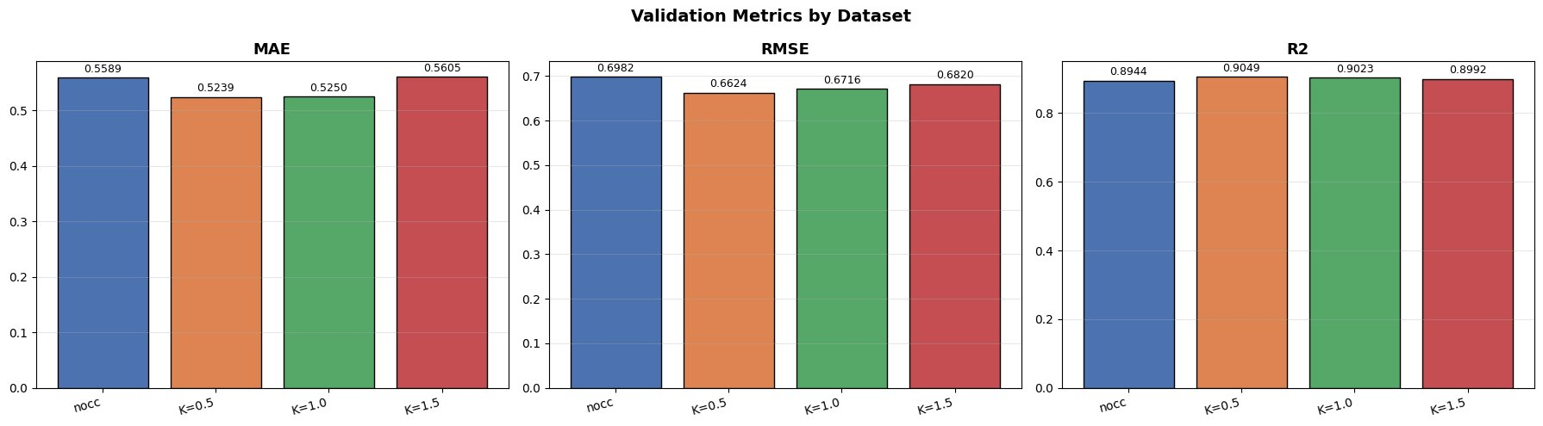

Slide 3
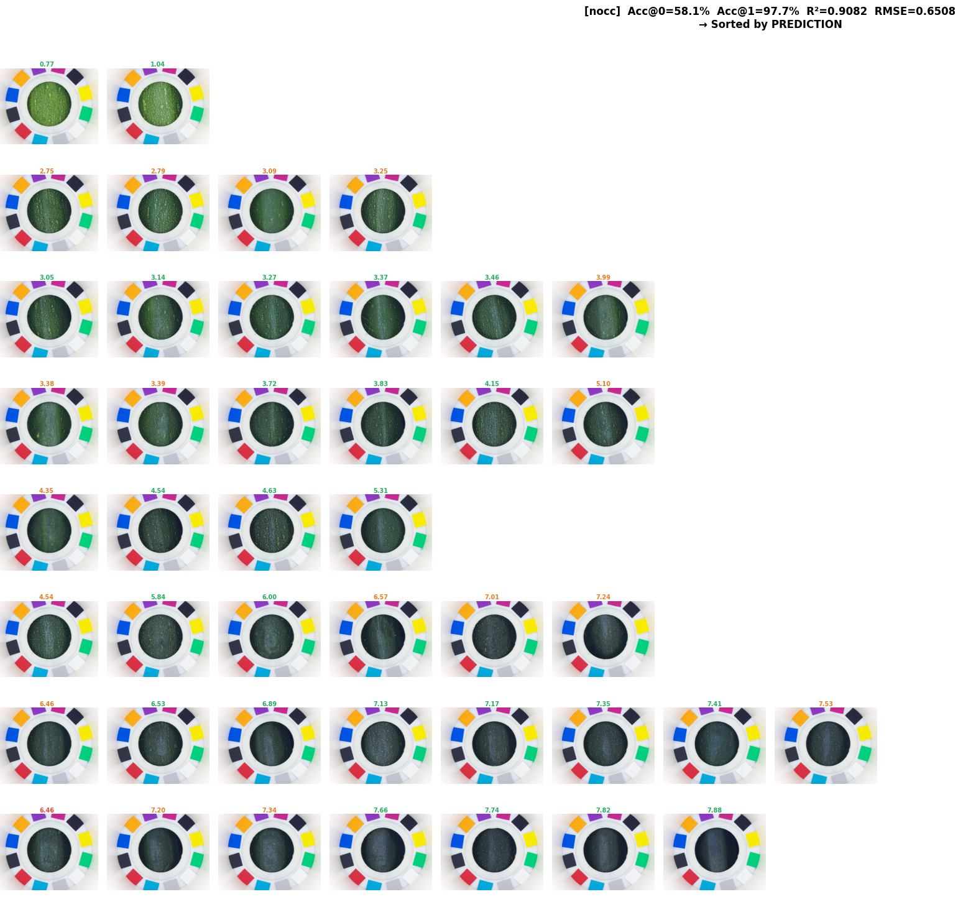

Predictions
Annotations

Slide 4
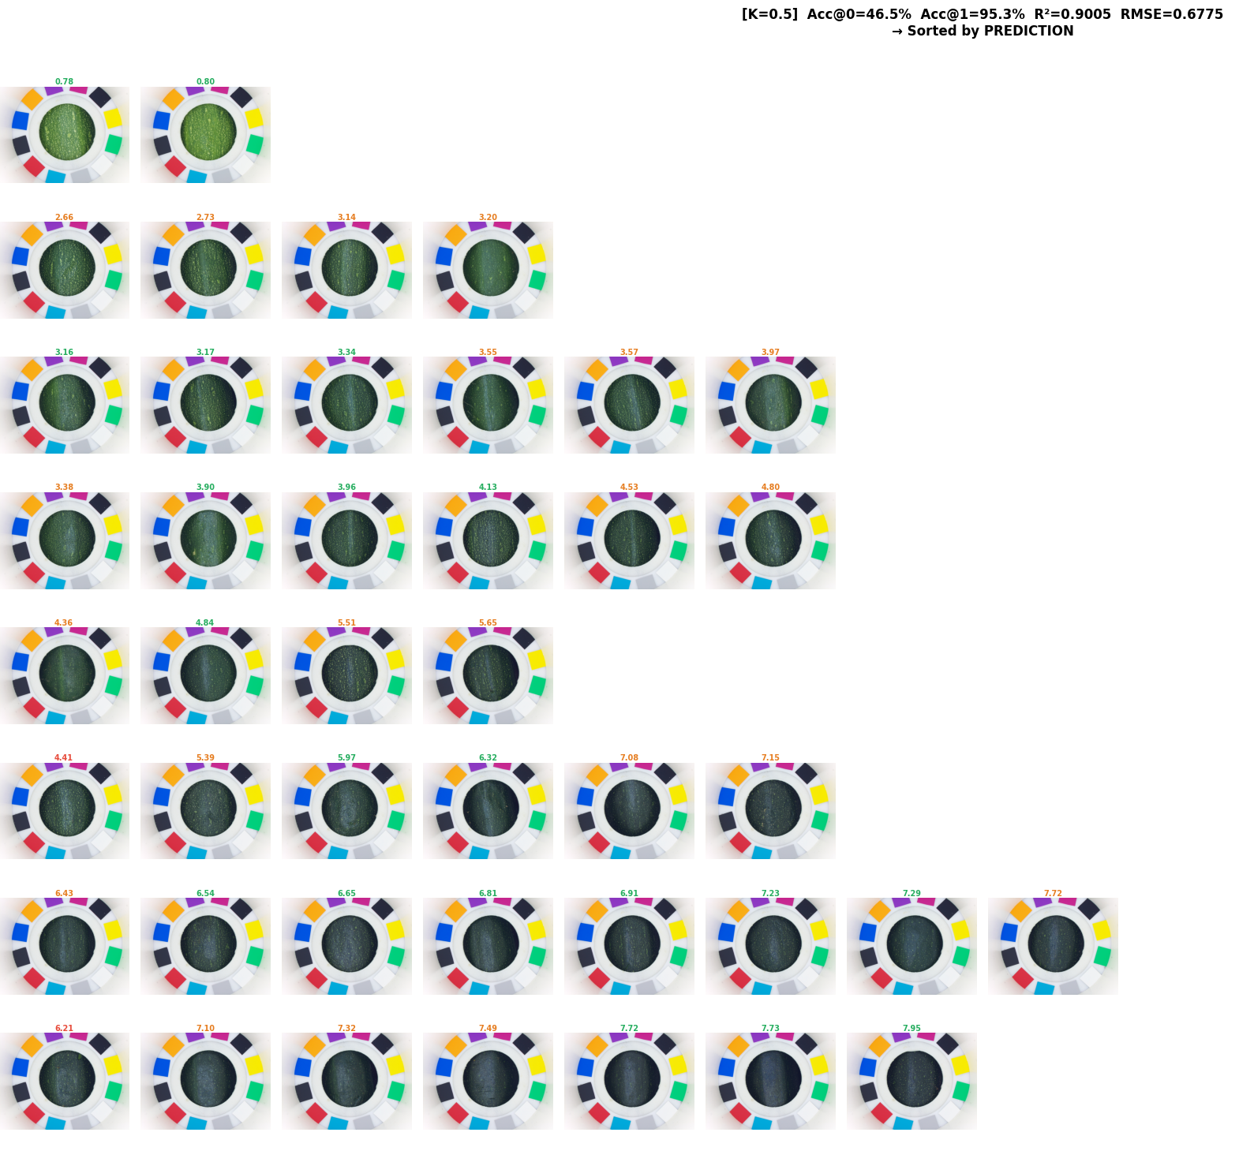
Predictions​
Annotations

Slide 5

Predictions​
Annotations

Slide 6

Predictions​
Annotations

Slide 7

Predictions​
Annotations

Slide 8

Predictions​
Annotations

Slide 9
Aspect | SVM | Random Forest | KNN | XGBoost
Model Type | Margin-based classifier | Ensemble of decision trees | Instance-based learner | Gradient-boosted trees
Linearity | Linear or Non-linear (kernel) | Non-linear | Non-linear | Non-linear
Training Speed | Medium-Slow | Fast-Medium | Very Fast | Medium-Slow
Inference Speed | Fast | Fast | Slow | Fast
Memory Usage | Medium | High | Very High | Medium
Feature Scaling | Yes | No | Yes | No
High Dimensions | Excellent | Good | Poor | Good
Small Datasets | Excellent | Good | Good | Can overfit
Large Datasets | Moderate | Good | Poor | Excellent
Interpretability | Low | Medium-High | High | Medium
Robust to Noise | Good | Very Good | Poor | Very Good

Slide 10
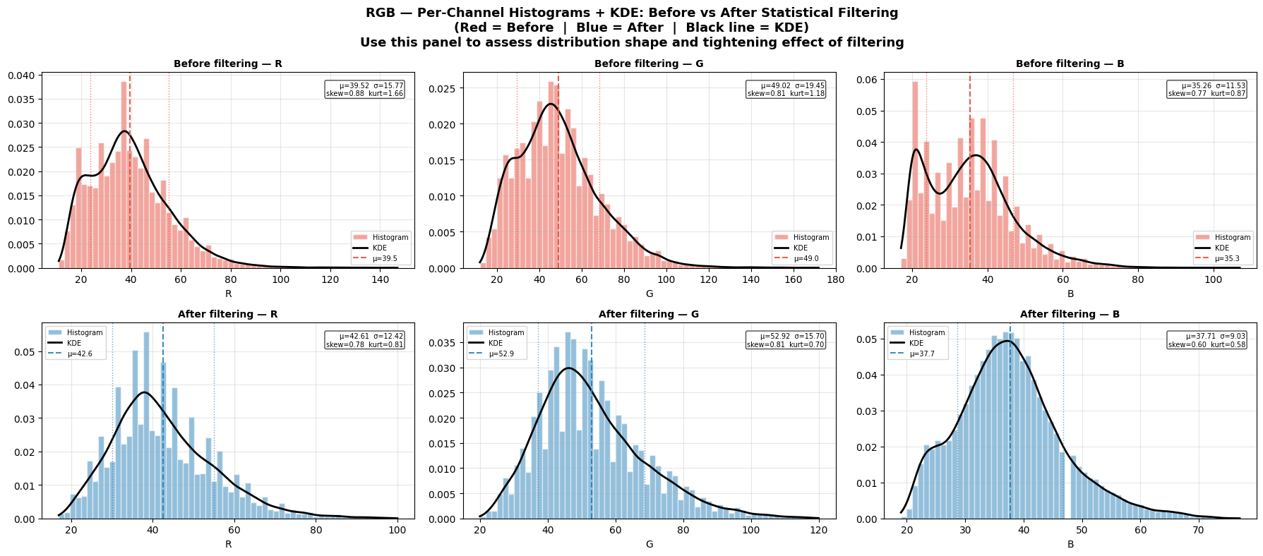

Slide 11
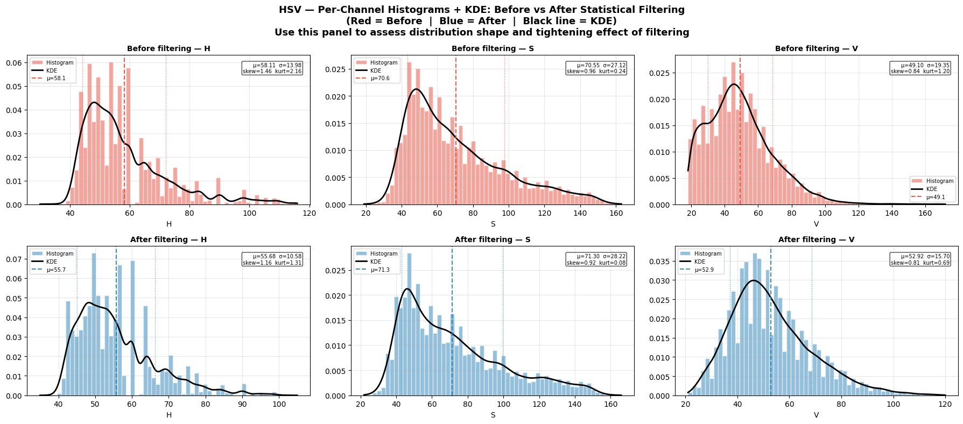

Slide 12
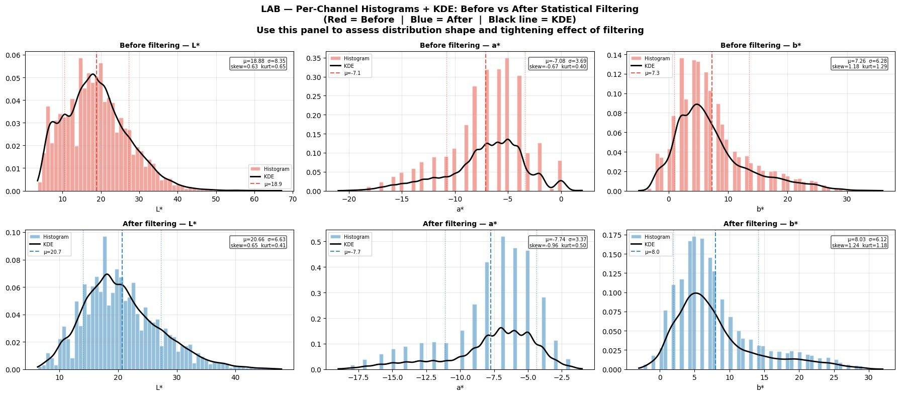

Slide 13
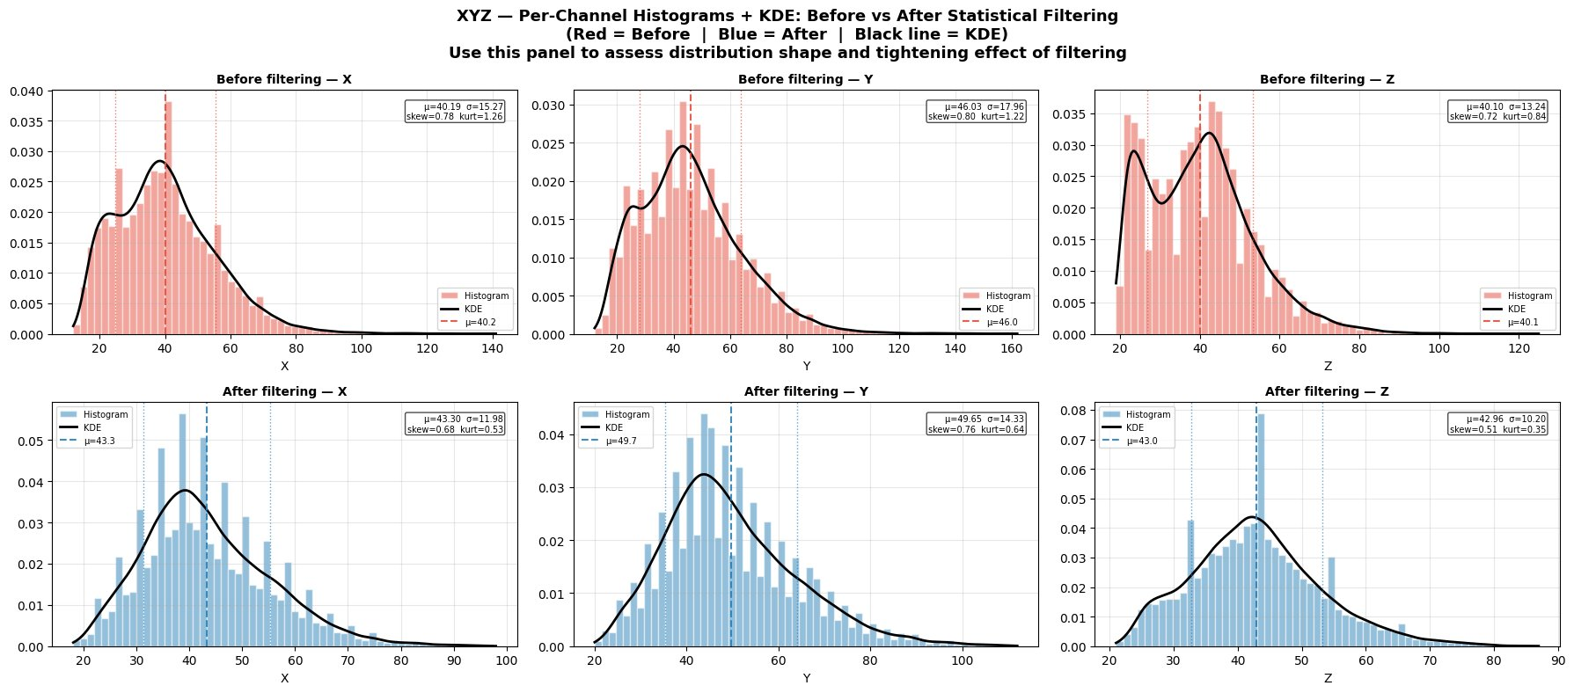

Slide 14
Color Space | Model (benchmark) | R² | RMSE | MAE | Spearman ρ
LAB | XGBoost | 0.845 | 0.845 | 0.661 | 0.9235
HSV | XGBoost | 0.854 | 0.820 | 0.647 | 0.9099
XYZ | XGBoost | 0.803 | 0.953 | 0.728 | 0.8930
RGB | XGBoost | 0.807 | 0.944 | 0.731 | 0.8896
Filtering Method | Accuracy | MAE | RMSE | R² | Spearman ρ
No Filter | 44.2% | 0.634 | 0.851 | 0.843 | 0.9149
Statistical (K=1.5σ) | 30.2% | 0.769 | 0.981 | 0.791 | 0.8680
Z-score (z< 2) | 27.9% | 0.803 | 1.016 | 0.776 | 0.8458

Slide 15
Channel | Spearman ρ | Kendall τ | Pearson r
XYZ X | -0.8075 | -0.6469 | -0.7894
XYZ Y | -0.8476 | -0.6921 | -0.8145
XYZ Z | -0.4763 | -0.3515 | -0.4927
LAB L* | -0.8496 | -0.6951 | -0.8211
LAB a* | 0.9352 | 0.8094 | 0.9023
LAB b* | -0.9312 | -0.8010 | -0.8680
 | L* | a* | b*
XYZ X | 0.9971 | -0.9190 | 0.9106
XYZ Y | 0.9998 | -0.9437 | 0.9373
XYZ Z | 0.7898 | -0.5662 | 0.5286
Model | R² | RMSE | Spearman ρ
XYZ alone | 0.7334 | 1.109 | 0.8753
RGB+HSV+LAB (no XYZ) | 0.8065 | 0.945 | 0.8935
All CS (incl. XYZ) | 0.8444 | — | —
XYZ incremental gain (R²) | +0.0378 | — | —

Slide 16
Interpretation
Although XYZ channels exhibit very high correlations with LAB channels, particularly X/L* (r=0.9971) and Y/L* (r=0.9998), the inclusion of XYZ features improved Random Forest performance from R²=0.8065 to R²=0.8444. This indicates that XYZ provides complementary information that can be exploited by nonlinear tree-based models despite its apparent redundancy with LAB. Therefore, feature redundancy alone should not be used as a criterion for feature removal, and XYZ features were retained for subsequent experiments.

Slide 17
Method | Original Features | Reduced Components | Variance Explained
PCA (95% variance) | 288 | 49 | 95.03%
Feature Selection | 288 | 49 (top RF) | —
XGB-A (All CS)
Method | R² | RMSE | Spearman ρ
Baseline (full pipeline) | 0.8516 | 0.827 | 0.9128
PCA (95% variance) | 0.7407 | 1.094 | 0.9007
Feature Selection (top-49) | 0.8374 | 0.866 | 0.9153
RF-B (All CS)
Method | R² | RMSE | Spearman ρ
Baseline (full pipeline) | 0.8429 | 0.851 | 0.9246
PCA (95% variance) | 0.5276 | 1.476 | 0.8715
Feature Selection (top-49) | 0.8486 | 0.836 | 0.9272 ⭐

Slide 18
Each model was trained with a scientifically motivated feature pipeline:
SVM-A (LAB + HSV-S texture + StandardScaler): RBF kernel benefits from perceptually uniform LAB distances; HSV-S adds saturation signal.
SVM-B (LAB only): baseline to quantify HSV-S contribution.
RF-A (HSV + LAB, no scaling): scale-invariant; avoids XYZ/RGB collinearity.
RF-B (All 4 CS): tests whether broader features help random forest.
XGB-A (All CS combined): broadest feature set with strong regularisation.
XGB-B (LAB only): LAB baseline for XGBoost.
NB: Primary metrics: R² and RMSE (regression evaluation).
All channels (including LAB-b*, HSV-V) were retained unless feature importance analysis (Step 11) showed sum importance < 0.005 across both RF and XGBoost. Channels marked CANDIDATE in Step 11 are documented for future removal experiments.

Slide 19
Pipeline | Feature Set | Color Space | R² | RMSE | MAE | Spearman ρ | Acc@1
XGB-A (All CS) | All 4 CS combined | RGB+HSV+LAB+XYZ | 0.8523 | 0.826 | 0.675 | 0.9132 | 88.4%
RF-B (All CS) | All 4 CS combined | RGB+HSV+LAB+XYZ | 0.8444 | 0.847 | 0.695 | 0.9221 | 93.0%
XGB-B (LAB only) | LAB only | LAB | 0.8422 | 0.853 | 0.709 | 0.9183 | 88.4%
SVM-A (LAB+HSV-S+texture) | LAB + HSV-S + texture | LAB+HSV | 0.8378 | 0.865 | 0.727 | 0.9207 | 93.0%
RF-A (HSV+LAB) | HSV + LAB | HSV+LAB | 0.8285 | 0.890 | 0.735 | 0.9232 | 88.4%
SVM-B (LAB only) | LAB only | LAB | 0.7877 | 0.990 | 0.838 | 0.9084 | 93.0%

Slide 20
conclusion
Gaussianity analysis was performed on RGB, HSV, LAB, and XYZ color channels before and after score-based filtering using Shapiro–Wilk and D'Agostino normality tests. All channels exhibited statistically significant departures from normality (p < 0.05) both before and after filtering. Filtering reduced channel variance in most cases, indicating noise reduction and a more compact distribution, but did not substantially improve Gaussianity. Channels such as HSV-S and LAB-b remained strongly positively skewed with heavy tails, while HSV-H exhibited near-zero skewness but a highly platykurtic distribution.
Since the final models (Random Forest and XGBoost) are tree-based and do not assume normally distributed inputs, the observed non-Gaussianity does not represent a limitation for downstream modeling.

