Slide 1
Automated Color Evaluation for Vegetable Crops
CSVS Pipeline Results
Pepper · Zucchini · Lettuce

Slide 2
Presentation Overview
01
Project Context & Objectives
02
Zucchini Results
03
Pepper Results
04
Lettuce Results
05
Perspective

Slide 3
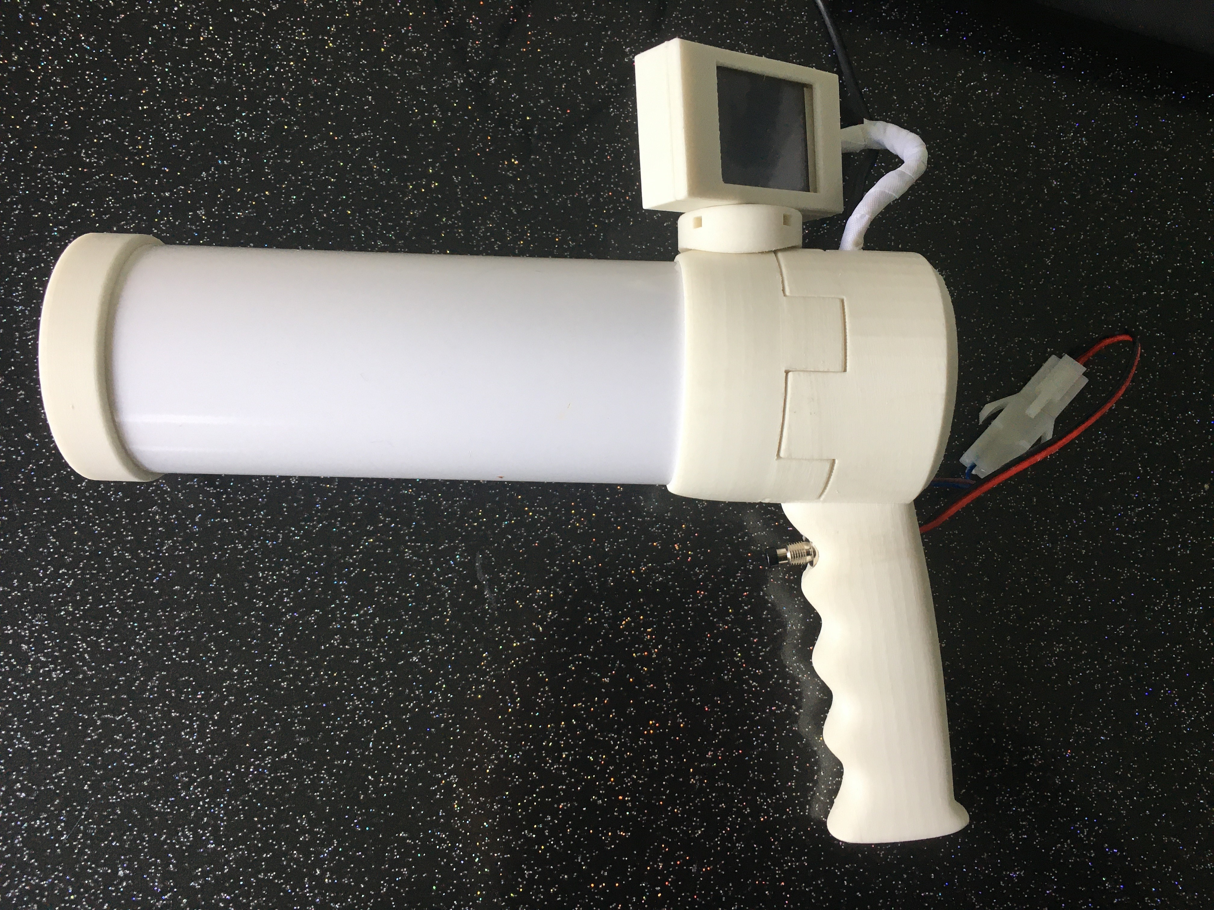
Project Context & Objectives

Slide 4




The CSVS: Data aquisition tool built for the field
CONTEXT
A portable device combining fixed LED lighting with a built-incolour calibration checker designed to measure vegetable color reliably, even outside a laboratory.
The problem: a vegetable photographed outdoors looks different depending on the lighting or the context none which reflects its real color.
The solution: the CSVS chamber removes ambient light entirely,so every measurement is precise in every scenario
Portable
Quasi-controlled
Colour correction
Affordable
Usable directly in the field, greenhouse, or portakabin
Fixed lighting removes dependence on weather or time of day
Built-in checker calibrates every acquisition session
A lightweight alternative to a full laboratory acquisition chain

Slide 5







The pipeline : From field capture to colour score
CONTEXT
Goal : replace manual visual assessment with an automatic, reliable, and reproducible colour measurement.
Acquisition
Colour
correction
Image
cleaning
Colour
evaluation
Three evaluation approaches compared
Statistical / classical ML
Deep learning (CNN)
Unsupervised
Colour descriptors + simple models (trees, regression)
Neural network trained directly on images
Automatic grouping by similarity ( no note needed)

Slide 6
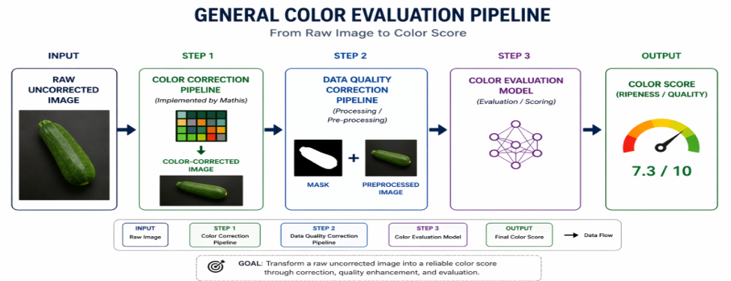
General Pipeline
Specular Highlights
Netting & Textures
Dirt & Disease
Dark ROI Edges

Slide 7
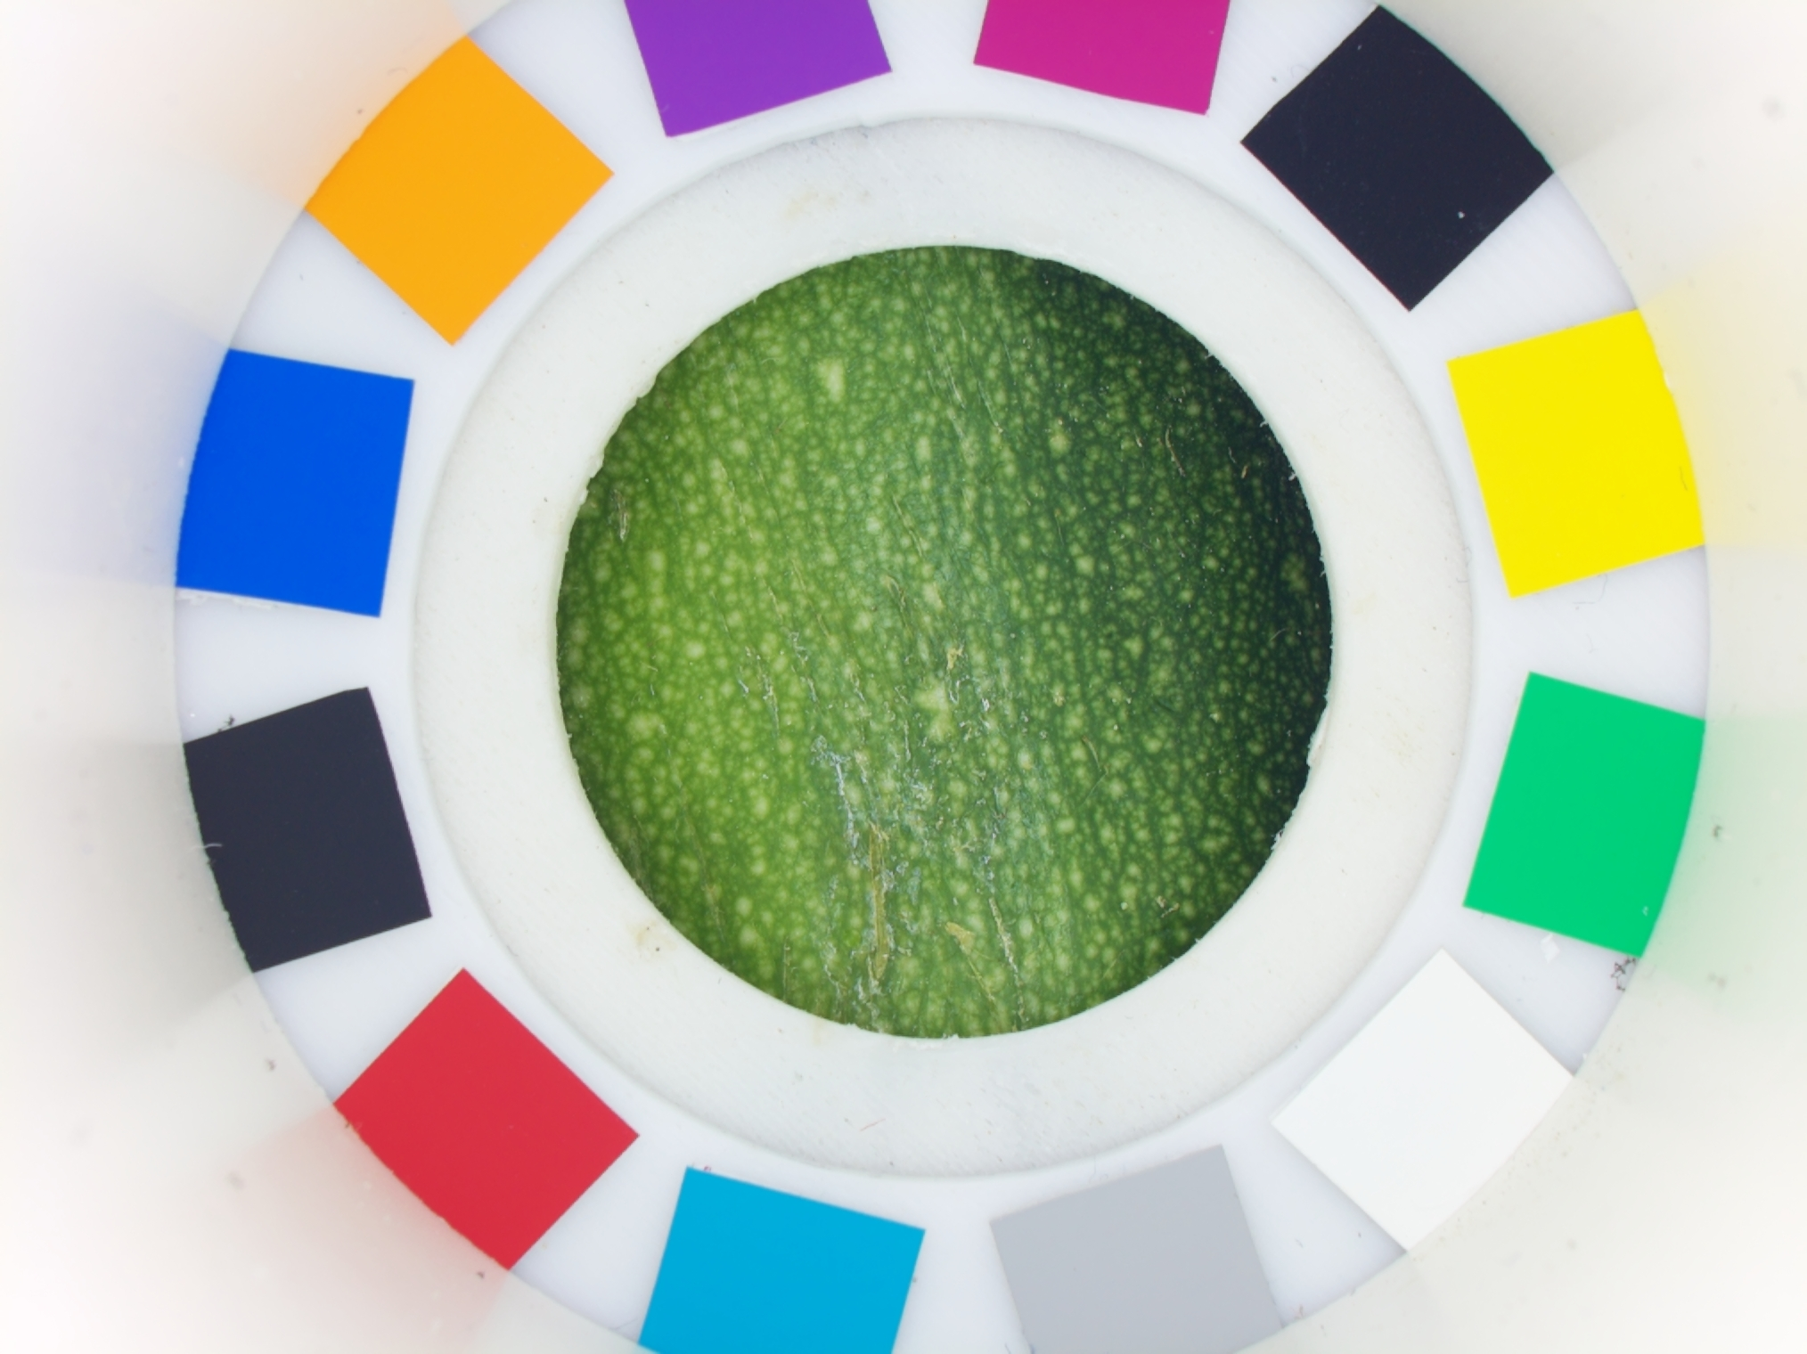
2. Zucchini
213 annotated images · 8 maturity classes

Slide 8
A single, well-annotated dataset for model training
ZUCCHINI PROCESSING
213
8
1
annotated
images
maturity classes
(1–8)
CSVS
device
Processing steps applied to every image
Colour correction (tested with and without)
Crop to region of interest
Statistical colour filter (removes glare, dark edges)
Feature extraction for scoring
After Cropping
After Filtering

Slide 9

Does the image need processing before training?
ZUCCHINI COMPARISON
Method | MAE ↓ | RMSE ↓ | R² ↑ | Spearman ρ ↑ | Acc@0 ↑ | Acc@1 ↑ | Winner
Not Filtered | 0.587 | 0.729 | 0.887 | 0.931 | 52.6% | 96.2%
Filtered | 0.552 | 0.712 | 0.893 | 0.936 | 55.4% | 95.8% | Best
Processed (Filtered) images win
Adds 5% Accuracy & R2
16% faster then using full image
Raw camera
capture
Fully processed
image
A reassuring, rigorously tested result: even though the raw and processed images look very different, the model scores vegetables just as well either way a little better with formal statistical testing and faster. This gives more flexibility in how the pipeline is deployed, with no quality trade-off.

Slide 10
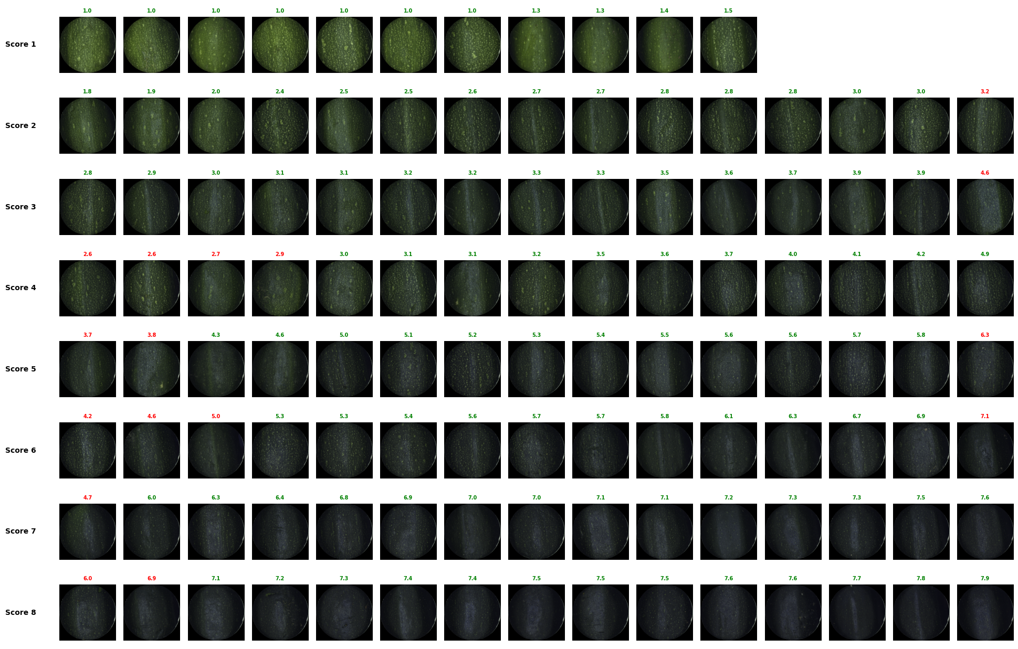
ZUCCHINI EVALUATION
0.91
model quality
score (R²)
99%
of scores predicted
within ± 1 class

Slide 11
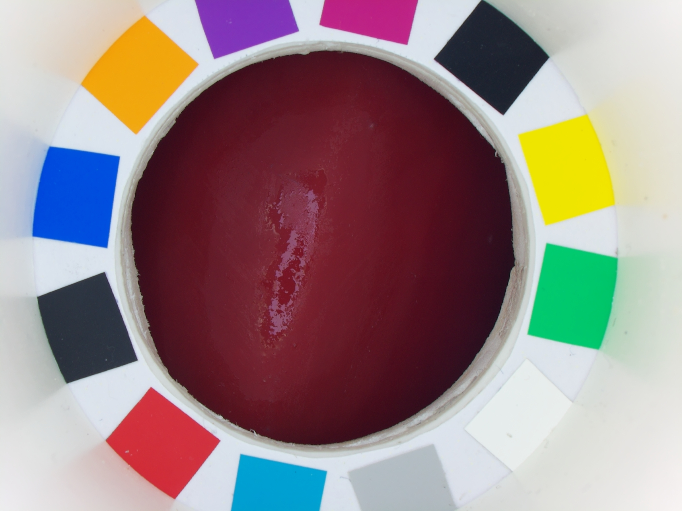
3. Pepper

Slide 12
Two devices, three acquisition sessions
PEPPER DATASET
2
3
287
1–9
CSVS devices
compared
acquisition
sessions
images across
all sessions
colour scoring
scale
Session
Device(s)
N
Notes
Comparison Portakabin
CSVS00 + CSVS01
76
Paired, same samples
Evaluation Greenhouse
CSVS00
40
Variable natural light
Evaluation Portakabin
CSVS00
171
Full 1–9 scale
Three evaluation groups were defined:
Group A (Cross-Device), which assesses robustness across different imaging devices
Group B (Cross-Context), which evaluates performance under varying acquisition conditions such as lighting and environment Group C (Combined), which includes all images and represents the most challenging scenario

Slide 13
How far apart are the two devices, and does correction help?
Device Deviation
Color | ΔE Before Correction | ΔE After Correction | Change
Red | 2.474 | 1.484 | −40%
Orange | 3.928 | 2.255 | −43%
Yellow | 3.536 | 3.012 | −15%
Global Average | 3.234 | 2.294 | −29%
ΔE range | interpretation
< 1 | Perfect
1–2 | Very good
2–3 | good
Yellow peppers track each device consistently but with a large offset
a systematic bias the calibration checker can be extended to fix. Orange shows a noisier disagreement, harder to correct.

Slide 14
Correction matters most where lighting is unpredictable
PEPPER COMPARISON
Group | Type | N | OOF R² | OOF Spearman ρ | OOF MAE | Mean R² ± Std | Mean ρ ± Std
Group A | NOCC | 76 | 0.968 | 0.985 | 0.355 | 0.967 ± 0.006 | 0.985 ± 0.007
Group A | CC | 76 | 0.970 | 0.983 | 0.328 | 0.971 ± 0.010 | 0.984 ± 0.005
Group B | NOCC | 249 | 0.887 | 0.941 | 0.545 | 0.885 ± 0.023 | 0.943 ± 0.018
Group B | CC | 249 | 0.892 | 0.948 | 0.547 | 0.890 ± 0.021 | 0.948 ± 0.013
Group C | NOCC | 287 | 0.907 | 0.955 | 0.515 | 0.900 ± 0.034 | 0.949 ± 0.024
Group C | CC | 287 | 0.893 | 0.946 | 0.551 | 0.884 ± 0.049 | 0.942 ± 0.029
Color correction is only needed when the imaging context changes. Under controlled acquisition conditions, the workflow provides robust cross-device consistency without requiring additional color correction.

Slide 15
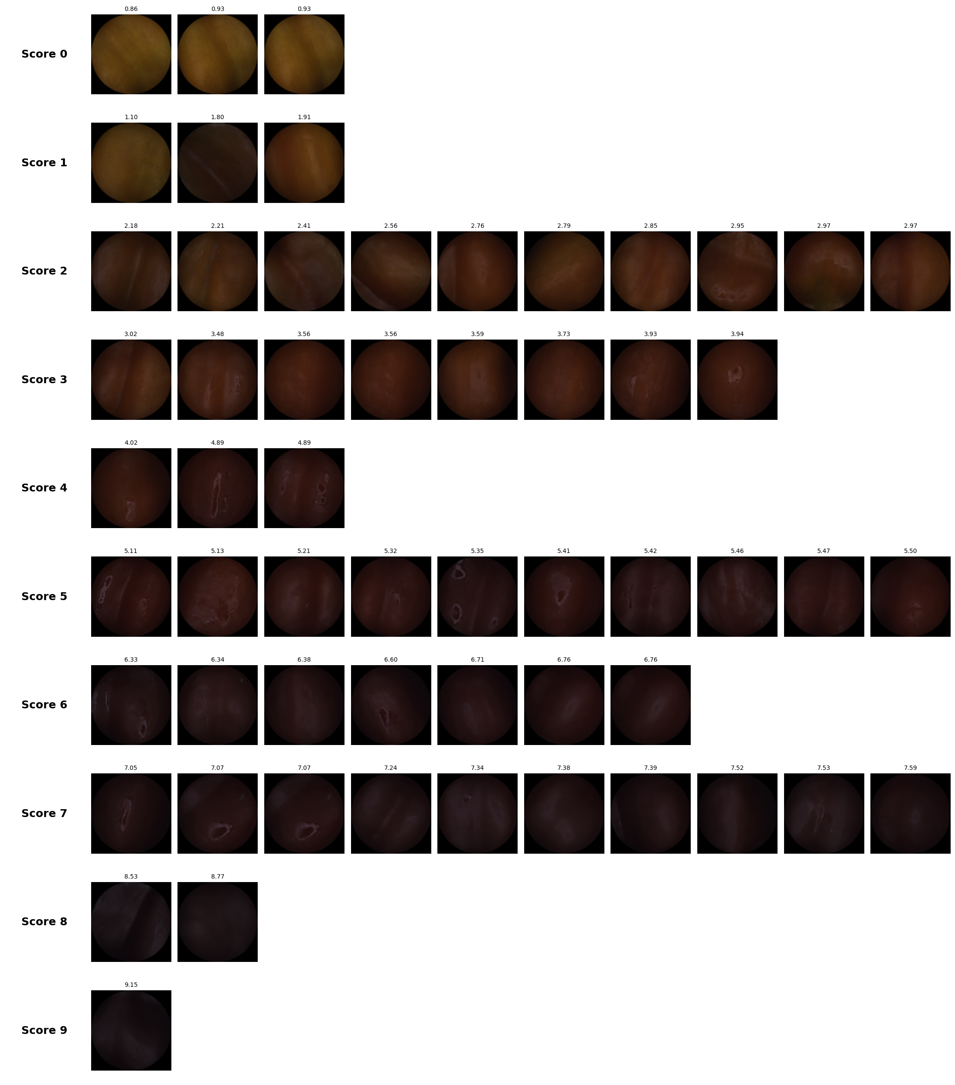
PEPPER EVALUATION
Metric | Value
RMSE | 0.5536
R² Score | 0.9378

Slide 16
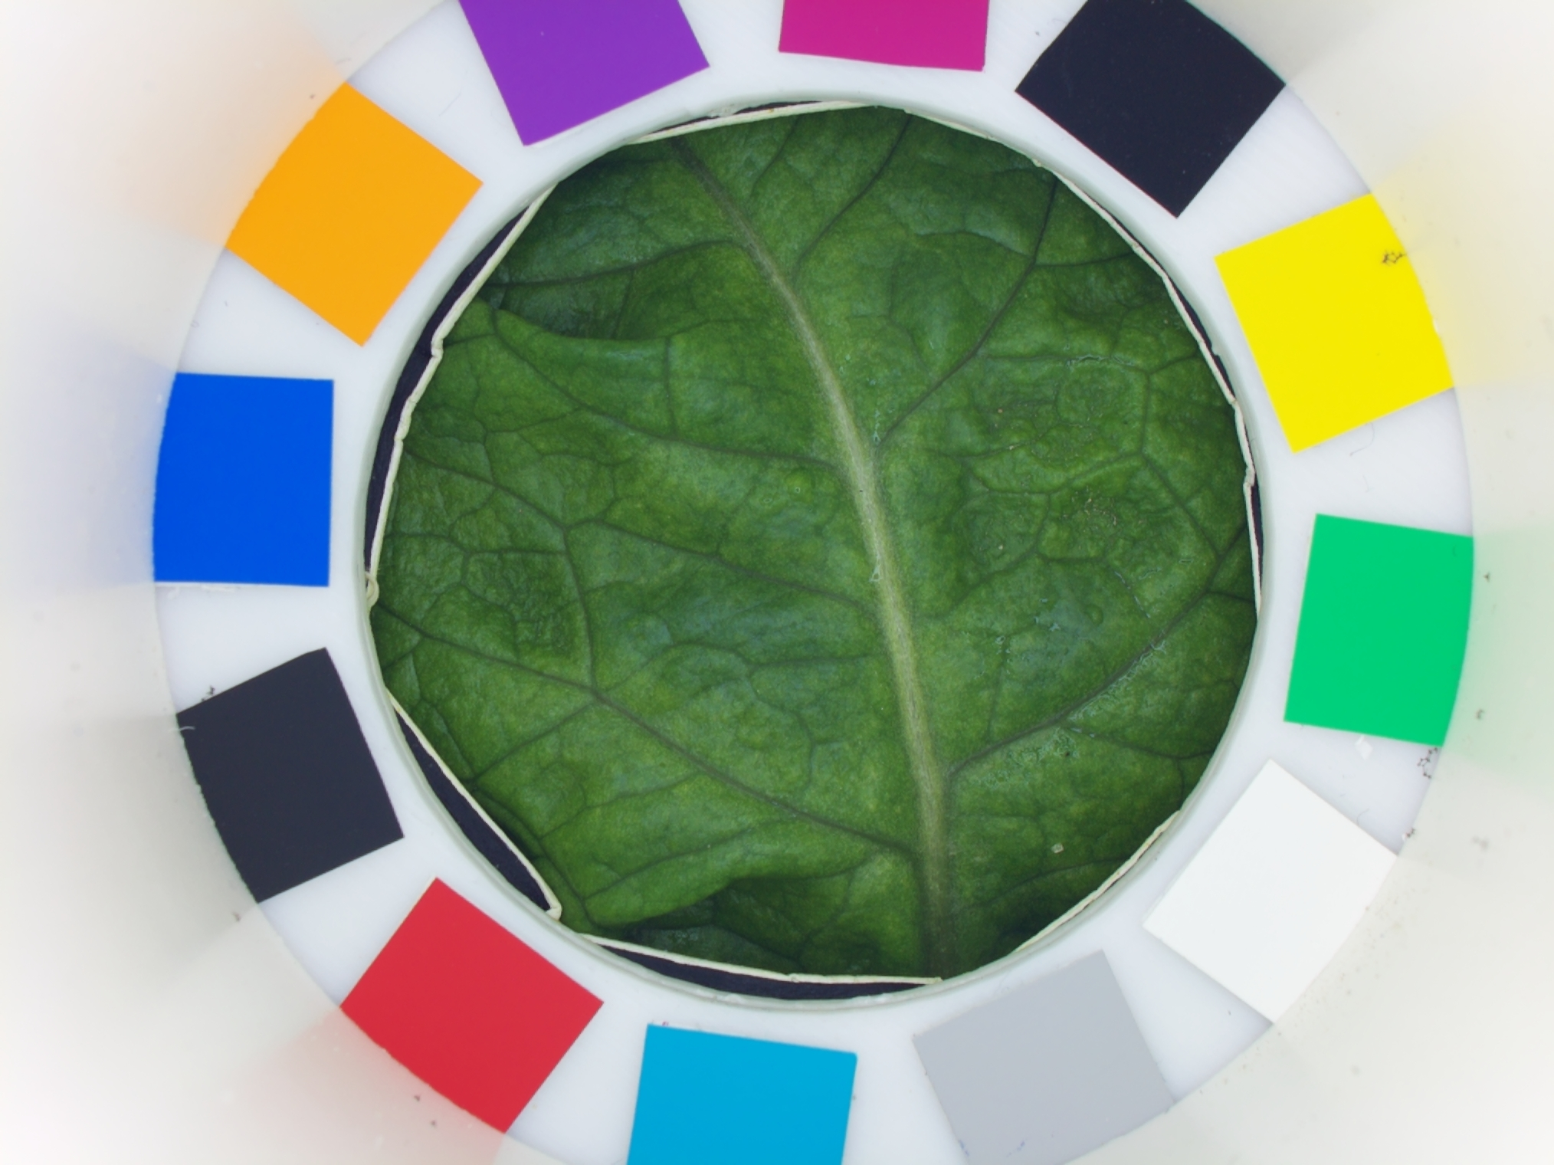
4. Lettuce
38 images · no colour annotation available

Slide 17
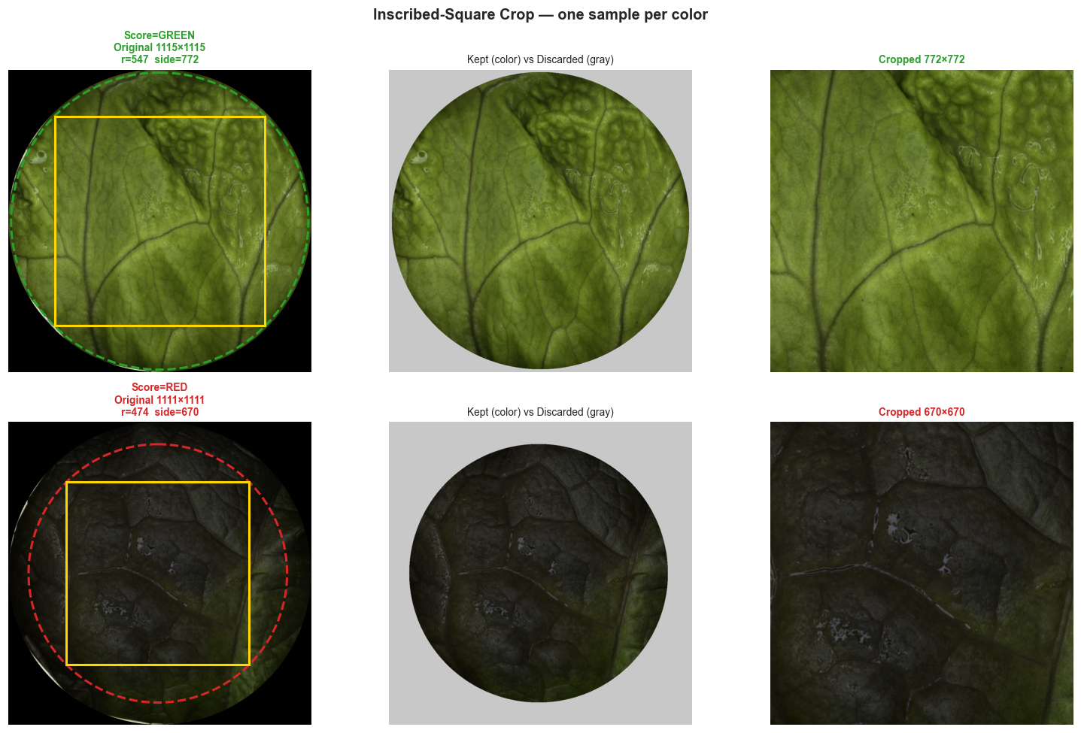
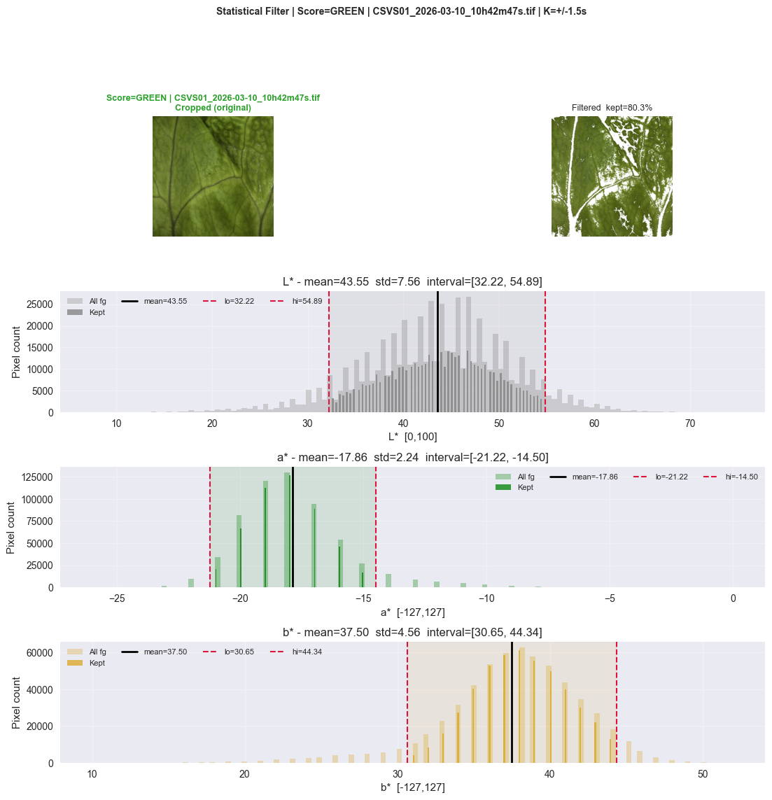
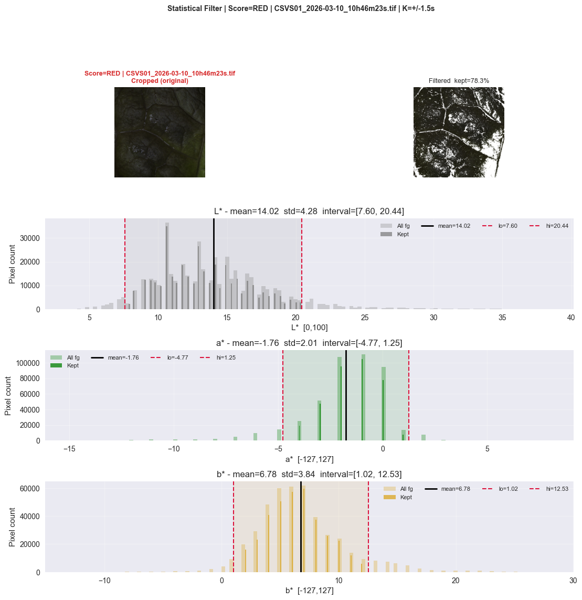
No existing annotations: a different approach was needed
LETTUCE PROCESSING
38 images: 21 green, 17 red
Solution: automatic grouping by colour similarity
Images were first preprocessed to ensure consistent colour representation.
They were then automatically grouped according to colour similarity, without requiring human scoring.
After Cropping
After Filtering
After Cropping​
After Filtering​

Slide 18
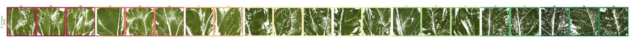
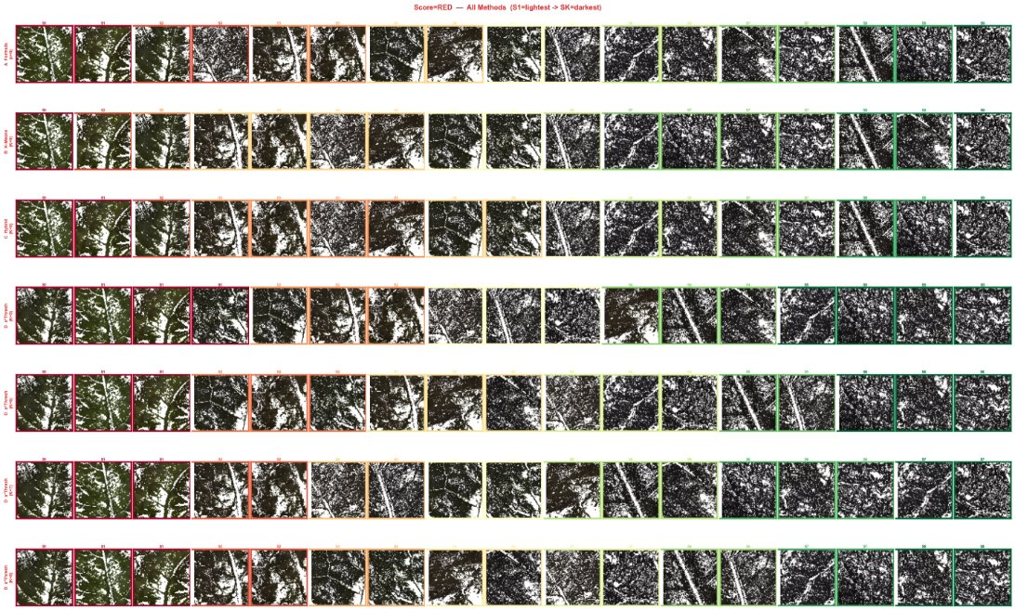
A first colour dataset for lettuce, fully validated
LETTUCE ANNOTATION
Images were first sorted by their mean LAB a channel value. Consecutive images were compared using ΔE, and a new score was assigned when the color difference exceeded a selected threshold. Threshold optimization resulted in nine distinct scoring levels.
LETTUCE GREEN
LETTUCE RED

Slide 19
5. Perspective

Slide 20

When does colour correction actually matter?
ACROSS ALL THREE CROPS
Looking at every experiment together, one clear pattern emerges:
Variable / outdoor lighting
Correction required
Greenhouse and field sessions need it to stay accurate.
Stable, single-device sessions
Correction optional
A simpler, faster pipeline performs just as well.
Comparing across devices
No Correction Needed
Needed to make two CSVS units genuinely comparable.
One consistent step always helps: cleaning each image (removing glare and dark edges) before scoring — regardless of the correction decision.

Slide 21


Technical Directions
PERSPECTIVES
Pipeline improvement
Refine colour correction and cleaning further & rechecking existing annotations along the way.
Device standardization
Extend the calibration checker so any CSVS unit measures colour the same way.
Collect more data
Certain maturity classes are under-represented; more balanced data would sharpen every comparison.

Slide 22



Project Growth Plan
PERSPECTIVES
Production deployment
Make the validated pipeline available to field teams, with a monitoring dashboard.
Extend to other crops
The method developed here is reusable for new species with minimal adaptation.
Explore hyperspectral imaging
Going beyond visible colour to capture information invisible to the naked eye.

Slide 23
Thank you

