Slide 1
Zucchini 5 Processing Method Comparaison
Variant | Preprocessing Description | Outlier Handling | Inpainting Method
nocc | Cropped TIFF images (no filtering) | ❌ None | ❌ None
filtered | Statistical filtering | ✅ Removed | ❌ None
inp_mean | Filtering + mean value filling (per channel) | ✅ Removed | ✅ Mean interpolation
inp_linear | Filtering + spatial interpolation (linear) | ✅ Removed | ✅ Linear interpolation
inp_cubic | Filtering + spatial interpolation (cubic) | ✅ Removed | ✅ Cubic interpolation

Slide 2
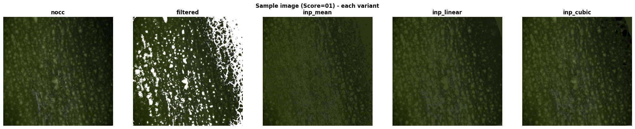

Slide 3
Method | MAE ↓ | RMSE ↓ | R² ↑ | Spearman ρ ↑ | Acc@0 ↑ | Acc@1 ↑
NOCC (Direct CNN ) | 0.5870 | 0.7293 | 0.8872 | 0.9313 | 0.526 | 0.962
Filtered (Cropping + Filtering) | 0.5523 | 0.7119 | 0.8925 | 0.9363 | 0.554 | 0.958
Inpainting (Mean) | 0.5823 | 0.7204 | 0.8899 | 0.9345 | 0.493 | 0.967
Inpainting (Linear) | 0.5985 | 0.7446 | 0.8824 | 0.9299 | 0.493 | 0.944
Inpainting (Cubic) | 0.5747 | 0.7309 | 0.8867 | 0.9316 | 0.516 | 0.958

Slide 4
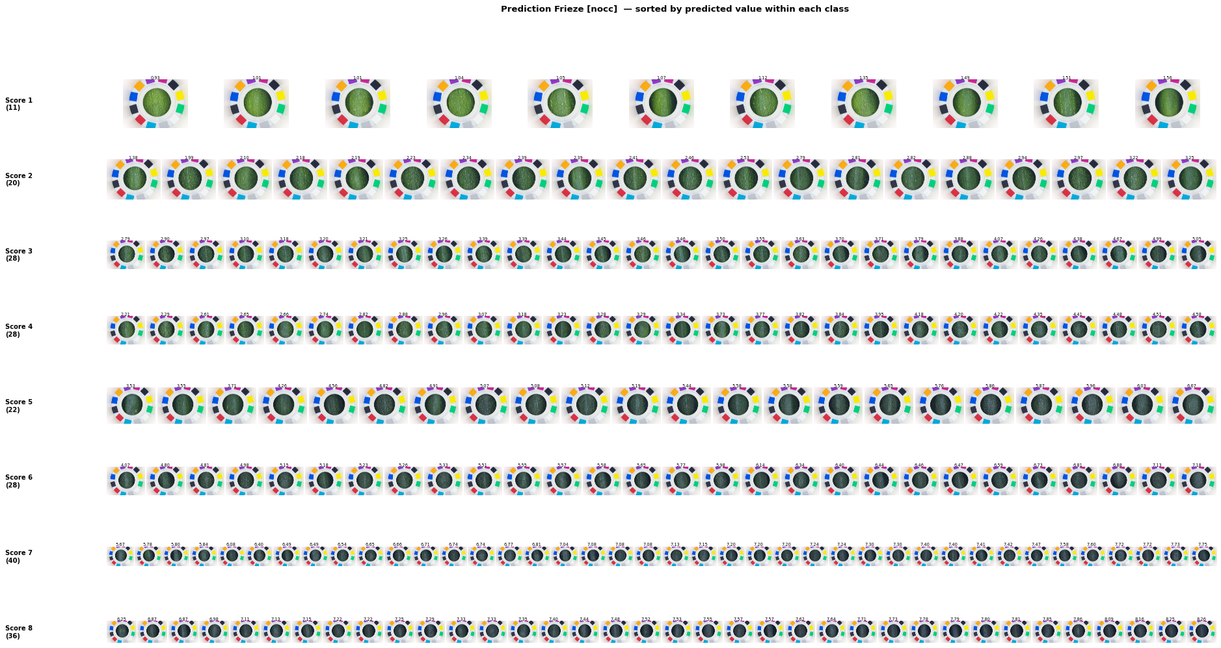

Slide 5
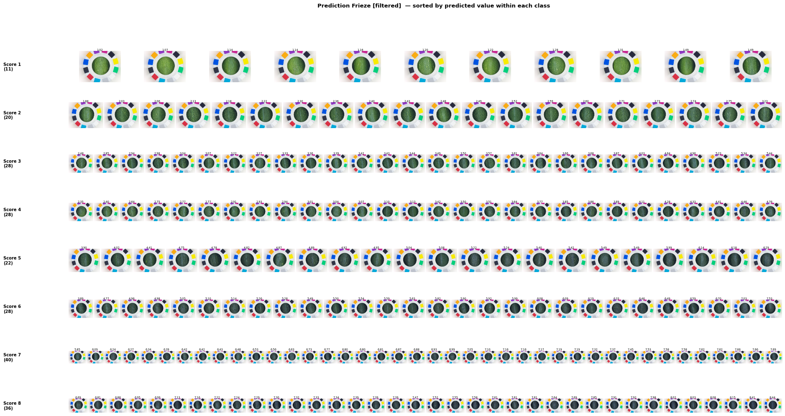

Slide 6
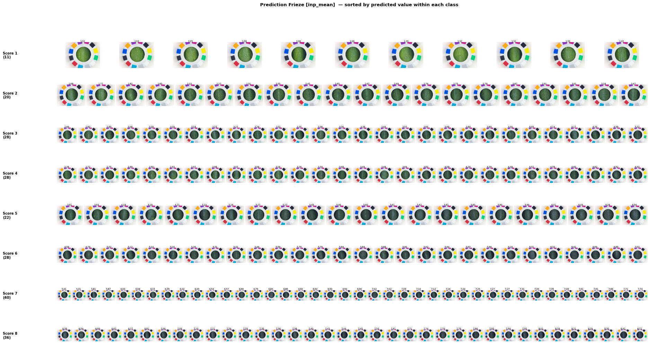

Slide 7
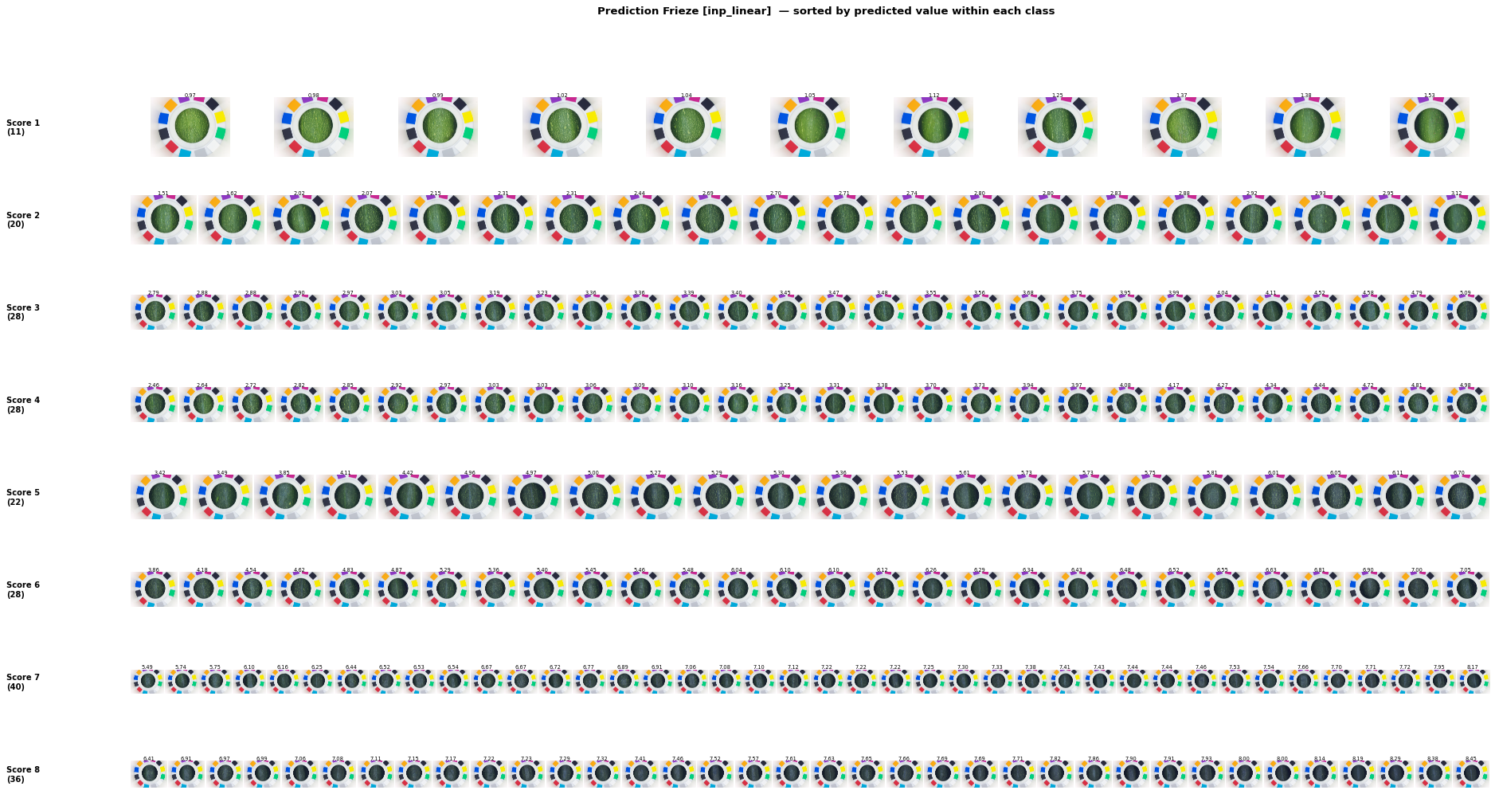

Slide 8
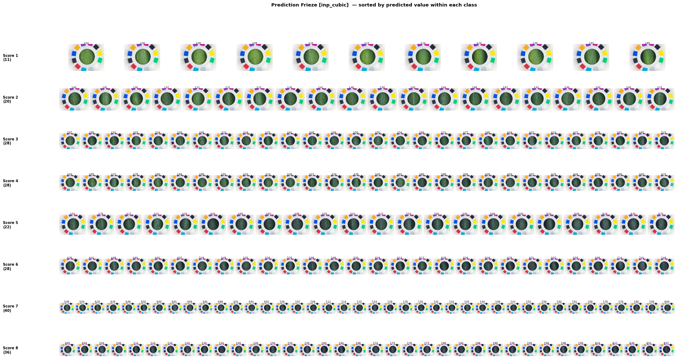

Slide 9
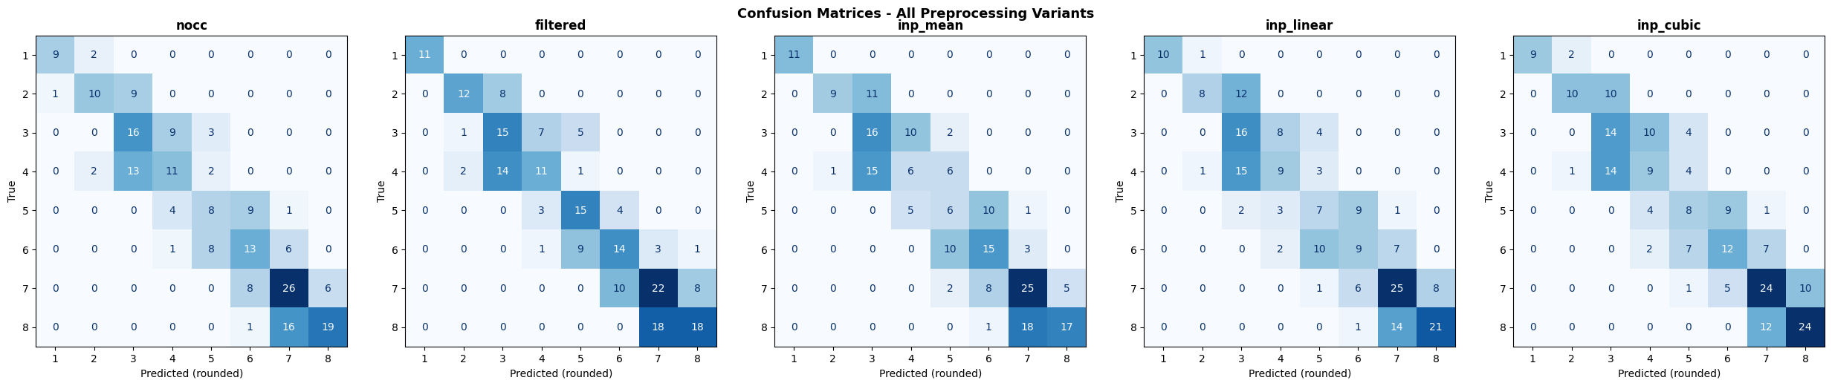

Slide 10
INTERPRETATION
Removing outlier pixels via LAB filtering is the most effective preprocessing step so we can deduct that the outlier pixels were genuinely hurting the model, and removing them was the right call.
All three inpainting strategies perform worse than the bare Filtered baseline across most metrics
The CNN now trains on pixels that were synthetically generated rather than simply absent, and that fabricated signal hurts more than it helps.

Slide 11
Pepper (nocc)
Group | Description | Total Images | Sources Included | Source Detail | Scores
Group A | Cross Device | 76 | 2 datasets | CSVS00/CSVS01 | 1–9
Group B | Cross C​ontexte Same device | 249 | 3 datasets | Comp_Port: 38 Ev_Green: 40 Ev_Port: 171 | 1–9
Group C | Both | 287 | 4 datasets | Comp_Port00: 38 Comp_Port01: 38 Ev_Green: 40 Ev_Port: 171 | 1–9

Slide 12
NOCC
Group | N | Folds | OF R² | OF Spearman ρ | OF MAE | OF RMSE | Mean R² ± Std | Mean ρ ± Std
Group A | 76 | 3 | 0.9676 | 0.9851 | 0.3550 | 0.4700 | 0.9672± 0.006 | 0.9854 ± 0.007
Group B | 249 | 5 | 0.8869 | 0.9411 | 0.5451 | 0.7266 | 0.885 ± 0.023 | 0.943 ± 0.018
Group C | 287 | 5 | 0.9067 | 0.955 | 0.5151 | 0.672 | 0.9 ± 0.034 | 0.949 ± 0.024
CC
Group | N | Folds | OOF R² | OOF Spearman ρ | OOF MAE | OOF RMSE | Mean R² ± Std | Mean ρ ± Std
Group A | 76 | 3 | 0.9702 | 0.9825 | 0.3277 | 0.4214 | 0.971 ± 0.010 | 0.984 ± 0.005
Group B | 249 | 5 | 0.8917 | 0.9476 | 0.5466 | 0.7112 | 0.890 ± 0.021 | 0.948 ± 0.013
Group C | 287 | 5 | 0.8929 | 0.9456 | 0.5506 | 0.7199 | 0.884 ± 0.049 | 0.942 ± 0.029

Slide 13
Group | Type | N | OOF R² | OOF ρ | MAE | RMSE | Mean R² ± Std | Mean ρ ± Std
Group A | NOCC | 76 | 0.9676 | 0.9851 | 0.3550 | 0.4700 | 0.967 ± 0.006 | 0.985 ± 0.007
 | CC | 76 | 0.9702 | 0.9825 | 0.3277 | 0.4214 | 0.971 ± 0.010 | 0.984 ± 0.005
Group B | NOCC | 249 | 0.8869 | 0.9411 | 0.5451 | 0.7266 | 0.885 ± 0.023 | 0.943 ± 0.018
 | CC | 249 | 0.8917 | 0.9476 | 0.5466 | 0.7112 | 0.890 ± 0.021 | 0.948 ± 0.013
Group C | NOCC | 287 | 0.9067 | 0.9550 | 0.5151 | 0.6720 | 0.900 ± 0.034 | 0.949 ± 0.024
 | CC | 287 | 0.8929 | 0.9456 | 0.5506 | 0.7199 | 0.884 ± 0.049 | 0.942 ± 0.029
The comparison between CC and NOCC reveals that preprocessing has a context-dependent impact. While filtering significantly improves performance in controlled and moderately heterogeneous settings enhancing both prediction accuracy and ranking consistency.
It may degrade performance in highly diverse datasets by removing informative variability. Consequently, CC is beneficial for improving robustness in structured scenarios, whereas NOCC better preserves generalization capability in complex, real-world conditions.

Slide 14
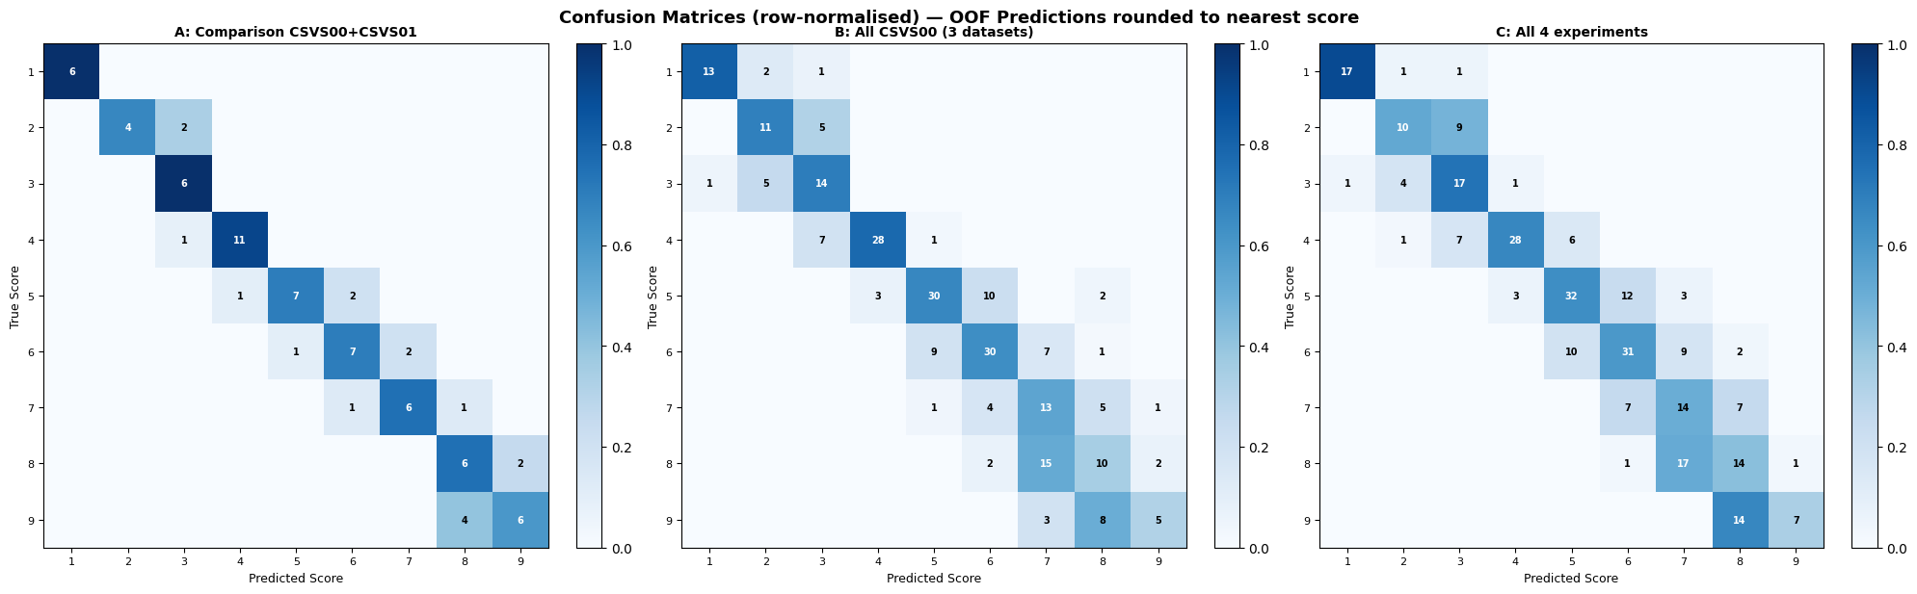

Slide 15
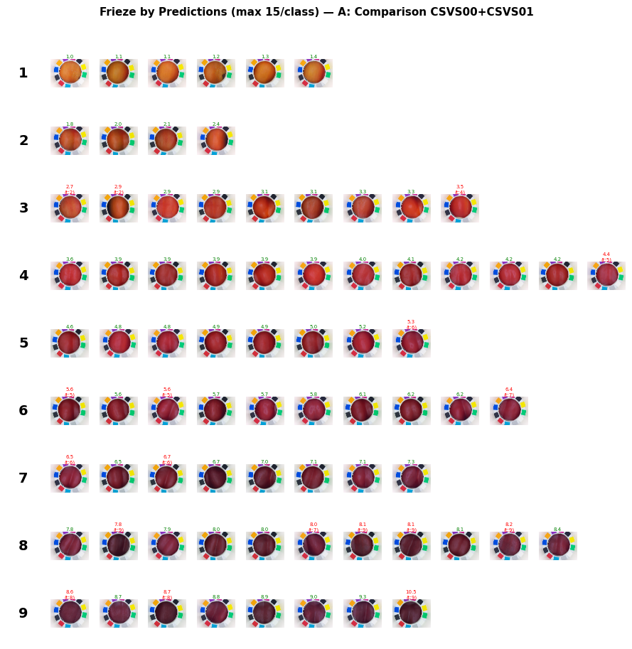
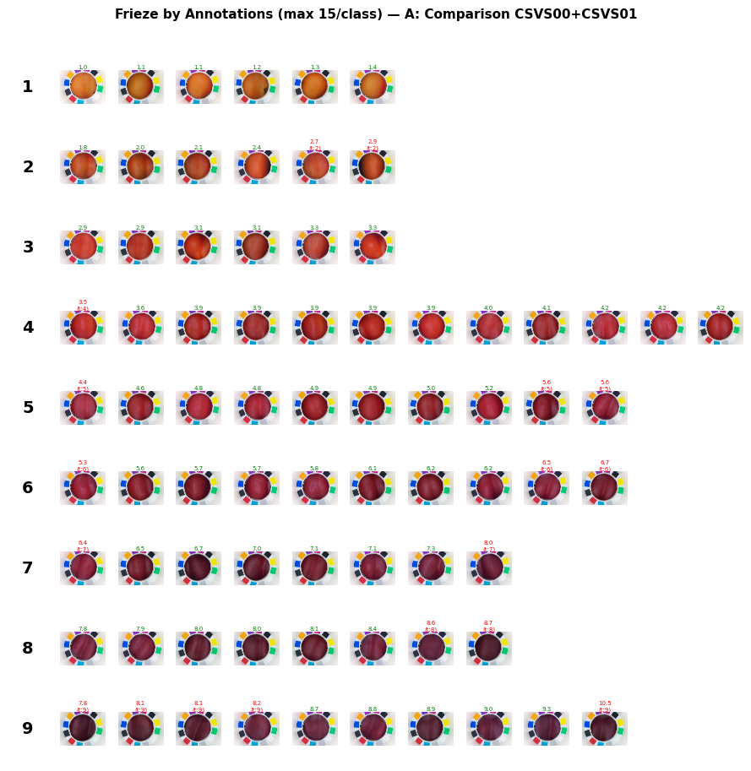

Slide 16
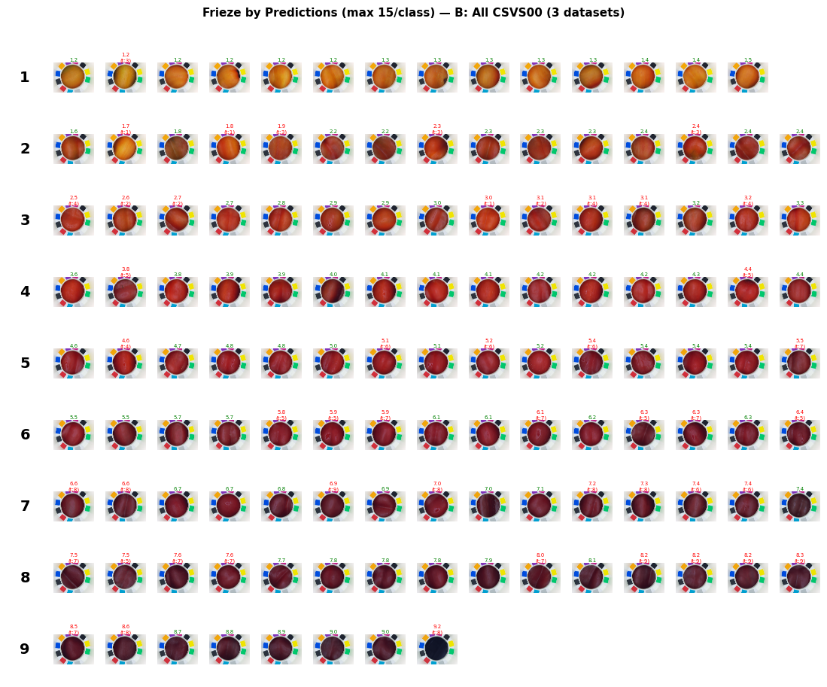

Slide 17
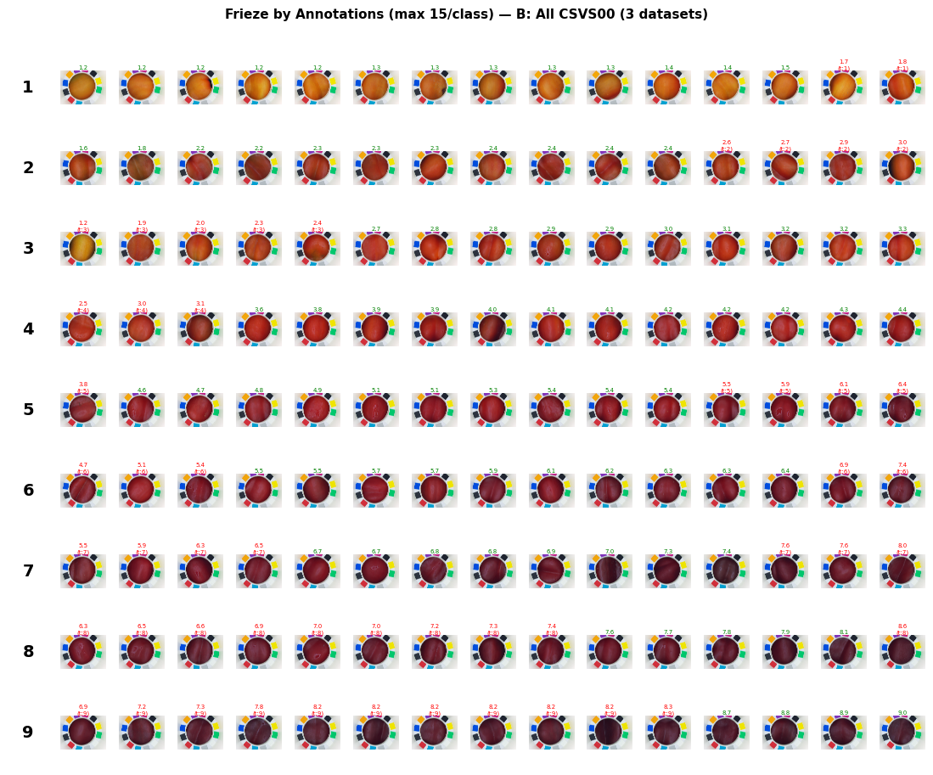

Slide 18
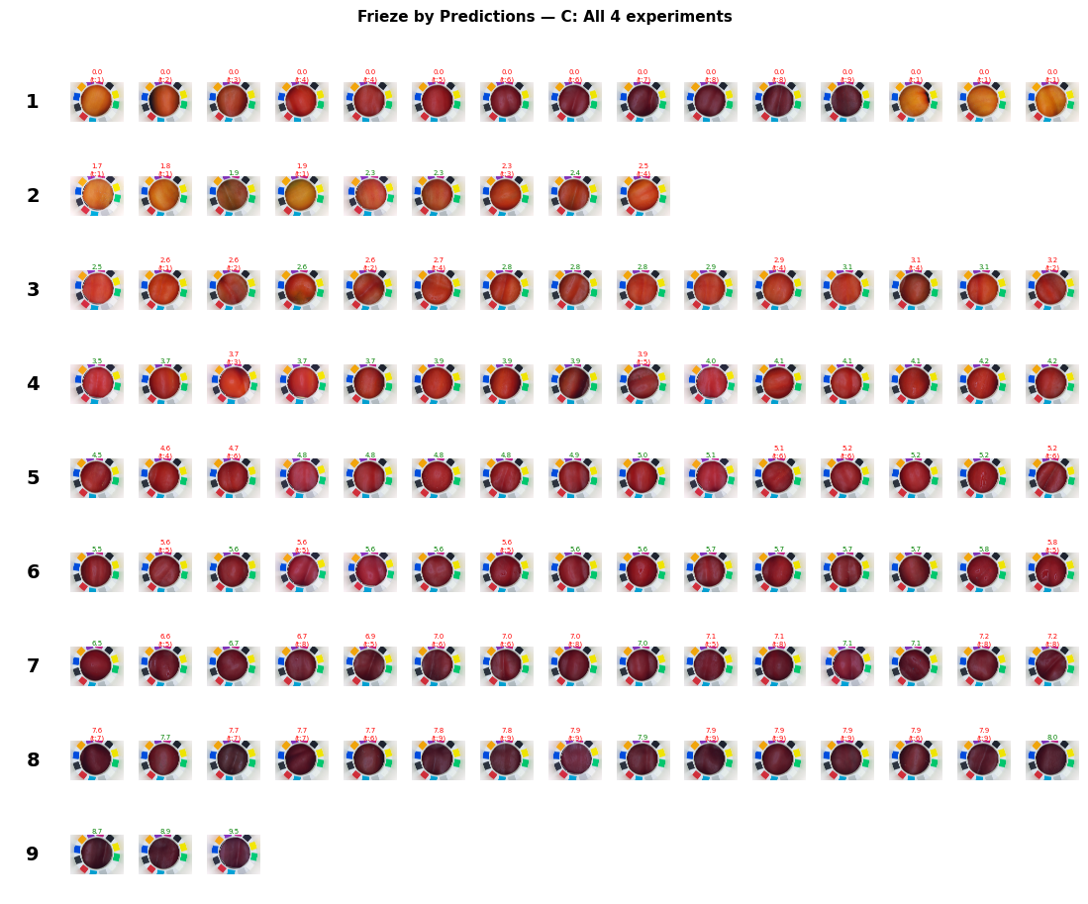
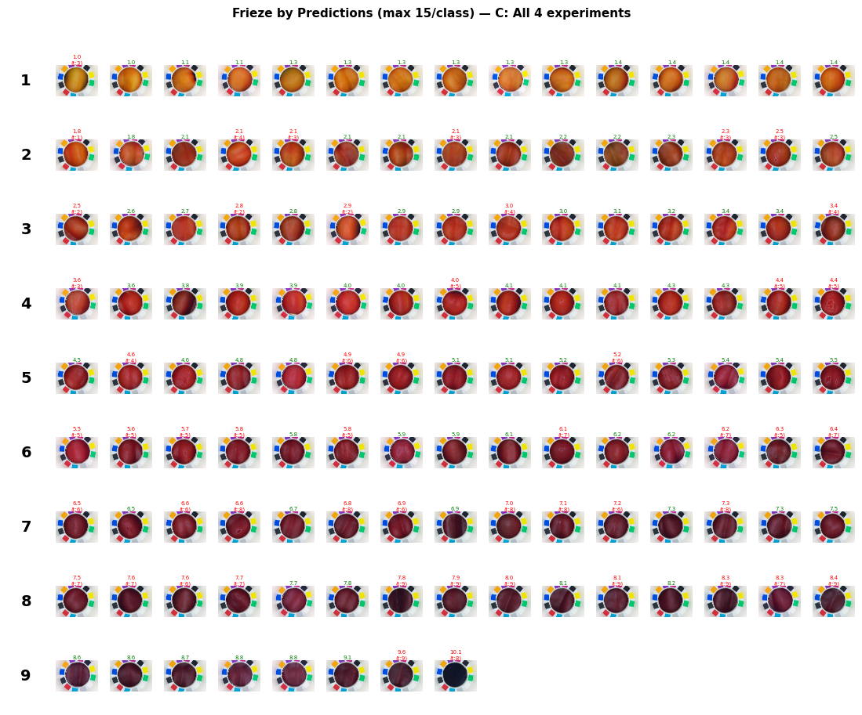

Slide 19
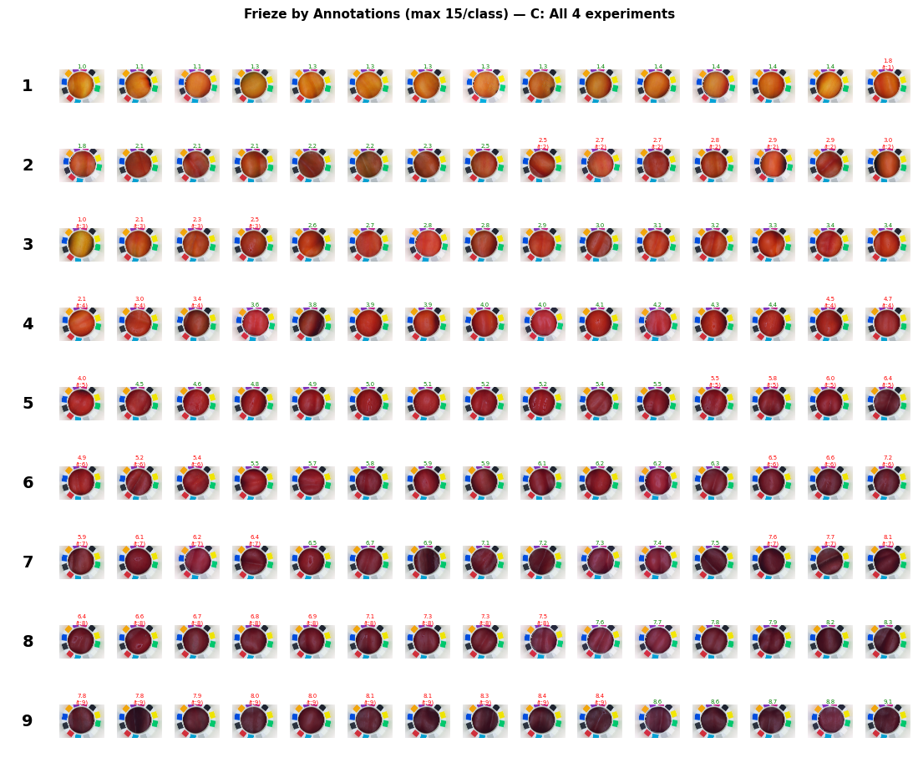

Slide 20
Interpretation
Group A
Group A achieves spectacular numbers but It has only 76 images across 2 devices
These scores tells that the model can learn intra-device colour variation but they say nothing about robustness
Group B
Even though the device is the same, the model faces:
Strong domain shift (different contexts: greenhouse vs portakabin)
Data imbalance (171 vs 38 vs 40 images)
Context variability impacts performance more than device change.
Group C
Combining datasets from multiple devices and contexts improves generalization, leading to a better trade-off between robustness and accuracy

