Slide 1


Slide 2
Business insights
Aim of the analysis is to gain insights on how people feel about their local communities in Scotland through the Scottish Household Survey. In particular about the relationship between the distance to outdoor spaces and neighbourhood ratings.
Crucial to inform the Fairer Scotland Agenda and the National Performance Framework.

Slide 3
Scottish Household Survey (SHS Website)
The Scottish Household Survey is carried out by the Scottish government. It started in 1999 and the survey is an annual, cross-sectional survey that provides evidence on the composition, characteristics, attitudes and behaviour of private households and individuals in Scotland.
Random sample of Scotland’s 32 local authorities.
Questions are asked by an interviewer in Scottish homes.
Participation is voluntary.

Slide 4
Business questions
Are there certain groups that have or lack access to a green space?
What are the differences in how far people have to walk to access their green space?
Are there differences in green space access between rural and urban areas?
What is the difference between neighbourhoods in terms of green space access? How do people rate their neighbourhoods and community in relation to green space access?
Is there any way to predict which households would have higher rating?

Slide 5
The Data
Collection of Scottish Household Survey Data from 2012 to 2019:
Internal Data Sources : Scottish Household Survey
Distance to Green or Blue Space - Scottish Household Survey
Neighbourhood rating - Scottish Household Survey
Community Belonging - Scottish Household Survey
Aggregated Data
External Data Sources :
Scottish Council Areas
Data type:
Categorical data (Dichotomous two levels: 1, 0);
CSV format.

Slide 6
Ethics & Limitations
Part of the data is masked for ethical and privacy reasons. It is only possible to know only a few characteristics of a survey response.
For this reason there were numerous “All” values which were filtered out during my analysis.
This presents a limitation as it is not possible to know specific details of the data. Therefore a descriptive data analysis approach has been adopted.
The data presents higher responses from specific societal groups (e.g. people who rate their community or neighbourhoods higher) and specific geographical areas (South Lanarkshire, West Dunbartonshire, Dundee City). However, this hasn’t influenced the analysis as the data has been analysed using percentages and proportions.

Slide 7
Analysis
Descriptive analysis as opposed to a prescriptive analysis.
RStudio
Loaded and cleaned the data, calculated proportions, statistical tests and filtered out the “All” values from analysis and plotting.

Slide 8
Are there certain groups that have or lack access to a green space?
Green Space: “Public green or open space in your local area [...] a park, countryside, wood, play area, canal path, riverside or beach”. (SHS website).
Access to a green space: “Proportion of adults who live within a 5 minute walk of their local green or blue space”. (SHS website).
Difference in how people have to walk: 5 minute walk or less, within 6-10 minute walk, 11 minute walk or more.

Slide 9
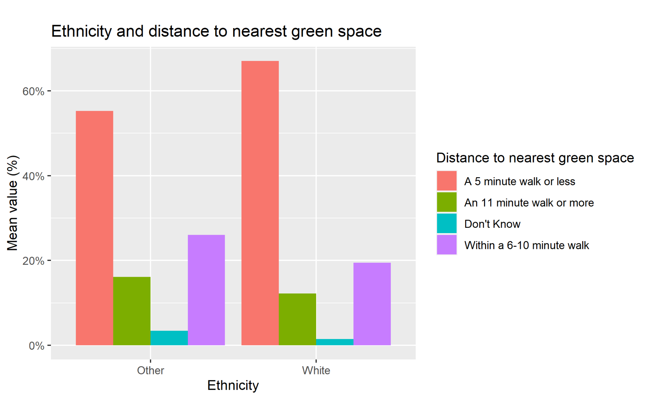
Ethnicity and distance to nearest green space
Wider disparity in distance from a green space.
Access to a green space: 65% (whites) vs. 55% (others).
Lack of access: ~35% (whites) vs. ~45% others.
Statistical test shows that white people have higher access to a green space.

Slide 10
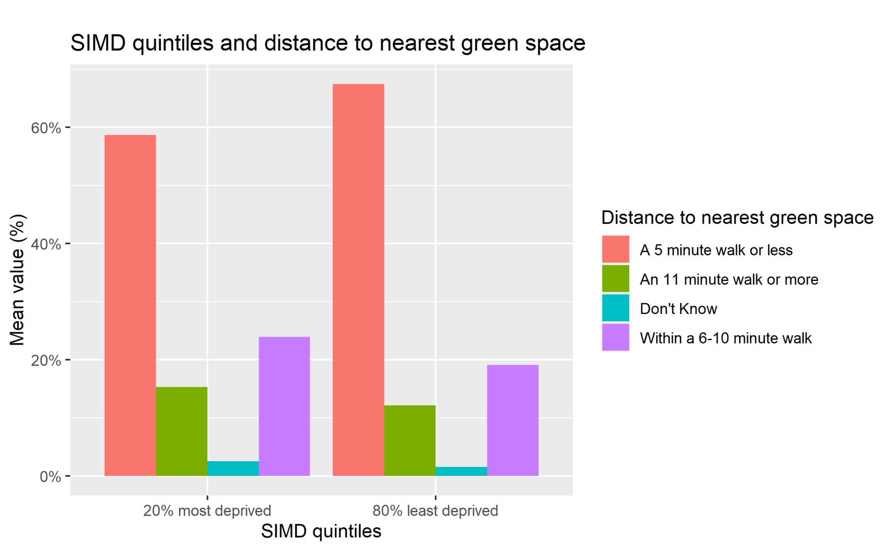
SIMDs and distance to nearest green space
Access: 70% (least deprived) vs. 60% (most deprived).
Lack of access: ~30% (least deprived) vs. ~40% (most deprived).
Hypothesis test shows that least deprived communities have higher access to a green space.

Slide 11
Are there differences in green space access between rural and urban areas?
Urban area: “above 10,000 inhabitants”.
Rural area: “settlements of less than 3,000 people” (Scottish Government).

Slide 12
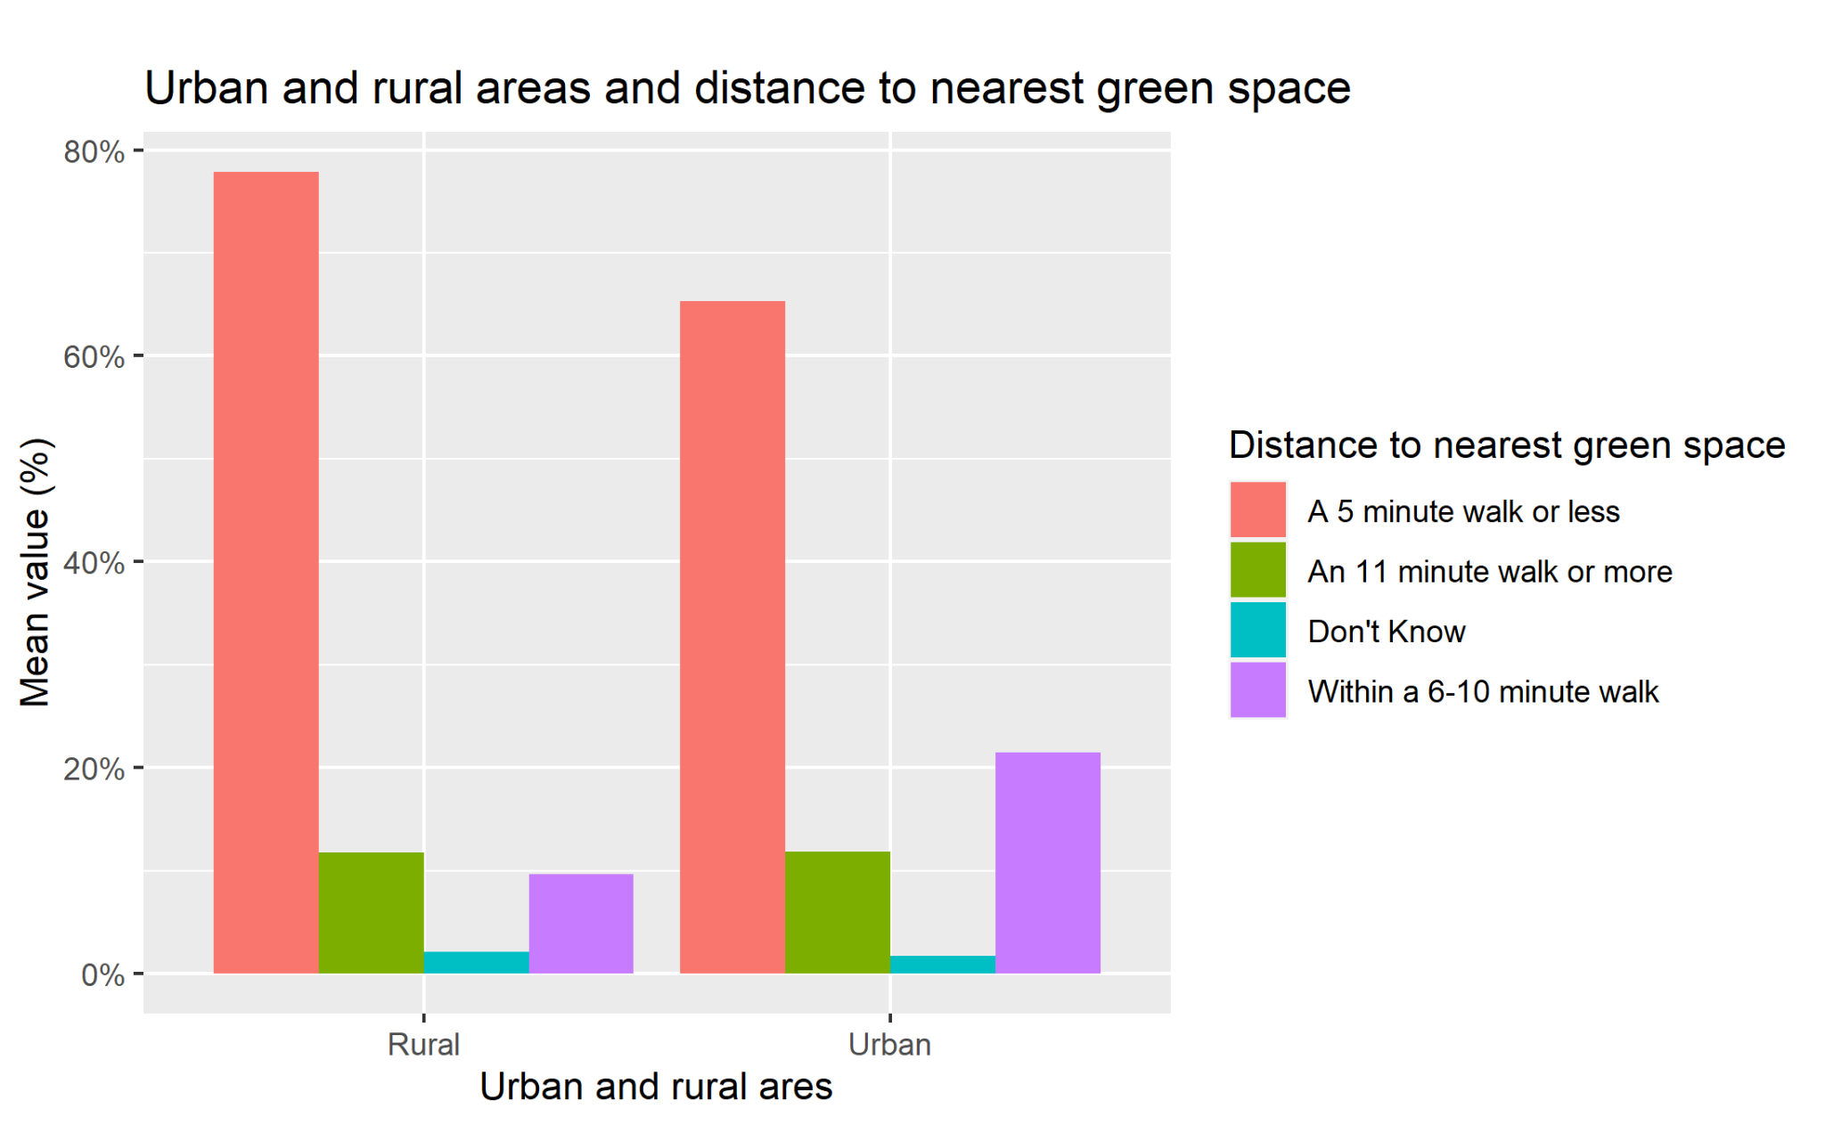
Urban and rural areas and distance to nearest green space
Nearly 80% of Rural residents live within 5 minutes from a green space vs. ~ 65% Urban residents.
~20% of rural residents live more than 5 minutes away from a green space vs. Urban residents ~35%.
Approximately the same percentage of people in rural and urban areas (~12%) live more than 11 minutes walk away.

Slide 13
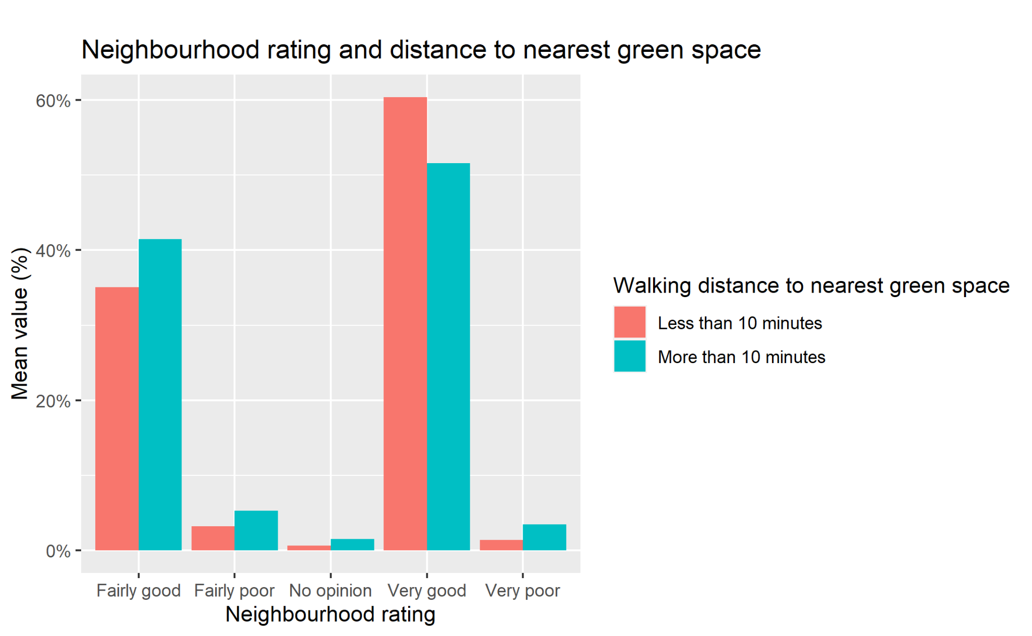
Relationship between neighbourhoods rating and green space access
Respondents were asked to rate their neighbourhoods.
Overall, the data shows that a higher neighbourhood rating corresponds to a shorter distance from a green space.
However, people who rate their neighbourhood as “Fairly good” seem to be an exception.

Slide 14
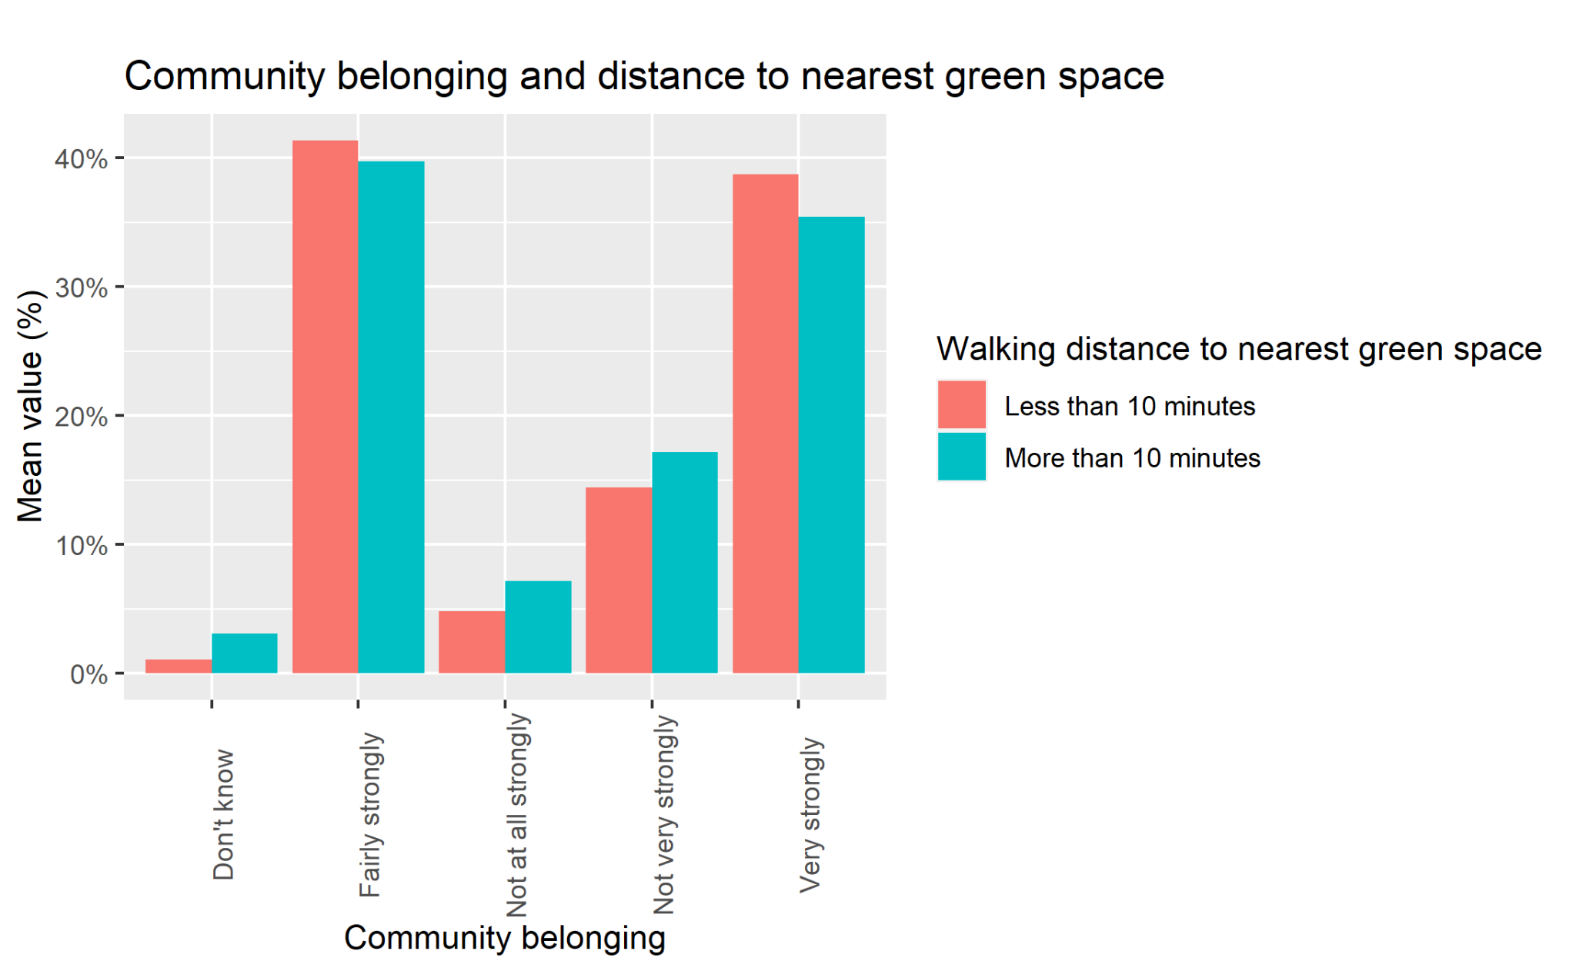
Relationship between community belonging and green space access
Respondents were asked to rate their community belonging.
The data shows that a higher community belonging is associated with a shorter distance from a green space.
Conversely, a lower community belonging is associated with a longer distance from a green space.

Slide 15
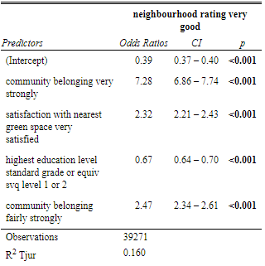
Households with higher neighbourhood ratings
Descriptive analysis using logistic regression.
Considering “Very good neighbourhood” rating, the model shows that an increase in a very and fairly strong community belonging, a very high satisfaction with nearest green space and an education level of svq 1 or 2 will increase our “neighbourhood very good” parameter.

Slide 16
Plots and data that haven’t made it to the final presentation
Original code, statistical tests, time series analysis, models and other plots can be accessed on my GitHub Profile.

Slide 17
Questions?

