Slide 1

Towards Minimizing the Required Bandwidth for Mobile Web Browsing
Project by Madhu Jayakumar, Marcela Melara, and Nayden Nedev
17 May, 2013
Analytics and Systems of Big Data
Prof. Kai Li
Spring 2013
Notes:
<number>

Slide 2
<number>
Introduction
Problem:
Growing base of smartphone and mobile web users.
High bandwidth requirements to download web data.
Motivation: High data plan costs.
Solution:
Leverage redundancies in data to reduce amount of transmitted data.
Result: More efficient use of data plan!
Notes:
<number>

Slide 3
<number>
Previous Work
Wide-area Network Acceleration for the Developing World. [Ihm et al., ATC '10].
Towards Understanding Modern Web Traffic. [Ihm et al., SIGMETRICS '11].
Web Caching on Smartphones: Ideal vs. Reality. [Qian et al., MobiSys '12].
Notes:
<number>

Slide 4
<number>
Our Contributions
System design.
Protocol design.
Two simulators
Experimental evaluation.
Notes:
<number>

Slide 5
<number>
System Design
Chunking:
Partition webpage data into fixed-sized chunks.
Fingerprinting:
Rabin hashing to generate chunk fingerprints.
Used to identify unique data chunks, smaller.
Caching:
Fingerprint-chunk mappings (various eviction algos).
URL-fingerprint list mappings.
Notes:
<number>

Slide 6
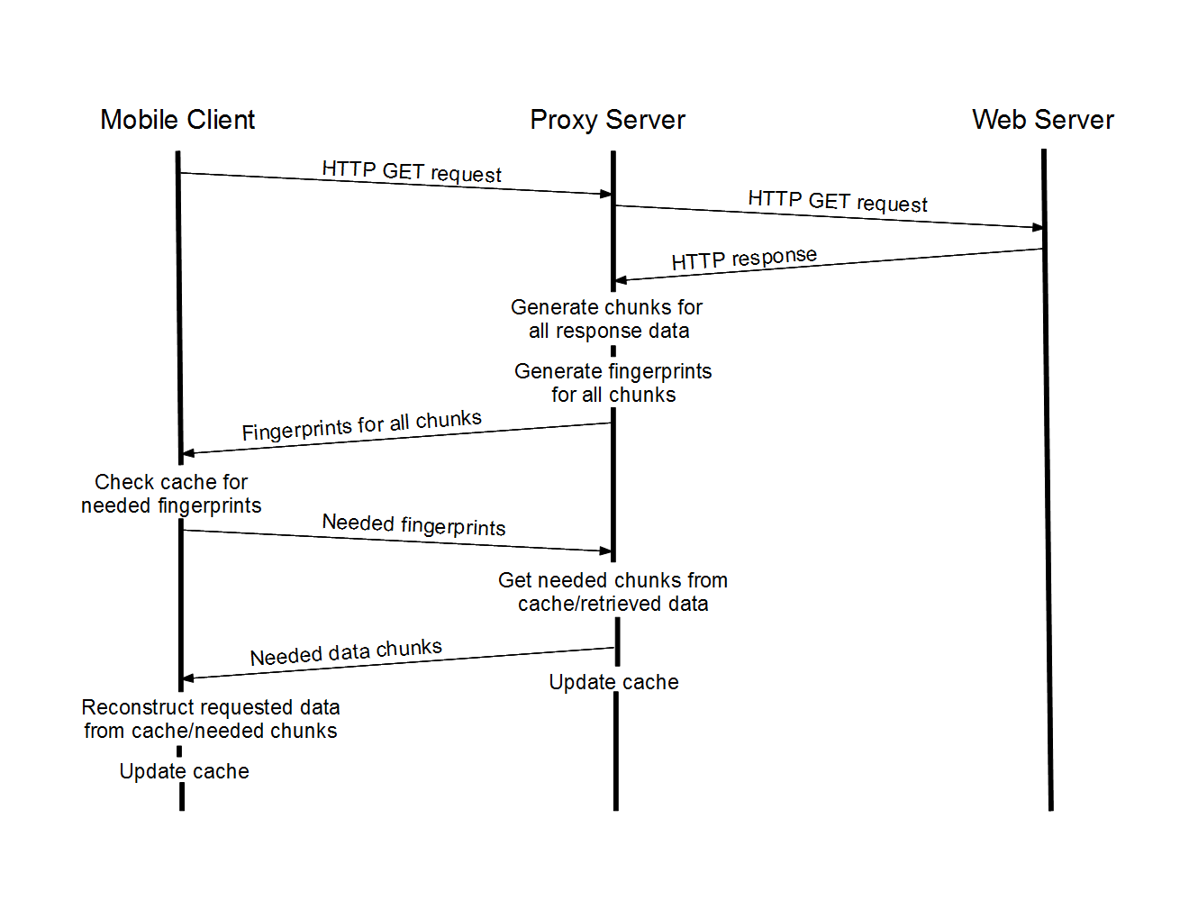
<number>
Protocol
Notes:
<number>

Slide 7
<number>
Implementation - Offline
Two simulators:
Find intra-website redundancy.
Find inter-website redundancy.
Use Wireshark to collect HTTP response packet bytes from browsing.
Simulator iterates over data files.
Calculates proxy and mobile cache missrates each round.
Notes:
<number>

Slide 8
<number>
Implementation - Networked
Basic proxy server:
Gets requested webpage from web server.
Performs chunking, fingerprinting.
Mobile client simulator:
Makes requests to proxy server.
Allows for sequential requests.
Reconstructs received data into HTML pages.
Caching algorithm: MRU.
Notes:
<number>

Slide 9
<number>
Demo
Notes:
<number>

Slide 10
<number>
Notes:
<number>

Slide 11
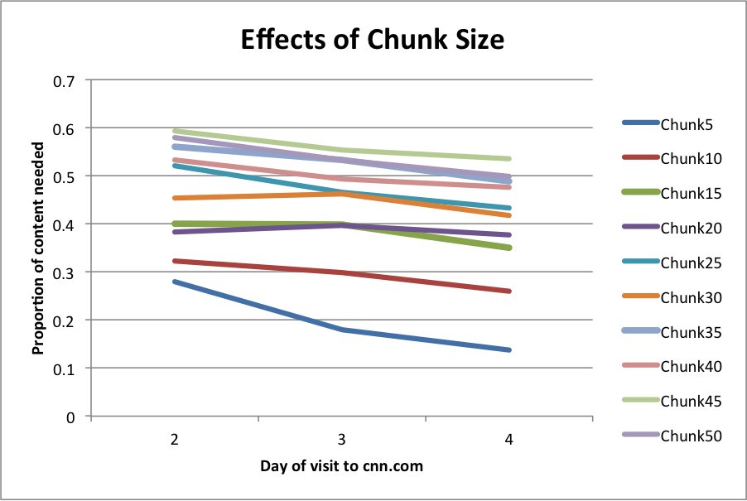

Slide 15
<number>
Future Work & Conclusion
Future work:
Delta encoding of chunks to achieve higher dedup.
Implementation using smartphones.
Look at mobile app HTTP traffic.
Conclusion:
Designed and built complete basic simulators.
Evaluated our protocol on a large number of web pages and sites.
Results:
Notes:
<number>

Slide 16
<number>
Questions? Comments?
Notes:
<number>

