Slide 1

Towards Minimizing the Required Bandwidth for Mobile Web Browsing
Project by Madhu Jayakumar, Marcela Melara, and Nayden Nedev
17 May, 2013
Analytics and Systems of Big Data
Prof. Kai Li
Spring 2013

Slide 2
Introduction
Motivation: High data plan costs.
Problem:
  Growing base of smartphone and mobile web users.
  High bandwidth requirements to download web data.
Solution:
  Leverage redundancies in data to reduce amount of transmitted data.
Result: More efficient use of data plan!

Slide 3
Previous Work
Wide-area Network Acceleration for the Developing World. [Ihm et al., ATC '10].
Towards Understanding Modern Web Traffic. [Ihm et al., SIGMETRICS '11].
Web Caching on Smartphones: Ideal vs. Reality. [Qian et al., MobiSys '12].

Slide 4
System Design
Chunking:
  Partition webpage data into fixed-sized chunks.
Fingerprinting:
  Rabin hashing to generate chunk fingerprints.
  Used to identify unique data chunks, smaller.
Caching:
  Fingerprint-chunk mappings.
  Multiple caching algorithms.

Slide 5
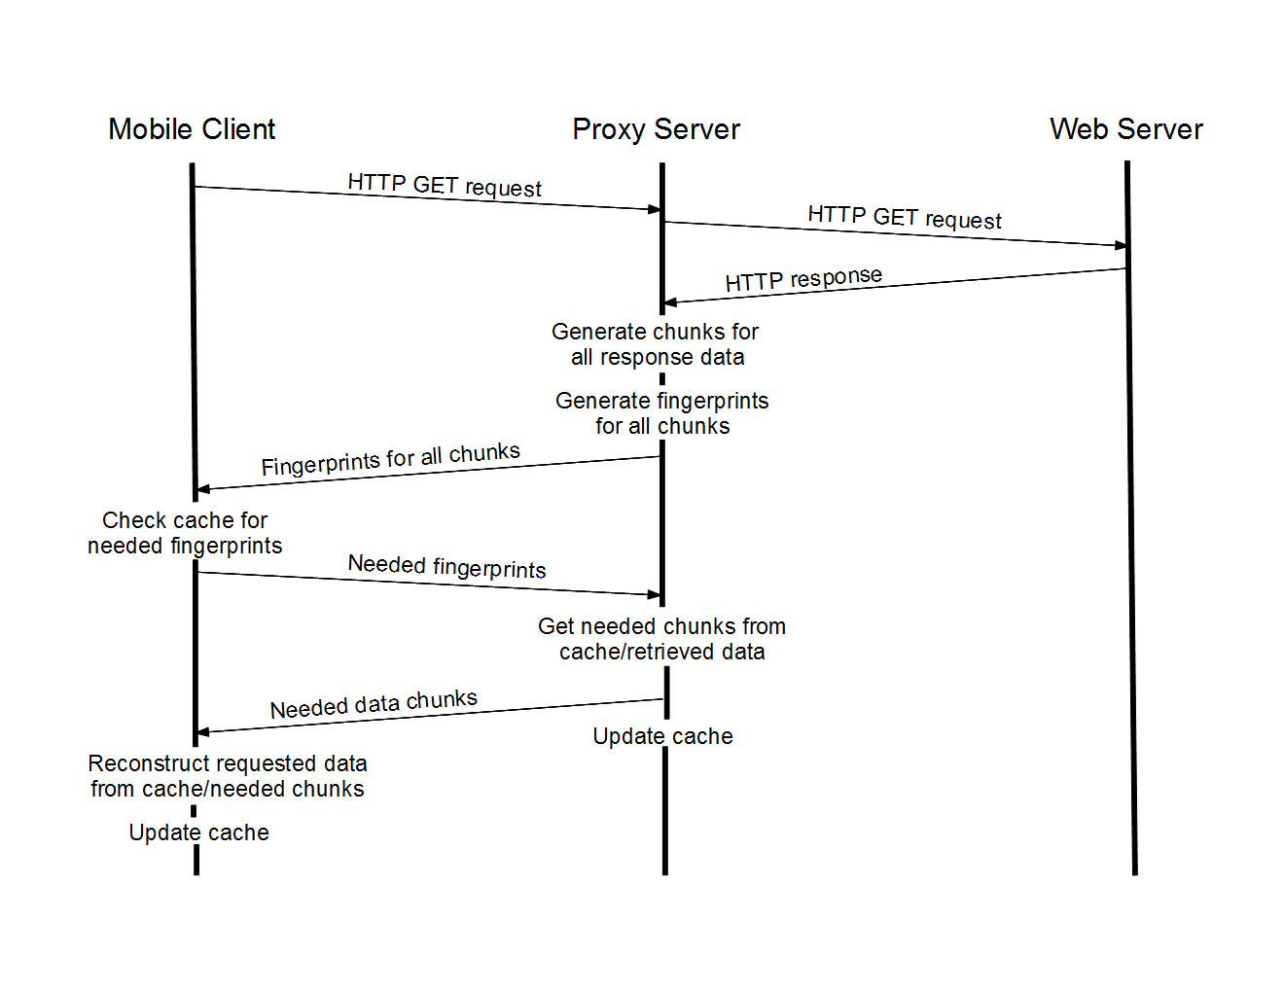
Protocol

Slide 6
Implementation - Offline
Two simulators:
  Find intra-website redundancy.
  Find inter-website redundancy.
Use Wireshark and telnet to collect HTTP response packet bytes from browsing.
Simulator iterates over data files.
Calculates proxy and mobile cache missrates each round.

Slide 7
Implementation - Networked
Basic standalone proxy server.
Mobile client simulator:
  Allows for sequential requests.
  Reconstructs received data into HTML pages.
Caching eviction scheme: MRU.

Slide 8
Demo

Slide 9
Mobile Chunked
Mobile Not Chunked
Desktop Chunked
Desktop Not Chunked

Slide 10
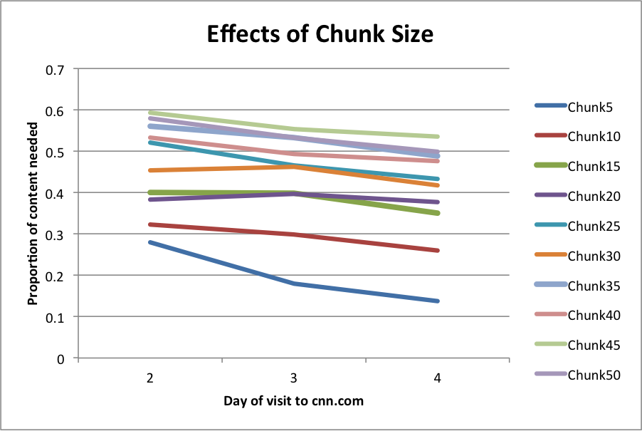

Slide 11
Transfer
Missrate

Slide 12
chunk10

Slide 13
Chunked Transfer
Not Chunked

Slide 14
Future Work & Conclusion
Future work:
  Delta encoding of chunks to achieve higher dedup.
  Implementation using smartphones.
  Look at mobile app HTTP traffic

Slide 15
Questions? Comments?

