Slide 1
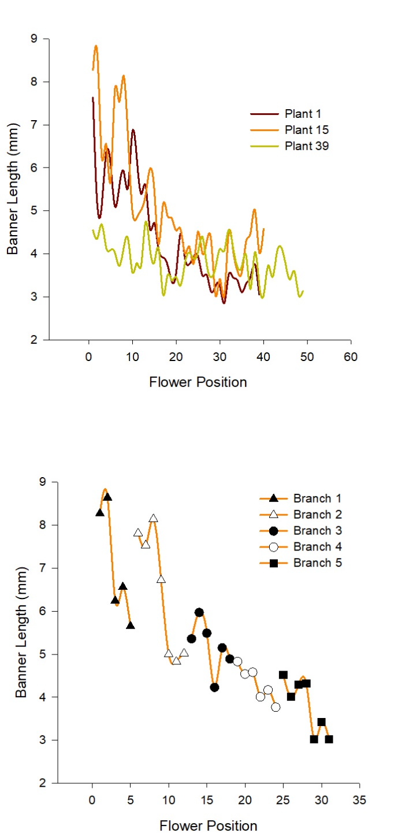
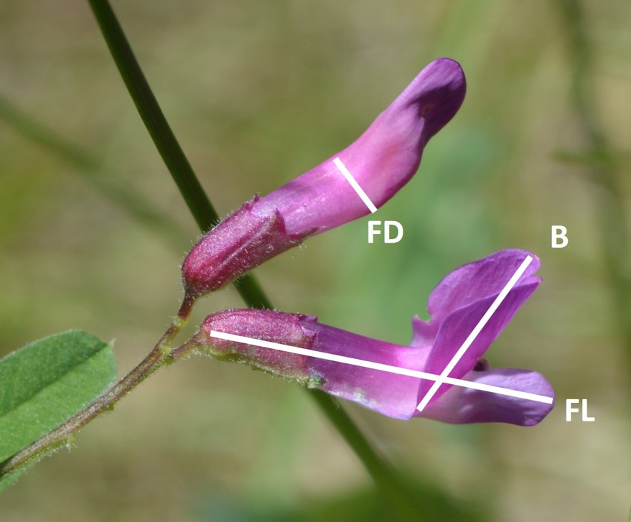
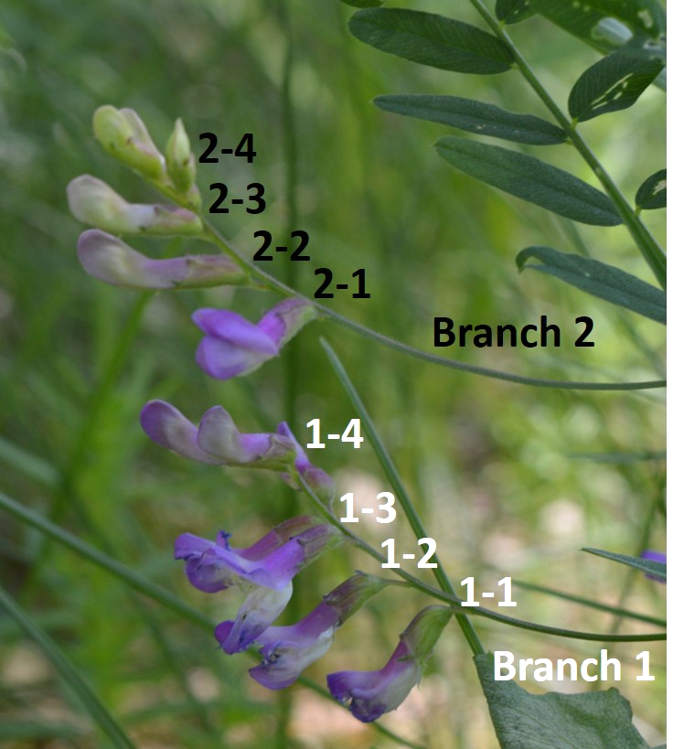
Floral Traits:
B – banner height
FD – flower diameter
FL – flower length
Functional Regression Model:
Seeds ~ functional(banner height) + Branch.Number,
Offset=total.flower.number

