Slide 1
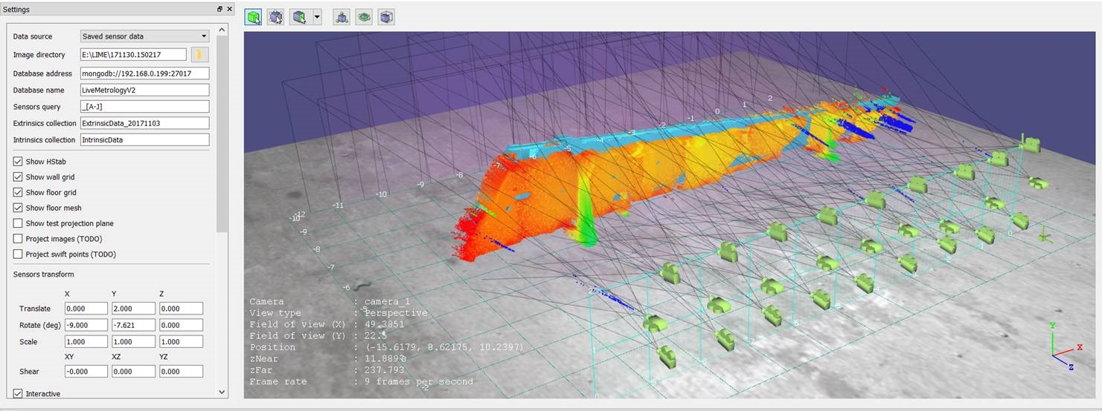
Live Metrology: Boeing Salt Lake System Integration Lab
High Level Requirement
Long-range: Generate 3D point cloud of H-stab in less than 5 minutes to 3 thou accuracy
Approach
Hierarchical Sensor Configuration
Low resolution: fixed sensors provide contextual information
High resolution: Pan/tilt-mounted sensors
Technologies
Polarized light
Structured light
Texture to increase correspondences
Encoding to limit search
Stereo + depth (Time of flight)
Shape from Shading
Surface derivatives and continuity
Global coordinate system
Highly accurate calibration process is critical
(Focus of this presentation)

Slide 2
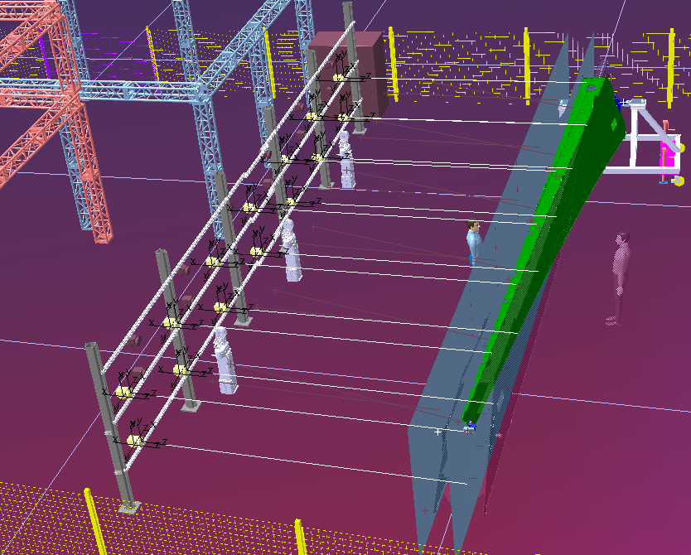
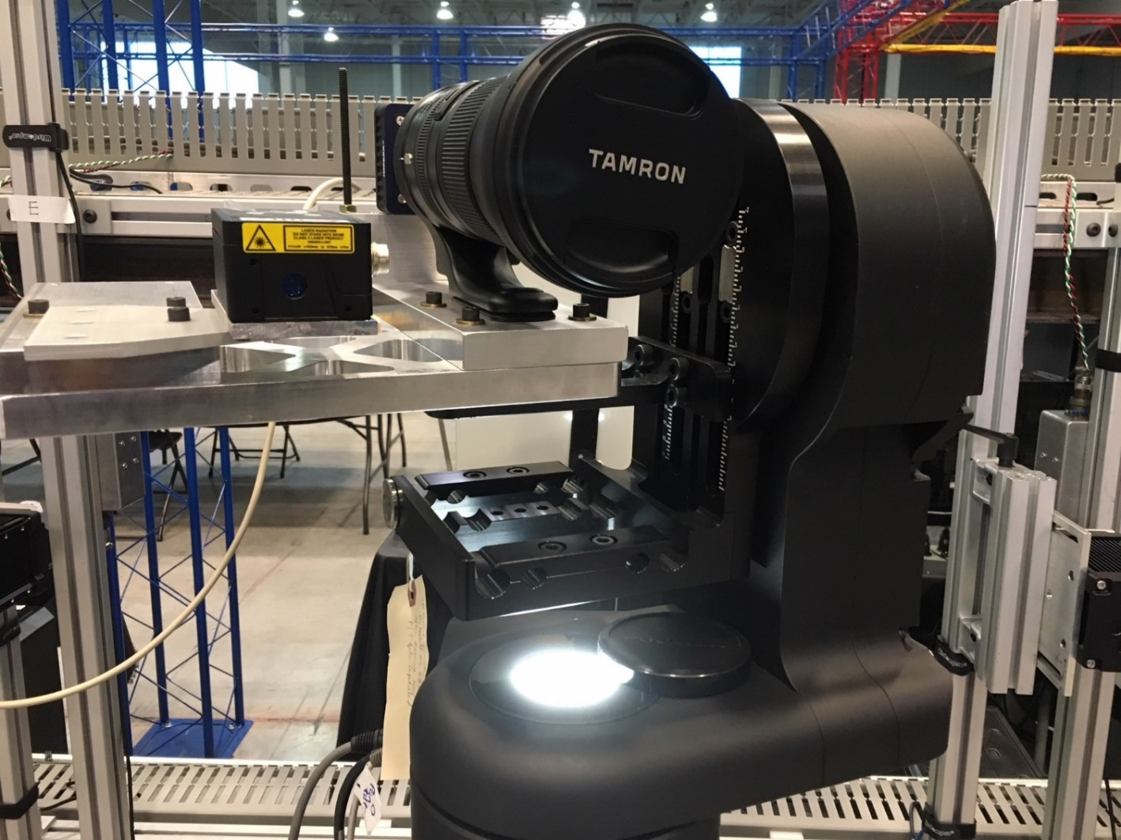
Dynamic Scanning Calibration Requirements
Static Scene Calibration
Dynamic Scene Calibration
y
Rangefinder
x
Tilt axis
Pan axis
Static calibration requirement
Sub-pixel mean reprojection error
Dynamic calibration requirement
Given the pan, tilt values of the unit
Mounted sensors have sub-pixel mean reprojection error relative to sensor wall

Slide 3
Dynamic (Pan-Tilt) Scanning Approach [LIVPLN-4]
Supplement the fixed sensor wall with dynamic scanning capability
Enable higher-resolution, smaller field of view sensors
Photon-X [LIVPLN-13]
Imperx stereo and structured light [LIVPLN-12]
Stereo + depth [LIVPLN-2]
Calibration [LIVPLN-111]
For a given pan-tilt configuration, where do the mounted cameras live relative to the fixed sensor wall
Phase I: Rough-level extrinsics that support path planning with overlapping FOVs
Phase II: High-accuracy extrinsics based on feature extraction
Scan paths [LIVPLN-78, LIVPLN-74]
Camera pairs (and possibly projectors) require overlapping fields of view
Minimize angular distance traveled OR
Minimize number of captures needed based on coverage and overlap needs

Slide 4
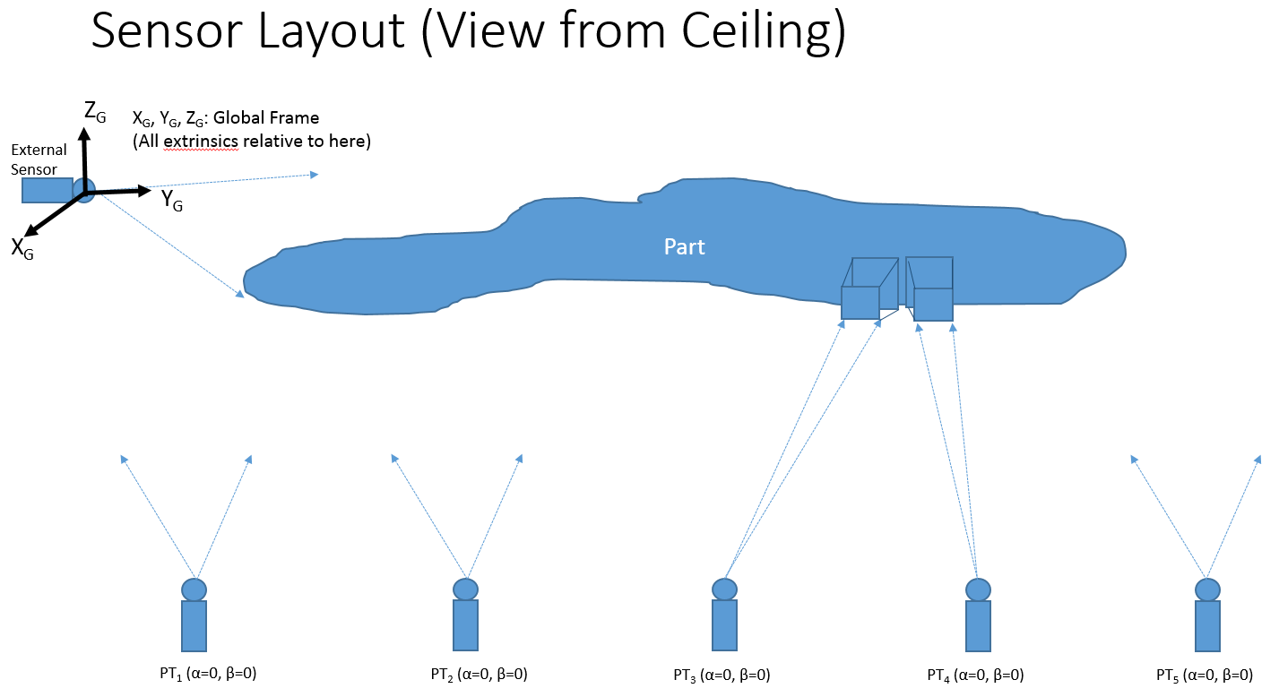
Scan Path Planning
Requires accurate extrinsics model
Sensors will be paired spanning multiple pan-tilt units
A low-res point cloud (perhaps a mesh?) of the part in the World Frame will be provided
Using intrinsics and extrinsics, we will simulate the camera frustum intersections and associated (pan, tilt) values that provide field of view overlap for paired cameras [LIVPLN-74]
A path will provide a sequence of (pan, tilt) values for all units simultaneously [LIVPLN-78]

Slide 5
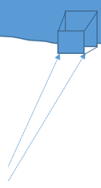


Rail
Application
Stringer
No controllable focus
No pan-tilts
1-d
Calibration
Laser inferometer
Extrinsics relative to the world should be more accurate

Slide 6
Other Considerations
Controllable Focus [LIVPLN-205, LIVPLN-277]
High resolution sensors have a small depth of focus
Focus controllers will adjust focus based on external sensor data
Adds additional calibration complexity
Lighting
Control ambient conditions
Projectors provide texture
Hardware triggering to synchronize image capture

Slide 7

April 2018 Milestone: Dynamic Scanning High-Level Tasks
Sensor Strategies
Photon-X
LIVPLN-4
Alternate [LIVPLN-12]
Lighting
Rough-Order Calibration [LIVPLN-111]
Next-Level Extrinsic Accuracy (e.g. feature extraction)
1
?
Others
Focus Controller
[LIVPLN-205,209,277]
Depth of Field Control [LIVPLN-468]
Notes:
Rough-order calibration ~160 hrs
Focus controller ~300 hrs
Path planning ~120 hrs
Frustum sim ~80 hrs
Focus controller work in in parallel with all others
Feature extraction likely in critical path
Timeline?
Low-res point cloud comes from static sensors
Task for CSIRO
Move frustum work into BoeingMetrologyLib
Request from Anthony
Block diagrams and class diagrams for #4
5
Low-Res Point Cloud in World Frame
[numerous]
Overexposure Avoidance [LIVPLN-467]
2
Frustum Simulation
[LIVPLN-74]
Lighting Control
3
Coordinated Scanning (Path Planning) Algorithm
[LIVPLN-78]
4
2018
Jan | Feb | Mar | Apr | June | July | August | Sept
4
1
2
3
4
5

Slide 8
Pan/Tilt Calibration Schedule
Goal: Rough level accuracy to support scan path planning
Software/Process Remaining Tasks
ZMQ comms for Acuity (20 hrs)
Pan-tilt management in the database (4 hrs)
Finish calibration collection workflow (16 hrs)
Collect valid data
Currently at 40’ – multiple intrinsic calibrations (8 hrs)
Potential to use monitor and only a single intrinsic calibration
Collect actual pan/tilt sweeps (8 hrs)
Improved process that uses more collection data to improve accuracy NEW
Verification of SensorGeometry (computes pan-tilt rotation axes and rangefinder extrinsics in the camera’s frame) (8 hrs)
See “Dual Mounted Camera and Rangefinder Calibration” document
Process to transform to world frame (80 hrs)
Known issue about tracking axes transforms as pan and tilt change
Other units on the wall must view the calibration board
Verification
?
Potential rework (40 hrs)
Hardware Tasks (?)
Acuity mounting and cabling
Imperx mounting and cabling
Summary: By March 6 (4 weeks) we have a software process in place that can be used to calibrate any of the pan-tilt mounted cameras relative to the world. This is a critical input to the scan path planning.

Slide 9
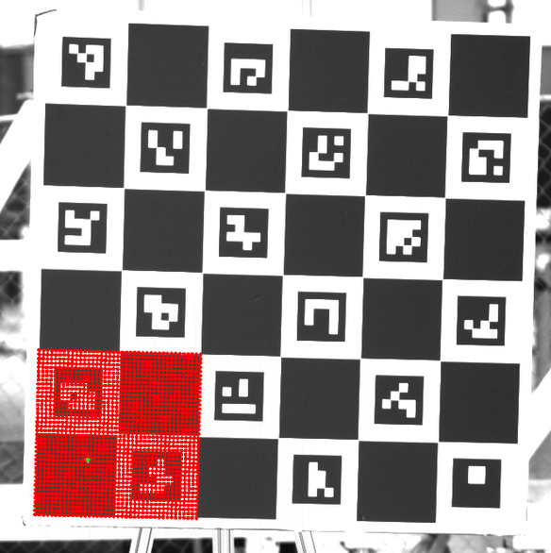

Dynamic Calibration Process
Calibration of static wall defines World Frame (extrinsics of all static sensors)
Pan-Tilt Sweeps Collect sensor data of known calibration object for mounted sensors (rangefinder + camera)
Extract 3D pose data between calibration object, camera, and rangefinder (Associated with pan, tilt values)
Oper_SensorGeometry
Output
Camera extrinsic model F(pan, tilt)
Rangefinder extrinsic model F(pan, tilt)
Compute extrinsics between rangefinder and camera
Compute rotation axes defined in the mounted Camera’s Coordinate System
Relate the rotation axes to the World Frame with static techniques at a “home position” pan-tilt value
y
x
Rainer
What we need
Transform between Pan-tilt mounted camera and external camera
Pan, Tilt Angle
Calibration Model

Slide 10
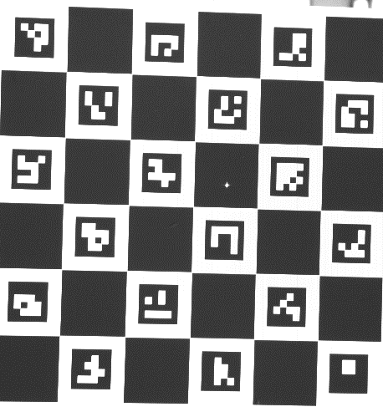
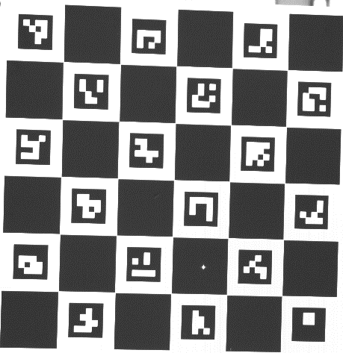
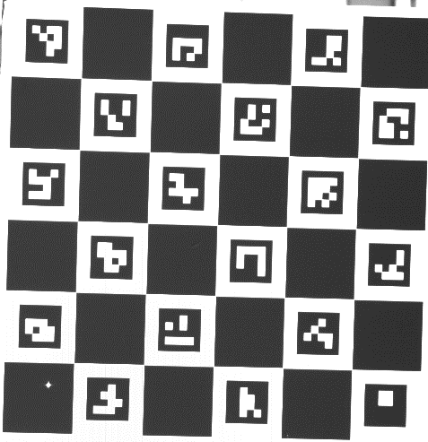
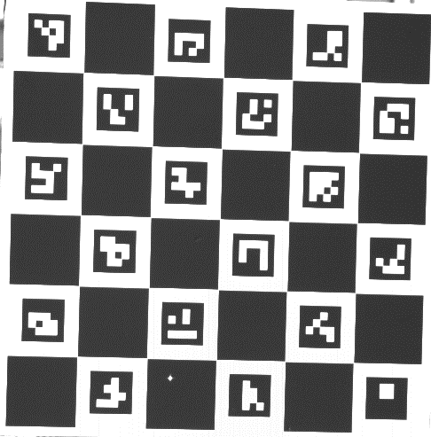
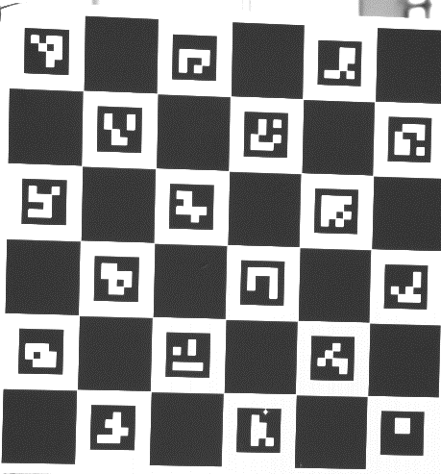
Local Pan/Tilt Calibration Concept
Collection Methodology
Collect L-sweep of pan and tilt data
2 pan only, 2 tilt only, one common frame

Slide 11
Local Pan/Tilt Calibration Concept
Determining 3d Points from Calibration Board
Aruco detector provides pixel coordinates of fiducials from calibration board
Aruco detector provides Object Space coordinates of fiducials from calibration board
Object Space is the right-handed coordinate system whose origin lies on an arbitrary chessboard corner and whose X-Y plane is given by the calibration board.
Scale is determined by the known dimensions of the chessboard squares
The OpenCV routine solvepnp computes the pose of the calibration board in each image with respect to the camera
Uses a form of Levenberg-Marquardt optimization
Provides the transformation for computing 3d Camera Space coordinates from the 2d Object Space coordinates
Camera Space is the right-handed coordinate system whose origin lies at the focal point of the camera lens and whose X-Y plane is parallel to the camera image plane and whose Z-axis points in the camera viewing direction
The OpenCV routine HoughCircles is used to locate circular objects on each checkerboard. The Calibration selects the circle defined by the Rangefinder laser dot
Applies the Hough Transform to find circles
The laser dot center is converted into a 3d point in camera space using an iterative grid-based search
A grid of points about the closest chessboard corner (in Object Space) is reprojected onto the image.
A new (finer) grid is generated about the point (in Object Space) whose reprojection is closest to the pixel coordinates of the laser dot center

Slide 12
Local Pan/Tilt Calibration Concept
Determining Pan / Tilt Rotation Axes
From the perspective of the camera, during a series of pan movements (or tilt movements, but NOT mixed) a single point (e.g. a chessboard corner) will move along the arc of a circle whose center lies on the desired rotation axis.
3 points along this arc will allow us to determine the plane containing the circle (i.e. the plane perpendicular to the rotation axis) from the vector cross product.
The center of the circle (which lies on the rotation axis) can then be found from the intersection of the perpendicular bisectors of chords defined by the 3 points.
Rotation Path
Sample Point
Chord Line
Chord Midpoint
Bisector Line
Center Point
Figure 1 - Geometry of fitting a circle to three points

Slide 13
Local Pan/Tilt Calibration Concept
Determining Rangefinder Orientation and Location
The key behind determination of the location and orientation of the rangefinder (relative to the camera) is to visualize what the system looks like from the perspective of the camera. In this perspective, the rangefinder is in a fixed location, and projects a fixed line through space. As the calibration board rotates through space around the various axes (again, from the camera’s perspective), the location of the projected point will change, but it will always lie along the projected line.
$$R={\left[x_{r}, y_{r}, z_{r}\right]}^{T}=Location of rangefinder in Camera Space$$
$$d=<x_{d}, y_{d},z_{d}> =Rangefinder direction$$
$$P_{i}={\left[x_{pi}, y_{pi}, z_{pi}\right]}^{T}=Observed Rangefinder dot in Camera Space, i∈\{1,2\}$$
$$r_{i}=Rangefinder measurement corresponding to the observed dot, i∈\{1,2\}$$
$$R=P_{1}−r_{1}d=P_{2}−r_{2}d=6 equations and 6 unknowns$$

