Slide 1
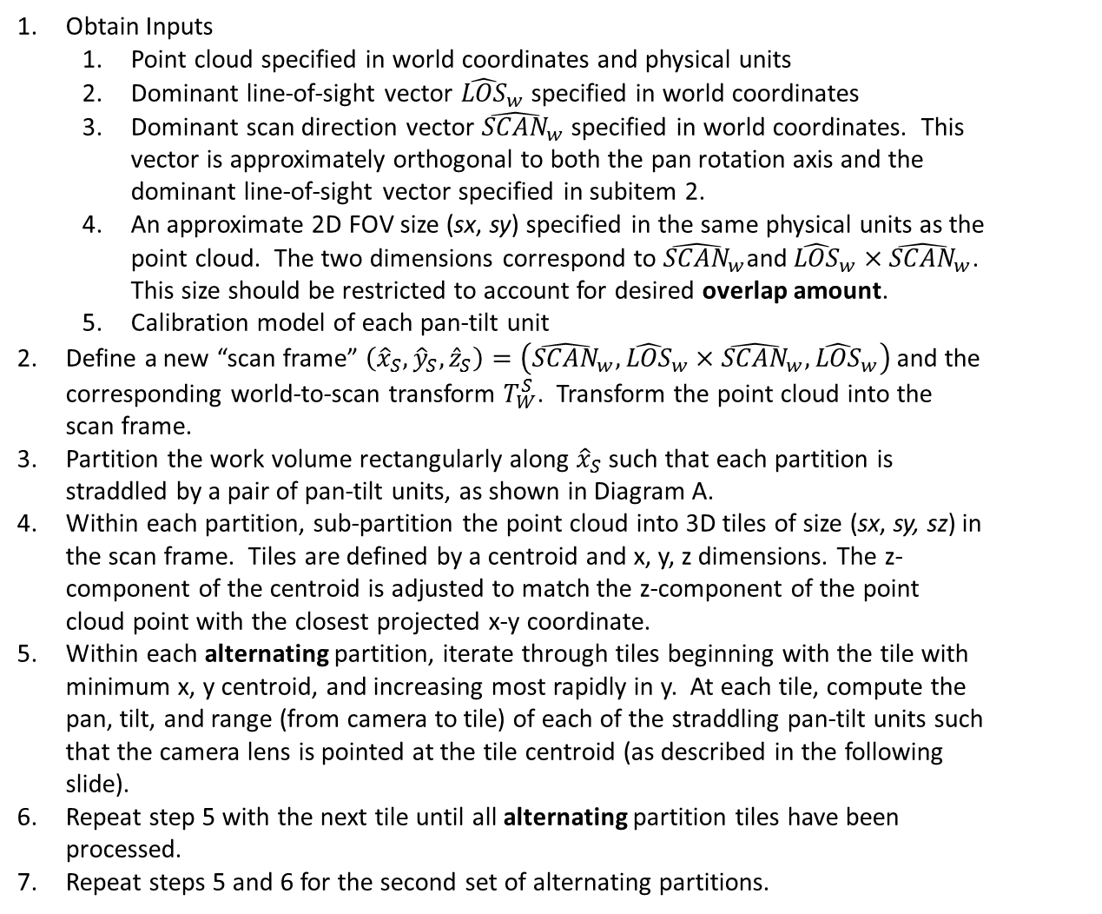
PairWise Pan-Tilt-Mounted Scanning Algorithm
Diagram A
Obtain Inputs
Point cloud specified in world coordinates and physical units
Dominant line-of-sight vector ${\hat{LOS}}_{w}$ specified in world coordinates
Dominant scan direction vector ${\hat{SCAN}}_{w}$ specified in world coordinates. This vector is approximately orthogonal to both the pan rotation axis and the dominant line-of-sight vector specified in subitem 2.
An approximate 2D FOV size (sx, sy) specified in the same physical units as the point cloud. The two dimensions correspond to ${\hat{SCAN}}_{w}$and ${{\hat{LOS}}_{w}×\hat{SCAN}}_{w}$. This size should be restricted to account for desired overlap amount.
Calibration model of each pan-tilt unit
Define a new “scan frame” $\left({\hat{x}}_{S},{\hat{y}}_{S},{\hat{z}}_{S}\right)=\left({\hat{SCAN}}_{w},{{\hat{LOS}}_{w}×\hat{SCAN}}_{w},{\hat{LOS}}_{w}\right)$ and the corresponding world-to-scan transform $T_{W}^{S}$. Transform the point cloud into the scan frame.
Partition the work volume rectangularly along ${\hat{x}}_{S}$ such that each partition is straddled by a pair of pan-tilt units, as shown in Diagram A.
Within each partition, sub-partition the point cloud into 3D tiles of size (sx, sy, sz) in the scan frame. Tiles are defined by a centroid and x, y, z dimensions. The z-component of the centroid is adjusted to match the z-component of the point cloud point with the closest projected x-y coordinate.
Within each alternating partition, iterate through tiles beginning with the tile with minimum x, y centroid, and increasing most rapidly in y. At each tile, compute the pan, tilt, and range (from camera to tile) of each of the straddling pan-tilt units such that the camera lens is pointed at the tile centroid (as described in the following slide).
Repeat step 5 with the next tile until all alternating partition tiles have been processed.
Repeat steps 5 and 6 for the second set of alternating partitions.
Surface
Pan
A
B
C
Partition 1
Partition 2
Surface
Diagram B
Pan
A
B
C

Slide 2







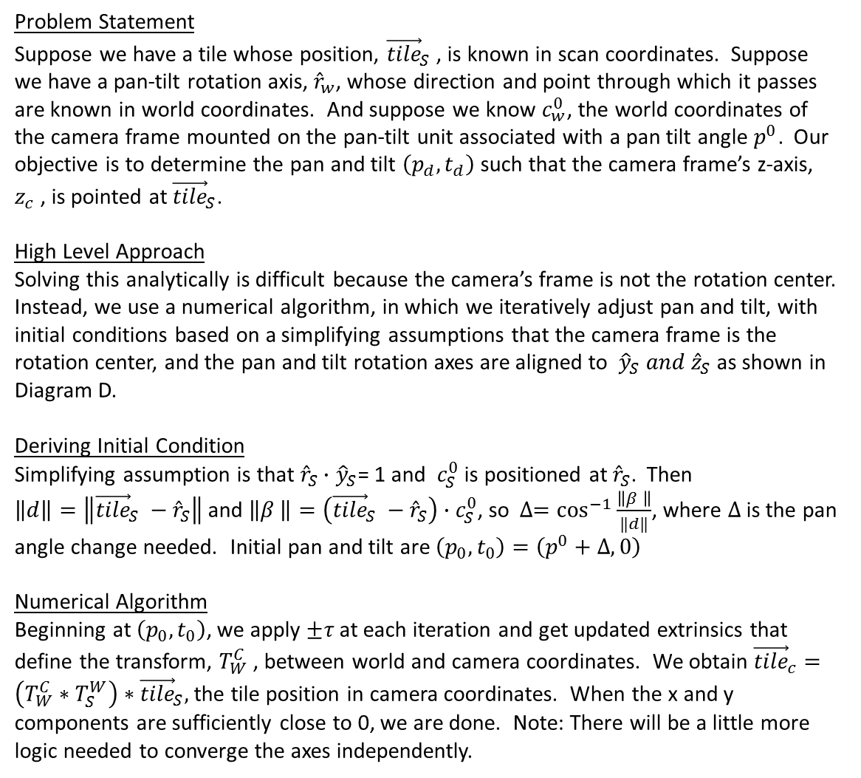




Pan-Tilt-Mounted Lens Pointing Algorithm
Diagram C
Surface
Problem Statement
Suppose we have a tile whose position, ${\vec{tile}}_{S}$ , is known in scan coordinates. Suppose we have a pan-tilt rotation axis, ${\hat{r}}_{w}$, whose direction and point through which it passes are known in world coordinates. And suppose we know $c_{w}^{0}$, the world coordinates of the camera frame mounted on the pan-tilt unit associated with a pan tilt angle $p^{0}$. Our objective is to determine the pan and tilt $\left(p_{d},t_{d}\right)$ such that the camera frame’s z-axis, $z_{c}$ , is pointed at ${\vec{tile}}_{S}$.
High Level Approach
Solving this analytically is difficult because the camera’s frame is not the rotation center. Instead, we use a numerical algorithm, in which we iteratively adjust pan and tilt, with initial conditions based on a simplifying assumptions that the camera frame is the rotation center, and the pan and tilt rotation axes are aligned to ${\hat{y}}_{S} and {\hat{z}}_{S}$ as shown in Diagram D.
Deriving Initial Condition
Simplifying assumption is that ${\hat{r}}_{S}∙$ ${\hat{y}}_{S}$= 1 and $c_{S}^{0}$ is positioned at ${\hat{r}}_{S}$. Then $\left\|d\right\|=\left\|{\vec{tile}}_{S} −{\hat{r}}_{S}\right\|$and $\left\|β \right\|=\left({\vec{tile}}_{S} −{\hat{r}}_{S}\right)∙c_{S}^{0}$, so $∆=\cos^{−1}{\frac{\left\|β \right\|}{‖d‖}}$, where $∆$ is the pan angle change needed. Initial pan and tilt are $\left(p_{0},t_{0}\right)=\left(p^{0}+∆, 0\right)$
Numerical Algorithm
Beginning at $\left(p_{0},t_{0}\right)$, we apply $±τ$ at each iteration and get updated extrinsics that define the transform, $T_{W}^{C}$ , between world and camera coordinates. We obtain ${\vec{tile}}_{c}=\left(T_{W}^{C}∗T_{S}^{W}\right)∗{\vec{tile}}_{S},$ the tile position in camera coordinates. When the x and y components are sufficiently close to 0, we are done. Note: There will be a little more logic needed to converge the axes independently.
$${\vec{tile}}_{S}$$
$$z_{c}$$
$$x_{c}$$
$$z_{c}$$
$${\hat{z}}_{S}$$
$$z_{c}$$
$${\hat{r}}_{S}$$
$$c_{S}^{0},p^{0}$$
$$x_{S}$$
Diagram D
Surface
$$d$$
$$β$$
$$∆$$

Slide 3
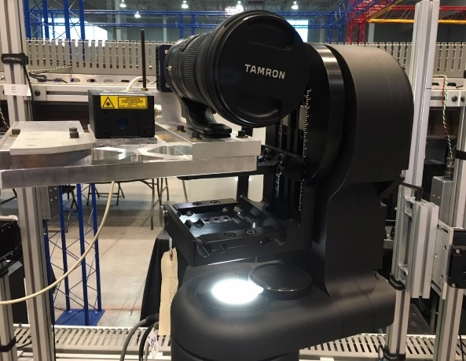




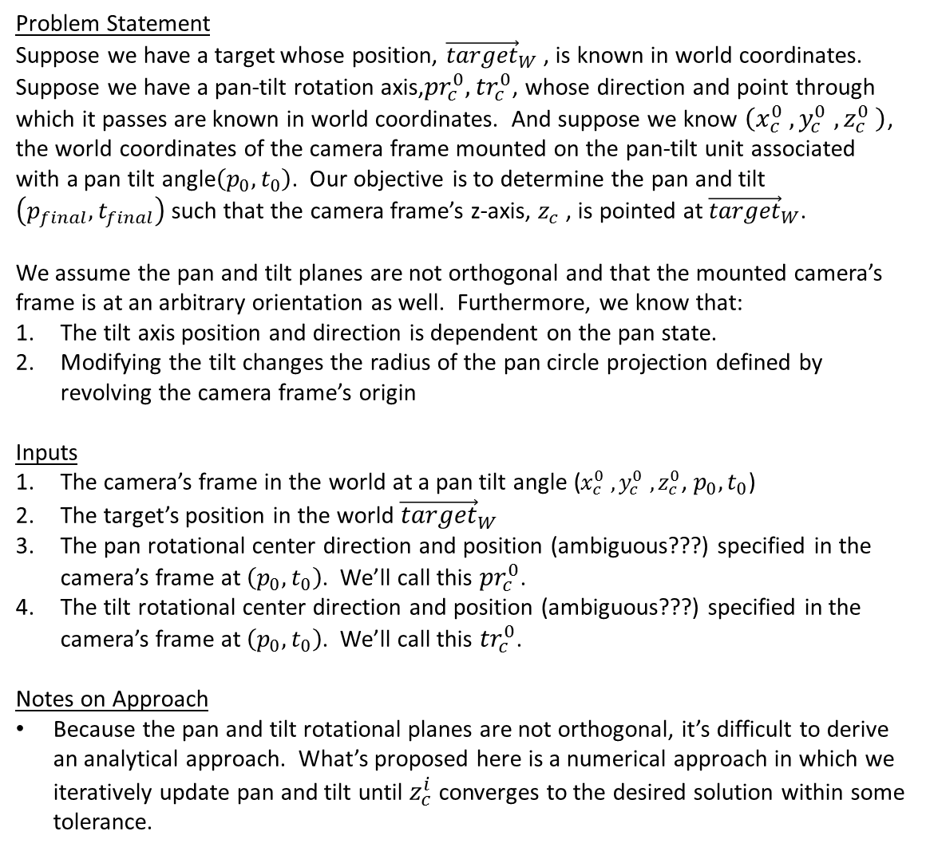







y
Pan-Tilt-Mounted Lens Pointing Algorithm: Problem Statement
x
Problem Statement
Suppose we have a target whose position, ${\vec{target}}_{W}$ , is known in world coordinates. Suppose we have a pan-tilt rotation axis,${pr}_{c}^{0},{tr}_{c}^{0}$, whose direction and point through which it passes are known in world coordinates. And suppose we know $\left(x_{c}^{0} ,y_{c}^{0} ,z_{c}^{0} \right)$, the world coordinates of the camera frame mounted on the pan-tilt unit associated with a pan tilt angle$\left(p_{0},t_{0}\right)$. Our objective is to determine the pan and tilt $\left(p_{final},t_{final}\right)$ such that the camera frame’s z-axis, $z_{c}$ , is pointed at ${\vec{target}}_{W}$.
We assume the pan and tilt planes are not orthogonal and that the mounted camera’s frame is at an arbitrary orientation as well. Furthermore, we know that:
The tilt axis position and direction is dependent on the pan state.
Modifying the tilt changes the radius of the pan circle projection defined by revolving the camera frame’s origin
Inputs
The camera’s frame in the world at a pan tilt angle ($x_{c}^{0} ,y_{c}^{0} ,z_{c}^{0}$, $p_{0},t_{0}$)
The target’s position in the world ${\vec{target}}_{W}$
The pan rotational center direction and position (ambiguous???) specified in the camera’s frame at $\left(p_{0},t_{0}\right)$. We’ll call this ${pr}_{c}^{0}$.
The tilt rotational center direction and position (ambiguous???) specified in the camera’s frame at $\left(p_{0},t_{0}\right)$. We’ll call this ${tr}_{c}^{0}$.
Notes on Approach
Because the pan and tilt rotational planes are not orthogonal, it’s difficult to derive an analytical approach. What’s proposed here is a numerical approach in which we iteratively update pan and tilt until $z_{c}^{i}$ converges to the desired solution within some tolerance.
Tilt axis
Pan axis
$${\vec{target}}_{W}$$
Pan Rotational Plane
$${\vec{T}}_{p}^{W}$$
$$p_{2}$$
$$p_{1}$$
$$z_{c}^{1}$$
$$γ_{pan}$$
$$r_{pan}$$
$$p_{0}$$
$${180 −γ}_{pan}$$
$$z_{c}^{0}$$
$r_{pan}$ changes with tilt

Slide 4




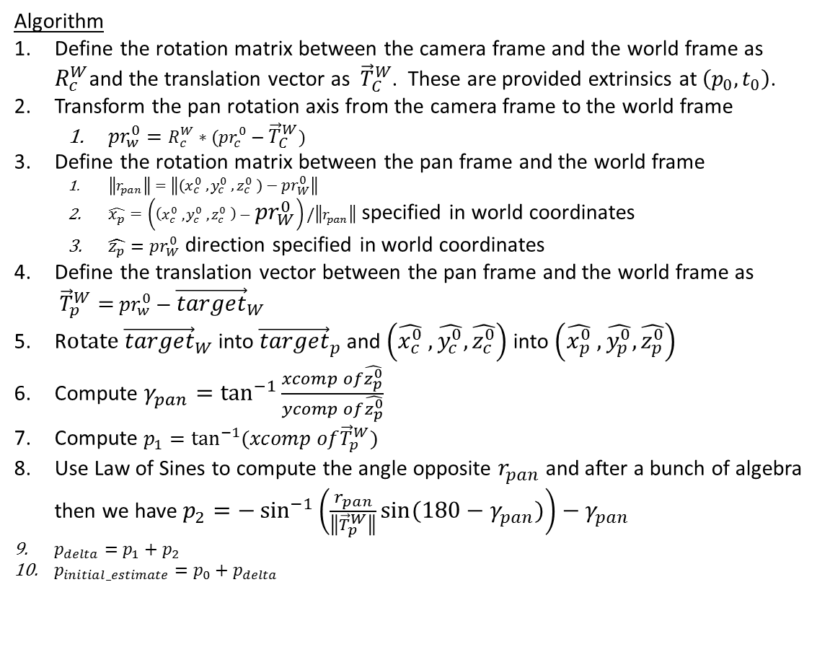







$$\hat{y_{p}}$$
Pan-Tilt-Mounted Lens Pointing Algorithm: Pan Angle Initial Estimate
$${\vec{target}}_{W}$$
Algorithm
Define the rotation matrix between the camera frame and the world frame as $R_{c}^{W}$and the translation vector as ${\vec{T}}_{C}^{W}$. These are provided extrinsics at $\left(p_{0},t_{0}\right)$.
Transform the pan rotation axis from the camera frame to the world frame
${pr}_{w}^{0}=R_{c}^{W}∗({pr}_{c}^{0}−{\vec{T}}_{C}^{W})$
Define the rotation matrix between the pan frame and the world frame
$\left\|r_{pan}\right\|=\left\|\left(x_{c}^{0} ,y_{c}^{0} ,z_{c}^{0} \right)−{pr}_{W}^{0}\right\|$
$\hat{x_{p}}=\left(\left(x_{c}^{0} ,y_{c}^{0} ,z_{c}^{0} \right)−{pr}_{W}^{0}\right)/\left\|r_{pan}\right\|$ specified in world coordinates
$\hat{z_{p}}={pr}_{W}^{0}$ direction specified in world coordinates
Define the translation vector between the pan frame and the world frame as ${\vec{T}}_{p}^{W}=$ ${pr}_{w}^{0}−{\vec{target}}_{W}$
R$otate {\vec{target}}_{W}$ into ${\vec{target}}_{p}$ and $\left(\hat{x_{c}^{0}} ,\hat{y_{c}^{0}},\hat{z_{c}^{0}}\right)$ into $\left(\hat{x_{p}^{0}} ,\hat{y_{p}^{0}},\hat{z_{p}^{0}}\right)$
Compute $γ_{pan}=\tan^{−1}{\frac{xcomp of\hat{z_{p}^{0}}}{ycomp of\hat{z_{p}^{0}}}}$
Compute $p_{1}=\tan^{−1}(xcomp of{\vec{T}}_{p}^{W})$
Use Law of Sines to compute the angle opposite $r_{pan}$ and after a bunch of algebra then we have $p_{2}=−\sin^{−1}\left(\frac{r_{pan}}{\left\|{\vec{T}}_{p}^{W}\right\|}\sin{(180−γ_{pan})}\right)−γ_{pan}$
$p_{delta}=p_{1}+p_{2}$
$p_{initial_estimate}=p_{0}+p_{delta}$
Pan Rotational Plane
$$\hat{x_{p}}$$
$${\vec{T}}_{p}^{W}$$
$$p_{2}$$
$$p_{1}$$
$$z_{c}^{1}$$
$$γ_{pan}$$
$$r_{pan}$$
$$p_{0}$$
$${180 −γ}_{pan}$$
$$z_{c}^{0}$$
$r_{pan}$ changes with tilt

Slide 5



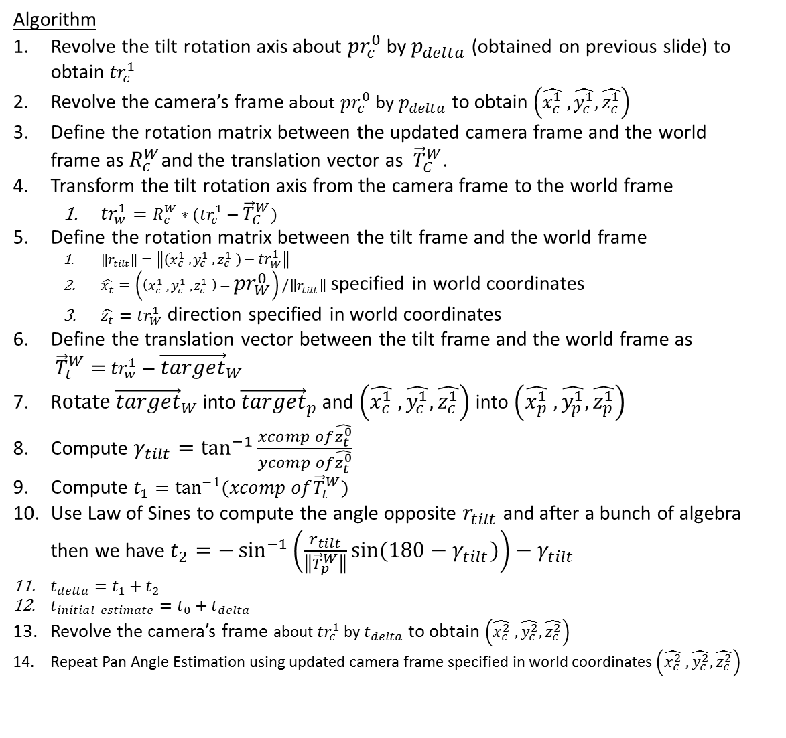






$$\hat{y_{t}}$$
Pan-Tilt-Mounted Lens Pointing Algorithm: Tilt Angle Initial Estimate
Algorithm
Revolve the tilt rotation axis about ${pr}_{c}^{0}$ by $p_{delta}$ (obtained on previous slide) to obtain ${tr}_{c}^{1}$
Revolve the camera’s frame about ${pr}_{c}^{0}$ by $p_{delta}$ to obtain $\left(\hat{x_{c}^{1}} ,\hat{y_{c}^{1}},\hat{z_{c}^{1}}\right)$
Define the rotation matrix between the updated camera frame and the world frame as $R_{c}^{W}$and the translation vector as ${\vec{T}}_{C}^{W}$.
Transform the tilt rotation axis from the camera frame to the world frame
${tr}_{w}^{1}=R_{c}^{W}∗({tr}_{c}^{1}−{\vec{T}}_{C}^{W})$
Define the rotation matrix between the tilt frame and the world frame
$\left\|r_{tilt}\right\|=\left\|\left(x_{c}^{1} ,y_{c}^{1} ,z_{c}^{1} \right)−{tr}_{W}^{1}\right\|$
$\hat{x_{t}}=\left(\left(x_{c}^{1} ,y_{c}^{1} ,z_{c}^{1} \right)−{pr}_{W}^{0}\right)/\left\|r_{tilt}\right\|$ specified in world coordinates
$\hat{z_{t}}={tr}_{W}^{1}$ direction specified in world coordinates
Define the translation vector between the tilt frame and the world frame as ${\vec{T}}_{t}^{W}=$ ${tr}_{w}^{1}−{\vec{target}}_{W}$
R$otate {\vec{target}}_{W}$ into ${\vec{target}}_{p}$ and $\left(\hat{x_{c}^{1}} ,\hat{y_{c}^{1}},\hat{z_{c}^{1}}\right)$ into $\left(\hat{x_{p}^{1}} ,\hat{y_{p}^{1}},\hat{z_{p}^{1}}\right)$
Compute $γ_{tilt}=\tan^{−1}{\frac{xcomp of\hat{z_{t}^{0}}}{ycomp of\hat{z_{t}^{0}}}}$
Compute $t_{1}=\tan^{−1}(xcomp of{\vec{T}}_{t}^{W})$
Use Law of Sines to compute the angle opposite $r_{tilt}$ and after a bunch of algebra then we have $t_{2}=−\sin^{−1}\left(\frac{r_{tilt}}{\left\|{\vec{T}}_{p}^{W}\right\|}\sin{(180−γ_{tilt})}\right)−γ_{tilt}$
$t_{delta}=t_{1}+t_{2}$
$t_{initial_estimate}=t_{0}+t_{delta}$
Revolve the camera’s frame about ${tr}_{c}^{1}$ by $t_{delta}$ to obtain $\left(\hat{x_{c}^{2}} ,\hat{y_{c}^{2}},\hat{z_{c}^{2}}\right)$
Repeat Pan Angle Estimation using updated camera frame specified in world coordinates $\left(\hat{x_{c}^{2}} ,\hat{y_{c}^{2}},\hat{z_{c}^{2}}\right)$
$$\hat{x_{t}}$$
Tilt Rotational Plane (Pan already applied)
$$γ_{tilt}$$
$$z_{c}^{1}$$
$$r_{tilt}$$
$$t_{0}$$
$$z_{c}^{2}$$
$${\vec{T}}_{t}^{W}$$
$${\vec{target}}_{W}$$
Issues
No reason to expect convergence
Rotation axes “position” ambiguous

Slide 6
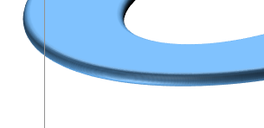

Alternate Approach: Look-up Table for Torus
Camera Frame
Look-Up Table
 |  | Pan Angle
 |  | 0 | 1 | … | 360
Tilt Angle | -90 | Guts of Table Contain: XYZIJK
 | -89
 | …
 | 90
Building the LUT
Given rotation axes in the World Frame at a given pan, tilt value, perform rotations at desired sampling rate
Using the LUT
Let’s say I had a table like this with just XYZIJK. How would I back out pan, tilt given a target position in the world? Generally, we want to minimize dot(I, (target –XYZ.norm())
2D binary search
Assumes no local minima issues
Based on the dot products of the 4 adjacent tabulated values, interpolate p, t
Pan Cross-Section
Tilt Cross-Section
World Frame
*I’m not sure this is exactly a torus when axes are not orthogonal
Advantages of LUT
Can be populated (refined) with external info (e.g. pose graph info)
Search methods and minimization criteria can be added as needed
$${\vec{target}}_{W}$$

Slide 7
Alternate Approach: Look-up Table for Torus
Tasks to Use This Method Without Existing Calibration Work
Align the acuity LOS and the Imperx LOS as close to parallel as possible and as close to orthogonal to the tilt axis as possible
Navigate pan-tilt until laser dot is approximately
level with the floor
Orthogonal to sensor wall
i.e. a tilt sweep should move the laser dot vertically on a board that’s tilted backward but otherwise parallel to the wall
Define the pan axis direction as (0, -1, 0) and the tilt axis direction as (-1, 0, 0)
This is only true if the reference camera is orthogonal to the wall!
Think more about this…
Camera Frame
Pan Cross-Section
Tilt Cross-Section
World Frame
*I’m not sure this is exactly a torus when axes are not orthogonal
Advantages of LUT
Can be populated (refined) with external info (e.g. pose graph info)
Search methods and minimization criteria can be added as needed
$${\vec{target}}_{W}$$

Slide 8
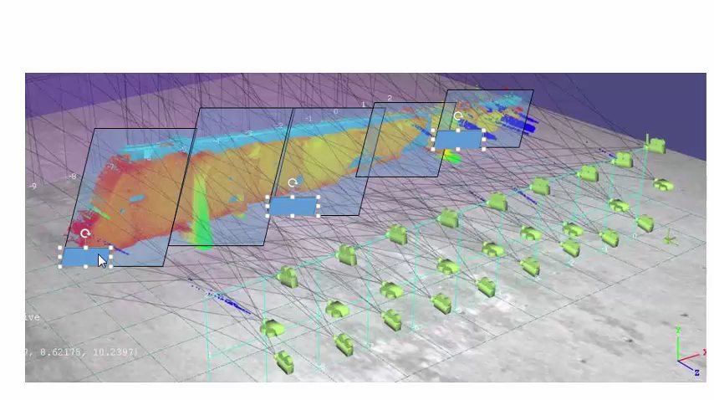
Simple Rectangular Partitioning Cartoon Movie

Slide 9
Calibration Needs
Given a provided pan, tilt pair: output the extrinsics of the camera in the world frame
Inverse: given the direction at which the camera needs to point in the world frame, output the pan, tilt angles (this avoids the numerical approach outline in slide 2)
If numerical approach is needed only:
The pan rotation axis direction in the world frame
The world coordinate through which the pan rotation axis passes when the z-component is constrained to correspond to the tilt rotation axis plane

Slide 10
Control/Path Execution Classes
// A motion unit combined with a sensor suite and the combined state at a single //moment in time
BoeingMetrology::Scanning::Control::ControlStateBase
// Based on specifics of a facility, will generate a path plan for each motion system //calibration model that it’s provided. The output path plan is a sequence of //ControlGroup objects corresponding to that calibration model list.
BoeingMetrology::Scanning::PathPlan
Data Members
motionSystemName
motionSystemType (enum)
Vector<ExtrinsicData> sensorExtrinsics // Camera-to-World
Cv::Point3d targetCoordinate // Position in world
Data Members
Facility // E.g. “BSL Dev Cell”. Dictates simplifying scanning assumptions like nominal LOS, nominal scan direction, and approximate FOV size
Vector<ControlGroup> // List of ControlGroups over time
Methods
GetRangeToTarget() // For a mounted sensor, get range to targetCoordinate
Methods
DetermineWorkVolumeType() // E.g. Facility == BSL Dev Cell -> “Rectangular”
DefinePathPlan()
// A pan-tilt unit combined with a sensor suite and the combined state at a single //moment in time
BoeingMetrology::Scanning::Control::PanTiltControl : ControlStateBase
// Contain a list of ControlStateBase objects
BoeingMetrology::Scanning::Control::ControlGroup
Data Members
Vector<ControlStateBase> // list of motion units and associated sensors
Vector<vector<ConstrolStateNames>> // lists of grouped sensors with overlapping FOVs at each state
Data Members
panAngle, tiltAngle
Methods
GetPanTiltAngle()
Methods
GetSensorNames()
GetMotionSystemNames()

Slide 11
Path Planning Classes
// Determine scan paths for a group of motion units that must be coordinated and //cannot scan independently.
BoeingMetrology::Scanning::PathPlanning::PanTilt::Partition
// A summary representation of a portion of the surface of a point cloud
BoeingMetrology::Scanning::Tile
Data Members
Pair<string, string> panTiltNames
Vector<Pair<Tile, Pair<PanTiltControl, PanTiltControl>>> panTiltControlState // For each tile, a pair of pan-tilt units
Pair<PanTiltCalibModel *, PanTiltCalibModel *> panTiltCalibModelPtrs
Data Members
Int id
Cv::Point3d dimsXYZ
Cv::Point3d projCentroidXYZ
Methods
CreateTiles() // Create tiles within a bounding box given a desired size
SortTiles() // Sort tiles into the desired iteration order
ProcessTiles() // Iterate through tiles and populate this-> panTiltControlState
LensPointerInitCond() // See block diagram
LensPointerNumAlg() // See block diagram
Methods
Tile() // Initialize data members
// Assign motion units to regions of the point cloud to achieve optimal scanning. //Organize the results into a time-dependent sequence of ControlGroup objects
BoeingMetrology::Scanning::PathPlanning::PanTilt::WorkVolume
// A collection of points and any associated transforms that have been applied
BoeingMetrology::Scanning::PointCloud
Data Members
WorkVolumeType // e.g. “Rectangular”
Pair<vector<Partition>, vector<Partition>> partitionList; // Alternating partition lists
PointCloud * pointCloud
vector<PanTiltCalibModel *>; // List of Pan-tilts in the work volume
Data Members
Vector<cv::Point3d> points;
Cv::Mat3x4 transform // All transforms applied since creation
Methods
TransformToScanFrame()
PartitionWorkVolume() // Partition such that adjacent pan-tilts straddle each partition. Populate this->partitionList
ProcessAlternatingPartitions() // Iterate through this->partitionList and call Partition::ProcessTiles()
FinalizeControlGroupSequence() // Re-arrange PanTiltControl from partition-dependence into a time-dependent list of ControlGroups
Methods
ProjectedNN() // Project a point into a plane and find the closest point in 2D
BoundingBox() // Compute the bounding box of the point cloud
TransformFrame() // Apply a transform to the point cloud

Slide 12
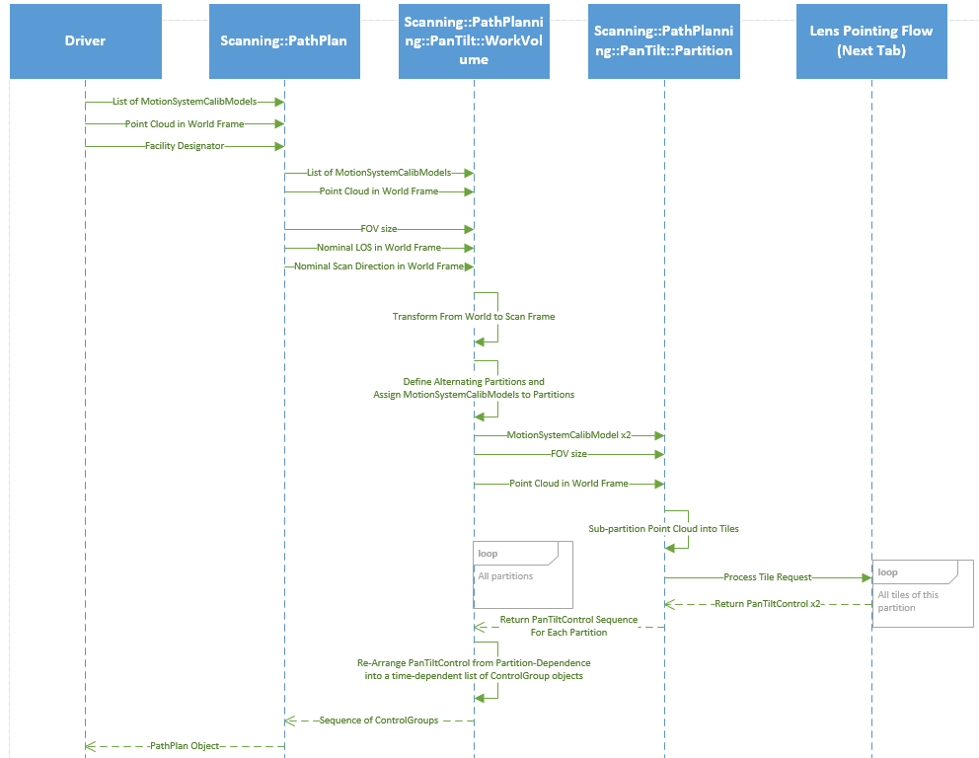
Path Planning Flow Diagram

Slide 13
Lens-Pointing Flow Diagram

Slide 14

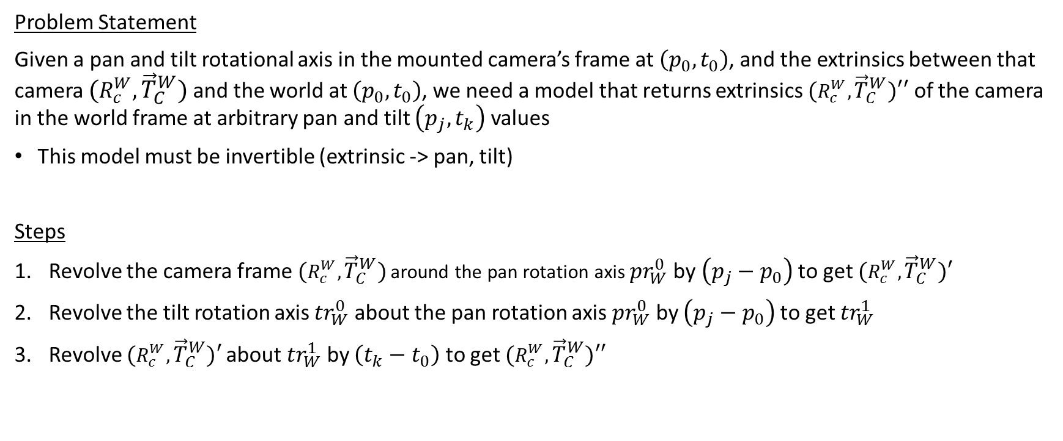
Pan-Tilt Calibration: Angle-Dependent Extrinsics
Problem Statement
Given a pan and tilt rotational axis in the mounted camera’s frame at $\left(p_{0},t_{0}\right)$, and the extrinsics between that camera ${(R_{c}^{W},\vec{T}}_{C}^{W})$ and the world at $\left(p_{0},t_{0}\right)$, we need a model that returns extrinsics ${(R_{c}^{W},\vec{T}}_{C}^{W})′′$ of the camera in the world frame at arbitrary pan and tilt $\left(p_{j},t_{k}\right)$ values
This model must be invertible (extrinsic -> pan, tilt)
Steps
Revolve the camera frame ${(R_{c}^{W},\vec{T}}_{C}^{W})$ around the pan rotation axis ${pr}_{W}^{0}$ by $\left(p_{j}−p_{0}\right)$ to get ${(R_{c}^{W},\vec{T}}_{C}^{W})′$
Revolve the tilt rotation axis ${tr}_{W}^{0}$ about the pan rotation axis ${pr}_{W}^{0}$ by $\left(p_{j}−p_{0}\right)$ to get ${tr}_{W}^{1}$
Revolve ${(R_{c}^{W},\vec{T}}_{C}^{W})′$about ${tr}_{W}^{1}$ by $\left(t_{k}−t_{0}\right)$ to get ${(R_{c}^{W},\vec{T}}_{C}^{W})′′$
Revolving A Point (Or Vector) Around An Axis
Rotate the point into the “Axis Frame”
Apply 2D rotation in “Axis Frame”
Rotate back to original frame
Deriving Angle Of Revolution That’s Needed
Rotate the two points into the “Axis Frame”
Angle = acos(dot(p1,p2)) <- replace with atan2
Inverses
$R_{Orig}^{Orig′}=R_{axis}^{orig}$*$R_{axis}^{axis′}$*$R_{orig}^{axis}$

Slide 15
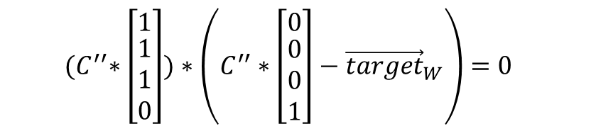


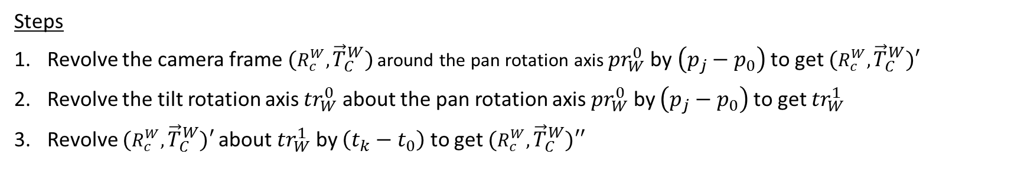



Pan-Tilt Calibration: Angle-Dependent Extrinsics
Steps
Revolve the camera frame ${(R_{c}^{W},\vec{T}}_{C}^{W})$ around the pan rotation axis ${pr}_{W}^{0}$ by $\left(p_{j}−p_{0}\right)$ to get ${(R_{c}^{W},\vec{T}}_{C}^{W})′$
Revolve the tilt rotation axis ${tr}_{W}^{0}$ about the pan rotation axis ${pr}_{W}^{0}$ by $\left(p_{j}−p_{0}\right)$ to get ${tr}_{W}^{1}$
Revolve ${(R_{c}^{W},\vec{T}}_{C}^{W})′$about ${tr}_{W}^{1}$ by $\left(t_{k}−t_{0}\right)$ to get ${(R_{c}^{W},\vec{T}}_{C}^{W})′′$
Revolving A Point (Or Vector) Around An Axis
Rotate the point into the “Axis Frame”
Apply 2D rotation in “Axis Frame”
Rotate back to original frame
Deriving Angle Of Revolution That’s Needed To Rotate From p to p’
Rotate the two points into the “Axis Frame”
Angle = acos(dot(p,p’)) <- replace with atan2
$R_{Orig}^{Orig′}=R_{axis}^{orig}$*$R_{axis}^{axis′}$*$R_{orig}^{axis}$
$$p^{′}=R_{Orig}^{Orig^{′}}∗p$$
Single-Axis Case
$${R_{orig}^{axis}∗(p}^{′}∗p^{−1})∗R_{axis}^{orig}=R_{axis}^{axis′}$$
decompose
Applying Pan & Tilt Rotation
Revolve camera frame around pan axis
$C′={(R}_{pan}^{world}$*$R_{pan}^{pan′}$*$R_{world}^{pan})∗C$
Revolve tilt axis around pan axis
$R_{world}^{tilt}′={(R}_{pan}^{world}$*$R_{pan}^{pan′}$*$R_{world}^{pan})∗R_{world}^{tilt}$
Revolve camera frame around tilt’ axis
$C′′={(R}_{tilt}^{world}\text{'}\text{*}R_{tilt}^{tilt^{′}}\text{*}R_{world}^{tilt}′)∗C′$
Substitution:
$C′′={(R}_{tilt}^{world}\text{′}\text{∗}R_{tilt}^{tilt^{′}}\text{∗}R_{world}^{tilt}′)∗({(R}_{pan}^{world}\text{*}R_{pan}^{pan^{′}}\text{*}R_{world}^{pan})∗C)$
…
$${(C}^{′′}∗\left[\begin{matrix}1 \\ \begin{matrix}1 \\ 1 \\ 0\end{matrix}\end{matrix}\right])∗\left(C^{′′}∗\left[\begin{matrix}0 \\ \begin{matrix}0 \\ 0 \\ 1\end{matrix}\end{matrix}\right]−{\vec{target}}_{W}\right)=0$$
Multi-Axis Case
$C′′=R∗C$

Slide 16
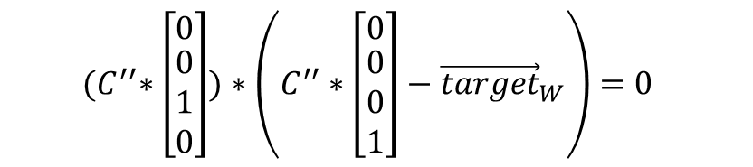
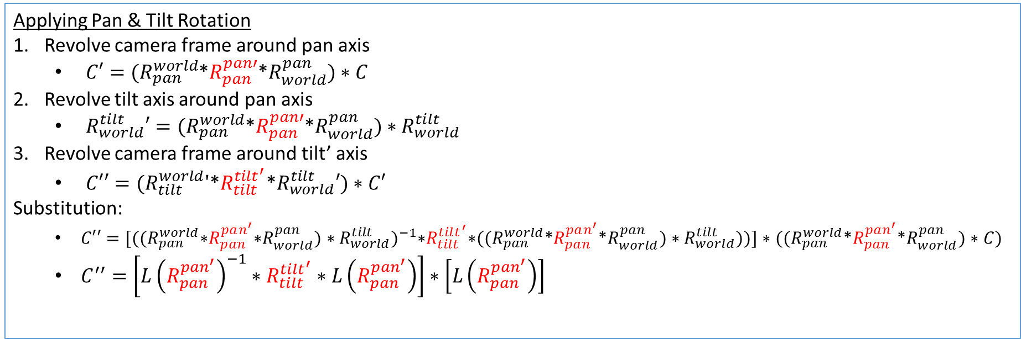
Pan-Tilt Calibration: Angle-Dependent Extrinsics
Applying Pan & Tilt Rotation
Revolve camera frame around pan axis
$C′={(R}_{pan}^{world}$*$R_{pan}^{pan′}$*$R_{world}^{pan})∗C$
Revolve tilt axis around pan axis
$R_{world}^{tilt}′={(R}_{pan}^{world}$*$R_{pan}^{pan′}$*$R_{world}^{pan})∗R_{world}^{tilt}$
Revolve camera frame around tilt’ axis
$C′′={(R}_{tilt}^{world}\text{'}\text{*}R_{tilt}^{tilt^{′}}\text{*}R_{world}^{tilt}′)∗C′$
Substitution:
$C′′={[{((R}_{pan}^{world}\text{∗}R_{pan}^{pan^{′}}\text{∗}R_{world}^{pan})∗R_{world}^{tilt})}^{−1}\text{∗}R_{tilt}^{tilt^{′}}\text{∗}({(R}_{pan}^{world}\text{*}R_{pan}^{pan^{′}}\text{*}R_{world}^{pan})∗R_{world}^{tilt}))]∗({(R}_{pan}^{world}\text{*}R_{pan}^{pan^{′}}\text{*}R_{world}^{pan})∗C)$
$C^{′′}=\left[L{\left(R_{pan}^{pan^{′}}\right)}^{−1}∗R_{tilt}^{tilt^{′}}∗L\left(R_{pan}^{pan^{′}}\right)\right]∗\left[L\left(R_{pan}^{pan^{′}}\right)\right]$
…
$${(C}^{′′}∗\left[\begin{matrix}0 \\ \begin{matrix}0 \\ 1 \\ 0\end{matrix}\end{matrix}\right])∗\left(C^{′′}∗\left[\begin{matrix}0 \\ \begin{matrix}0 \\ 0 \\ 1\end{matrix}\end{matrix}\right]−{\vec{target}}_{W}\right)=0$$
Multi-Axis Case

