Slide 1
Move-DID
-- the DID protocol
implmentation on Aptos Network
NonceGeekDAO
2022 / 12

Slide 2
Short Introduction
MoveDID is a DID protocol that follows the w3c specification, and is implemented on Aptos.
The vision of MoveDID is to be the foundation for the next generation of large-scale Web3 finance and Web3 society.
MoveDID could be used for 3 types of subjects: human, organization, and bot.
https://movedid.build
https://manager.movedid.build
https://docs.movedid.build
https://github.com/NonceGeek/MoveDID

Slide 3
DID is the foundation of "large-scale Web3 financial system" and "large-scale Web3 society"
01

Slide 4
DID is the foundation of "large-scale Web3 financial system"
Build Web3 Fintech System：
* Level 0x03 —— Derivatives and other modern financial products
* Level 0x02 —— Credit and Credentials（SBT）
* Level 0x01 —— Token、Behaviour & Data
* Level 0x00 —— Identity (DID)

Slide 5
DID is the foundation of "large-scale Web3 society"
Build Web3 Society：
* Level 0x03 —— Communities make up society
* Level 0x02 —— Social relationships make up communities
* Level 0x01 —— Token、Behaviour & Data
* Level 0x00 —— Identity（DID）

Slide 6
Why impl DID on Move？
02

Slide 7
Why Impl DID on Move?
Ethereum is not natively adapted to large-scale financial scenarios.
Fintech on Ethereum belongs to spontaneous growth, and there is no L0x00 position in the ecosystem (domain name and did are not equivalent).

Slide 8
Why Impl DID on Move?
Resource-based Move Chains & DID are highly matched（主权个人）
DID is really stored under each account, not in the contract
Facing large-scale users is both Move-Chains' vision and DID's vision

Slide 9
Should only human be the subject of DID?
03

Slide 10
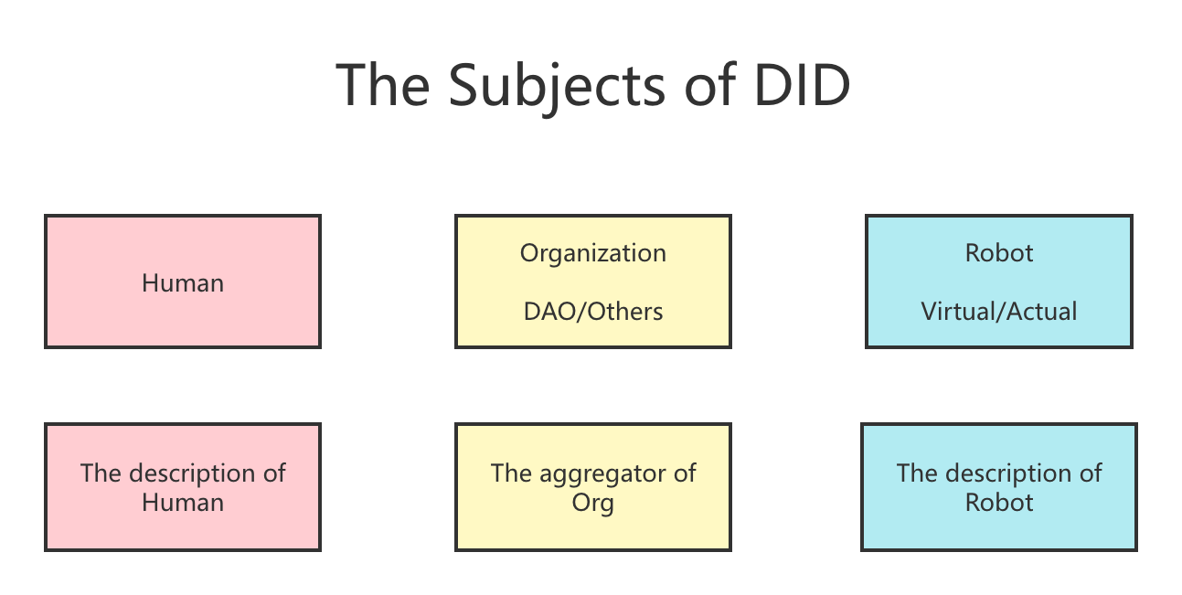
The subjects of DID

Slide 11
Quick Introduction for MoveDID
04

Slide 12
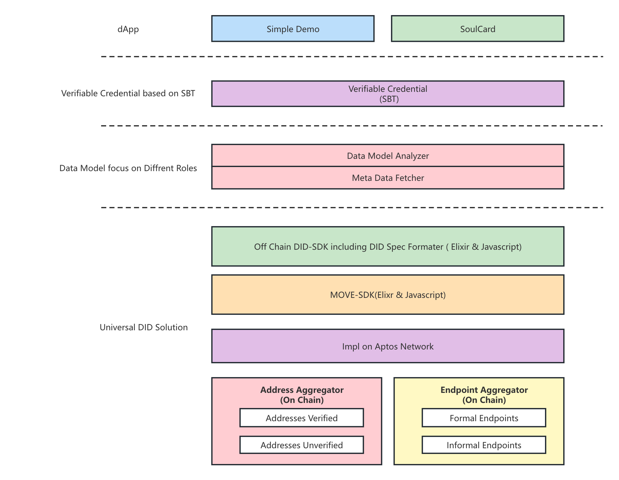
Quick Introduction for MoveDID
The first DID protocol for the Move Ecosystem
https://movedid.build
https://github.com/NonceGeek/MoveDID
MoveDID is in the first batch of aptos grant
The MVP version of the upper-layer application SoulCard won the 2022 Polkadot Summer Hackathon College Track Award & the first prize of the IPFS track of the 2022 Wanxiang Hackathon

Slide 13
Usage Scenarios of MoveDID
05

Slide 14
Usage Scenarios of MoveDID — Web3
Web3 Usage Scenarios of MoveDID
A complete DID protocol can help prevent sybil attacks without relying on centralized KYC services, while making user portraits more accurate, thereby assisting projects provide better service for real users.
On the basis of the DID protocol, "multi-address single-account login" with both Move and EVM addresses will be implemented to serve multi-chain applications.
Also, various organizations such as DAO can be profiled, so that the organization's on-chain/off-chain behavior, value, and other metrics can be more effectively evaluated.
On the basis of implementing MoveDID following W3C standard, further implementation of the SBT-based Verifiable Credentials Scheme, and buildout of an on-chain credit/credential system will be developed.
More ...

Slide 15
Usage Scenarios of MoveDID — Web2
Web2 Usage Scenarios of MoveDID
One-click login supported by both Web2 and Web3 can be realized through AddrAggregator and EndpointAggregator. For example, if you have connected a verified GitHub account, you can log in either using a browser plug-in or using GitHub. So that Web2 applications can be bridged seamlessly the Web3 world.
It helps Web2 companies to store member identity in a very light-weight solution - just put the member address under the DAO's DID, instead of using the traditional way of issuing NFT to members.
More...

Slide 16
dApp Example based on MoveDID
06

Slide 17
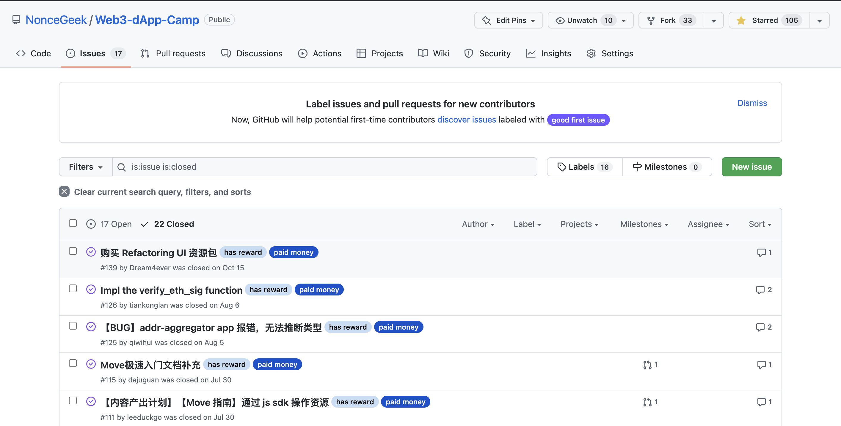
Application - DAO System based on Github
Background: The Github-based DAO model has been well practiced in NonceGeekDAO and requires the corresponding tool set for matching.
Notes:
// TODO：产品逻辑简述

Slide 18
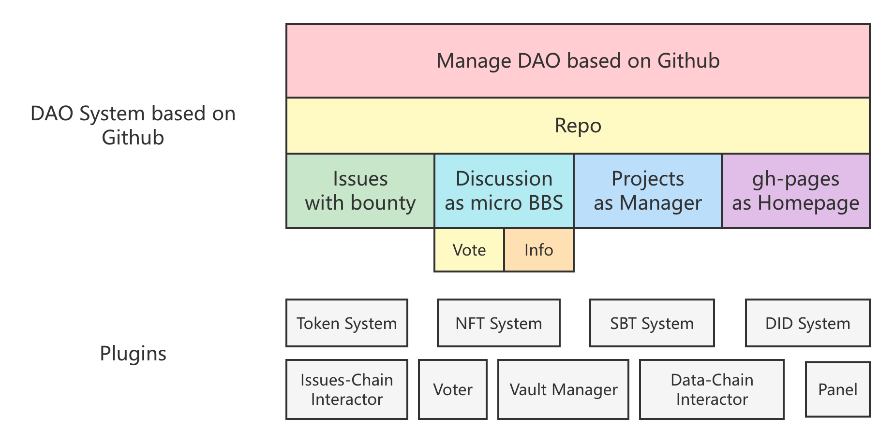
Application - DAO System based on Github
A DAO System based on Github that using MoveDID as the basic identity module
Notes:
// TODO：产品逻辑简述

Slide 19
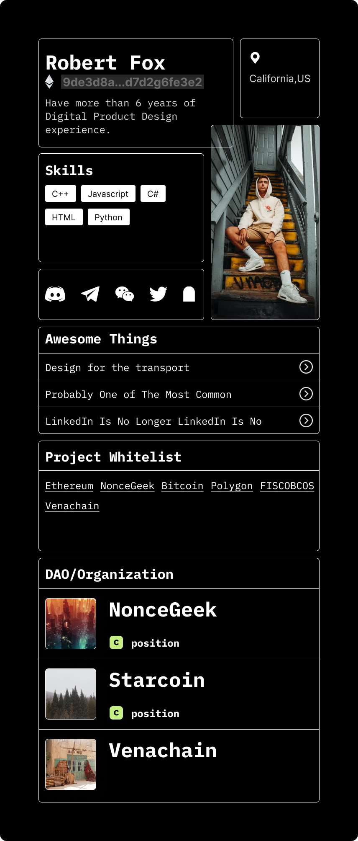
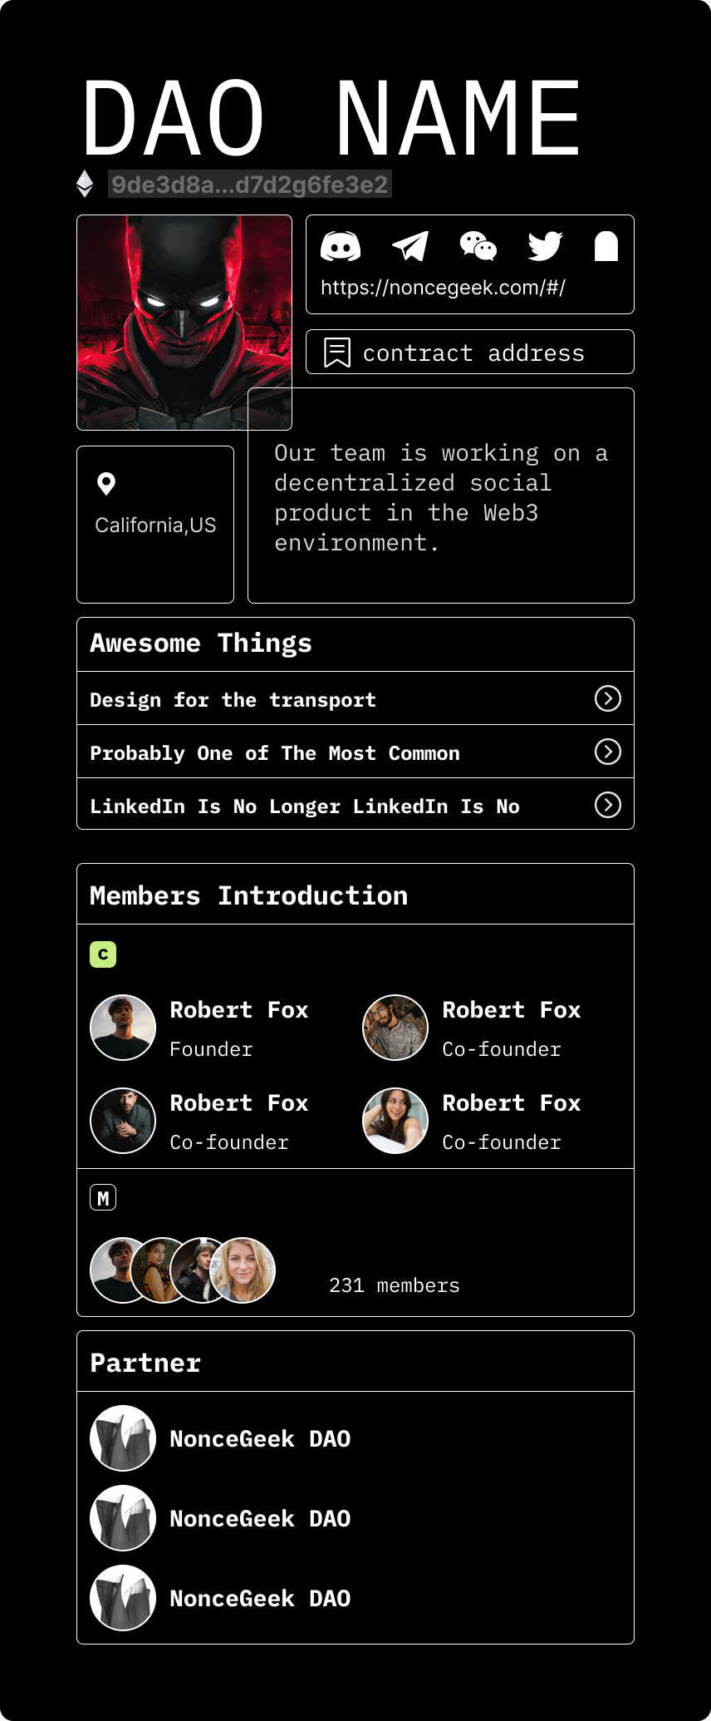
Application - SoulCard
Tai Shang Soul Card
A highly concentrated, interactive Buidler/DAO Namecard based on blockchain addresses and Web2/Web3 information sources
Status of SoulCard
Preview Status, PermaWeb Status(Arweave/IFPS), and NFT Status
Notes:
// TODO：产品逻辑简述

Slide 20
Token Model
07

Slide 21
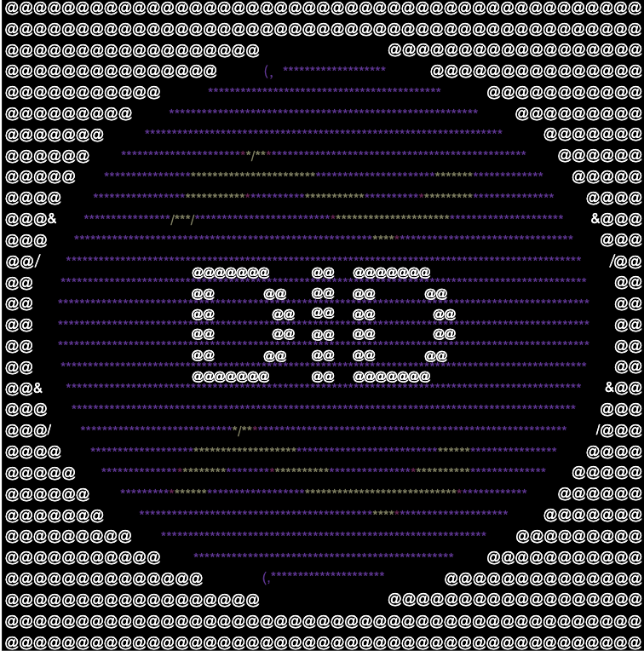
Token Model
Initial Supply 100,000 NFT
Key Words: ASCII
NFT Type | Proportion | Token Number
Community NFT | 50% | 50,000
Right NFT | 25% | 25,000
Airdrop NFT | 25% | 25,000
Notes:
// TODO：产品逻辑简述

Slide 22
Business Model
08

Slide 23
Business Model
MoveDID Protocol Layer — Open Source, Public Good
The MoveDID protocol itself is free and open source, non-profit public goods, and everyone is encouraged to join the MoveDID ecological network.
Data & Application Layer Business Model
* Implement a data model service (Template) for the role of developers, build a data layer ecology with partners, and make commercial profits by providing data services to Busniess-end users.
* Provide business toolset for profit.
Incubator business model (Vision)
On the basis of the protocol layer and data layer, develop the MoveDID application ecosystem (MoveDID Network), and combine HackerHouse and its culture to buidl the NonceGeek incubator.
Notes:
// TODO：产品逻辑简述

Slide 24
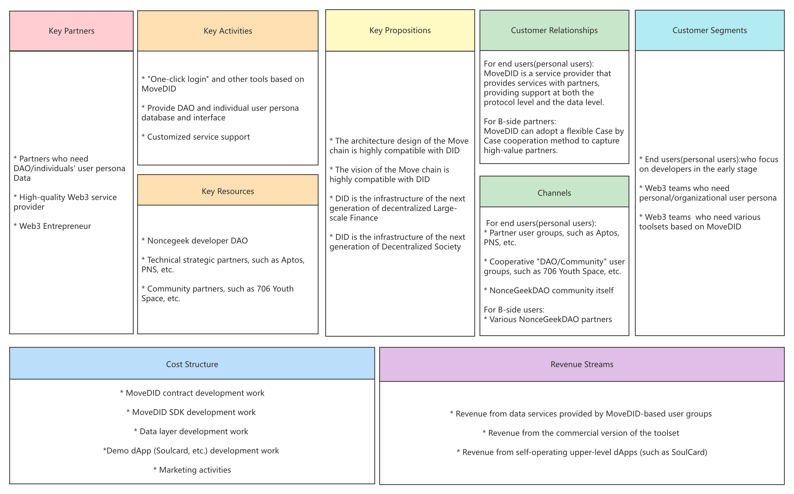
Business Canvas (Outside the Incubator)
Notes:
// TODO：产品逻辑简述

Slide 25
RoadMap
09

Slide 26
Road Map
2023.05.01
SoulCard with MOVE DID
Whitepaper with Token Model release
2023.03.01
publish ex SDK V2.0, publish DID V2.0, publish VC-NFT V2.0, publish dApp Examples
2022.12.01
publish ex SDK V1.0,publish DID V1.0, publish VC-NFT V1.0

Slide 27
Team Introduction
10

Slide 28


Team — NonceGeekDAO
Telegram: @leeduckgo
Wechat: 197626581
https://noncegeek.com
https://github.com/noncegeek
Cool-oriented Programming.

Slide 29
Team — NonceGeekDAO
A Decentralized Developer DAO that based on Github, which focus on Move in 2022
DAO Panel: https://dao.noncegeek.com/
Collaborative Records for MoveDID: https://github.com/NonceGeek/MoveDID/issues?q=is%3Aissue+is%3Aclosed
Web3 dApp Camp based on Github Discussion:
https://github.com/NonceGeek/Web3-dApp-Camp/discussions

Slide 30


Founders
Leeduckgo
Kei
Cool-oriented Programming
Years of experience Web3 Engineer
Master of Peking University
Graduated from HUST with a bachelor's degree
Studied interaction design in the UK
A product manager with 6 years of rich experience

