Slide 1
Python Programming for Finance
CPS 600
Example

Slide 2
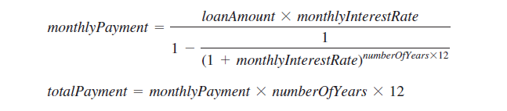
compute loan payments

Slide 3
Examples
python ComputeLoan.py
ipython ComputeLoan.py
Idle
Spyder
Jupyter notebook
Click on ‘ComputeLoan.py”
Pyinstaller --onefile ComputeLoan.py
  Creates dist\ComputeLoan.exe
GUI: LoanCalculator.py

