Slide 1
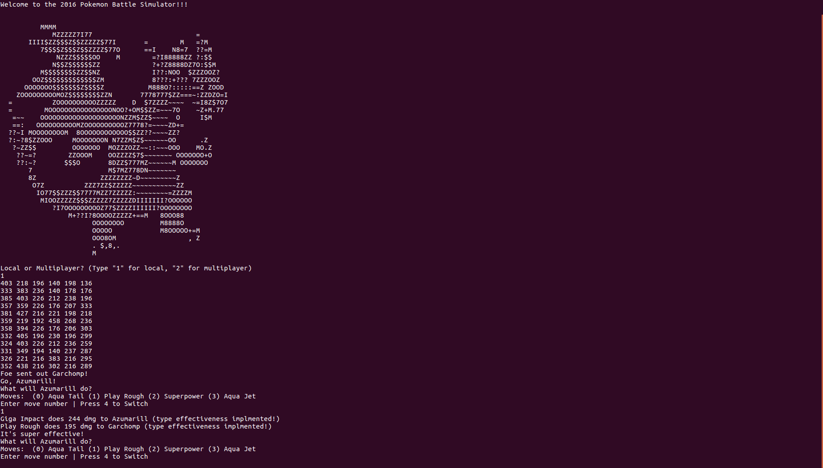
Pokémon Battle Simulator
Matt Chodaczek
Mason Cole
Keturah Jones
https://github.com/Luiserebii

Slide 2

The SUT
A Pokémon Battle engine coded in Java
Has local and multiplayer options (though not perfect)
Runs from command line
Loads Pokémon team from .txt files and uses the traditional formatting other Pokémon simulators use
Allows for custom Pokémon team options

Slide 3
Types of Testing
Whitebox Testing
Blackbox Testing (user based)
Mock Testing

Slide 4
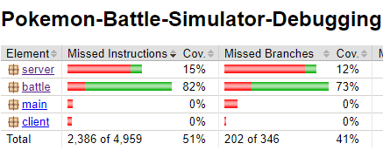
Coverage Report
Overall 41% on project, ~70% on whitebox-tested classes
Reasons for lack of coverage
Hardcoded inputs such as loading in a specific team .txt file from the project made it impossible to cover exception blocks.
Some features partly implemented (ex: ultra effective code block)
Some classes require mock-testing, which is not included in coverage
Some test cases failed resulting in incomplete coverage

Slide 5
Frustrations
Poor architecture
No consistent style
Coupling
Hardcoded inputs
Code duplication
Unfinished
No documentation

Slide 6
Some Examples And Workarounds
While the SUT doesn't come with direct specifications or an API, the rules it uses are encoded into the mainline Pokémon games which we can use to facilitate black-box testing.
Automated testing prevented by loops on main thread and RNG – Required Manual Black-Box Testing
Multiplayer gets stuck in an infinite loop during Black-Box Testing

Slide 7
Faults
Misspellings (lots)
Current and base stats are the same array
No input sanitization
Two of the three constructors for Pokémon don’t initialize their moves
Team input and move input are on the same input stream in the server
Can't handle Pokémon with < 4 moves (should have 1-4)
Can't handle teams with < 6 Pokémon (should have 1-6)

