Slide 1
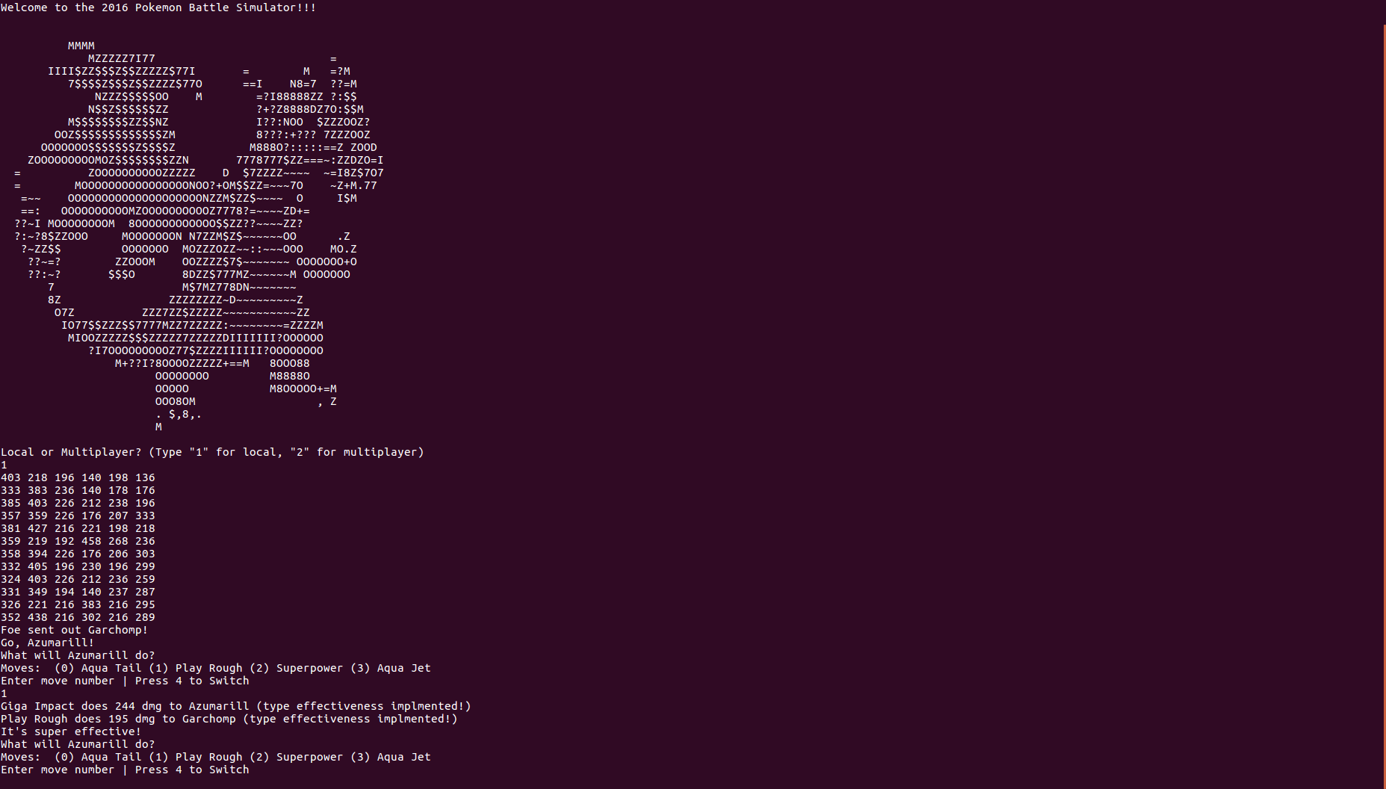
Pokémon Battle Simulator
Matt Chodaczek
Mason Cole
Keturah Jones
https://github.com/Luiserebii

Slide 2
The SUT

Slide 3
Types of Testing
Whitebox Testing
Blackbox Testing (?)
Mock Testing

Slide 4
(Coverage report?)

Slide 5
Frustrations
Coupling
Poor architecture
No documentation
Some things left unfinished
Hardcoded inputs

Slide 6
(Specific examples of frustrating things?)

Slide 7
Faults (?)
Misspellings (lots)
Current and base stats are the same array
No input sanitization
Two of the three constructors for Pokémon don’t initialize their moves
Team input and move input are on the same input stream in the server

