Slide 1
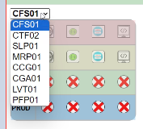
Quick Project Link/Path Manager
this program written by php with python
the stuff like CFS01,SLP01,.. etc are project code
there are 4 x 4 icon
horizontally,
- icon of cms : link to cms login
- icon of swagger : link to swagger which is testing UI for API
- icon of login : link to frontend index page
- icon of cmd : file path of the project
vertically,
- 1st row : localhost env
- 2nd row : common dev env
- 3rd row : uat for client env
- 4th row : production env
icon of crossed symbol "X"
- the icon will replace all of the icon when no value is set for icon of cms/swagger/login/cmd

Slide 2
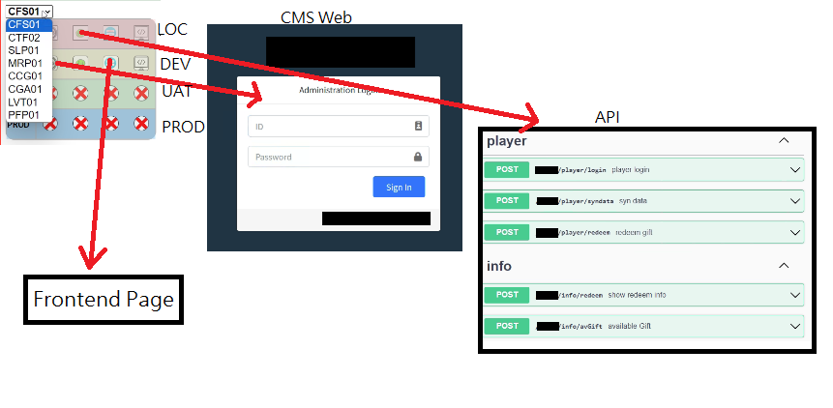

Slide 3
Project A
Introduction: The project worth a six-digit sum of money (HKD???,???). It is ready for test within one month.
Description: collect data of step count from Step Tracker apps via api. Then, reward participants gifts based on the point converted from step count. Have Chinese translation.
Some requirements:
etc.
Sync Data | data can be sync-ed at any time from Step Tracker apps to project api db.
CMS | Login users include admin and leaders. Leaders are for various group of participants.
Period | participant can only login in event period and redeem gift in another specified period which controlled in db.
Walkers table | except walker (participants) , there are also leader for each participant group.

Slide 4
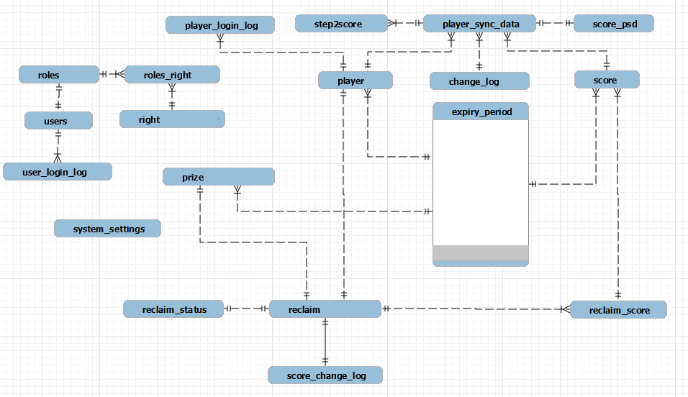
Project A - ER Diagram

Slide 5
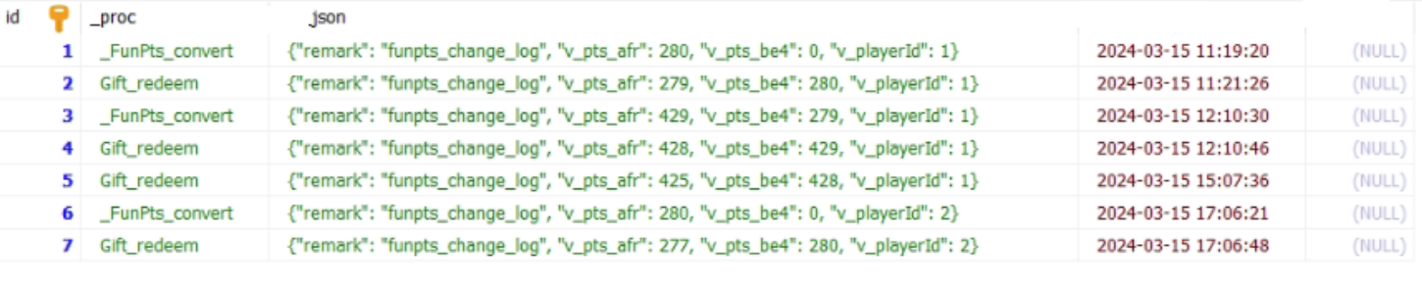
Project A - Some Table Result
Here’s some log for point changes which log players’ point before and after some process e.g. syn data and point changed after receive gift

Slide 6
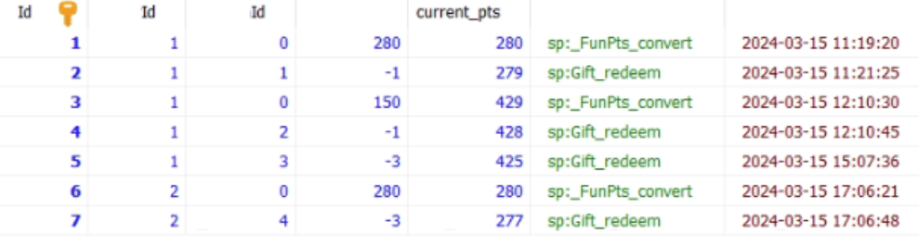
Project A - Some Table Result
This table store the amount changes in more detail so that it can join other tables more quickly. Those Ids are about pk , reclaim , and participant

Slide 7

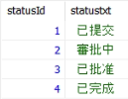
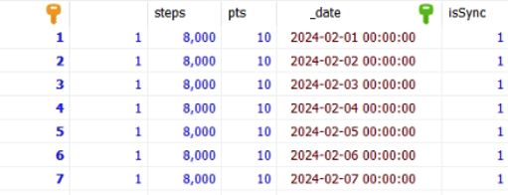
Project A - Some Table Result
Predefined Tables for converting step to points and redeem status text.
Some Sync-ed records.

Slide 8
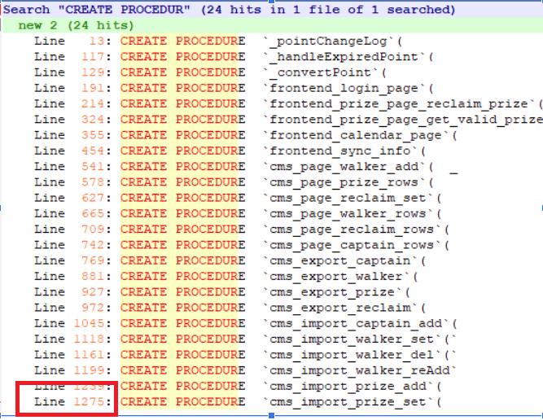
Project A - Procedure name

Slide 9
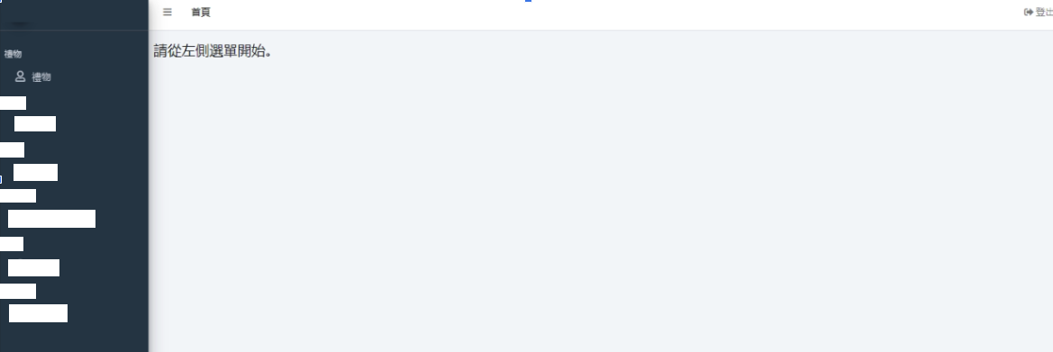
Project A - UI - CMS

Slide 10
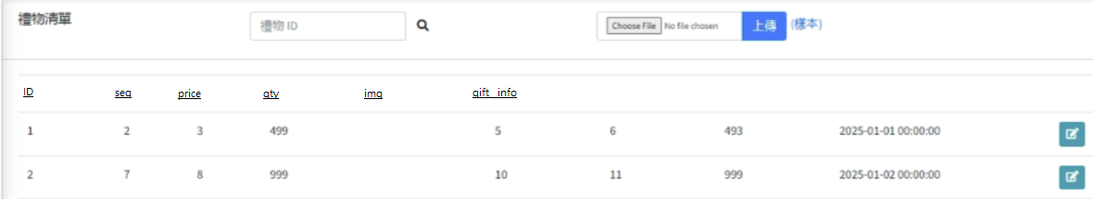

Project A - UI - CMS

Slide 11
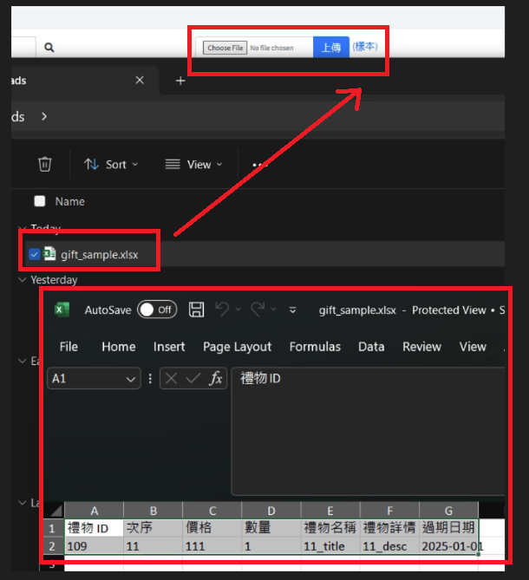
Project A - UI - CMS

Slide 12
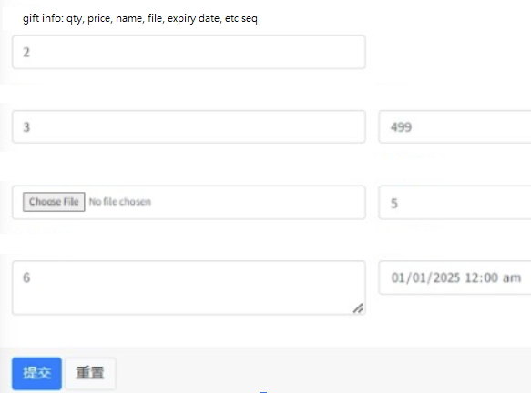
Project A - UI - CMS - gift edit

Slide 13
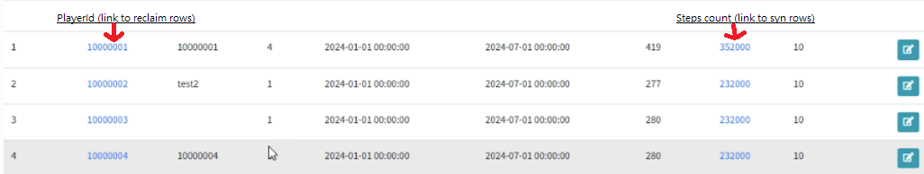
Project A - UI - CMS

