Slide 1
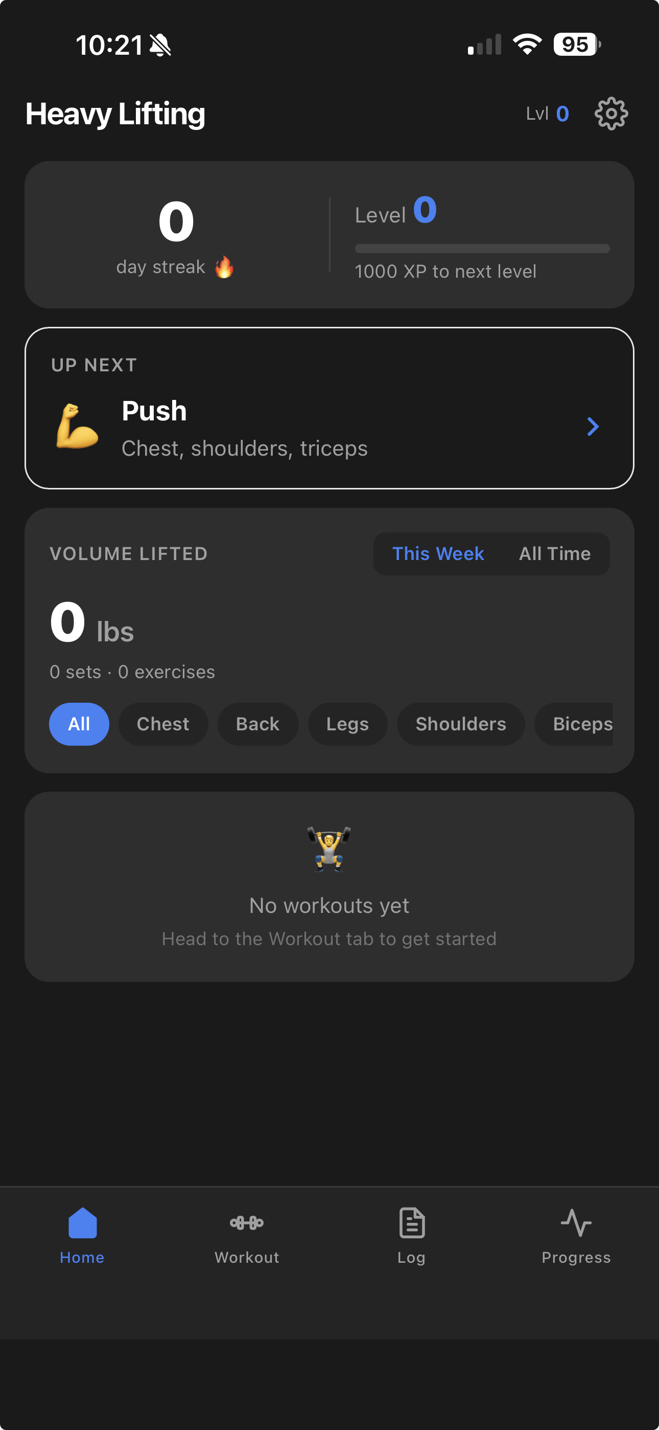
Heavy Lifting
A WORKOUT APP BUILT WITH AI
From idea to full-stack PWA — powered by Claude Code
Mason Hicks · April 2026

Slide 2
WHAT IS HEAVY LIFTING?
A full-stack fitness PWA built entirely with AI
🏋️ Smart Workouts
📊 Progress Tracking
AI-generated PPL programs personalized to your gym equipment and history
Lift charts, volume trends, PR history, and XP gamification
⚡ Works Offline
🤖 Claude Integration
Full PWA with service worker — no internet required after install
Optional Claude API for enhanced exercise swaps and weight recommendations

Slide 3
UNDER THE HOOD
Tech Stack
FRAMEWORK
Single-page app, no router — tabs via useState
React 18 + Vite
STYLING
Custom design tokens, dark theme, CSS vars
Tailwind CSS v3
DATABASE
Live queries, offline-first, persistent storage
Dexie.js (IndexedDB)
CHARTS
LineChart + BarChart for lift/volume history
Recharts
AI
Exercise swaps + weight suggestions (optional)
Anthropic Claude API
PWA
Service worker, offline cache, iOS install
vite-plugin-pwa + Workbox

Slide 4
THE DEVELOPMENT PROCESS
Built with Claude Code
Claude Code served as the primary developer throughout this entire project — from initial architecture to final polish.
01
Architecture Planning
Designed the full file structure, data models, and state machine before writing a single line
02
Feature Development
Wrote all React components, Dexie queries, and utility functions across 40+ files
03
AI Integration
Implemented the workout generator logic + Claude API client with offline fallbacks
04
Testing & QA
21 Vitest tests, build verification, mobile viewport checks, iOS Safari fixes

Slide 5
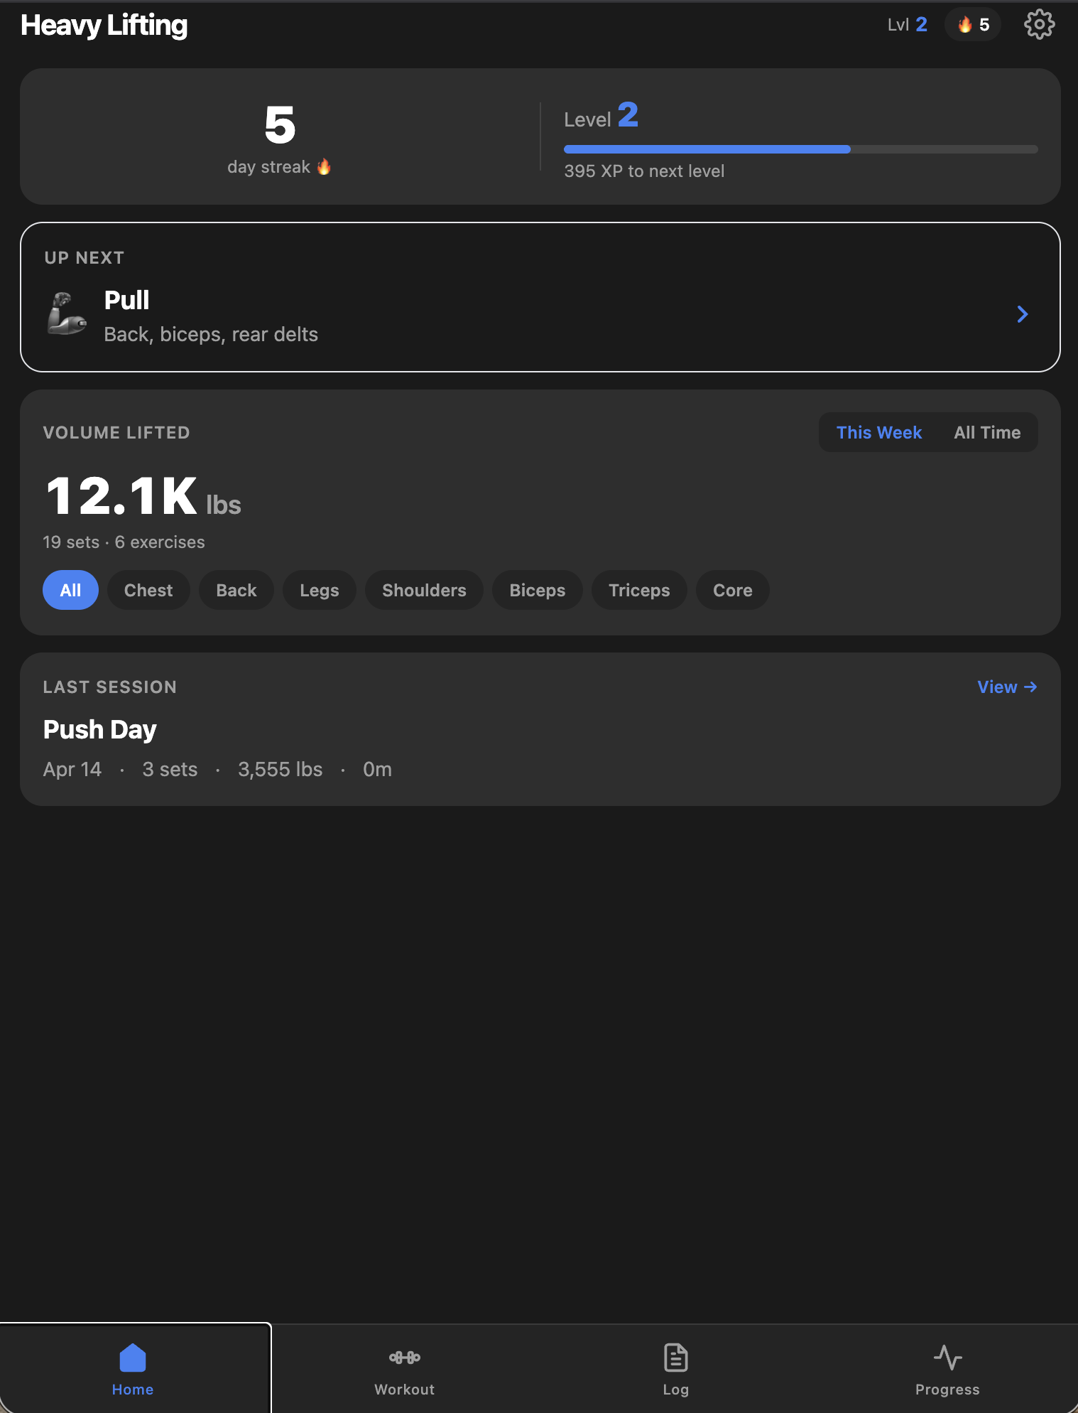
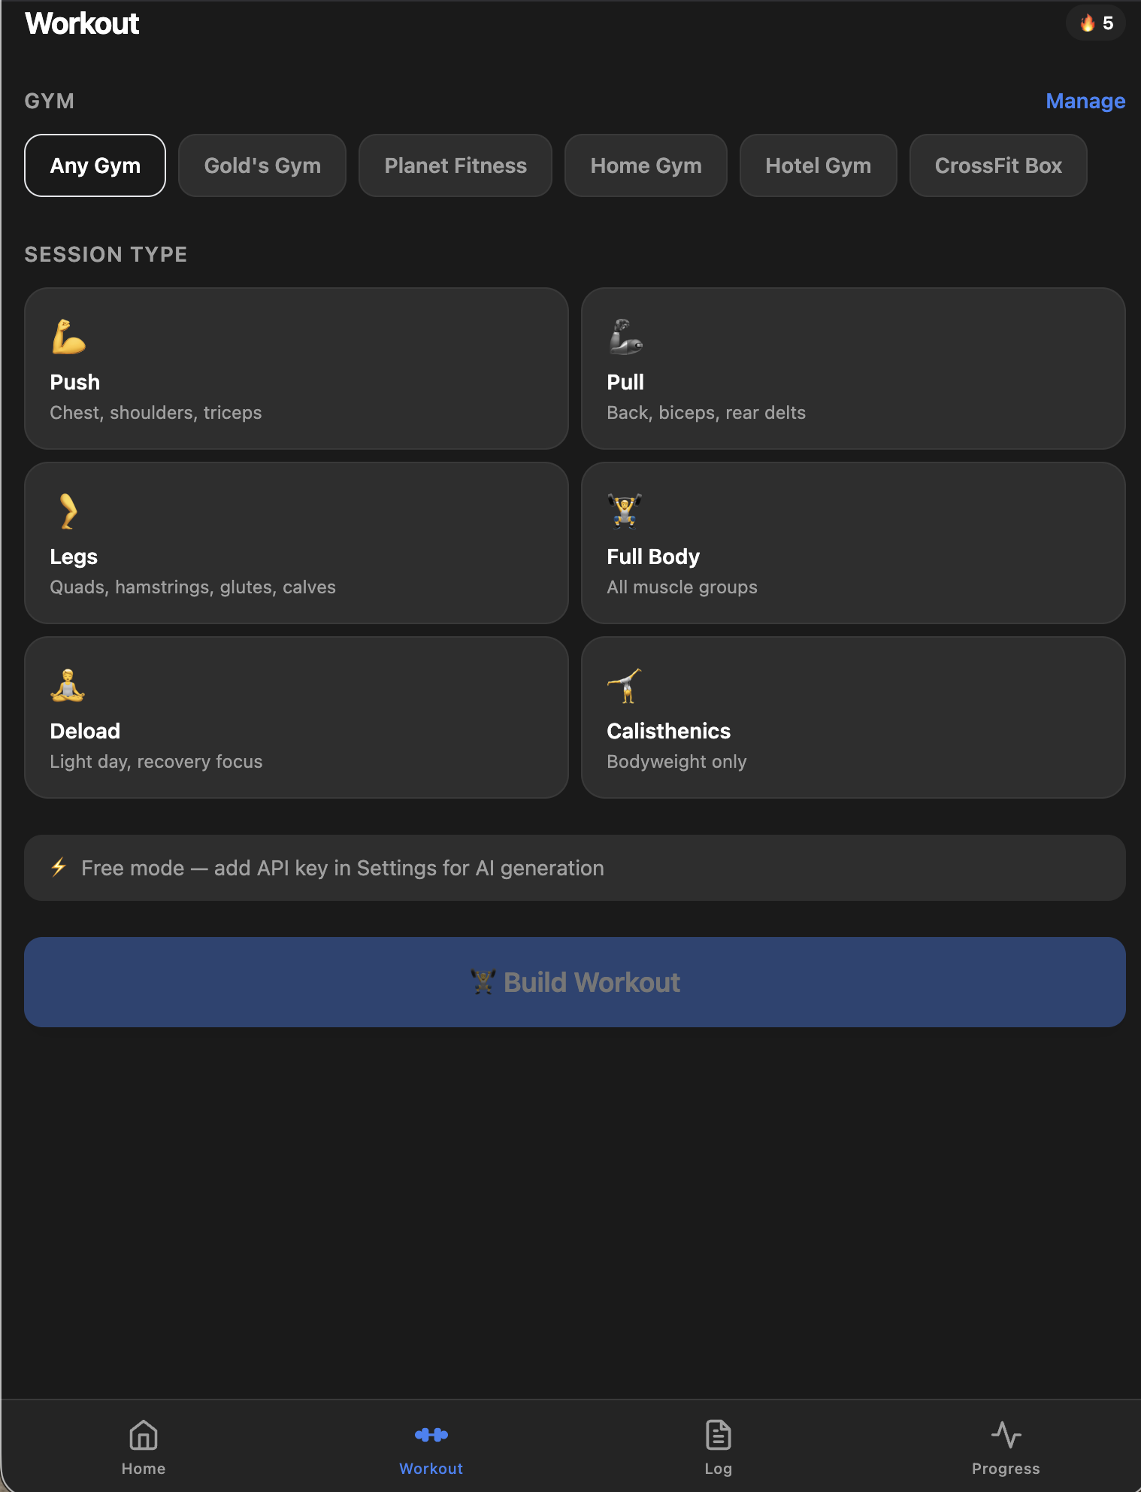
THE APP IN ACTION
HOME DASHBOARD
WORKOUT PLANNER

Slide 6
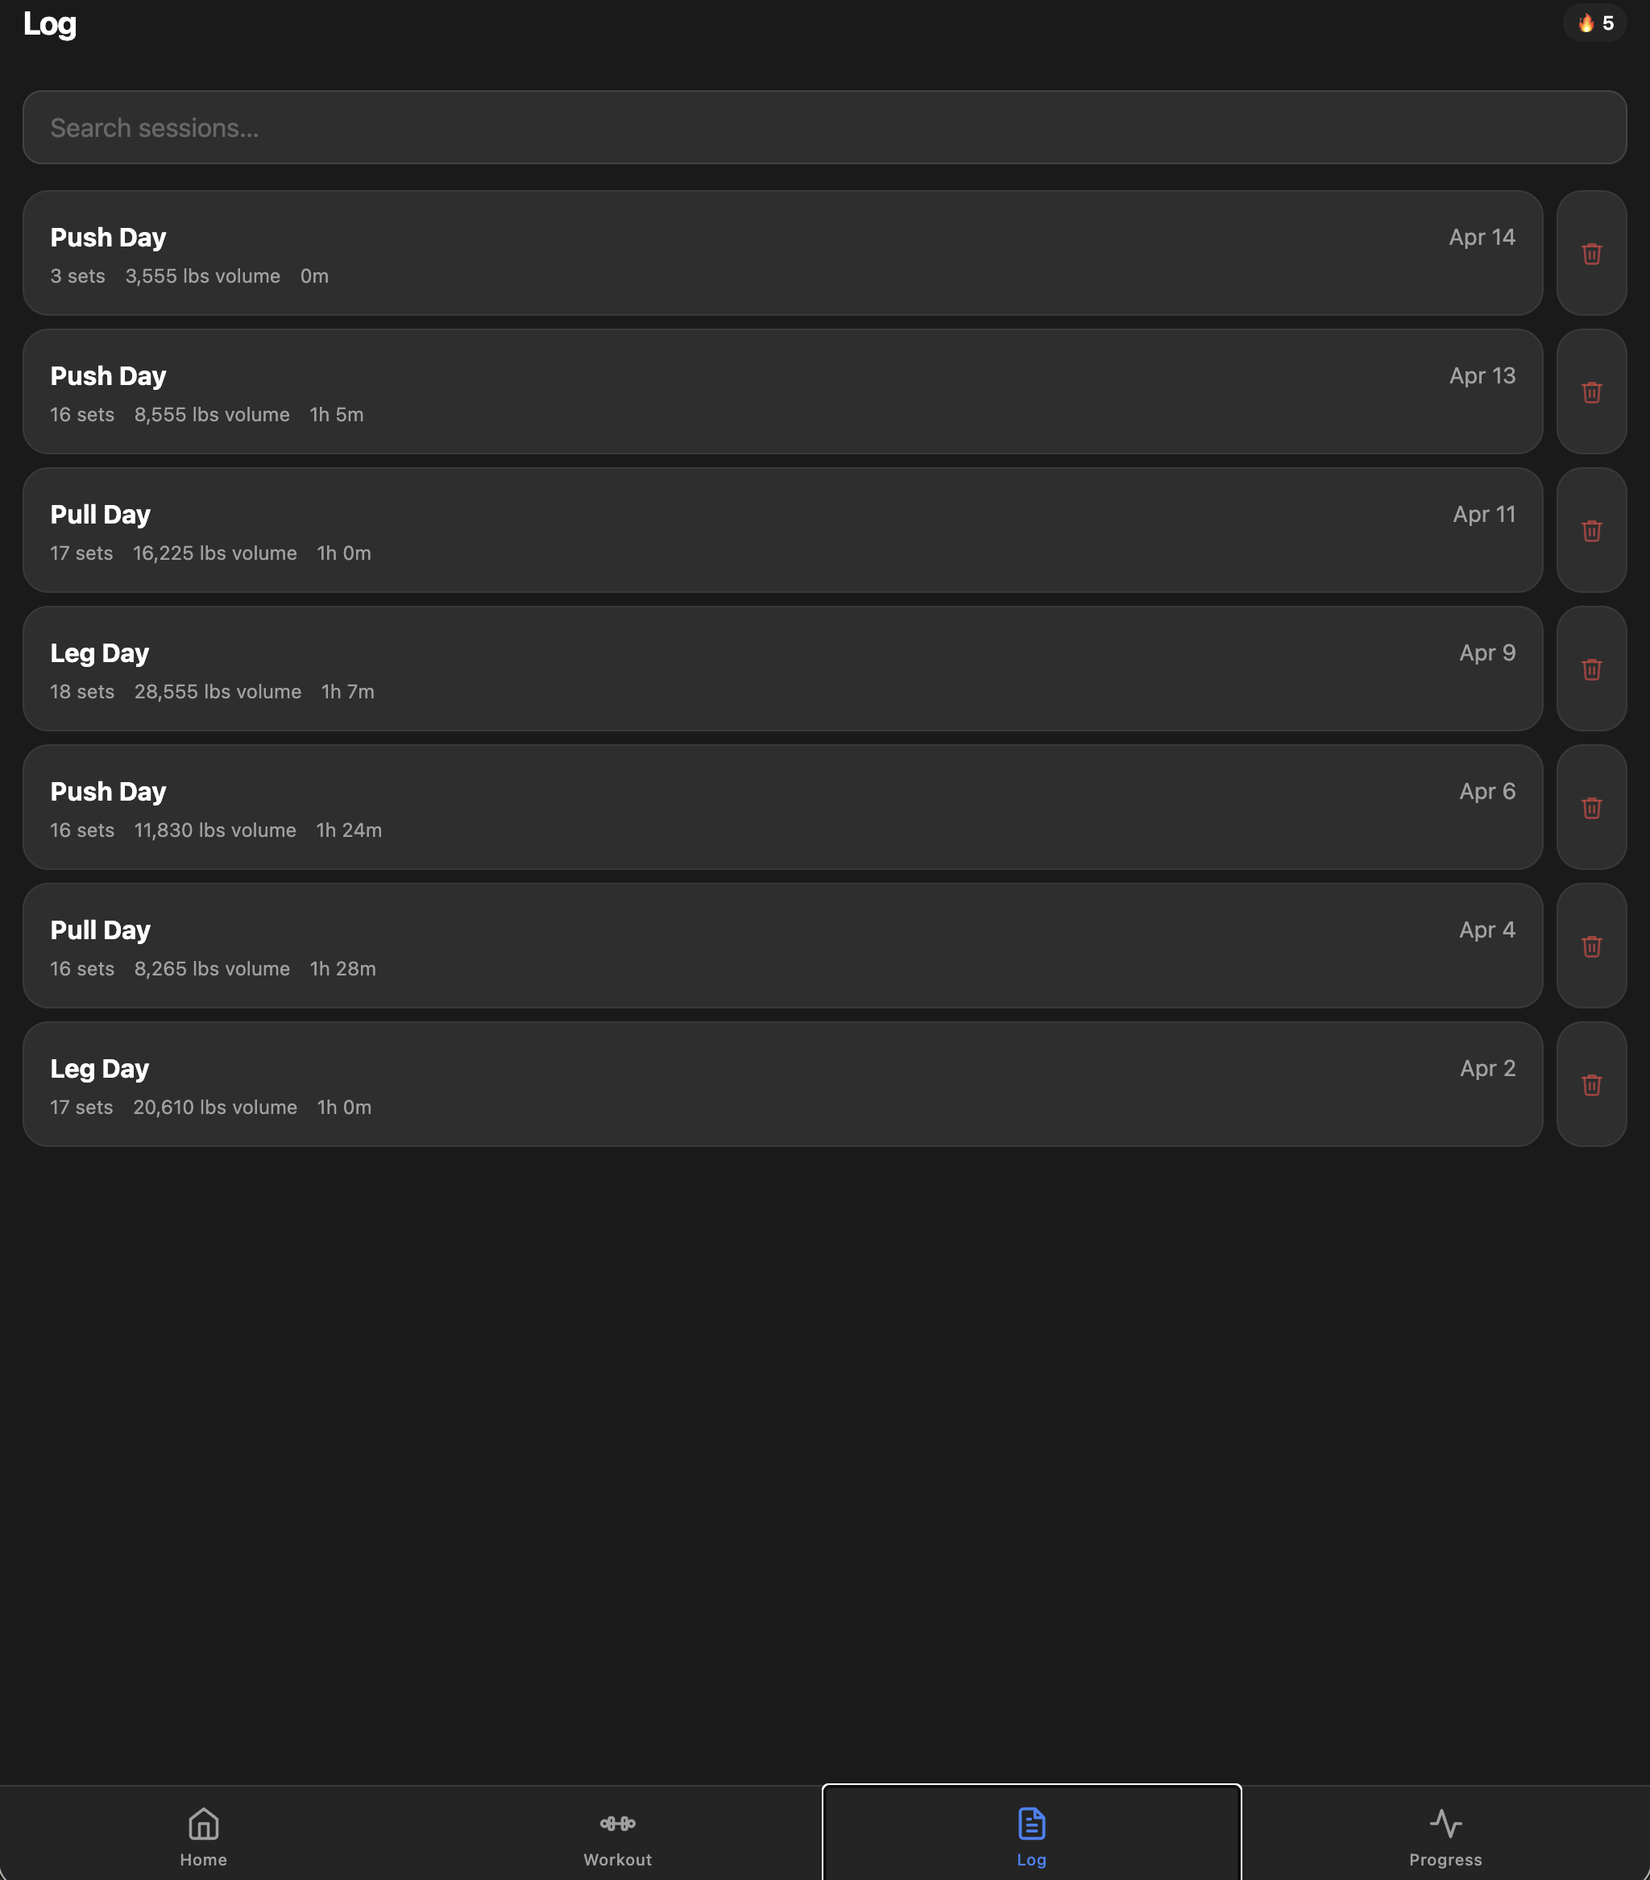
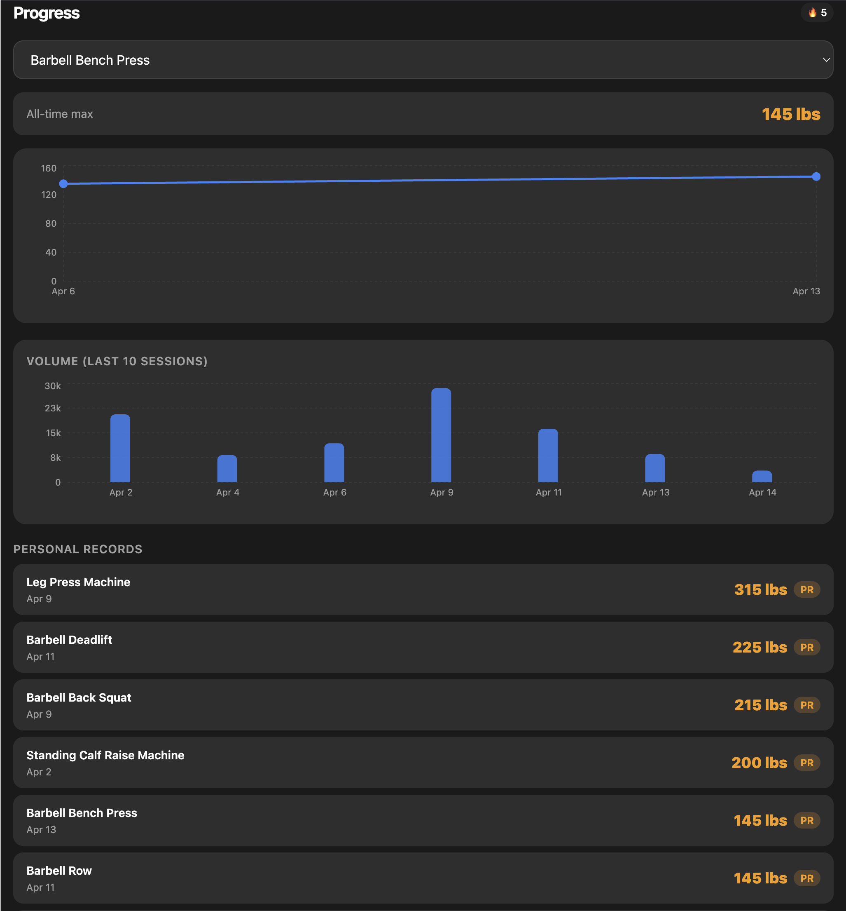
HISTORY & ANALYTICS
SESSION LOG
PROGRESS CHARTS

Slide 7
BY THE NUMBERS
What Claude Code built
40+
130
21
Source Files
Exercises
Vitest Tests
Components, hooks, utils, tests
Full exercise library with metadata
Workout generator fully covered
6
733KB
100%
Weeks
Bundle Size
Offline-first
Seed data generated for demos
Production build
PWA with service worker

Slide 8
AI INSIDE THE APP
Claude powers the workout intelligence
Pure-Logic Workout Generator
• PPL rotation (Push/Pull/Legs) — no API required
• Auto-deload when training 5+ consecutive days
• Selects exercises by gym equipment + history
• Muscle diversity: max 2 exercises per muscle group
Claude API Integration (Optional)
• AI-powered exercise swap suggestions
• Contextual session notes and coaching cues
• Weight recommendations with ±15% cap from base
• Full offline fallback — works without API key
Smart Weight Recommendations
• Layer 1: Last logged weight or exercise default
• Layer 3: AI overlay capped at ±15% from base
• Layer 2: Ease ratings (too-easy +5%, too-hard −10%)
• 3× "just right" = automatic progressive overload

Slide 9
KEY TAKEAWAYS
What this project demonstrates
🚀 AI Accelerates Full-Stack Development
🧱 Incremental, Always-Deployable Builds
A complete PWA with 40+ files, 130 exercises, 21 tests, and a gamification system — built in sessions rather than months.
Each session left the app in a working state. Claude Code followed a strict "finish one feature completely" philosophy before moving to the next.
🔒 AI Without Lock-In
📐 Architecture First, Code Second
The entire app works offline without an API key. Claude enhances the experience but every feature has a deterministic fallback.
Claude designed data models, state machines, and component boundaries before writing code — leading to a clean, maintainable codebase.

Slide 10
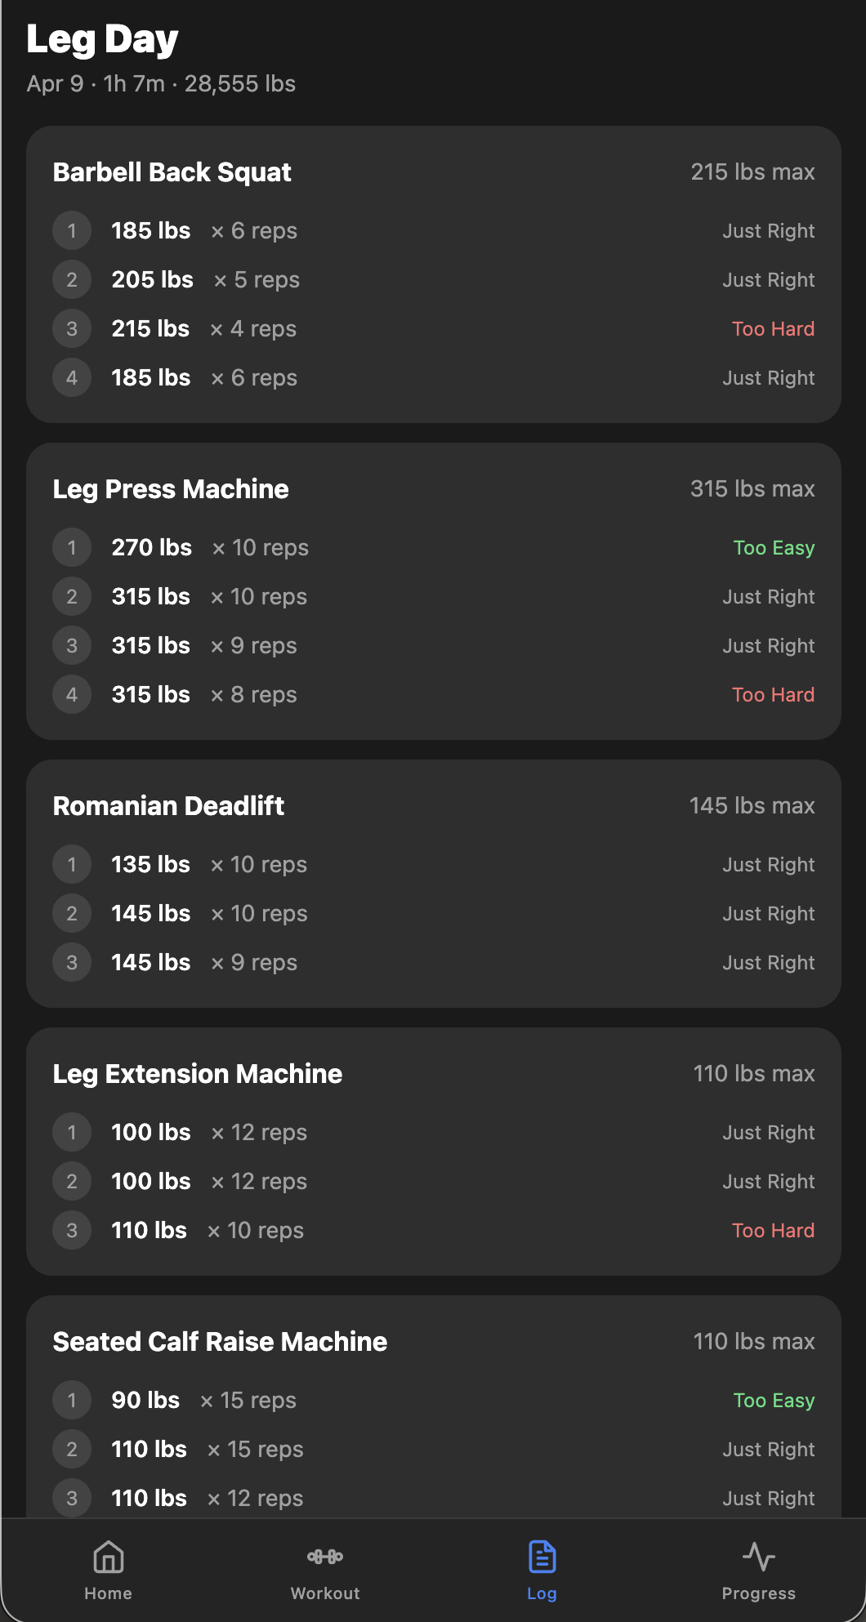
Heavy Lifting
Built with Claude Code — from zero to production in days, not months.
React 18
Tailwind
Dexie.js
Recharts
PWA
Claude API
Mason Hicks · April 2026

