Slide 1
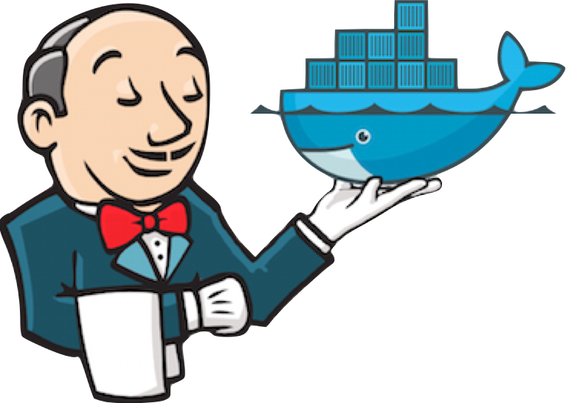
Continuous Integration With Jenkins and Docker
Notes:
Overview – Continuous Integration, using Jenkins as a CI tool, Setting up a Jenkins infrastructure using Docker, and using the python unittest framework to perform testing

Slide 2
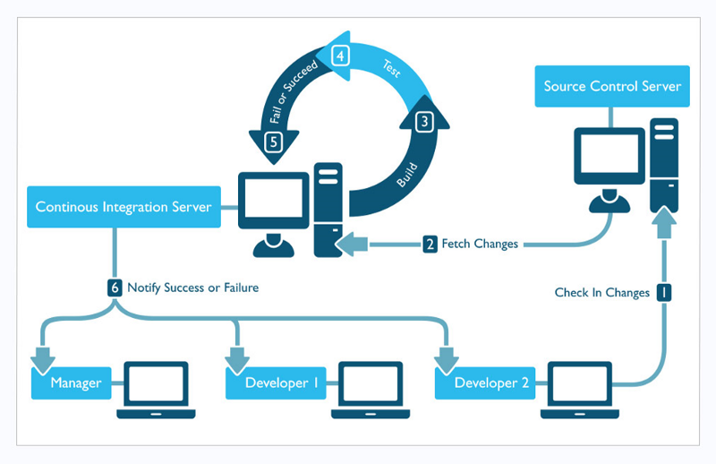
Continuous Integration

Slide 3
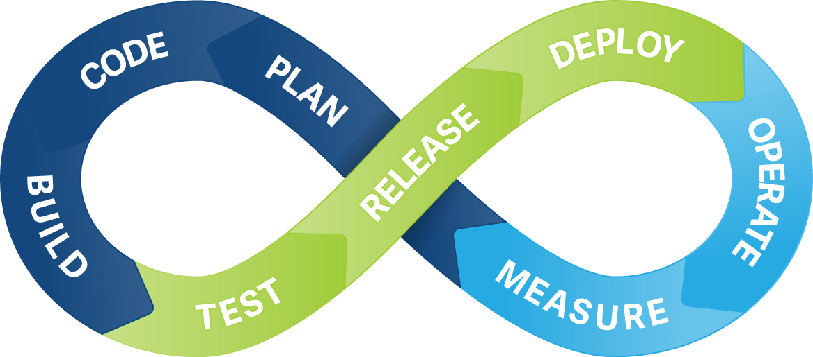
Continuous Integration - Overview
Software development practice - members of a team integrate their work frequently, up to multiple times per day
Involves a self-testing build which encapsulates testing mechanisms in the development process
Repeatable, scalable and modifiable
Notes:
Unit and integration tests are developed, maintained and version controlled alongside application software

Slide 4
Continuous Integration - Overview
Automatic build process eradicates errors that result from manual deployment
Testing occurs in a clone of the production environment, reducing compatibility errors due to difference in operating system versions, extensions, and software libraries
Allows for greater parallelism in software development due to reduced integration risk

Slide 5
Continuous Integration - Overview
Con - CI systems regularly break, must be maintained and run a on server which costs time and money
Con - CI requires additional resources to develop and maintain test software
Con – Can be costly to modify a legacy development system
Con – Project may be too small to justify the effort
ROI is increased time savings, errors avoided, and higher quality code

Slide 6
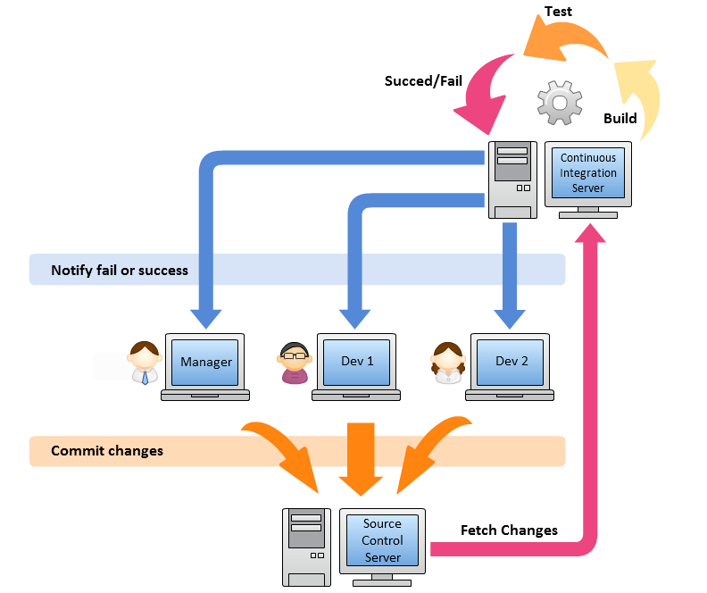
Continuous Integration - Requirements
Version control system – centralize and preserve code and environment changes over time & document the development process
Developers working in parallel, integration risk is high
CI Build Server – provides a stable and configurable environment to build projects
Onsite servers – allow for greater configurability of environment
Hosted servers – abstract maintenance of the environment and provide greater scalability

Slide 7
Continuous Integration - Servers
Build software, perform unit tests, integration tests, and acceptance tests
Provide adjustability to build software for multiple platforms
Monitor a repository for successful commit, pulls changes into the CI environment, and performs tasks defined by a CI pipeline
Code analysis, code coverage, & pipeline build comparisons

Slide 8

Jenkins

Slide 9
Jenkins
Open source continuous integration server written in Java
User friendly installation
Configuration via web based GUI
Extensive plugins allow for adaptability to a variety of workloads
Available for many platforms including Windows, Linux, and macOS
Large community of developers
Free
Implement CI pipeline as code

Slide 10
Pipeline as Code with Jenkins
Jenkins Pipeline plugin – allows for the implementation of an entire CI pipeline in code that can checked into source control
Provides a set of tools for modeling CI pipelines using the Pipeline Domain Specific Language (DSL) syntax based on the Groovy programming language
Pipeline can survive planned and unplanned restarts of Jenkins Master

Slide 11
Pipeline as Code with Jenkins
Pipeline provides Shared Libraries feature which allows libraries to be checked out of source control and used across multiple CI pipelines
Definition of a pipeline is written in a Jenkinsfile
Selects a build agent and defines the code to be executed in each stage of the pipe
Single source of truth, can be viewed and edited by multiple members of a team

Slide 12
Jenkins Pipeline
Node – a machine, physical or virtual, that is responsible for executing the pipeline
Stage – Conceptually distinct subset of tasks performed through the entire pipeline
Build, Unit Test, Integration Test, Deployment
Step – a single task to be executed
Shell script, print statement, flow control
Two discrete syntaxes used to implement a Jenkins Pipeline as code, Declarative and Scripted

Slide 13
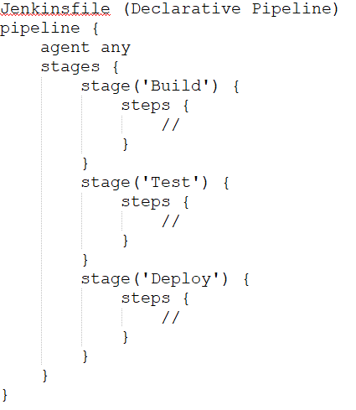
Declarative Syntax - Sections
Pipeline block defines all of the work done in the CI pipeline
Agent - specifies where the pipeline will execute in the Jenkins environment, what build agent will be used
A specific Docker container, any available container
Can be defined for the entire block or at each stage

Slide 14
Declarative Syntax - Sections
Stages - contains a sequence of one or more stage directives which perform the bulk of the CI workload
Steps - defines one or more tasks to be executed within a stage
Post - defines activities to perform after the completion of the completion of pipeline or stage

Slide 15
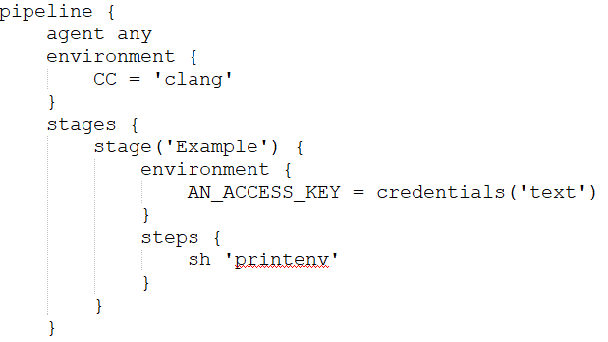
Declarative Syntax - Directives
Environment – specifies key value pairs defined as environment variables to be used throughout the pipeline
Parameters – provides a list of parameters the user should provide when triggering the pipeline
Triggers – provides a method of retriggering a pipeline automatically
Stage – typically contains the bulk of the work to be executed in the pipeline

Slide 16
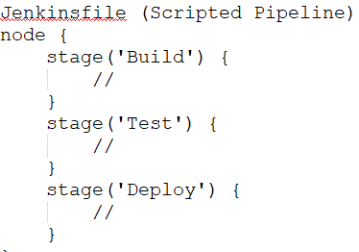
Scripted Syntax
General purpose DSL with most of the functionality of the Groovy language, flexible and expressive
Node block
adds steps to Jenkins queue to execute
creates a workspace to execute work in
specifies a build agent
Flow control managed by If/Else statements

Slide 17
Scripted Syntax
Try/Catch blocks provide exception handling
Does not introduce steps into the pipeline which are specific to its syntax
Scripted syntax offers greater flexibility than Declarative syntax
Declarative syntax has a predefined structure that is simpler to use

Slide 18
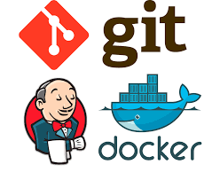
Creating a Jenkins Infrastructure with Docker

Slide 19
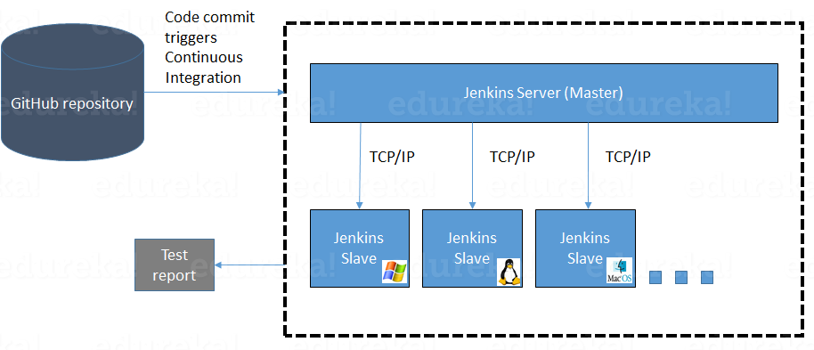
Jenkins Architecture
Master-Slave architecture – Master and Slave communicate over TCP/IP

Slide 20
Jenkins Architecture
Jenkins Master - Main Jenkins Server
Schedules build jobs
Dispatches builds to slave to be executed
Monitors slaves and distributes workload between them
Records and presents build results
Can also execute build jobs directly
Jenkins Slave – Java executable that runs on a remote machine
Hears requests from the Jenkins Master
Executes build jobs
Runs on a variety of operating systems
Can configure projects to run on specific slave machines

Slide 21
Jenkins + Docker – Build the Master
Build Jenkins Master using Jenkins Image from remote Docker registry
Install necessary Jenkins plugins
Copy startup scripts into Master image
Startup scripts specify the number of executors on the master, define security settings and authorized users

Slide 22
Jenkins + Docker – Build the Slave
Build Jenkins Slave using Ubuntu:16.04 Image from remote Docker registry
Install Docker + Docker Compose on slave which allow it to act as a build agent
Copy Python script used to run the slave executable
Python script
imports Jenkins Python modules
establishes a JNLP connection between slave and master
Downloads and runs .jar file which listens for requests from the master and executes build jobs
JNLP enables an application to be launched on a client desktop by using resources that are hosted on a remote web server

Slide 23
Jenkins Pipeline Setup From GUI
Add a new item, enter a name, select Pipeline
Add a build trigger to poll Source Control Management periodically
Define pipeline script from SCM
Copy link to Github repository URL
Set Script Path = Jenkinsfile

Slide 24
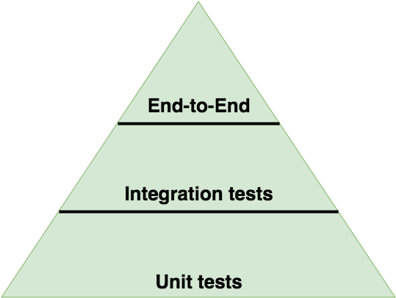
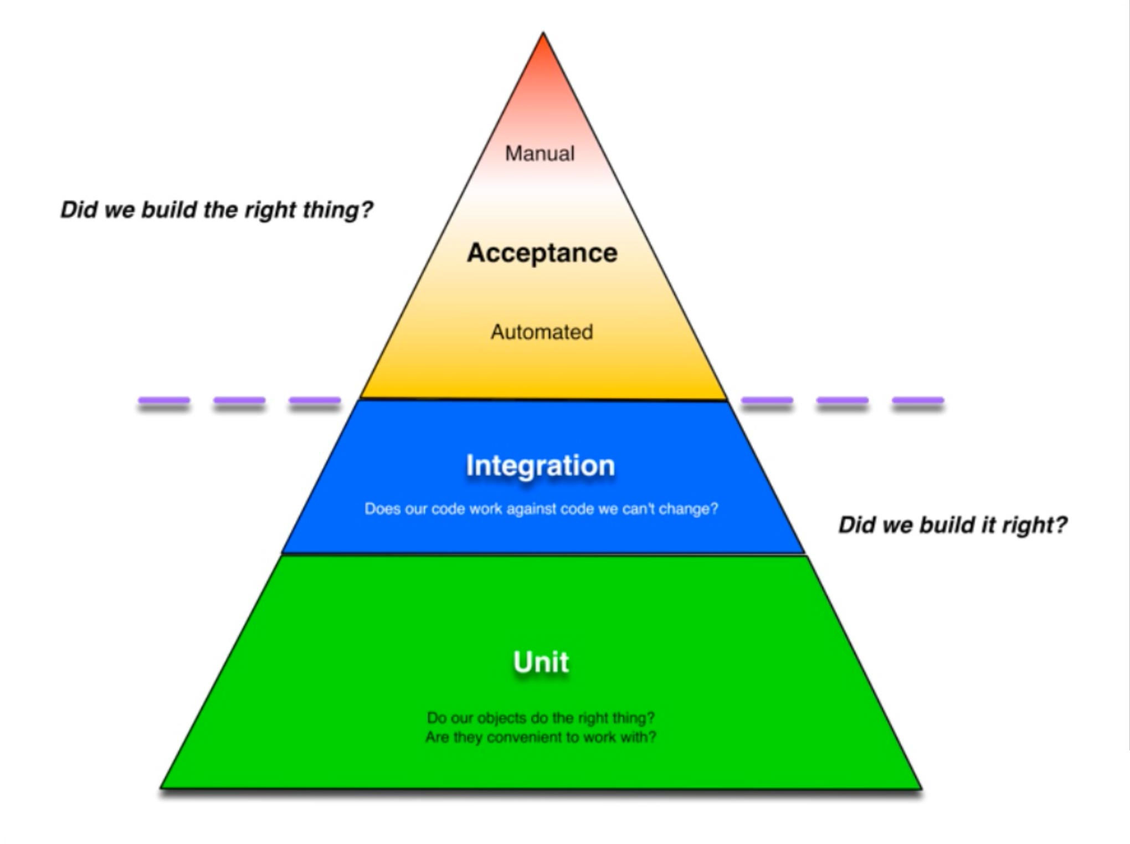
Unit & Integration Testing

Slide 25
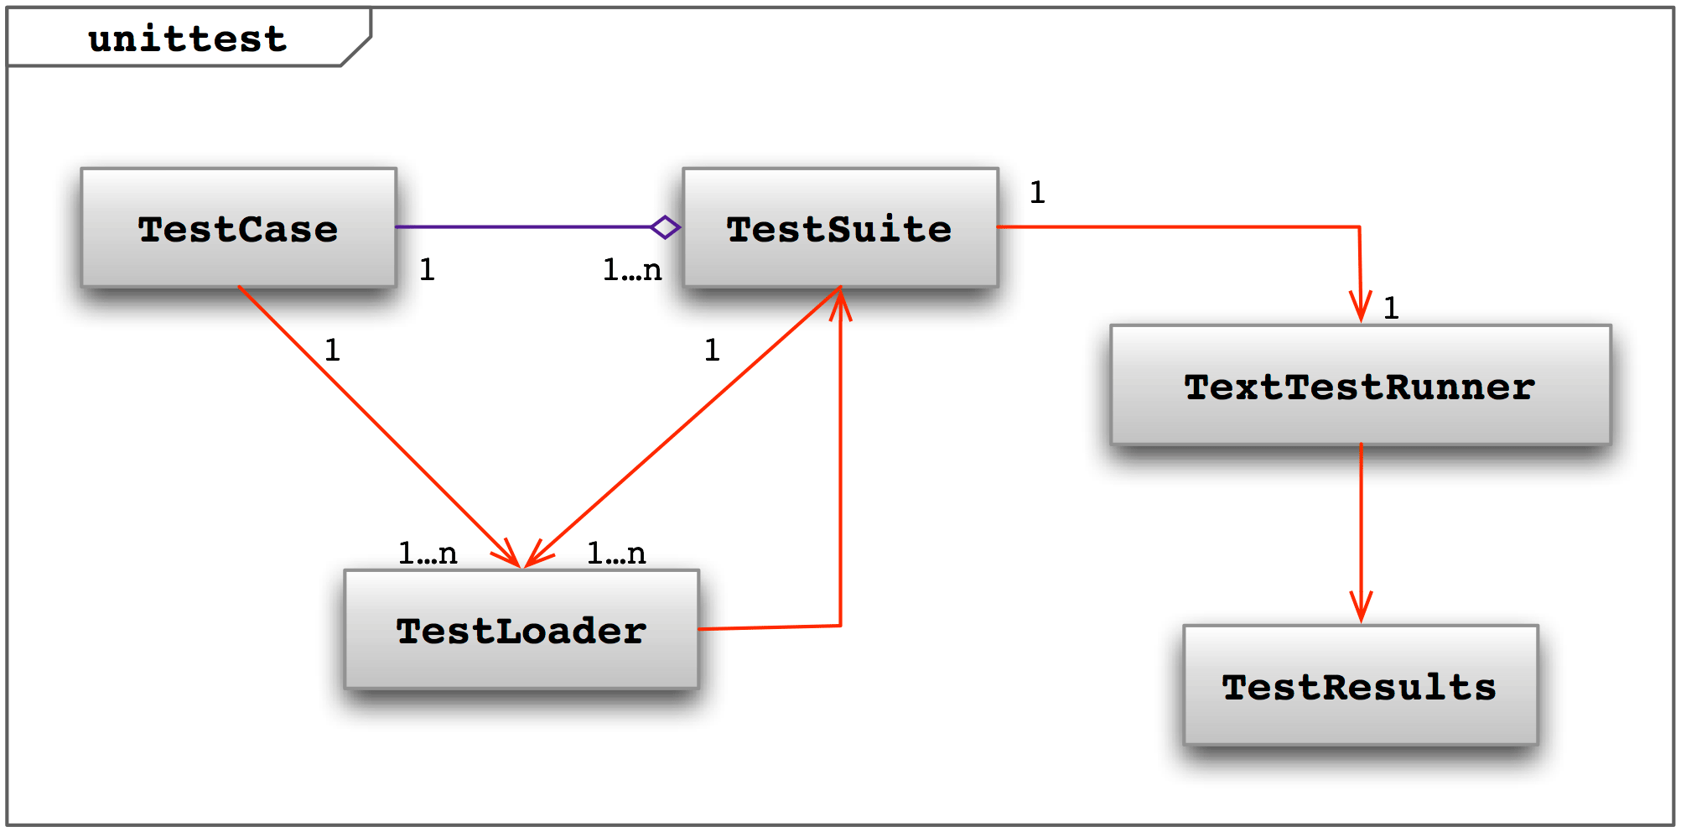
Python - unittest
Testing framework originally inspired by Junit
aggregation of tests into collections
setup and teardown routines
independence of tests from reporting framework
Test fixture – the preparation needed to perform one or more tests
Creating databases or starting a server process

Slide 26
Python - unittest
Test Case – checks for a specific response to a particular set of inputs using assert statements
Test Suite – a collection of test cases
Test Runner – orchestrates the execution of tests and provides results to the user
Failure messages
Execution time
Etc…

Slide 27
Demo Setup
Created a repository in Github to store application and test code, Jenkins infrastructure code, and Jenkinsfile that defines the CI pipeline
Created a budget application in Python with two classes, Budget and Expense class
Created unit test for each class, as well as an integration test to combine them
Each unit test has its own Dockerfile and docker-compose.yml file to allow them to be run separately
Set up and run Jenkins infrastructure using Docker
Configure a pipeline on the Jenkins GUI and linked to the Github repository

Slide 28
DEMO

