Slide 1
BioCoref
Biomedical Coreference Resolution
Using open-source libraries
CS710 – Artificial Intelligence
Mason Edmison
Notes:
For my final project, I built a Coreference System for biomedical text using open-source libraries in python.
Coreference Resolution is hard and important problem as there are many applications that could benefit or have benefited from coref. Some of these are: Question Answering, Text summarization, information extraction, and machine translation.

Slide 2
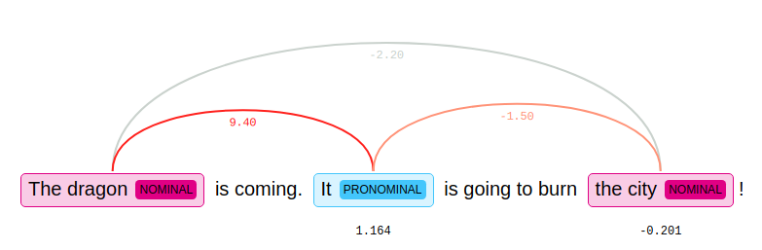
Coreference Resolution
Fundamentally a clustering problem
Which mentions in a text refer to the same ‘real-world’ entity
e.g. Given the text The dragon is coming. It is going to burn the city!
It is a referring expression referring to dragon (antecedent).
Notes:
So a quick primer on coreference resolution…
Coreference resolution fundamentally is a clustering problem.
Goal is to find which mentions in a text refer to the same real-world entity.
→ read and describe dragon example
→ Note the weights
→ simple visual using the displacy library

Slide 3
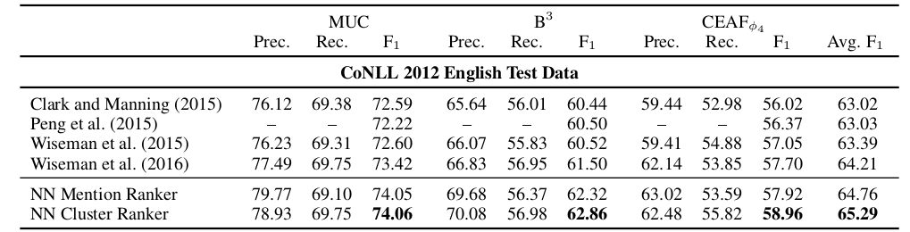
Recent Work
Great progress made thanks to advancements in ML and Deep Learning
Specifically, Clark and Manning (2016) published two papers describing a new Deep Learning system that outperformed the existing state of the art
[1] see Cluster Ranker on bottom row. ‘Wins’ emboldened.
Notes:
Largely in part due to advancements in computational power and reinforcement learning, coreference resolution has experienced a revival of sorts with many performant systems proposed in recent times.
More specifically, Neural Network based coreference systems employing entity-level information and reinforcement learning have produced new scores outperforming the previous state-of-the-art.
An example of such a system is the Deep Reinforcement Learning model proposed by Chris Manning and Kevin Clark in their 2016 paper Deep Reinforcement Learning for Mention-Ranking Coreference Models.

Slide 4
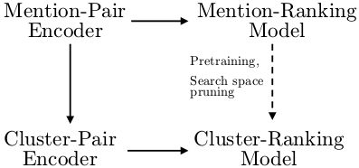
Clark and Manning Implementation
Builds distributed representation of coreference clusters
Learns when combining coreference clusters is desirable using a slack-rescaled ranking loss function
The deep NN is composed of three sub-networks: mention-pair encoder, cluster-pair encoder, cluster-ranking model
[1] System Architecture for deepcoref
Notes:
A bit more on this implementation…
The deepcoref system is a deep neural network that builds distributed representations of coreference
clusters using entity-level information and, using slack-rescaled ranking loss, learns when resolving
coreference clusters is desirable .
To gain better intuition is is better to think of network comprising three sub-networks: mention-pair encoder, cluster-pair encoder, cluster-ranking model.
At a high-level, the mention pair encoder produces distributed representations for pairs of mentions by passing relevant features through a feed-forward NN. The Cluster pair encoder produces distributed representations of pairs of clusters applying a combination of max and average pooling operation. The cluster ranking model then scores pairs of representations through a single neural network.
Also, a mention-ranking model is trained that scores a pair of mentions through a single layer NN – used to prune clusters which will be consiered by the cluster ranking model and its parameters are used to initialize the cluster ranking model.

Slide 5
NeuralCoref
Open-source python module written in cython that is greatly inspired by Clark/Mannings coreference system.
SpaCy pipeline extension – uses SpaCy’s state of the art dependency parsing, named entity recognition, and part of speech tagging
    Allows for flexibility regarding SpaCy models and other pipline components (EntityLinker, EntityRuler, etc.)
Ships pretrained on the ConLL 2012 dataset and tuned vectors (word embeddings) trained on the OntoNotes 5.0 dataset
Notes:
For this project, I used the neuralcoref library.
Neuralcoref is an open-source python module written in cython that is greatly inspired by Clark/Mannings coreference system.
It is SpaCy pipeline extension so it uses SpaCy’s document annotations (which I will discuss in further detail in just a moment).
Flexibility regarding SpaCy models and other pipeline components (EntityLinker, EntityRuler, etc.)
Neuralcoref Ships pretrained on the ConLL 2012 dataset and tuned vectors (word embeddings) trained on the OntoNotes 5.0 dataset

Slide 6
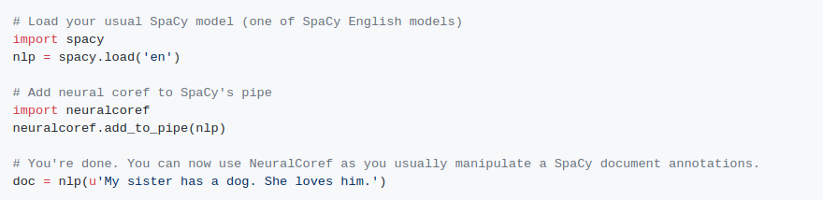
SpaCy → NeuralCoref
SpaCy handles NLP tasks and annotations such as Named Entity Recognition, Part of Speech Tagging, and tokenization
NeuralCoref uses these annotations to build mention pair distributed representations and passes these as input to neural network to ultimately produce a score for a given cluster pair.
Notes:
So a bit on the general process of how SpaCy and Neuralcoref work together. SpaCy essentially handles all of the natural language processing stuff, ie dependency parsing, named entity recognition, and part of speech tagging. So after input text is passed to a SpaCy Language object and annotations are completed, NeuralCoref uses this information and annotations to extract possible all possible mentions. It then builds vector representations of these possible mentions and passes them through the sub-networks I mentioned in the last slide.
briefly describe code snippet

Slide 7
How to Evaluate?
BioNLP 2011 shared task dataset to evaluate performance
2,300 annotated coreference relations – 800 pubmed abstracts
What’s a match?
    A cluster that comprises mentions that are either within a minimum span of a gold mention or that each mention subsumes a gold mention
System is evaluated using the F1, precision, and recall scores
Notes:
To evaluate the performance of this system, I used the annotated coreference resolution dataset from the 2011 BioNLP shared task.
Given that the neuralcoref library evaluates performance based off a file in the tabular CoNLL format, I wrote an evaluation script that closely follows the ‘match’ guidelines outlined in the shared task. Though writing these scripts was quite tedious, it proved to be very helpful when considering WHY and WHERE the system was performing poorly.
So given the Gold annotated dataset and our predictions...
A match is a cluster that comprises predicted mentions that are either within a minimum span of a gold mention or that each predicted mention subsumes a gold mention
The system is evaluated using the F1, precision, and recall scores.

Slide 8

Baseline Performance
Default parameter values with non-domain specific SpaCy model
Notes:
To establish a baseline performance, I used the SpaCy core medium model which resulted in a precision score of 15%, recall of 8%, and an F1 score of roughly 11%.

Slide 9
Improvements
Introduce biomedical word embeddings
  BioWordVec – 200 dimension word vectors trained using Fasttext algorithm on large pubmed corpus
Domain-specific NER and dependency parsing
    SciSpaCy which provides full SpaCy pipelines trained on biomedical text
Notes:
So given a baseline performance score and influenced by recent research, I chose to focus on introducing domain-specific named entity recognition, dependency parsing, word vectors as well as Knowledge Bases or Ontologies to improve performance.
Libraries I used to introduce these were:
BioWordVec – 200 dimension word vectors trained using Fasttext algorithm on large pubmed corpus
And for Domain-specific NER and dependency parsing,
SciSpaCy which provides full SpaCy pipelines trained on biomedical text
Re word embeddings: NeuralCoref uses static and tuned 50 dimensional word vectors that are used when calculating both mention embeddings as well as pair embeddings. Given that BioWordVec uses 200 dimensional vectors, I trained a new set of 50 dimensional word vectors on a corpus comprising 1 million Pubmed abstracts and a sampling of random walk sequences from a MeSh graph (Node2Vec).

Slide 10
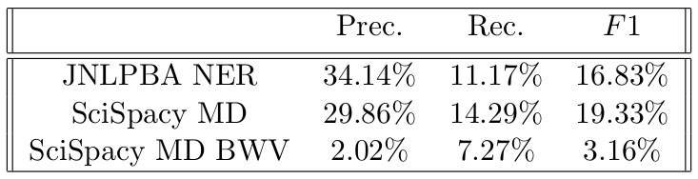
Results
Given the optimization of precision, the most performant combination was the of the SciSpacy medium model pruning by entity type using the JNLPBA NER module
Notes:
Here is a table listing results of some of the approaches to improve performance I listed in the last slide.
Given the high number of False Positives, I chose to improve precision as much as possible to avoid a ‘needle in the haystack’ problem when using this system in an nlp task.
The most performant combination was the use of the SciSpacy model, and pruning using a named entity recognition module trained on the JNLPBA corpus.
We see that in the third row of the table, very poor performance using word vectors trained on biomedical text. This can likely be attributed to the fact that the system was trained using the 50 dimensional google news vectors, so to see any performance gains using domain specific vectors we would need to retrain the system using these vectors.

Slide 11
Use Case
Task:
Find all sentences that contain a specific protein and gene
      sentence → It is also involved in T- acute and- chronic leukemias arising in cases of ataxia-telangiectasia (AT), an immunodeficiency syndrome.
Result:
Notes:
To resolve coreferring expressions in a possible downstream task, I wrote a simple command line script to annotate a coreffering expression with it’s antecedent.
read and describe task and result

Slide 12
Next steps
Train neural coref on large biomedical annotated dataset
Train model using different different word vectors, ie (ElMo, Bert, Fasttext)
Isolate mention-detection performance during evaluation
Utilize biomedical ontologies during last step of algorithm (Searching/ Clustering – [currently in development]
Rule based trimming of mention spans to only include appropriate number of entities (informed by referring expression
Introduce coref specific metrics such as CEAF and MUC
Notes:
Casually discuss next steps

Slide 13
BioCoref
Thanks for Listening!
Source code → <https://github.com/masonedmison/coref>
Notes:
Thank you for listening to my presentation. Please see the attached pdf document for a more in-depth description of this project.

