Slide 1

Simple Port and Vuln. Scanner
Ankit Mistry, Cody Blankenship, Shivam Mistry, Saish Malluri, Mason Hyman

Slide 2
What is SPVS?
A simple command line port scanning utility for UNIX.
Additionally, the SPVS team hosts an online version of the tool that may be used across any operating system.
Provides protocol fingerprinting for open ports on a target.

Slide 3
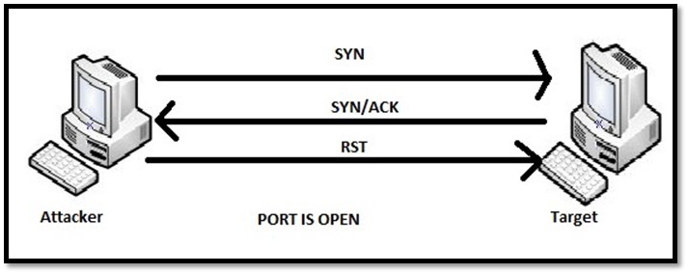
What is port scanning?
Common network technique used to determine open ports and potential vulnerabilities on a target or groups of targets.
Can also determine whether a specified host is online / offline. (Similar to UNIX ping)

Slide 4
Why two interfaces (CLI / Web)?
Web provides simple and easy to use port scanning functionality without having to open a terminal. Cannot reach internal host names or IP addresses because it is a provided on a server.
Similar to other UNIX tools, the CLI version of SPVS provides modular port scanning function and can be used within internal networks.
Greater modularity is always better!

Slide 5
SPVS CLI Usage Overview
Default scanning mode includes top 1000 most common ports.
Individual port / range scans.
File support for lists of hosts.
Multithreaded for faster port scanning.

Slide 6
SPVS Web Usage Overview
Similar functionality as the SPVS CLI version.
Provides easy to use interface.
File upload option provides easy way to scan multiple hosts.
Added functionality of the download button.

Slide 7
DEMO

Slide 8
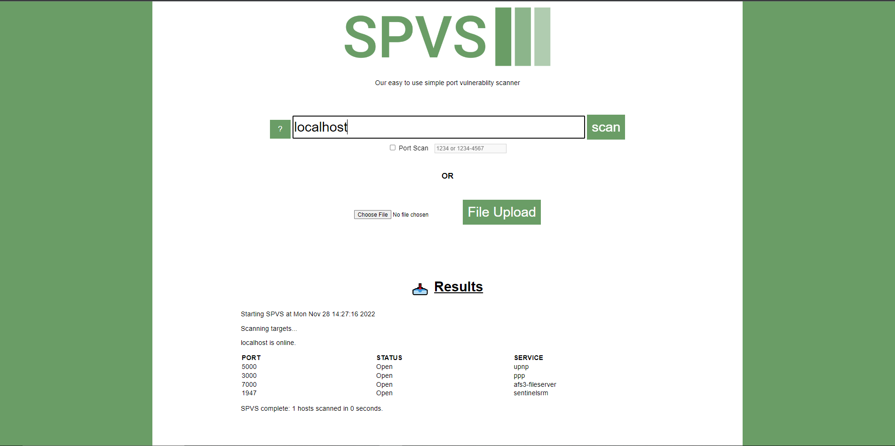

Slide 9
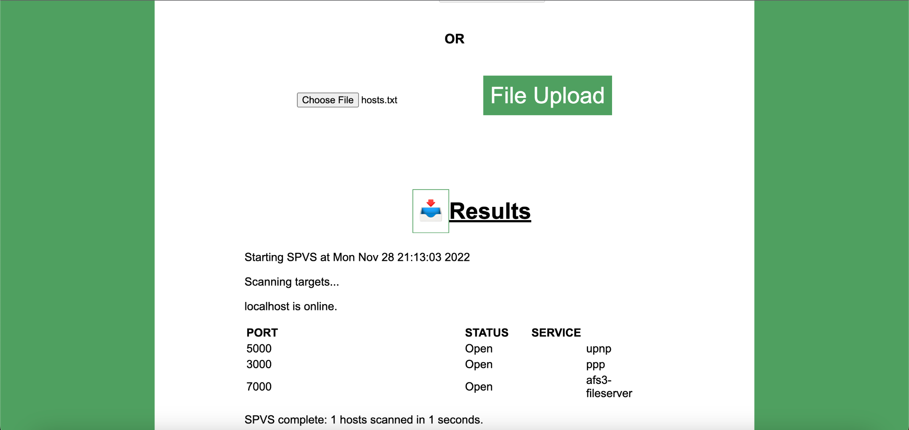

Slide 10
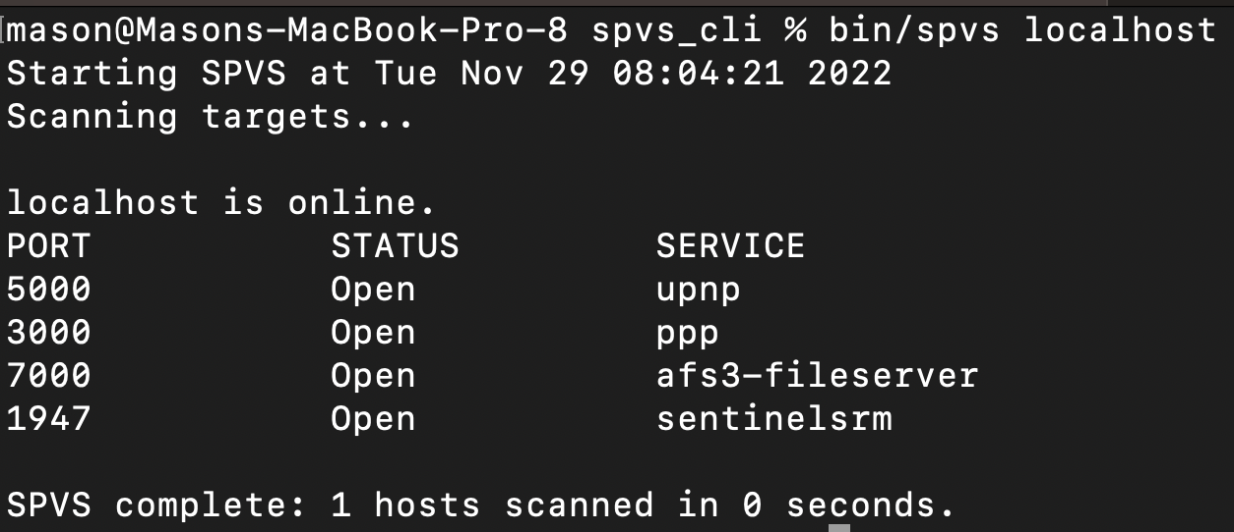

Slide 11
