Slide 1

Tweet Sentiments Impact on Stocks
Group 17 Insight Innovators
Yuxuan Li (yl8095)
Siyuan Lu (sl10865)
Mason Lonoff (ml9542)

Slide 2
Research Questions
Main focus: How do Tweet Sentiments Affect Stock Behavior?
Subquestions:
Are stocks with high and low volatility affected differently by tweet sentiments?
How do tweets and their sentiment scores affect stocks across industries?
Which stocks are most sensitive to tweet sentiments?

Slide 3
Dataset
Tweet Sentiment's Impact on Stock Returns: https://www.kaggle.com/datasets/thedevastator/tweet-sentiment-s-impact-on-stock-returns/data
Dataset consists of 14 columns and 1,395,450 rows
Dataset composition:
Tweet - Text of the tweet. (String)
Stock - Company's stock mentioned in the tweet. (String)
Date - Date the tweet was posted. (Date)
LAST_PRICE - Company’s last price at the time of tweeting (Float)
1_DAY_RETURN - Amount the stock returned or lost over the course of the next day after being tweeted about. (Float)
2_DAY_RETURN - Amount the stock returned or lost over the course of the two days after being tweeted about. (Float)
3_DAY_RETURN - Amount the stock returned or lost over the course of the three days after being tweeted about. (Float)
7_DAY_RETURN - Amount the stock returned or lost over the course of the seven days after being tweeted about. (Float)
PX_VOLUME - Volume traded at the time of tweeting. (Integer)
VOLATILITY_10D - Volatility measure across 10 day window. (Float)
VOLATILITY_30D - Volatility measure across 30 day window. (Float)
LSTM_POLARITY - Labeled sentiment from LSTM. (Float)
TEXTBLOB_POLARITY - Labeled sentiment from TextBlob. (Float)

Slide 4
1.
Data Cleaning and EDA
2.
Analyze sentiment impact on stocks with different volatility
3.
How do tweets and their sentiment scores affect stocks across industries?
4.
Determine the most sensitive stocks to tweet sentiment
5.
Limitations

Slide 5
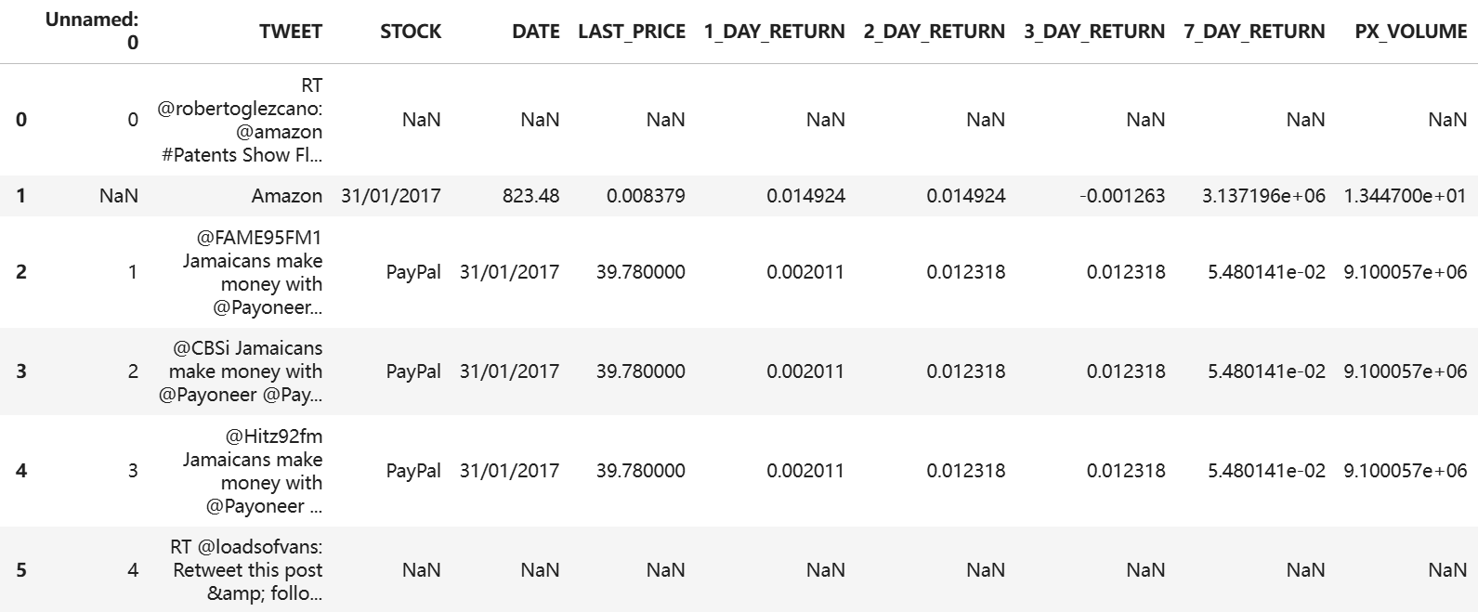
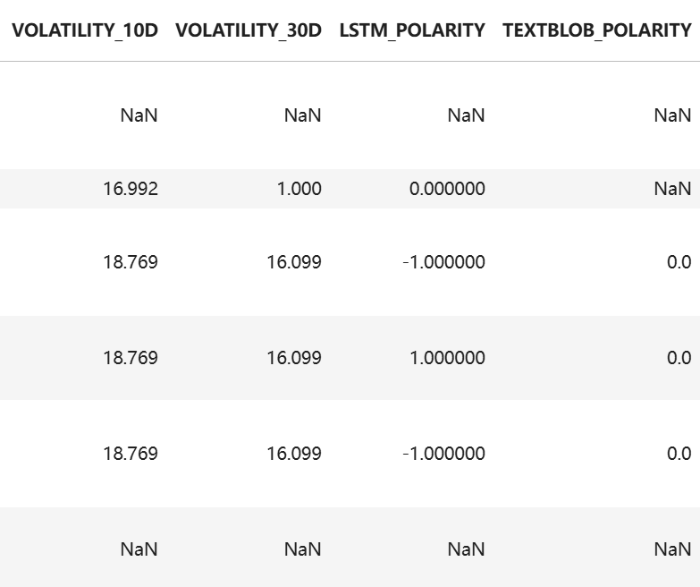
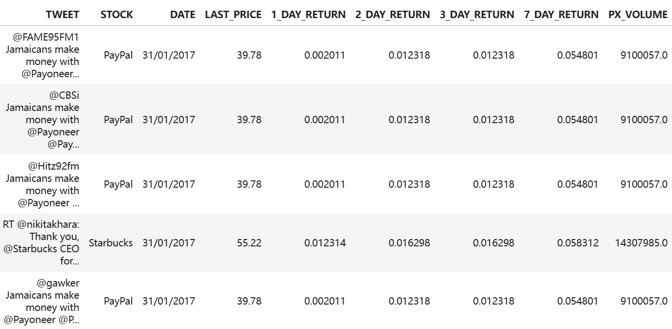
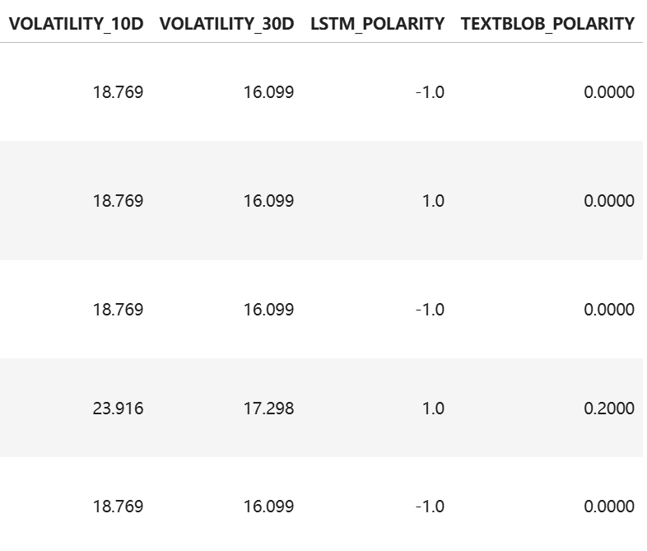
Data Cleaning and EDA
Filter out rows where 'STOCK' is 'Next' but 'TWEET' does not contain '@nextofficial'.
Drop rows where 'Unnamed: 0' has missing values.
Reset the index of the DataFrame.
Drop the 'index' and 'Unnamed: 0' columns.
Drop any remaining rows with missing values in the entire dataset.

Slide 6
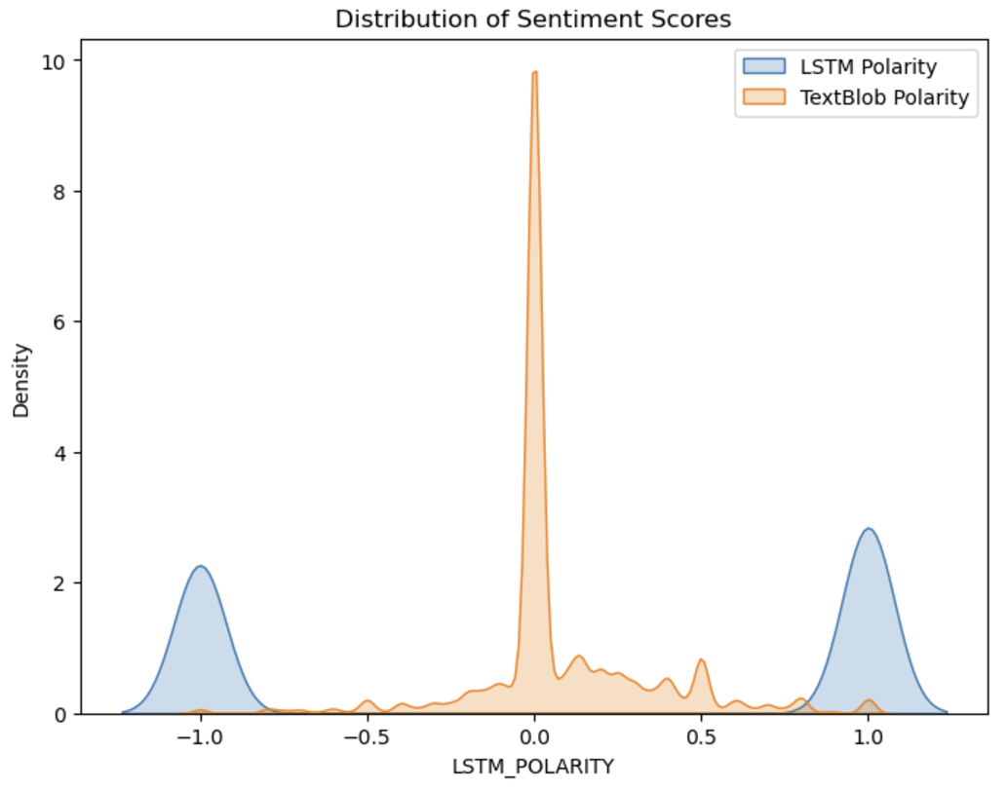
Data Cleaning and EDA
LSTM Polarity: bimodal distribution
LSTM model often classifies sentiments as strongly positive or strongly negative, with little to no neutral predictions.
TextBlob Polarity: sharply peaked at 0, with a much smaller density in the positive and negative sentiment ranges
TextBlob tends to assign neutral sentiment more often and is less confident in identifying strongly positive or negative sentiments.
Since TextBlob shows a large number of neutral sentiments, we focused only on the LSTM model in our following analysis.

Slide 7
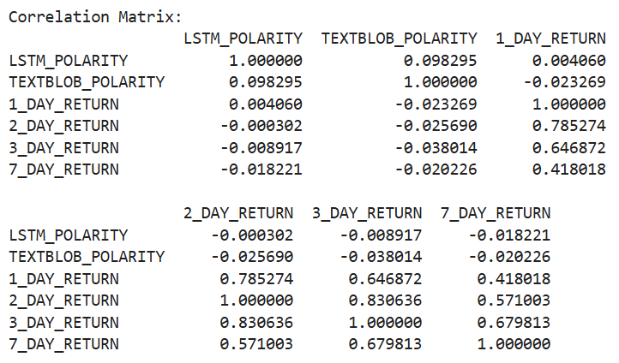
Data Cleaning and EDA
LSTM and TextBlob results on sentiment scores are not strongly aligned.
LSTM and TextBlob sentiment scores do not have a strong linear relationship with stock returns.

Slide 8
1.
Data Cleaning and EDA
2.
Analyze sentiment impact on stocks with different volatility
3.
How do tweets and their sentiment scores affect stocks across industries?
4.
Determine the most sensitive stocks to tweet sentiment
5.
Limitations

Slide 9
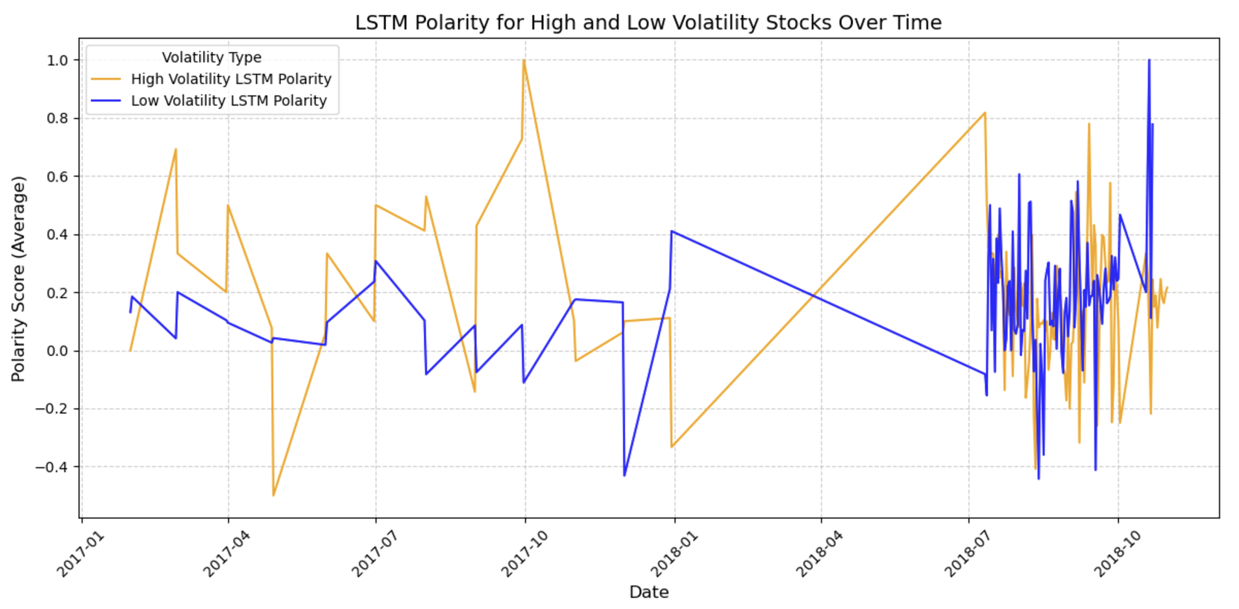
Sentiment Impact on Stocks with Different Volatility
—- Sentiment trends over time
The LSTM polarity scores for both high- and low-volatility stocks fluctuate significantly over time, we cannot observe any clear patterns suggesting that high or low volatility is related to LSTM sentiment polarity through this analysis.

Slide 10
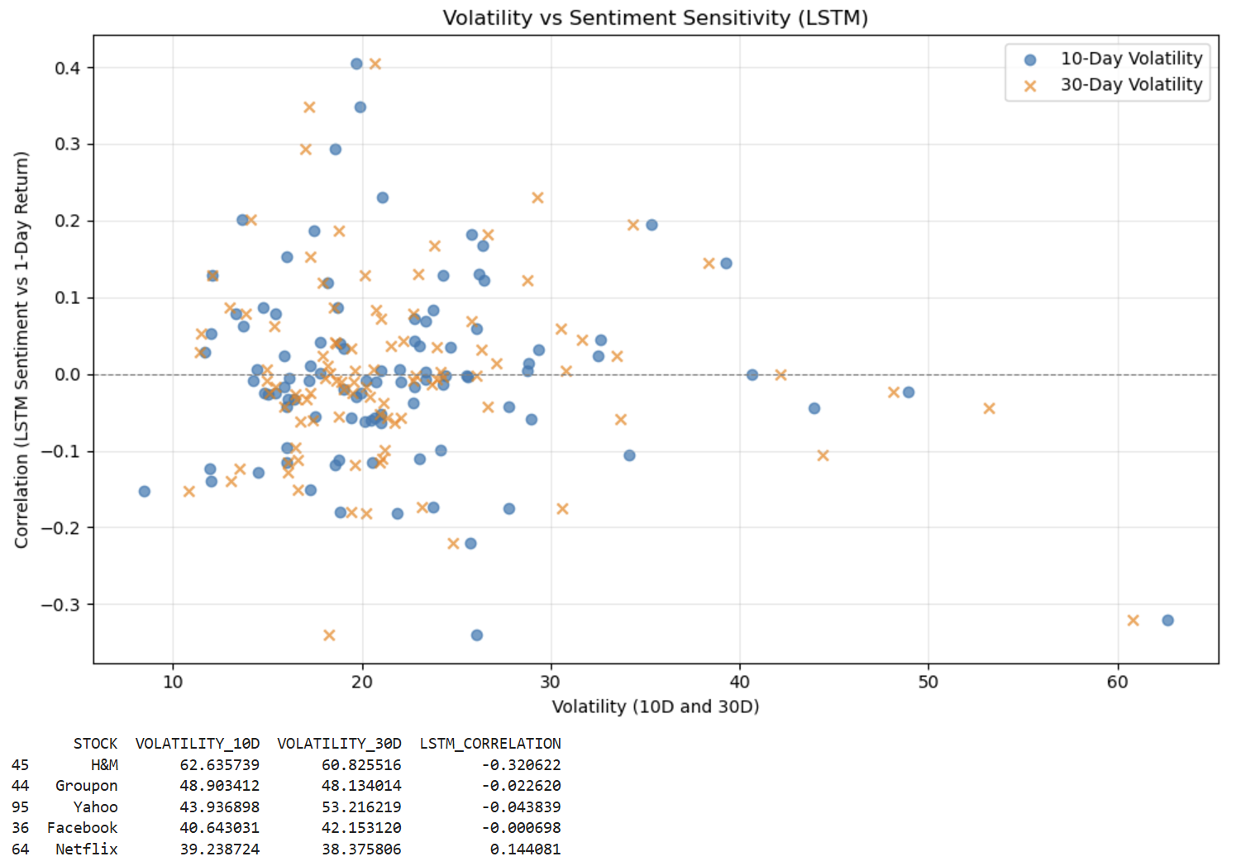
Sentiment Impact on Stocks with Different Volatility
—- Correlation analysis of LSTM sentiment
No strong linear relationship between volatility (both 10-day and 30-day measures) and sentiment sensitivity (correlation between LSTM polarity and 1-day returns).
Stocks with low volatility clusters around low sentiment sensitivity.
High volatility doesn't consistently translate to strong sensitivity to tweet sentiments.

Slide 11
1.
Data Cleaning and EDA
2.
Analyze sentiment impact on stocks with different volatility
3.
How do tweets and their sentiment scores affect stocks across industries?
4.
Determine the most sensitive stocks to tweet sentiment
5.
Limitations

Slide 12
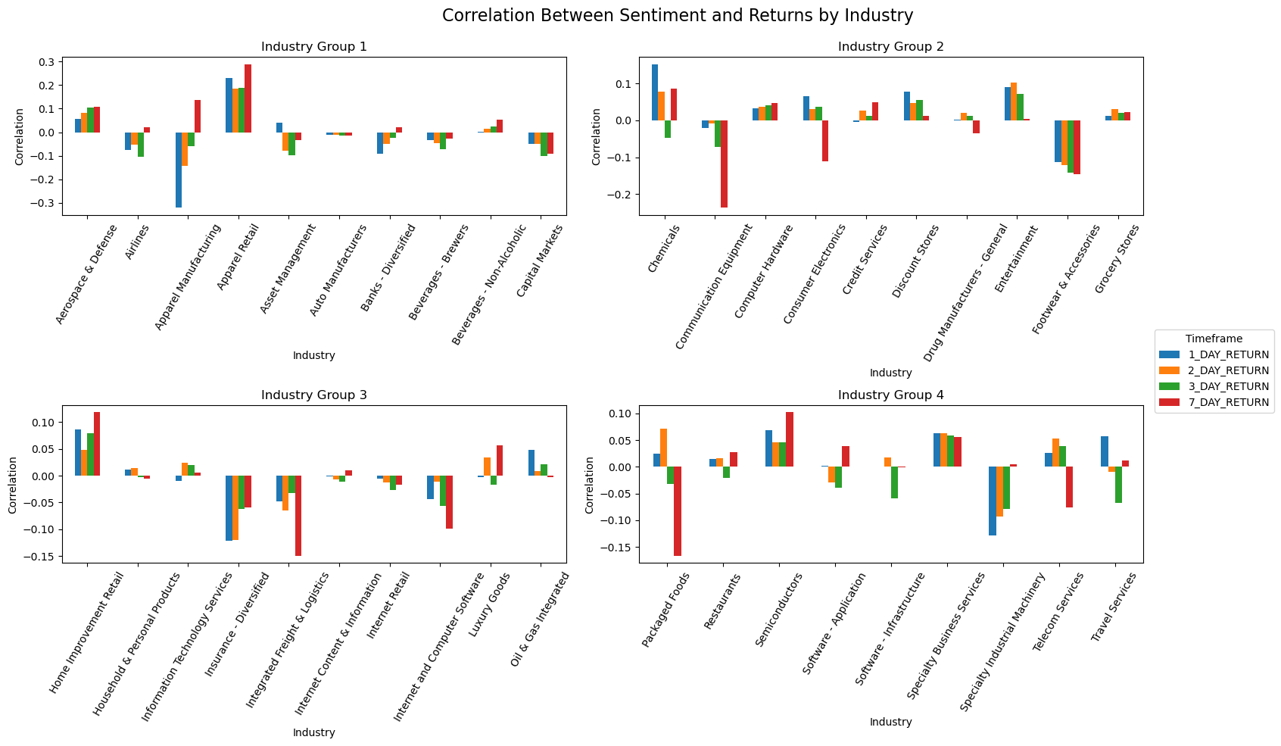
Correlations of Different Return Timeframes with Sentiment Scores

Slide 13
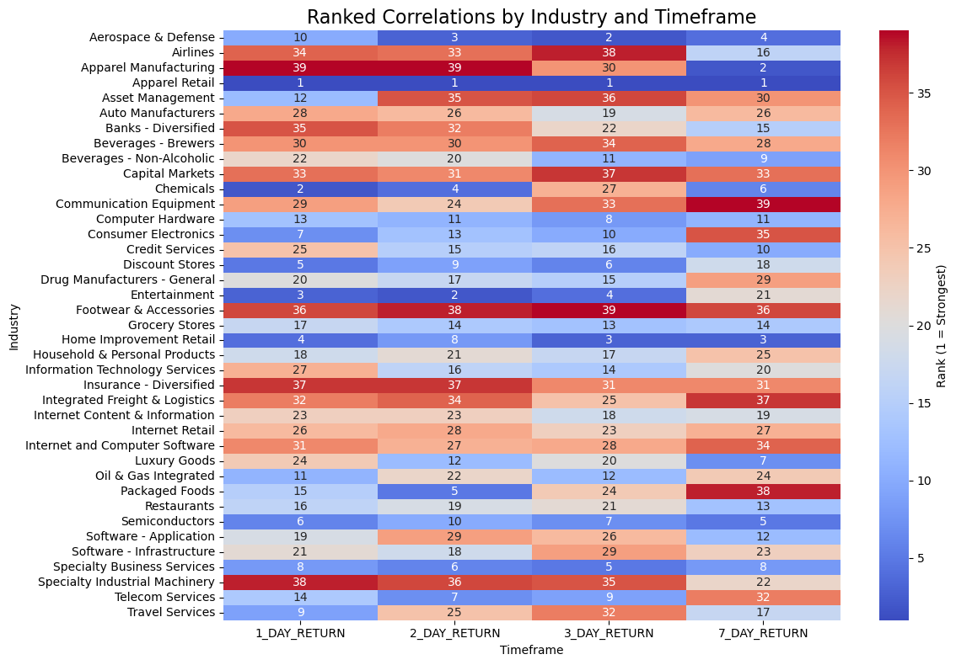
How Does Each Industry Compare to Eachother?

Slide 14
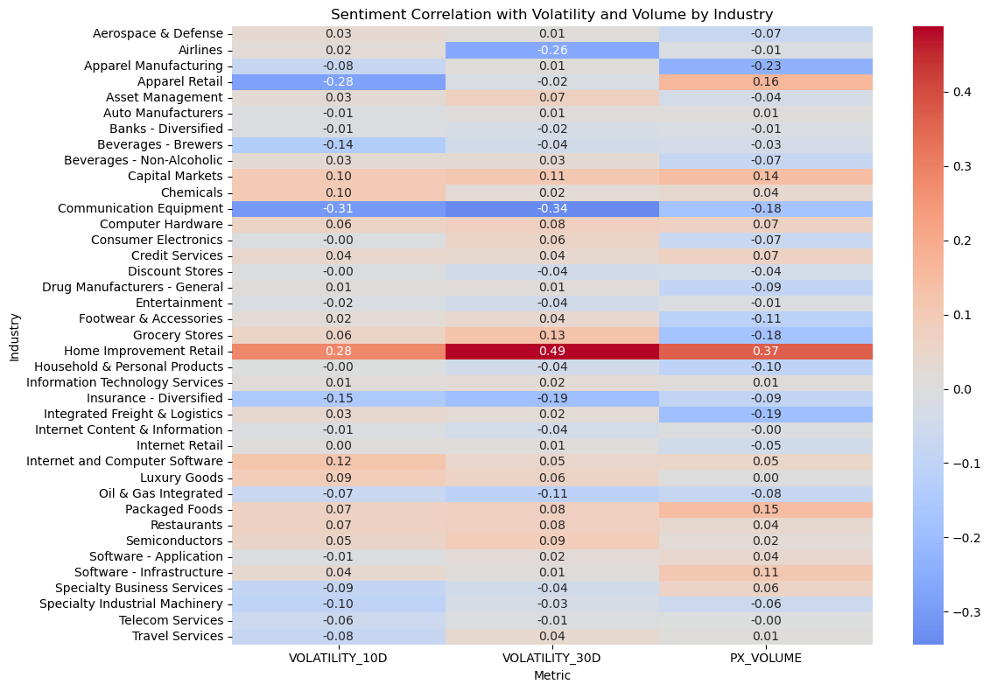
What’s the Relationship Between Sentiment Scores with Volatility and Volume?

Slide 15
1.
Data Cleaning and EDA
2.
Analyze sentiment impact on stocks with different volatility
3.
How do tweets and their sentiment scores affect stocks across industries?
4.
Determine the most sensitive stocks to tweet sentiment
5.
Limitations

Slide 16
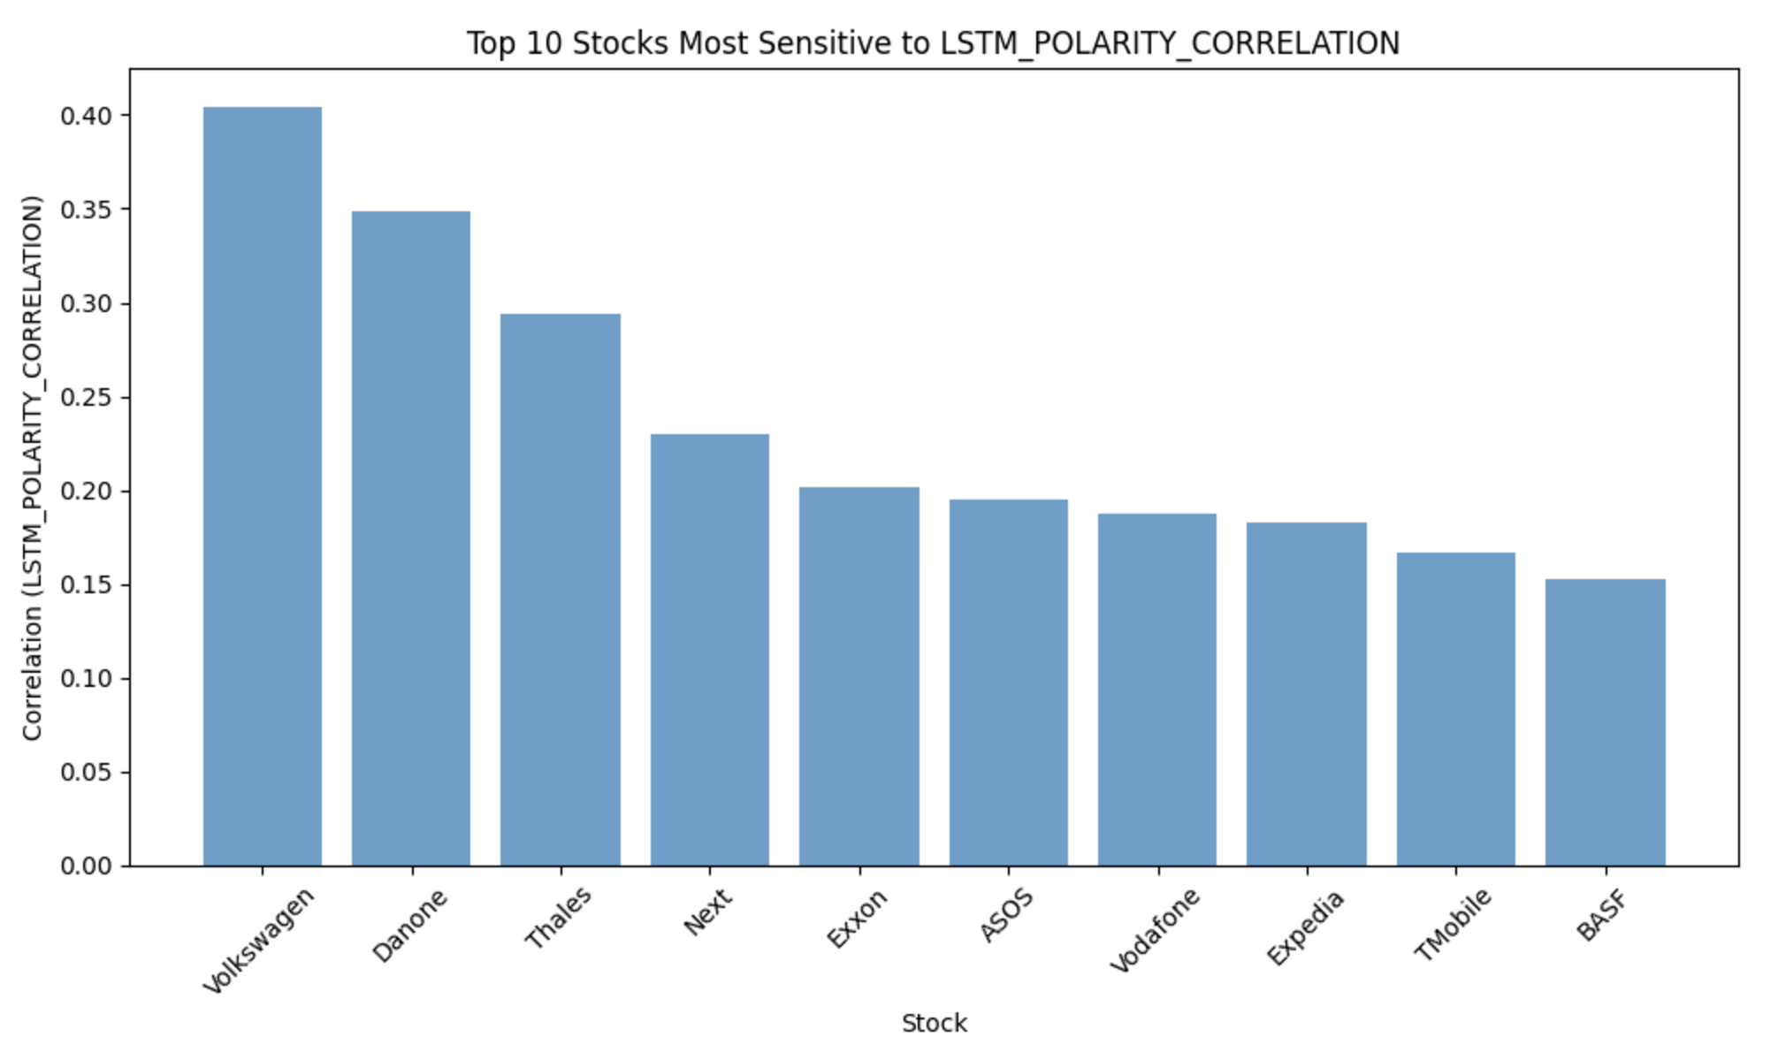
Determine the Most Sensitive Stock to Tweet Sentiment
Industry Matters
Investor Behavior
Potential Practical Implications

Slide 17
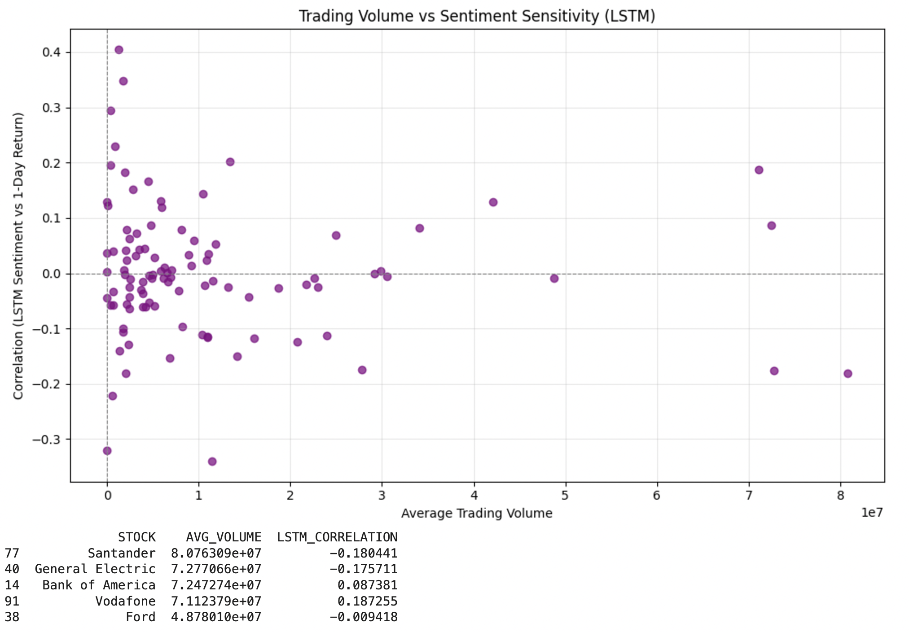
Determine the Most Sensitive Stock to Tweet Sentiment
—- Volume-Traded Perspective
Assumption: Stocks with higher trading volumes might exhibit greater sensitivity to tweet sentiments because they attract more traders who react to public information.
Weak Overall Relationship
High-Volume Stocks with Positive Correlation
Contrarian Behavior in High-Volume Stocks
High-Volume Stocks with Weak Correlation

Slide 18
Determine the Most Sensitive Stock to Tweet Sentiment
—- Volume-Traded Perspective
Assumption: Stocks with higher trading volumes might exhibit greater sensitivity to tweet sentiments because they attract more traders who react to public information.
Weak Overall Relationship
High-Volume Stocks with Positive Correlation
Contrarian Behavior in High-Volume Stocks
High-Volume Stocks with Weak Correlation

Slide 19
1.
Data Cleaning and EDA
2.
Analyze sentiment impact on stocks with different volatility
3.
How do tweets and their sentiment scores affect stocks across industries?
4.
Determine the most sensitive stocks to tweet sentiment
5.
Limitations

Slide 20
Limitations
Inconsistent Sentiment Scores for the Same Tweet
Different sentiment analysis models can produce varying scores for the same tweet, leading to inconsistencies and conflicting results. Some identical tweets also resulted in differing scores
Timeframe of Tweets and Specific Market Conditions
Tweets are collected over different time spans for each stock, and market conditions (e.g. volatility) vary across these timeframes.
Subsidiary Relationships Between Companies
Some companies in the dataset are subsidiaries of large parent companies. Tweets mentioning the parent or subsidiary may indirectly impact the other, causing correlation overlap.
Quarterly Differences in Data Volume
The number of tweets available for analysis may vary significantly across different quarters due to seasonal trends or reporting periods.

Slide 21
Questions?

