Slide 2


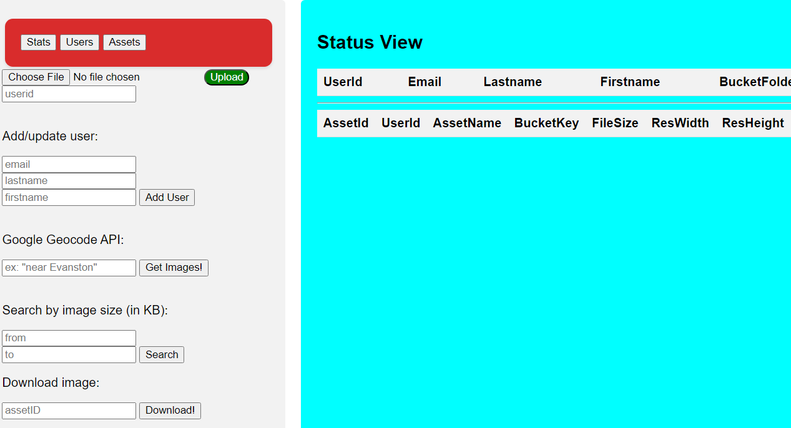

dbConn.query()
fetch()
response
Amazon RDS
res.status.json
Client
Web server (Elastic Beanstalk)
s3.send()
response

