Slide 1
Radio lab: improvements
Final Project

Slide 2
Final Project
Equalizer: (3 minutes)
Calculation
Schematic
Simulation
Results
Theoretical
Actual
Audio amp: (3 minutes)
Calculation
Schematics
Simulation
Results
Theoretical
Actual
Other attempted improvements: ☹ (2 minutes)
Breadboard design/ PCB design
Loop stick antenna
Demonstration: (2 minutes)
Want to demonstrate operating audio amplifier and equalizer.
Q&A: (5 minutes)

Slide 3
3-Band Active Baxandall Equilizer

Slide 4
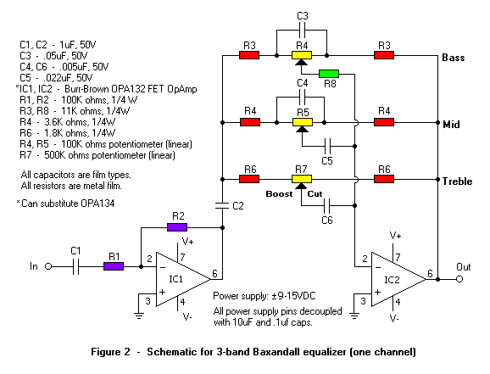
Equalizer: Calculation
Active Baxandall 3-band Equalizer (one channel)
Active
Peter Baxandall (1921-1996)
3-band
Audible range (20Hz to 20kHz)
Low pass
High pass
Band pass

Slide 5
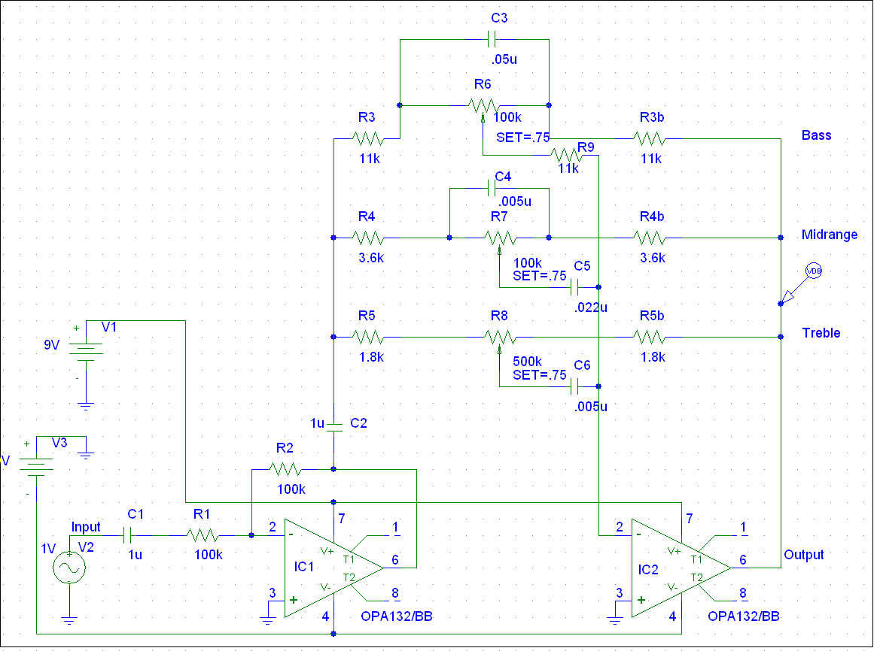
Equalizer: Schematic
Pspice

Slide 6
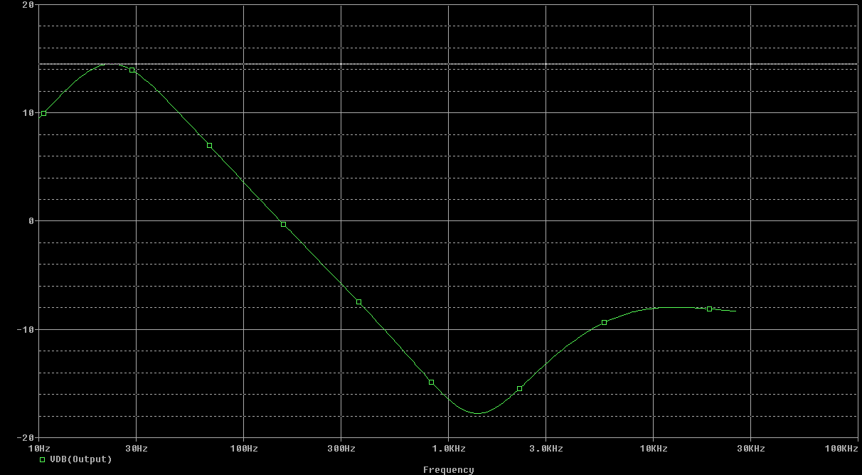
Equalizer: Simulation
Low-pass filter: Bass Equalizer Adjustment
f_{c}=1/(2*pi*R2*C1)=31.8 Hz (calculated)

Slide 7
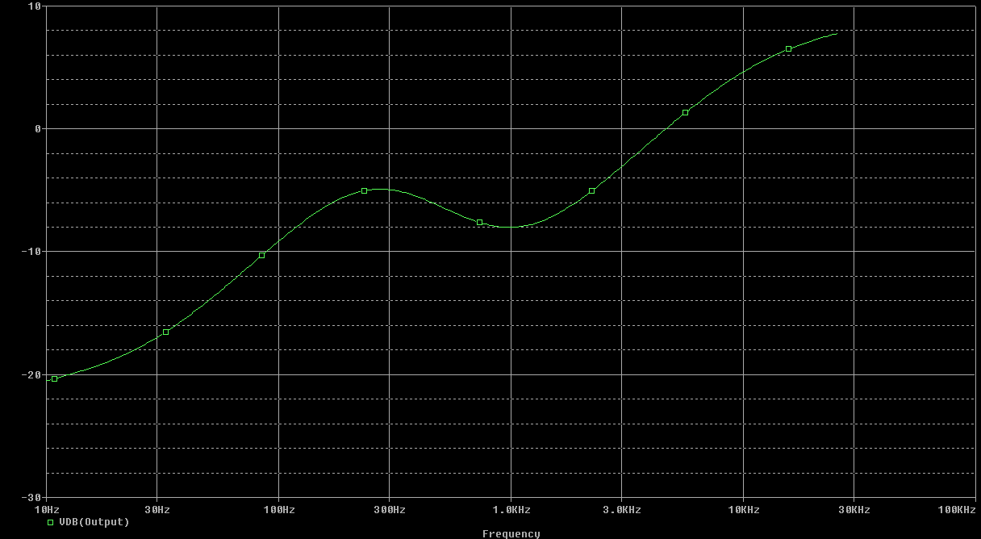
Equalizer: Simulation
High-pass filter: Treble Equalizer Adjustment
f_{c}=1/(2*pi*R2*C1)=17.7kHz (calculated)

Slide 8
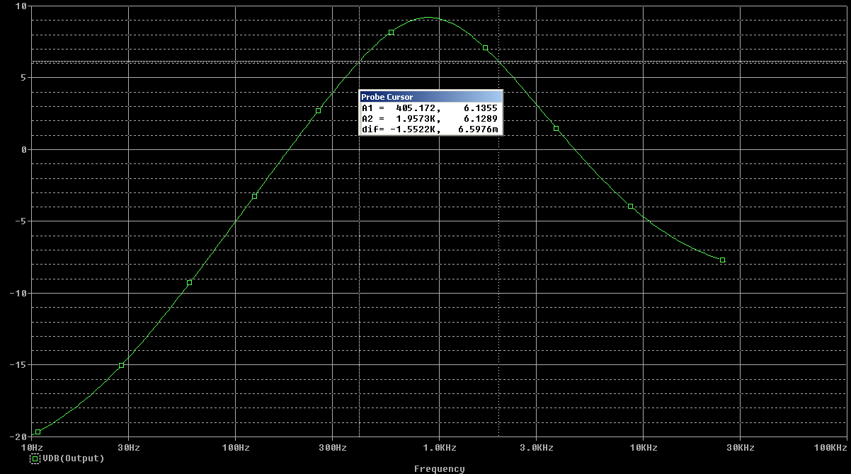
Equalizer: Simulation
Band-pass filter: Midrange Equalizer Adjustment
f_{c,low}=405.172 Hz, f_{c,high}=1.9573 kHz (observed)

Slide 9
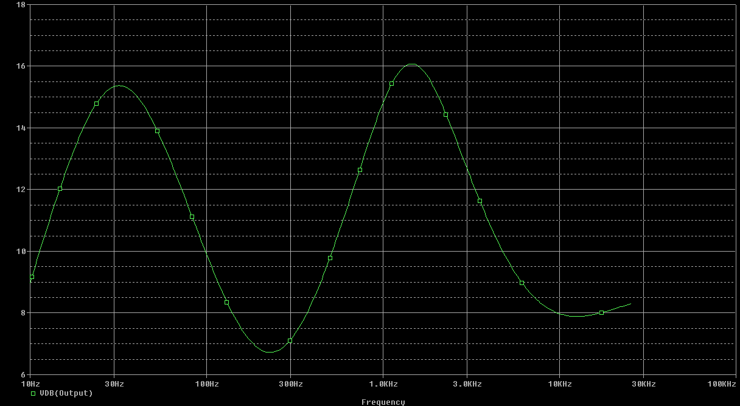
Equalizer: Simulation
All 3 bands turned all the way up

Slide 10
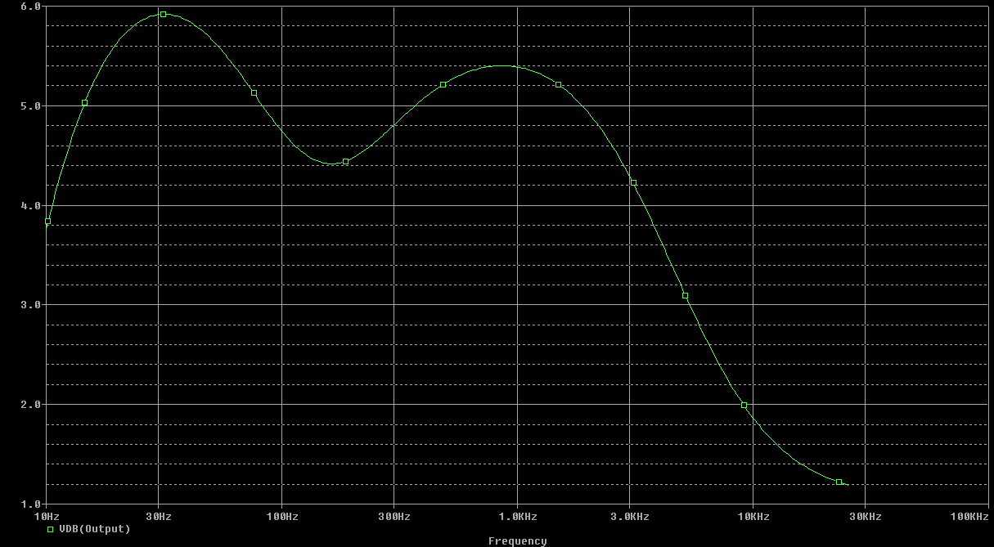
Equalizer: Simulation
All at 75%

Slide 11

Equalizer: Conclusion

Slide 12
Advanced Three-Stage Audio Amplifier

Slide 13
Audio Amp: Calculation
Design Breakdown
Input Stage: Current mirror
Gain Stage: Active load
Output Stage: Push-pull & Darlington Buffer
Design Benefits
Higher gain
Less distortion
Variable output gain

Slide 14
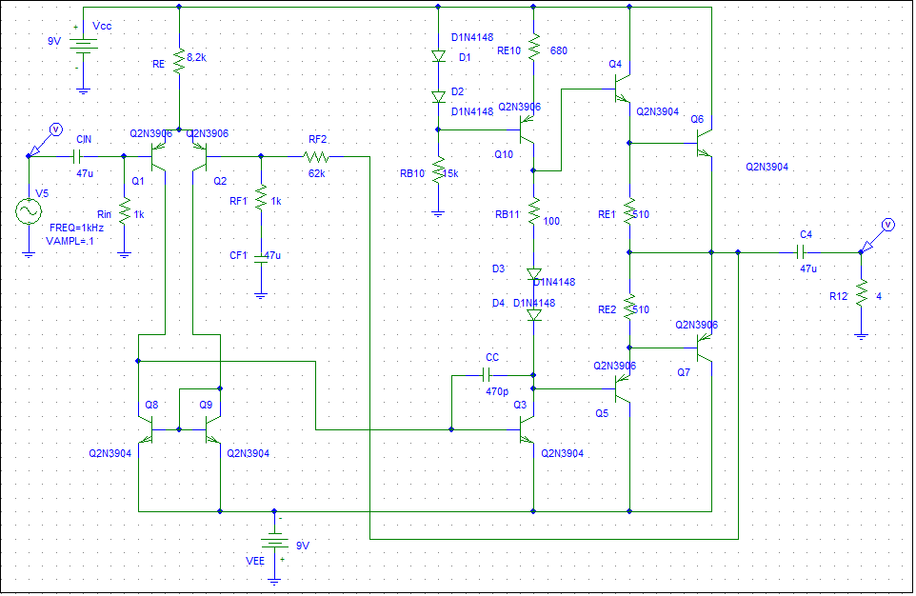
Audio Amp: Schematic
Pspice schematic

Slide 15
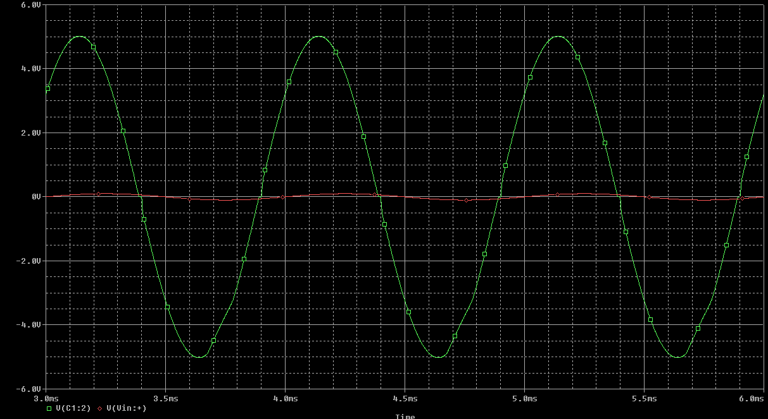
Audio Amp: Simulation
Advanced Audio Amp
Gain of about 50 V/V

Slide 16
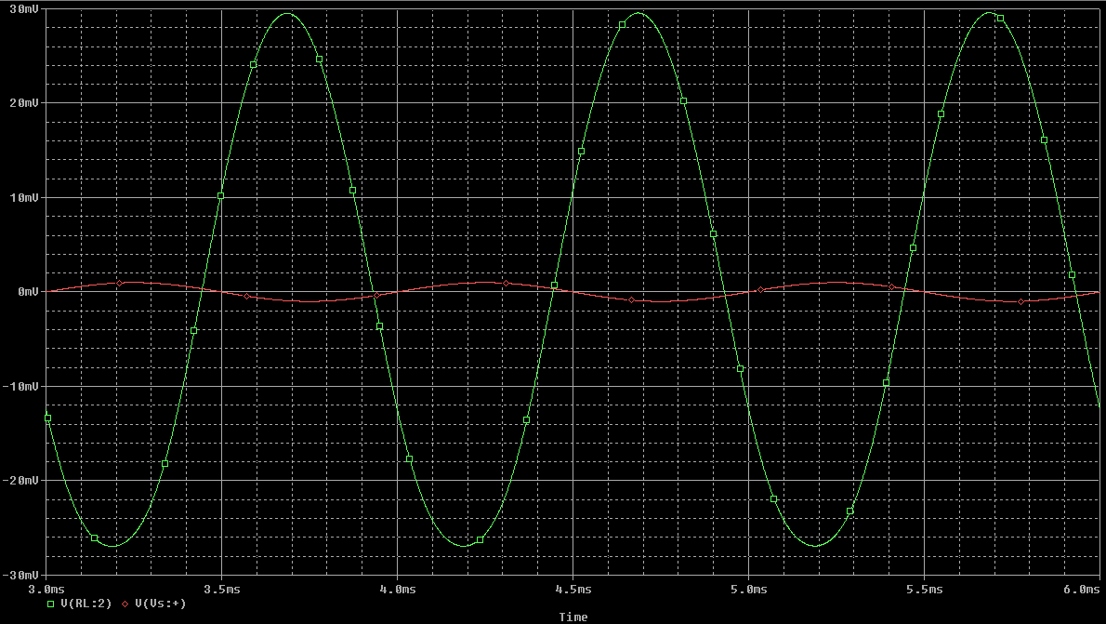
Audio Amp: Simulation
Audio Amp in Manual
Gain about 29.5 V/V
Advanced can handle a larger input, reduces distortion and has a higher gain.

Slide 17
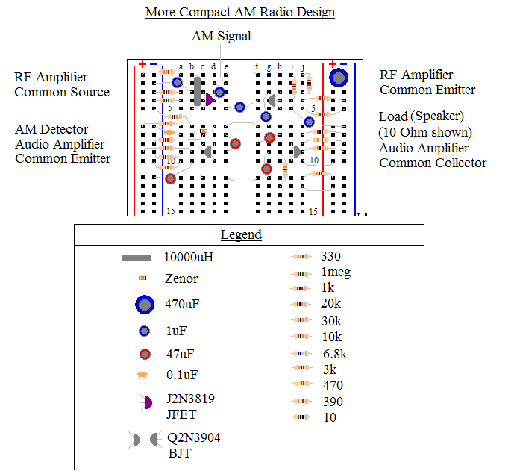
Other attempted improvements: ☹
Breadboard design/ PCB design

Slide 18
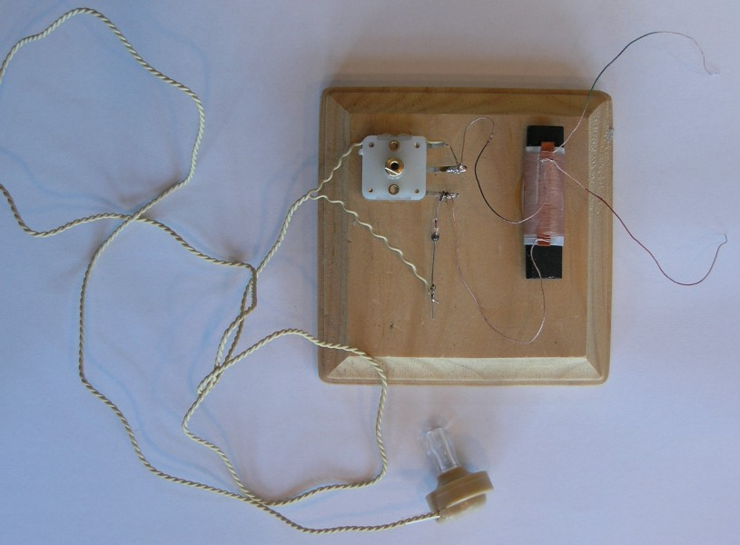
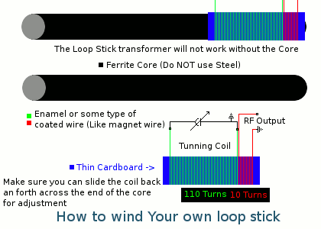
Other attempted improvements: ☹
Loop stick antenna

Slide 19
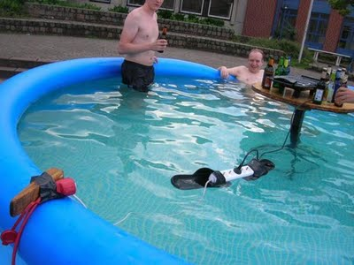
Demonstration and Q&A
Want to demonstrate operating audio amplifier and equalizer.

Slide 20

Working Radio

Slide 21
Sources
http://en.wikipedia.org/wiki/Peter_Baxandall
http://gilmore2.chem.northwestern.edu/projects/equal_prj.htm
http://en.wikipedia.org/wiki/Low-pass_filter

