Slide 1
Data Project: AtliQ
Mason Phung

Slide 2
Background
AtliQ is a B2B hardware & peripheral manufacturer that provides computer and network equipments for other businesses.
AtliQ has a headquarter in Mumbai and many regional branches across India.
In the previous quarters, the company was reported to have declining sales.
Bhavin Patel, AtliQ’s Sales Director is having trouble tracking where the business is falling in the local Indian market.
His team reported to him by providing him excel data screen captures, which are difficult to find issue and determine important trends

Slide 3
Project goals
Purpose
Discover insights from the data to figure out sales dropping issue.
Stakeholders
Sales director
Marketing team
Customer service team
Data & analytics team
IT
Expected results
Provide a real-time dashboard to support data driven decision making.
Success criteria
The dashboard is able to provide up-to-date sales data automatically.
Sales team is able to make better decision, cut down cost and gain more sales by a %.
Data team: data collecting and visualizing change to automatic, thus save more time & resources.

Slide 4
Data overview
In this project, we will work on AtliQ’s sales data from 2017 to 2020.
Data was manually extracted from the company’s Data warehouse, which was orignally stored in the company’s Sales database management system.
The data will be stored in a local MySQL database, then extracted and analyzed with SQL.
Data will be visualized using Tableau.

Slide 5
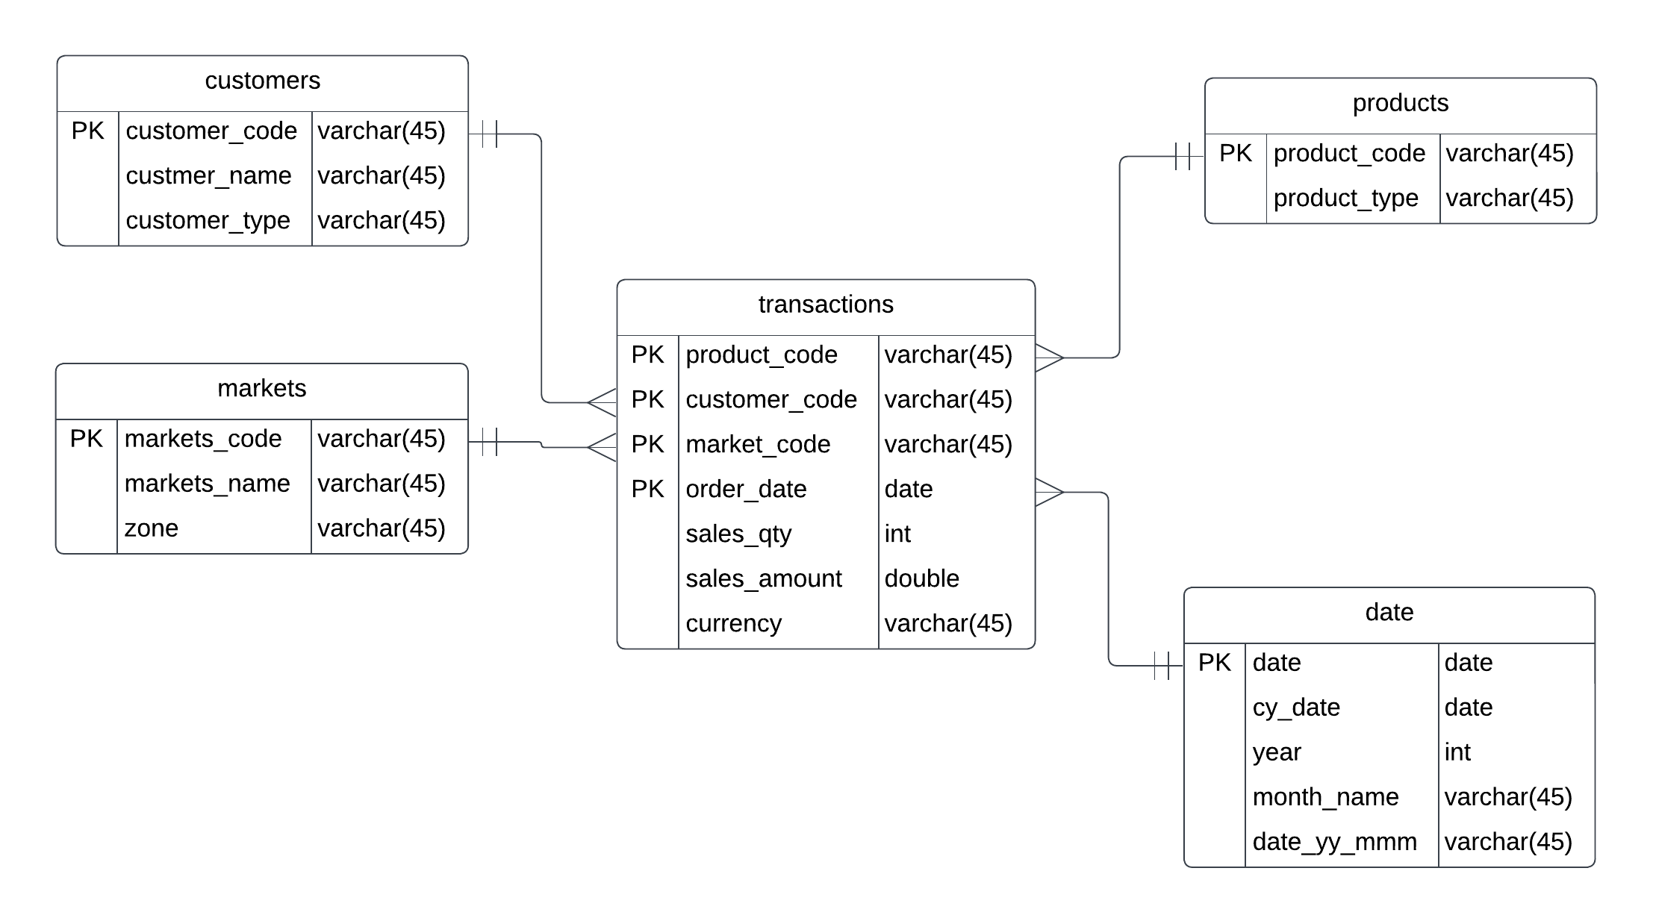
ER diagram

Slide 6
Data analysis with MySQL
The data dump file is loaded by SQL workbench and imported into the database
SQL queries will be executed in MySQL workbench.
SQL will be used to analyze the data, find insights and useful information and to make sure Tableau data visualization is correct.

Slide 7
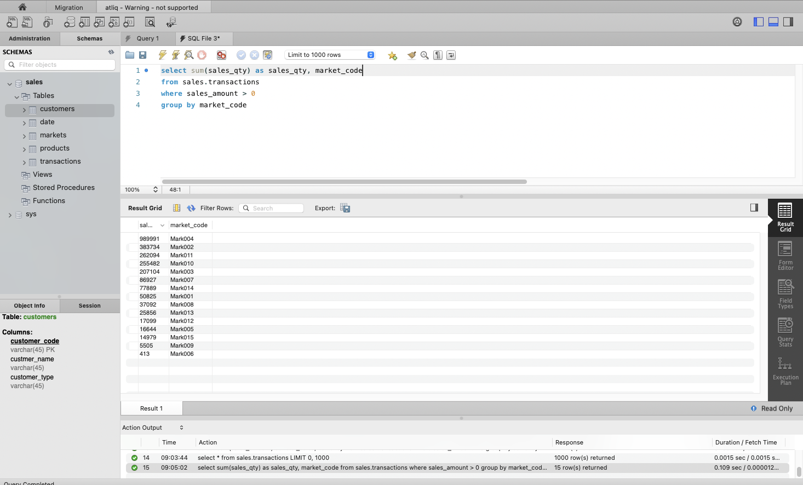
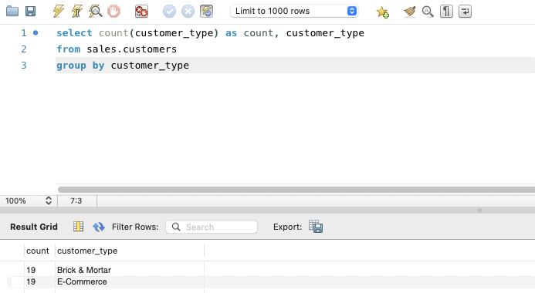
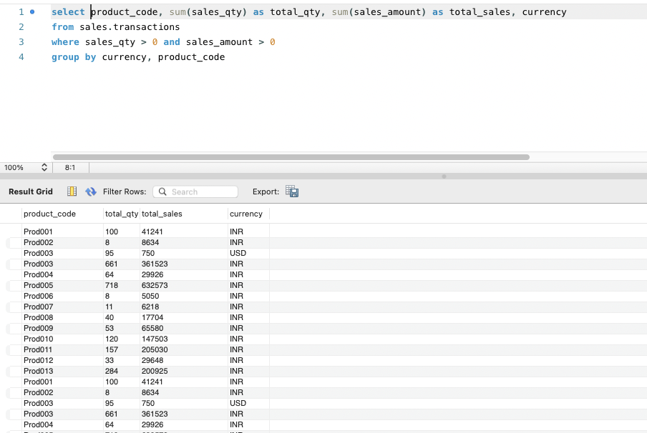
Data analysis with MySQL

Slide 8
Data visualization with Tableau
Log in to the local MySQL database with Tableau
Data will be visualized in a interactive, real-time Tableau dashboard
Each components of the dashboard will be created in a seperated sheet

Slide 9
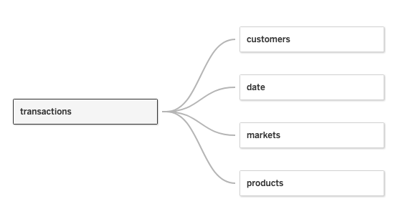
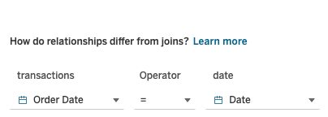
Data visualization with Tableau Table relationship connection
Set up the connections between the tables in the dataset based on the ER diagram

Slide 10
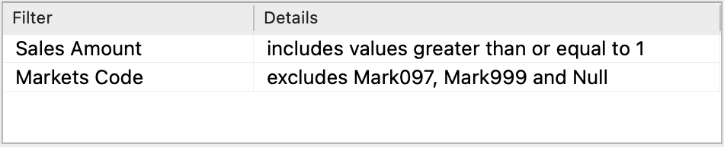
Data visualization with Tableau Data cleaning
After determining which variable will be presented in the dashboard, we will clean the dataset in Tableau using its filter. Remove:
Value that doesn’t make sense: Sales Amount’s values are sometimes ‘0’ or ‘-1’.
Values that are not required/needed by the analysis: ‘Mark097’ and ‘Mark999’ is New York and Paris city, these cities are not local India.
Convert data unit by using ‘Create calculated field’. In the dataset, both INR and USD are used, therefore we will convert them into INR. (IF [Currency] == "USD" THEN [Sales Amount] * 74 ELSE [Sales Amount] END – 74 is the exchange rate of USD and INR)

Slide 11
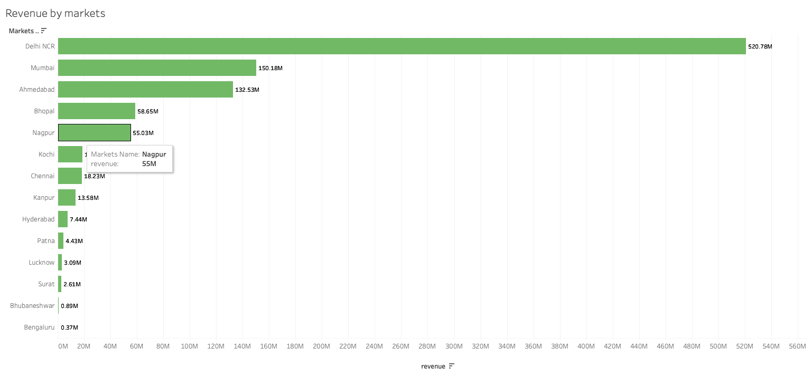
Data visualization with Tableau
Then, the data is visualized chart by chart by different characteristics

Slide 12
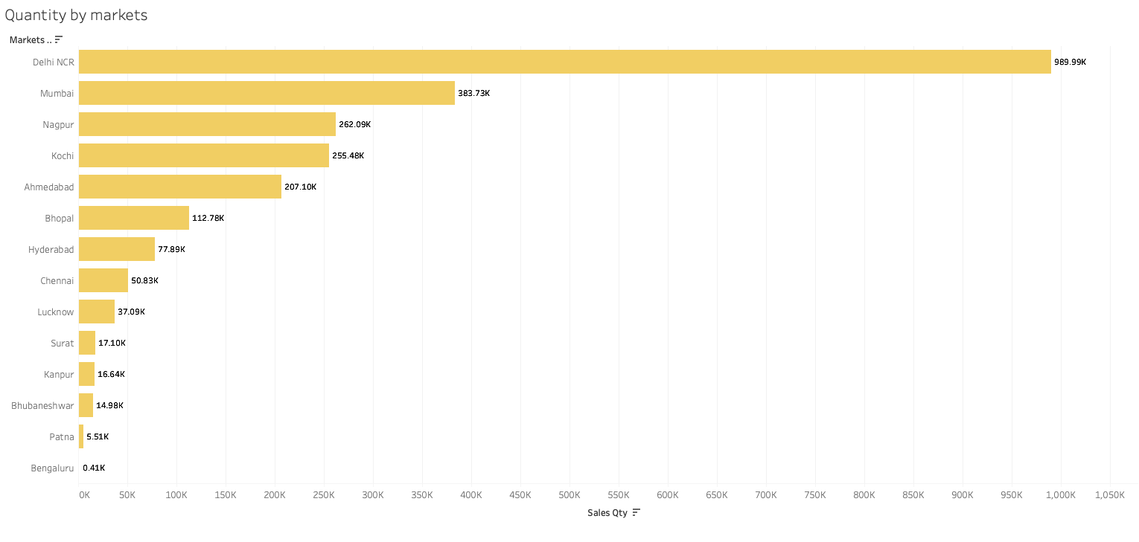
Data visualization with Tableau

Slide 13
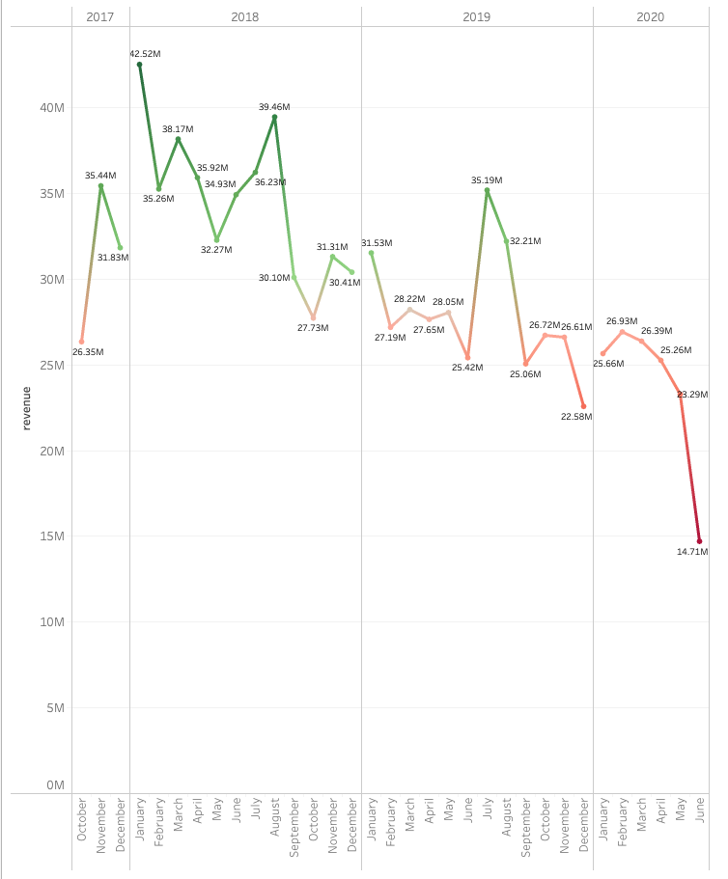
Data visualization with Tableau

Slide 14
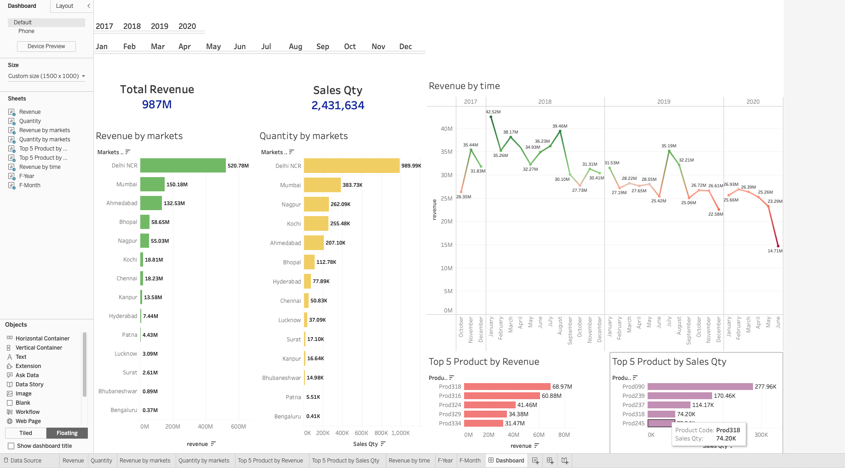
Final dashboard

Slide 15
Final dashboard
The dashboard is interactive, further details can be found when hover on the tables, lines, and bars.
The year/month bars on the top of the dashboard can be use to filter the dashboard data. When a certain time range is chosen, the whole dashboard will change according to the time range.
Regions can also be filtered when clicked on the corresponding bars in the bar chart. When a certain region is chosen, the whole dashboard will change according to the region.
The data is updated in real-time with the database.

