Slide 1
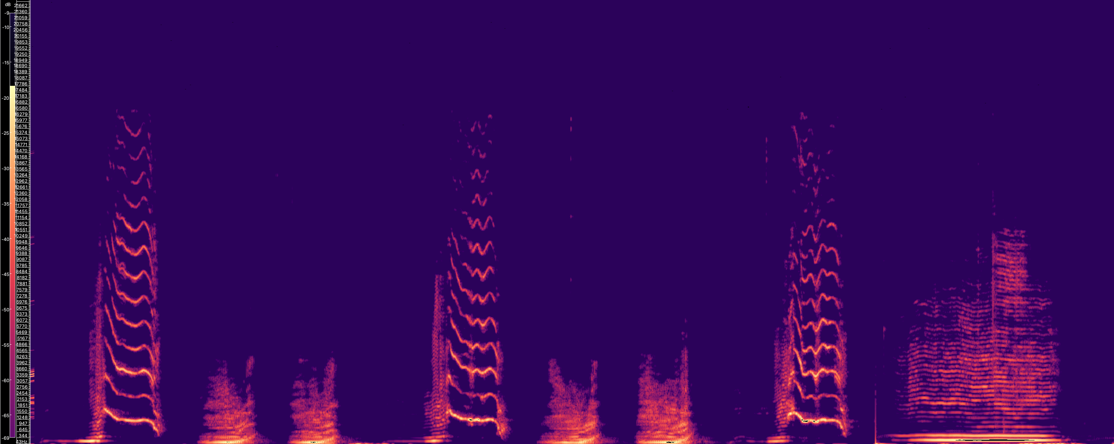

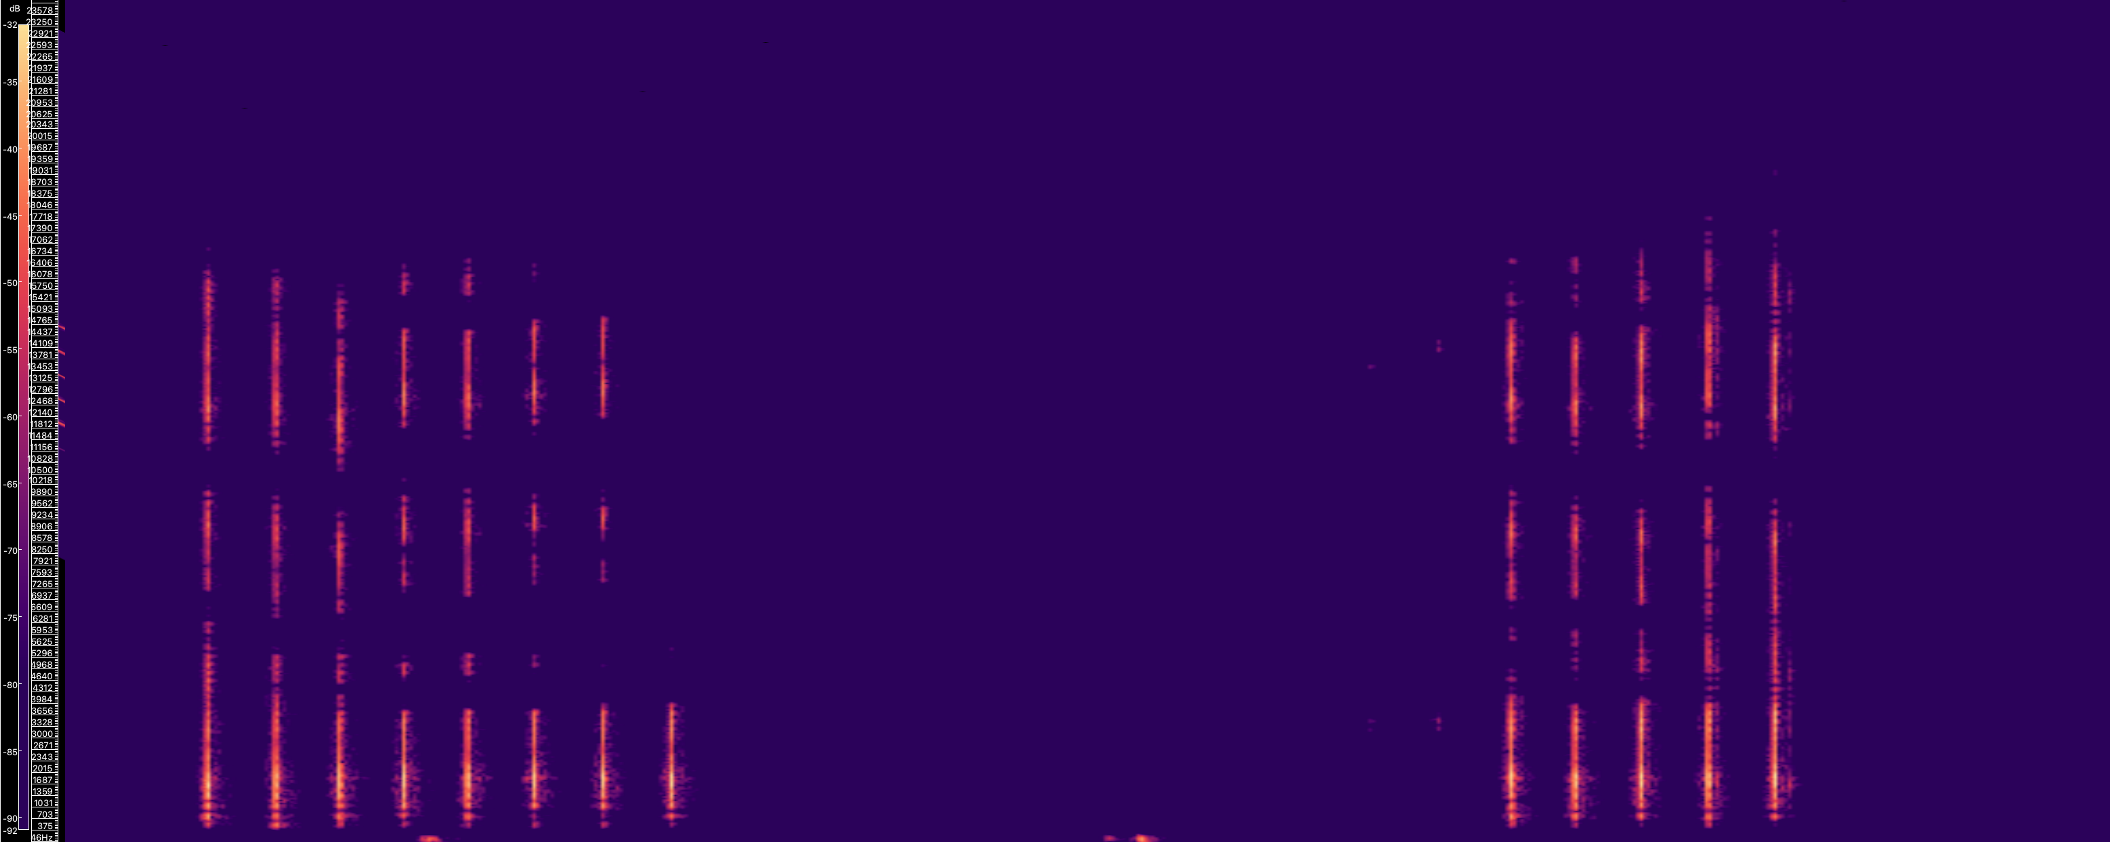

Humpback Whale (Owen et al., 2019) - Element Durations
12 kHz
0 kHz
5.72 s
23.2 s
Sperm Whale (Hersh et al., 2022) - Inter-Element Intervals
…
12 kHz
0 kHz
0.43 s
6.47 s
Notes:
Color rotation: 50
Color: magma
Scale: dB^2 (View)
Sperm whale: 0.43 to 6.47 seconds
Humpback whale: 5.72 to 23.20 seconds

