Slide 1
CUSTOMER INSIGHTS · SHOPPING BEHAVIOR
Customer Shopping
Behavior Analysis
What the data says.

Slide 2
EXECUTIVE READOUT
Three signals for business leaders
Descriptive findings across 3,900 purchases.
$59.76
27%
#1
Average purchase across 3,900 purchases.
Only 27% of customers are subscribers.
Clothing is the largest category by sales and revenue.

Slide 3
SUBSCRIPTION SIGNAL
Subscriptions have room to grow
Subscribers versus non-subscribers
Average spend is similar
1,053 vs 2,847
$59.49 vs $59.87
Subscribers vs non-subscribers
Promote exclusive benefits; do not assume subscription causes higher spend.

Slide 4
LOYALTY SIGNAL
Repeat buyers are a loyalty opportunity
3,116
701
83
Loyal
Returning
New
Customers classified as loyal
Customers classified as returning
Customers classified as new
Among customers with more than five purchases: 2,518 are non-subscribers and 958 are subscribers.
Reward repeat buyers and promote subscriber benefits.

Slide 5


CATEGORY MIX
Clothing leads
the category mix
Highlight best-selling products in campaigns.
1,737
Jewelry · 171 orders
Sandals lead footwear · 160 orders
Blouse · 171 orders
Pants · 171 orders
Clothing purchases

Slide 6
MARGIN SIGNAL
Discount use warrants a margin review
Balance sales boosts with margin control; discount use alone does not establish dependence.
50%
49.66%
839
Hats
Sneakers
Purchases
Highest discounted-purchase share
Second-highest discounted-purchase share
Discounted purchases above the overall average purchase amount

Slide 7
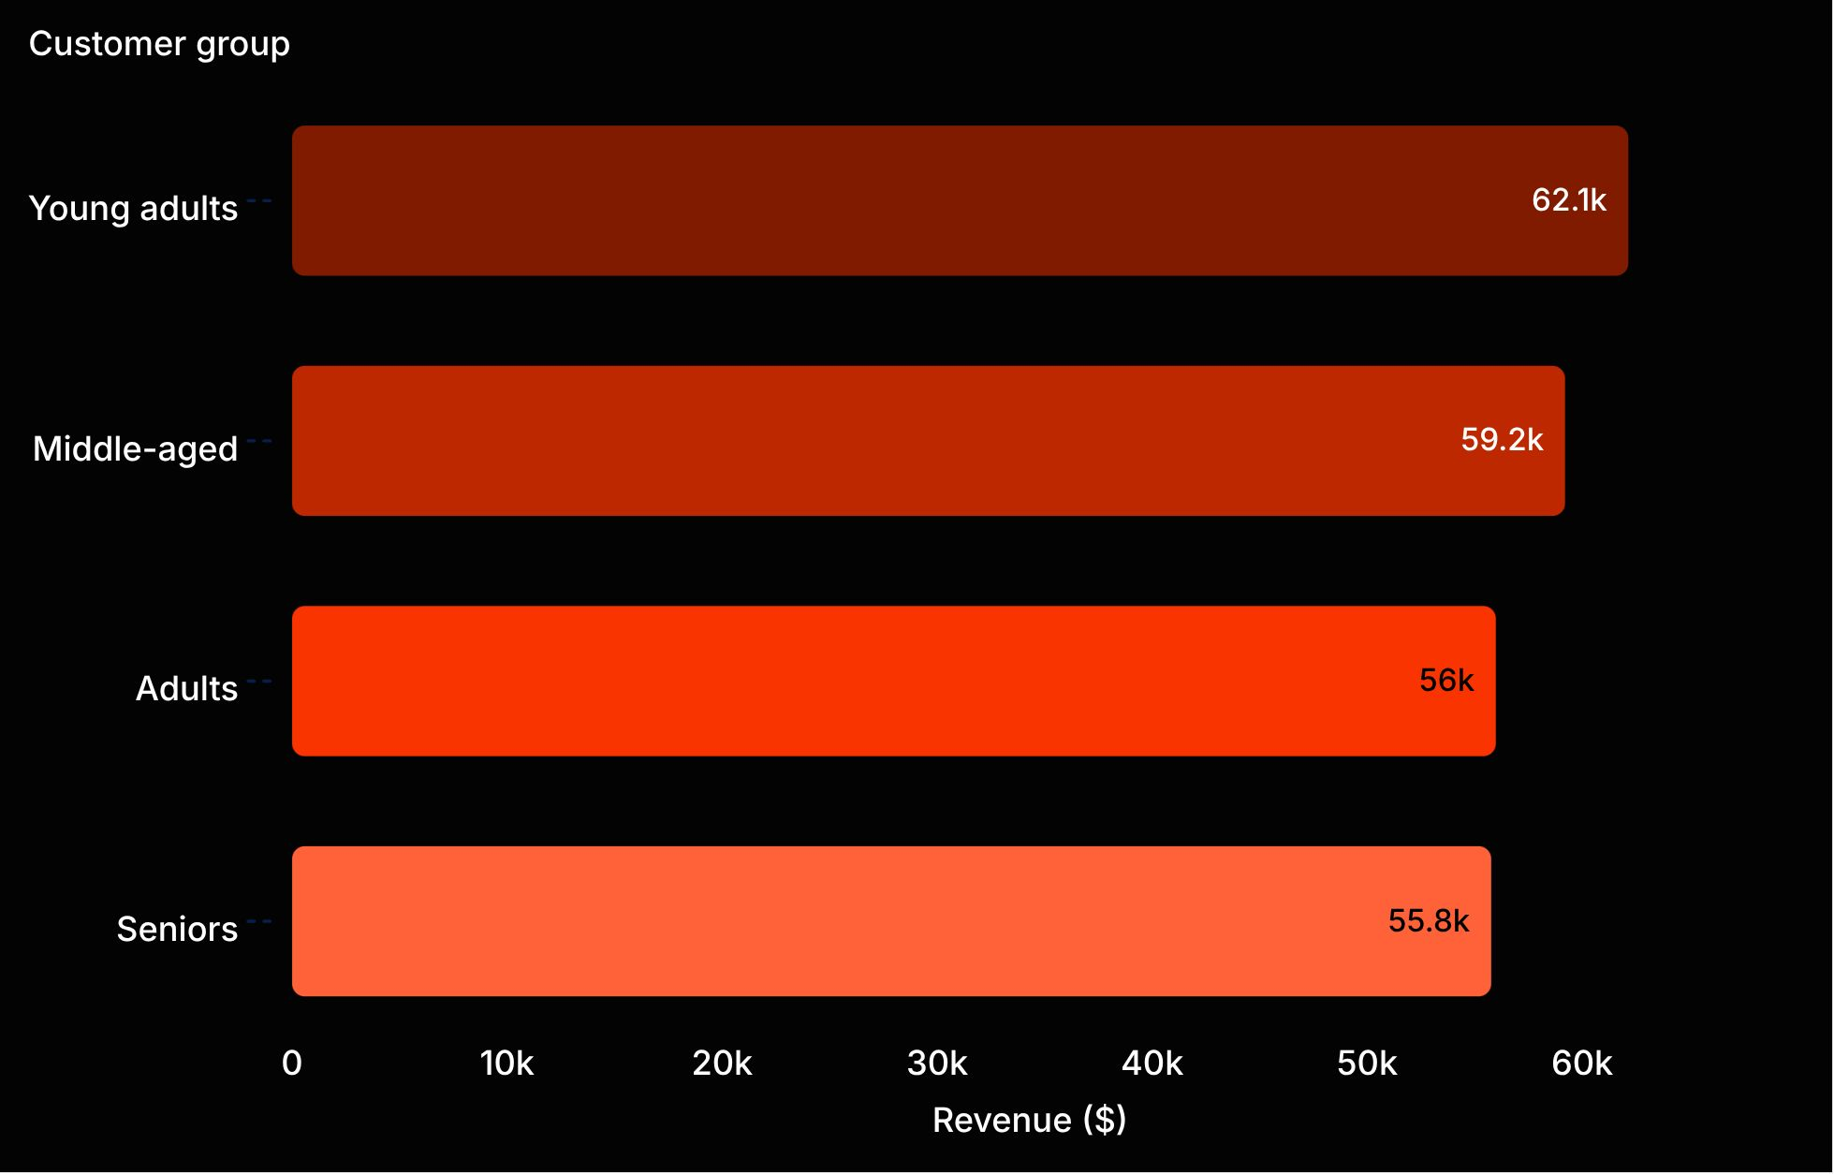
REVENUE SIGNAL
Revenue varies across customer groups
Age matters.
Use the age-group results to inform targeted marketing.
Male customers generate $157,890 and female customers $75,191 in the dataset; the customer counts differ.

Slide 8

CAMPAIGN CUES
Product ratings and
shipping offer cues
3.86
$60.48
Campaign cues
Sandals follow at 3.84. Standard-shipping average spend is $58.46. Highlight top-rated products and explore targeted marketing to express-shipping users.
Gloves: highest average product rating
Express-shipping average spend

Slide 9
DECISION AGENDA
Priorities for action
Promote subscriber benefits
Reward loyalty
Focus on repeat buyers.
Position best-selling, highly rated products.
Review discounts
Target with context
Check against margin goals.
Use age-group and shipping insights to guide targeted marketing.
Findings are descriptive; the report does not establish causal effects or define the age-group boundaries.

