Slide 1
PRESENTATION 2

Slide 2
EVOLUTION OF COMPUTERS
<<MECHANICAL ERA (Dark Ages)>>
1. Abacus (300 BC)
Basic arithmetic operations.
2. Napier’s Bones (1612 A.D.)
Made of 10 rods.
Multiplication and division
3. Slide Rule (1622 A.D)
Based on 2 movable rules.
Multiplication and division
4.Pascal’s Calculator (1642 A.D.)
Involved adjustment of wheels.
5. Lebniz Calculator
6. Babbage’s Difference and Anallytical Engiles

Slide 3
EVOLUTION OF COMPUTERS (CONTINUED)
<<ELECTRO-MECHANICAL ERA (Middle Ages)>>
Herman Hollerith’s Tabulating Machine (1890 A. D.)

Slide 4
EVOLUTION OF COMPUTERS (CONTINUED)
<<ELECTRONIC ERA (Modern Age)>>
1. First Generation of Computers (1940 TO 1946)
Based on vacuum tubes.
Involved machine language (0’s and 1’s)
Used for scientific research.
2. Second Generation of Computers (1956 TO 1963)
Based on transistors.
Usage of assembly language and high level language (FORTRAN)
Magnetic core used for internal storage.
3. Third Generation of Computers (1964 TO 1971)
Based on IC’s (Integrated Circuits)
Keyboard used as input device.
Monitor used as output device.
Usage of high level languages such as COBOL and Pascal.

Slide 5
EVOLUTION OF COMPUTERS (CONTINUED)
<<ELECTRONIC ERA (Modern Age) (continued)>>
4. Fourth Generation of Computers (1971 TO Present)
Invention of microprocessors
Faster, less expensive, smaller and more reliable computers
Usage of semi-conductor memories (RAM and ROM)
Used for advanced applications in many fields such as space research, business, and artwork
5. Fifth Generation of Computers (Present and Beyond)
Capable of simulating human intelligence by learning, reasoning, and generalization.

Slide 6
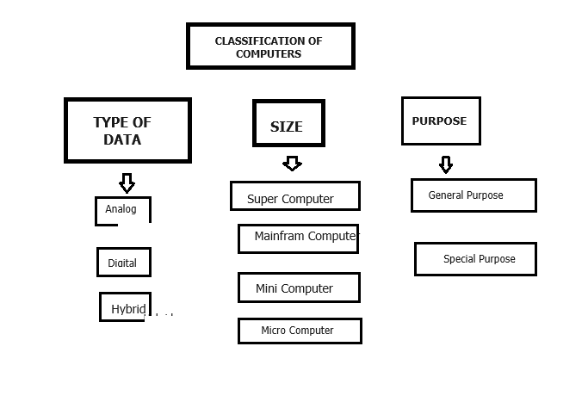
TYPES OF COMPUTERS

Slide 7
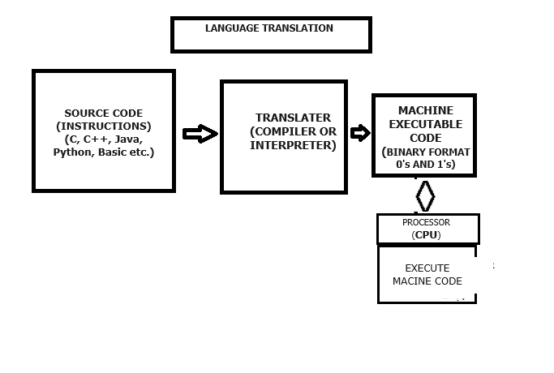
TRANSLATION OF SOURCE CODE

Slide 8
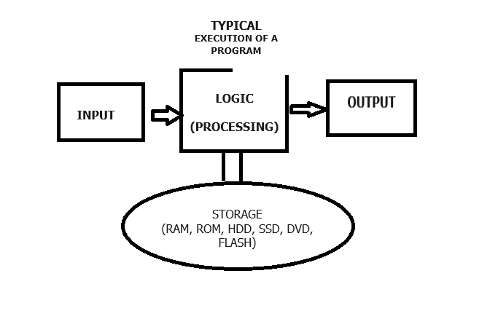
PROGRAM EXECUTION (TYPICAL FORMAT)

Slide 9
SAMPLE C++ CODE
using namespace std;
#include <iostream>
int main(int argc, char **argv) {
int a, b, c; // create variable a, b, and c of type int
int sum; // create variable sum of type int
// ACCETPT VALUE FOR a FROM USER
cout << “Enter value for a: “;
cin >> a;
// ACCETPT VALUE FOR b FROM USER
cout << “Enter value for b: “;
cin >> b;
// ACCETPT VALUE FOR c FROM USER
cout << “Enter value for c: “;
cin >> c;
// CALCULATE SUM OF a, b, c AND STORE RESULT IN sum
sum = a + b + c;
// SHOW SUM TO USER
cout << “The answer is: ” << sum
}

