Slide 1
PRESENTATION 2

Slide 2
EVOLUTION OF COMPUTERS
<<MECHANICAL ERA (Dark Ages)>>
1. Abacus (300 BC)
Basic arithmetic operations.
2. Napier’s Bones (1612 A.D.)
Made of 10 rods.
Multiplication and division
3. Slide Rule (1622 A.D)
Based on 2 movable rules.
Multiplication and division
4.Pascal’s Calculator (1642 A.D.)
Involved adjustment of wheels.
5. Lebniz Calculator
6. Babbage’s Difference and Anallytical Engiles

Slide 3
EVOLUTION OF COMPUTERS (CONTINUED)
<<ELECTRO-MECHANICAL ERA (Middle Ages)>>
Herman Hollerith’s Tabulating Machine (1890 A. D.)

Slide 4
EVOLUTION OF COMPUTERS (CONTINUED)
<<ELECTRONIC ERA (Modern Age)>>
1. First Generation of Computers (1940 TO 1946)
Based on vacuum tubes.
Involved machine language (0’s and 1’s)
Used for scientific research.
2. Second Generation of Computers (1956 TO 1963)
Based on transistors.
Usage of assembly language and high level language (FORTRAN)
Magnetic core used for internal storage.
3. Third Generation of Computers (1964 TO 1971)
Based on IC’s (Integrated Circuits)
Keyboard used as input device.
Monitor used as output device.
Usage of high level languages such as COBOL and Pascal.

Slide 5
EVOLUTION OF COMPUTERS (CONTINUED)
<<ELECTRONIC ERA (Modern Age) (continued)>>
4. Fourth Generation of Computers (1971 TO Present)
Invention of microprocessors
Faster, less expensive, smaller and more reliable computers
Usage of semi-conductor memories (RAM and ROM)
Used for advanced applications in many fields such as space research, business, and artwork
5. Fifth Generation of Computers (Present and Beyond)
Capable of simulating human intelligence by learning, reasoning, and generalization.

Slide 6
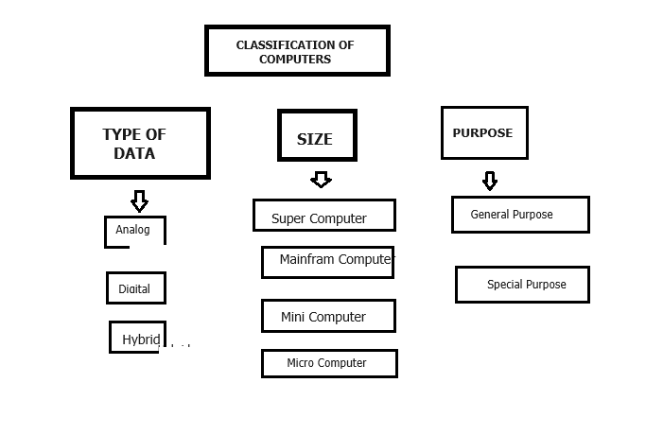
TYPES OF COMPUTERS

Slide 7
SYSTEM UNIT
The concepts discussed here are applicable to a Personal Computer (PC) or a Laptop.
However, some are also applicable to other types of computers.
The computer is visible to the eye as a box (or as a flat thin object if the computer is a laptop).
The box is termed as the System Unit.

Slide 8
SYSTEM UNIT (EXTERNAL COMPONENTS)
From outside, various external parts are attached to the box which comprises the System Unit.
If the computer is a Laptop, some of the outside parts are directly embedded within the body of the thin flat laptop.
Examples of external parts are keyboard, mouse, monitor, printer, network plug etc.

Slide 9
MOTHERBOARD
The most important and major INTERNAL PART of the SYSTEM UNIT IS the MOTHERBOARD
The motherboard is responsible for connecting different parts of a computer.
The MAJOR ELEMENTS POSITIONED on the MOTHERBOARD are listed below:
1. Microprocessor (CPU)
Components of CPU
Arithmetic Logic Unit (ALU)
Control Unit
Registers
Cache
Clock

Slide 10
MOTHERBOARD (CONTINUED)
MAJOR ELEMENTS POSITIONED ON THE MOTHERBOARD (CONTINUED)
2. Buses
(buses are mainly designed for transferring commands and data between components of motherboard)
Control Bus (for carrying commands)
Data Bus (for carrying data)
Address Bus (for carrying memory addresses)
Other types of buses (for other connection operations)

Slide 11
MOTHERBOARD (CONTINUED)
MAJOR ELEMENTS POSITIONED ON THE MOTHERBOARD (CONTINUED)
3. Controllers / Cards
(controllers are pieces of hardware designed for many different purposes)
Input device controllers
Output device controllers
Storage device controllers
Graphics controllers
Other types of controllers
4. Memory
Random Access Memory (RAM)
Read Only Memory (ROM)
5. System clock
(for synchronizing the connectivity and operations across different components on the motherboard)

Slide 12
Computer Software
SYSTEM SOFTWARE
Operating System (Most Important)
Device Drivers
Utility Programs
Language Translators
----Compiler
---- Interpreter
----Assembler
APPLICATION SOFTWARE
Productivity Software
Business Software
Entertainment Software
Educational Software

Slide 13
Important Components of the Operating System (OS)
• Process management
• Files management
• Command Interpreter
• **Graphical User Interface (usually in OS of PC, Tablet, Smartphones, etc.)
• System calls
• Signals
• Network management
• Security management
• I/O device management
• Secondary storage management
• Main memory management

Slide 14
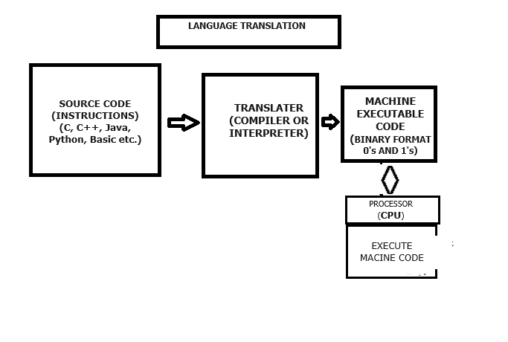
TRANSLATION OF SOURCE CODE

Slide 15
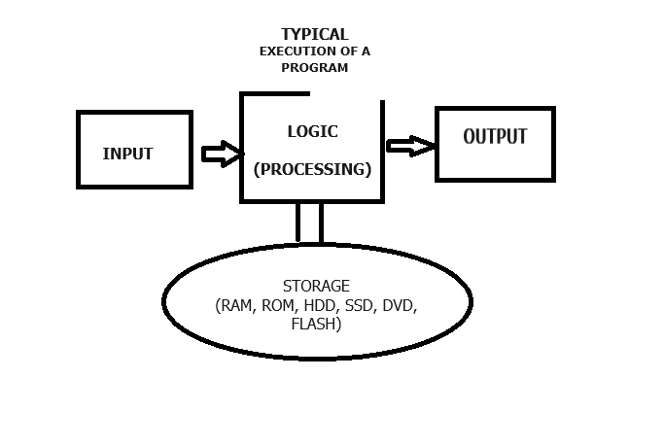
PROGRAM EXECUTION (TYPICAL FORMAT) (OFTEN REPEATED MANY TIMES)

Slide 16
SAMPLE C++ CODE
using namespace std;
#include <iostream>
int main(int argc, char **argv) {
int a, b, c; // create variable a, b, and c of type int
int sum; // create variable sum of type int
// ACCETPT VALUE FOR a FROM USER
cout << “Enter value for a: “;
cin >> a;
// ACCETPT VALUE FOR b FROM USER
cout << “Enter value for b: “;
cin >> b;
// ACCETPT VALUE FOR c FROM USER
cout << “Enter value for c: “;
cin >> c;
// CALCULATE SUM OF a, b, c AND STORE RESULT IN sum
sum = a + b + c;
// SHOW SUM TO USER
cout << “The answer is: ” << sum
}

